Slide 1
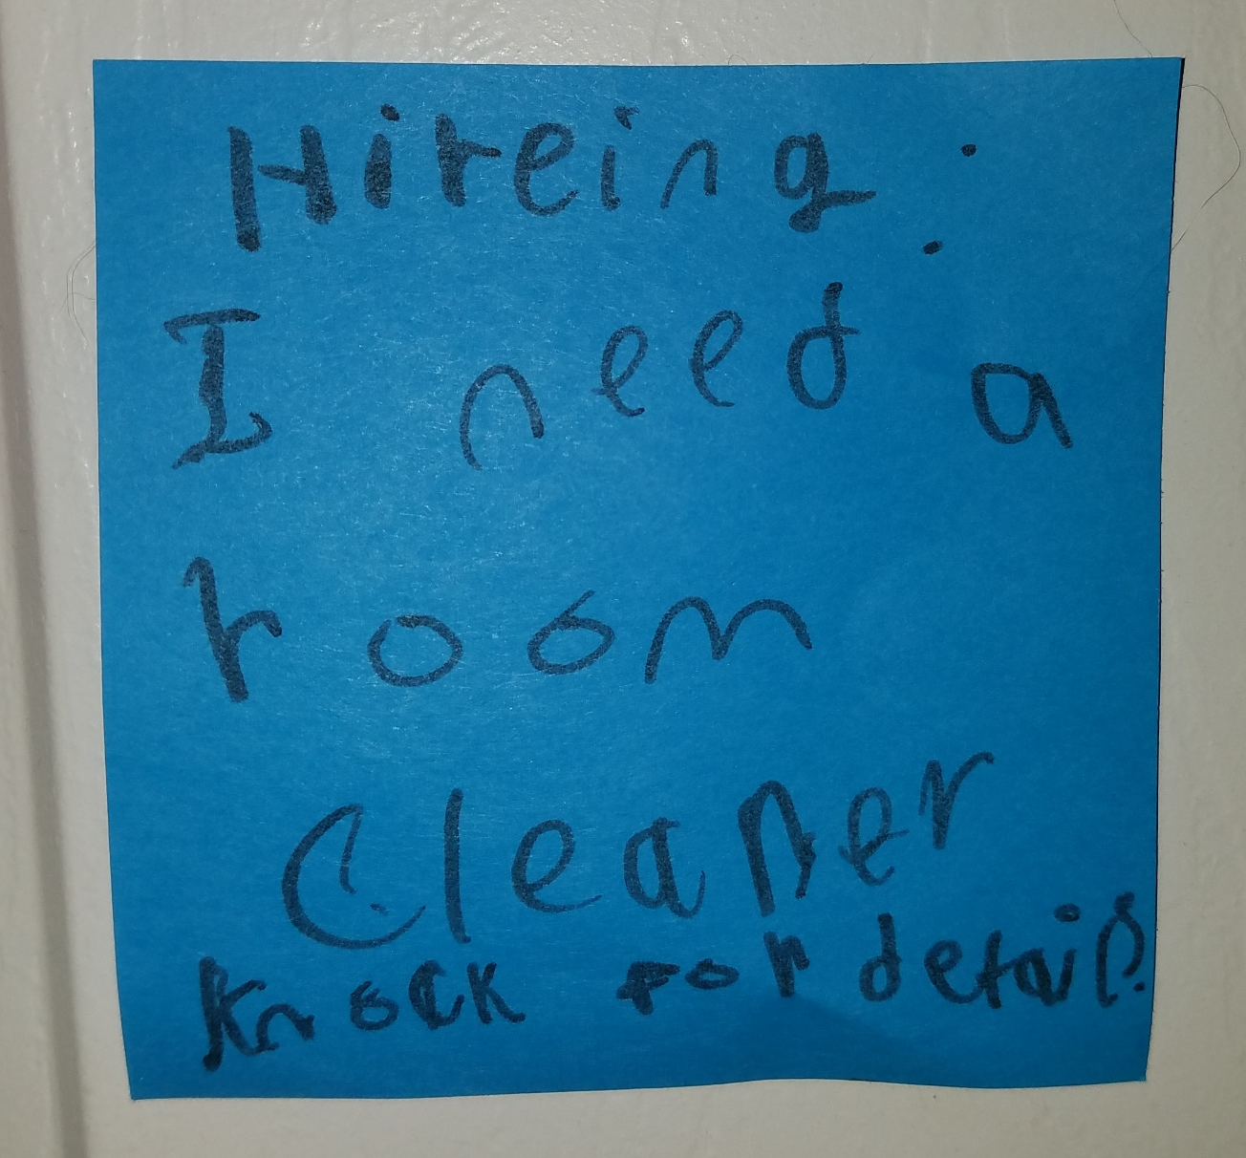

Slide 2
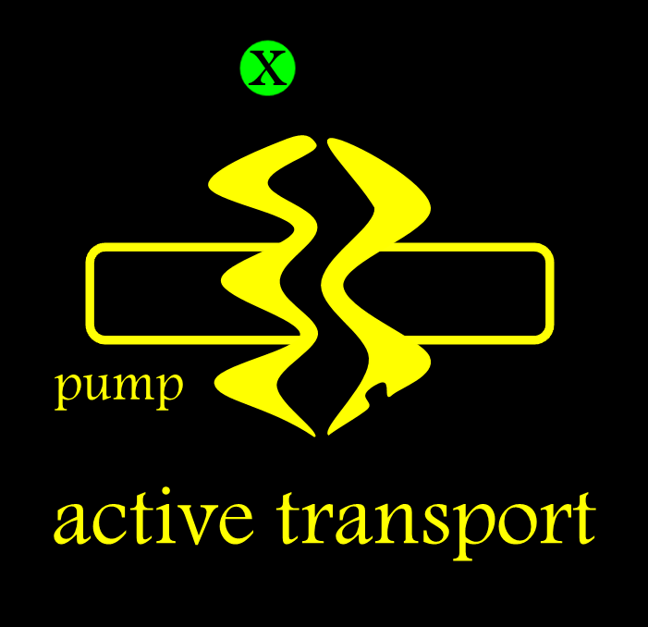
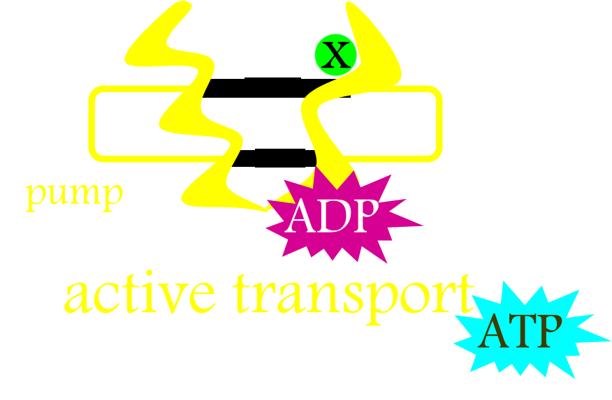
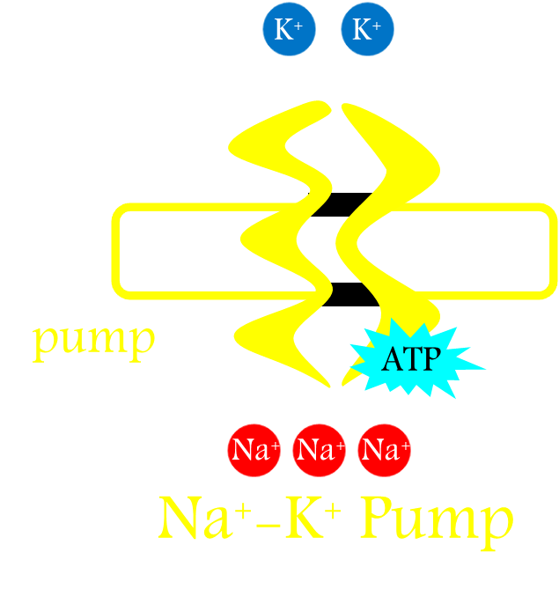
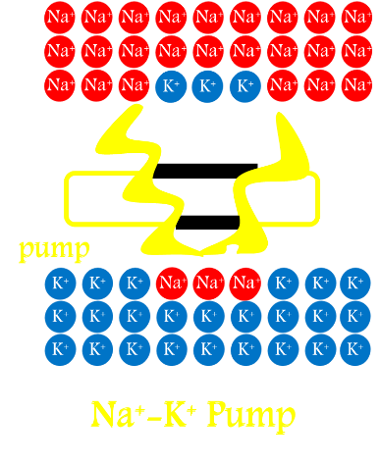
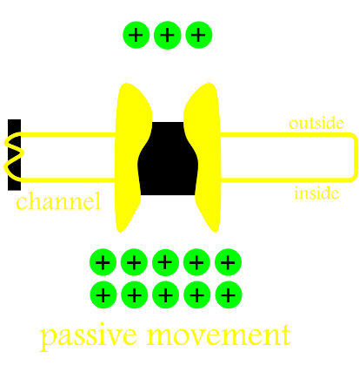
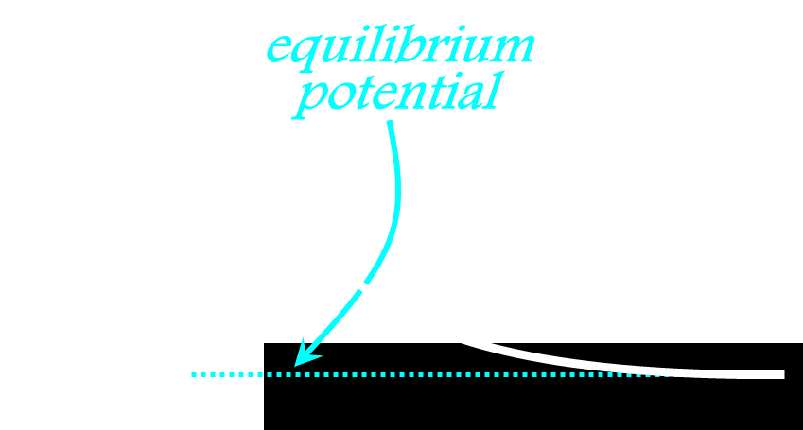
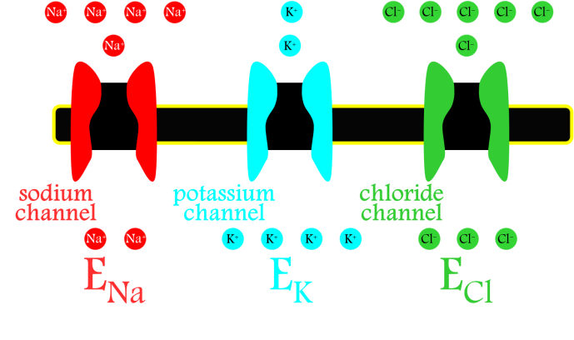
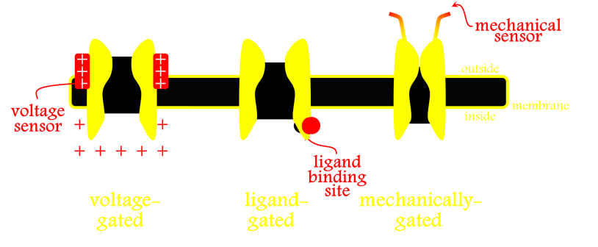
Ion Channels & Cellular Electrophysiology
Pumps
ATP-Driven Pumps
Na-K Pump
Na-K Gradients
Channels
Equilibrium Potential
Ion-Selective Channels
Channel Gating

Slide 3
Synaptic Transmission
&
Neurotransmitter Receptors

Slide 4
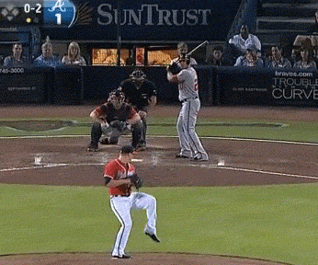

Slide 5
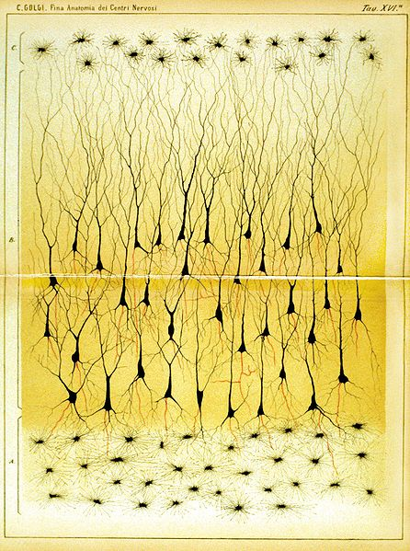
Two Ways Neurons Can Communicate

Slide 6
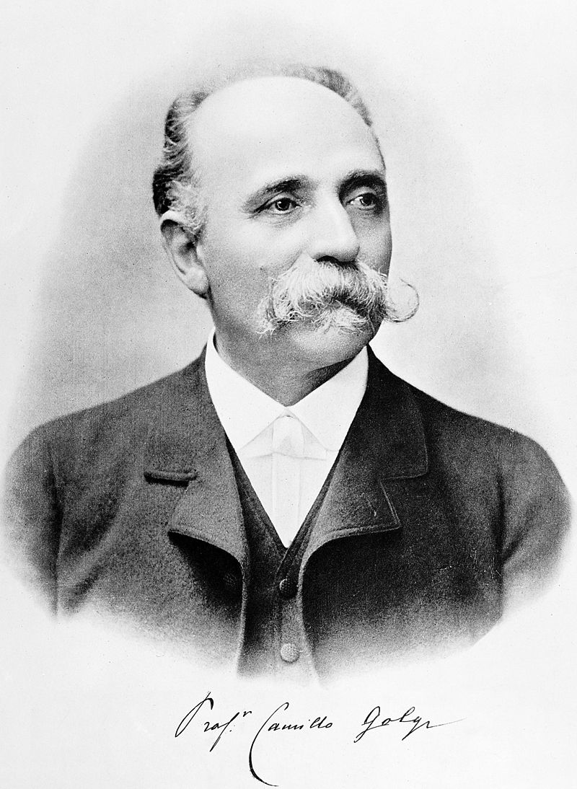
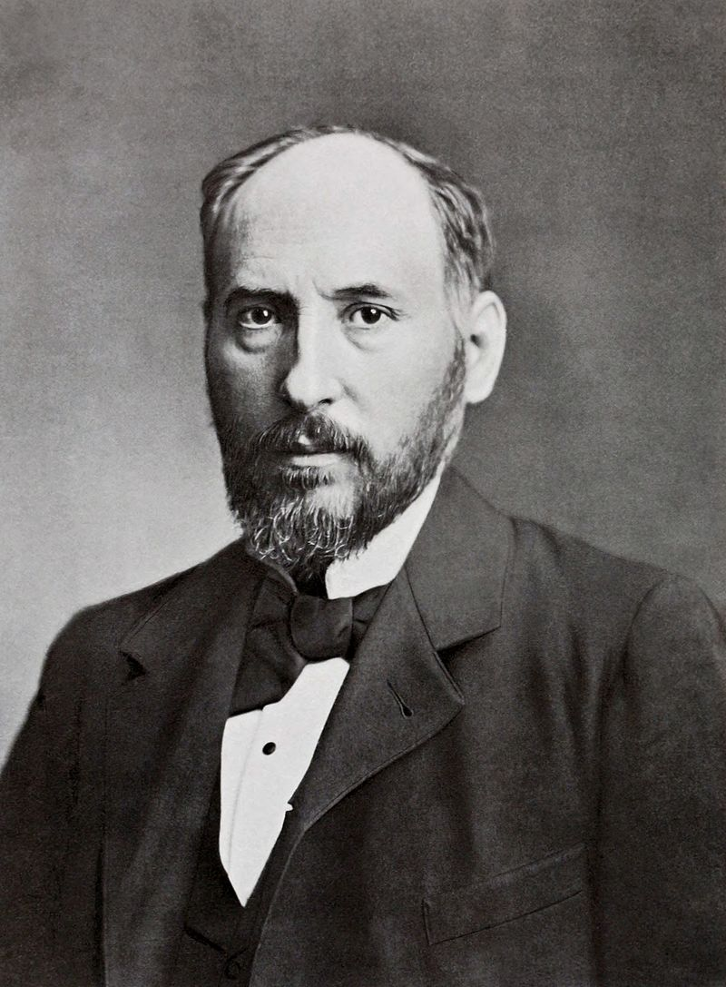
Two Ways Neurons Can Communicate
Camillo Golgi
Santiago Ramon y Cajal
Notes:
Nobel: 1906

Slide 7
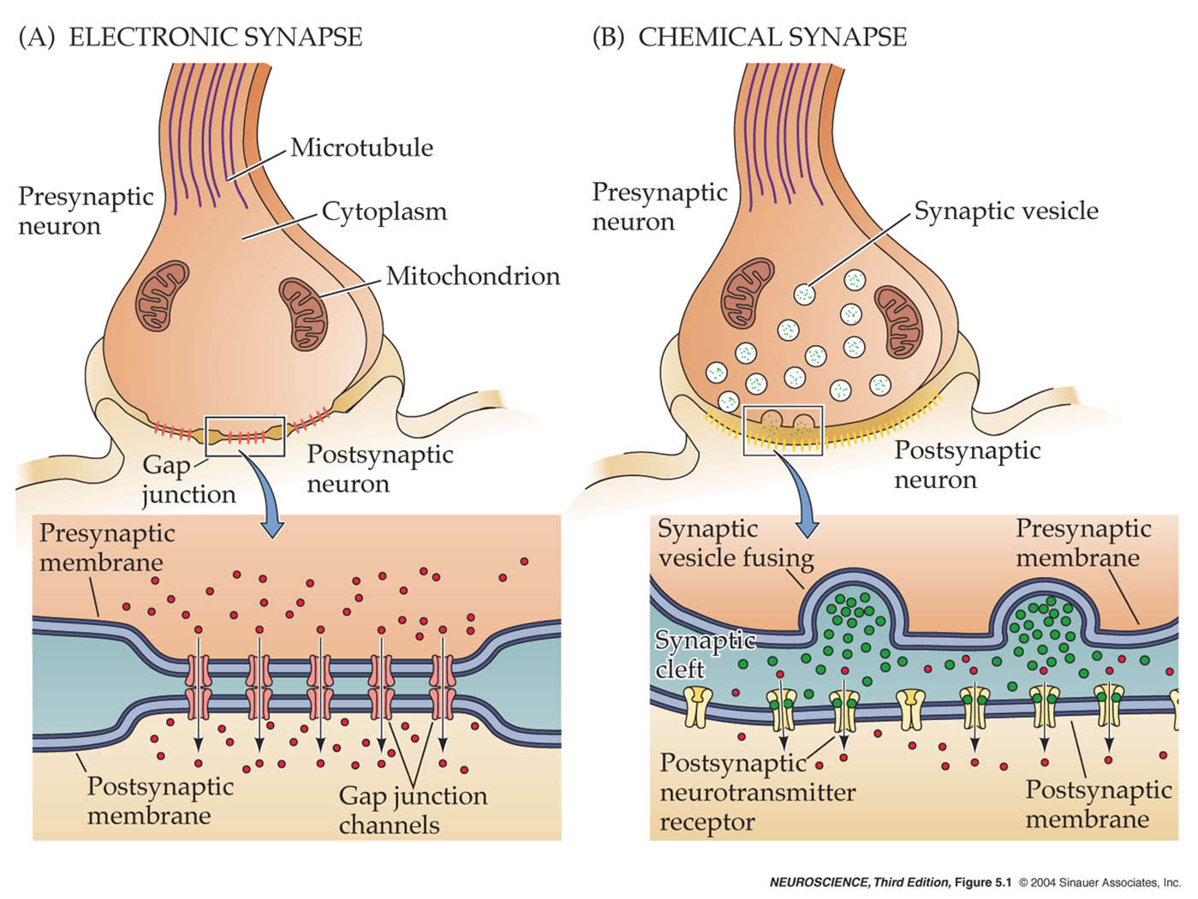
Two Ways Neurons Can Communicate

Slide 8
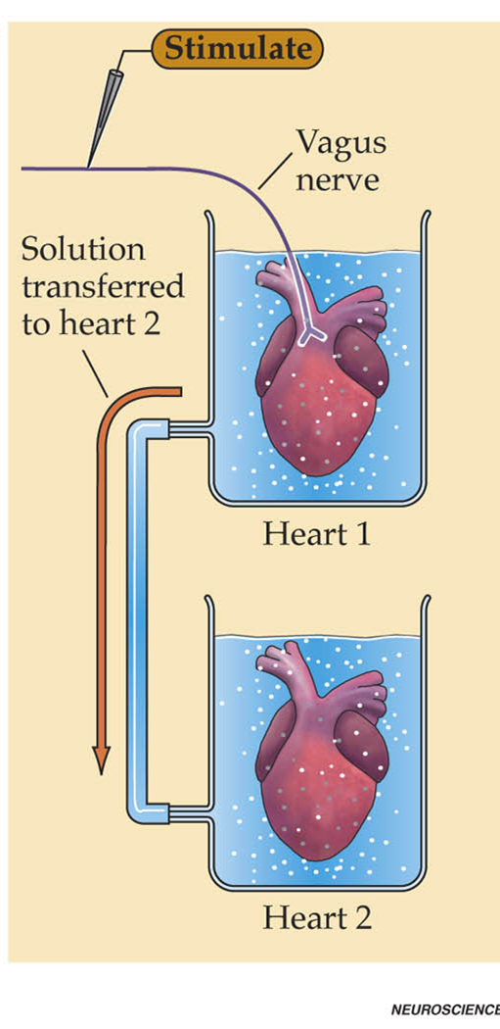
Two Ways Neurons Can Communicate

Slide 9
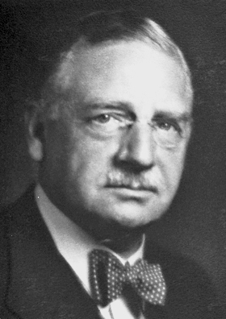
Two Ways Neurons Can Communicate
Otto Loewi
Notes:
Nobel 1936

Slide 10
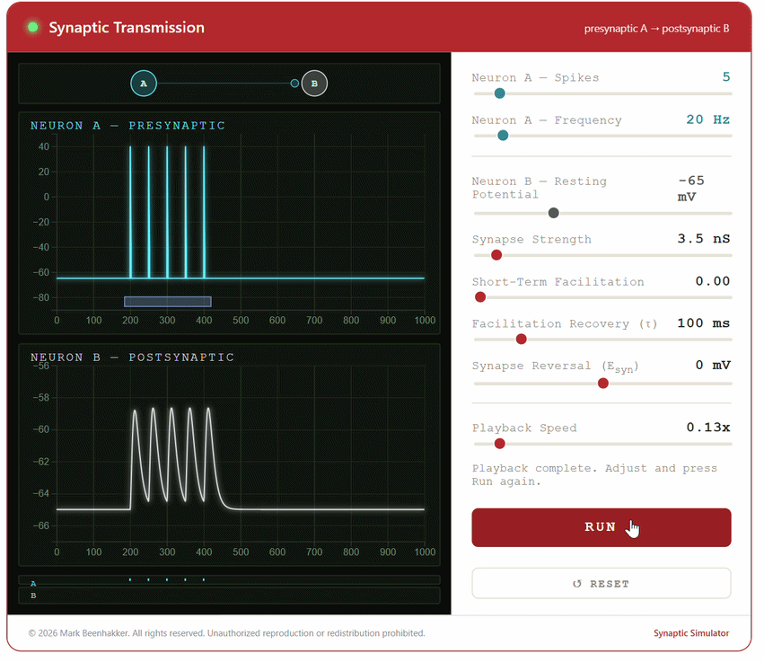
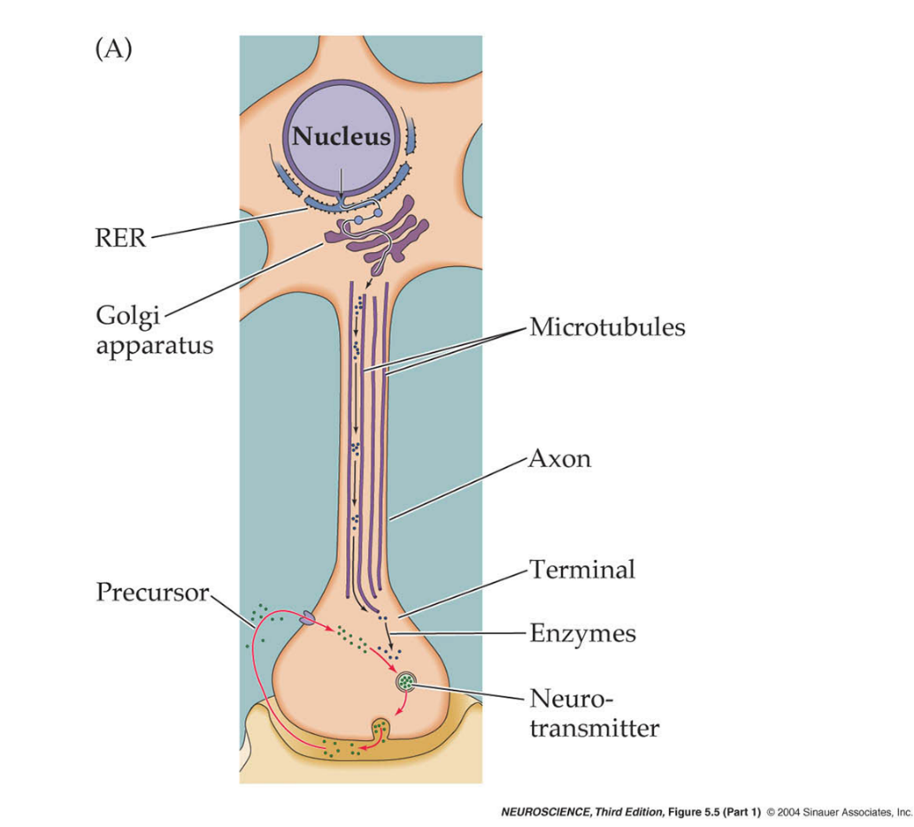

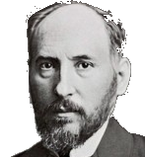
Special Structures For Neurotransmission

Slide 11
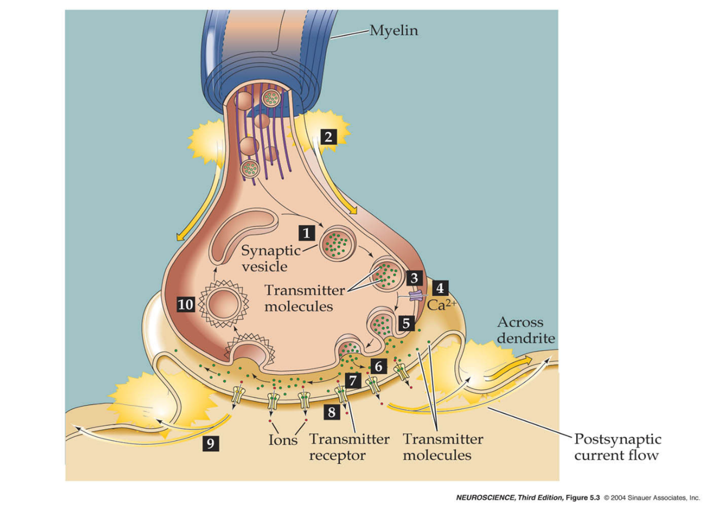
Steps of Neurotransmission

Slide 12
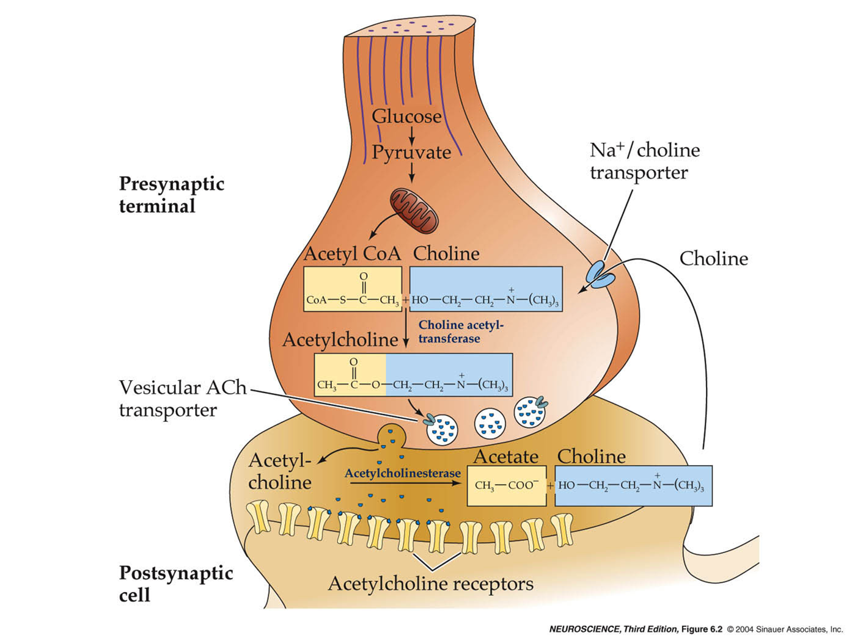
Cholinergic Synapse

Slide 13
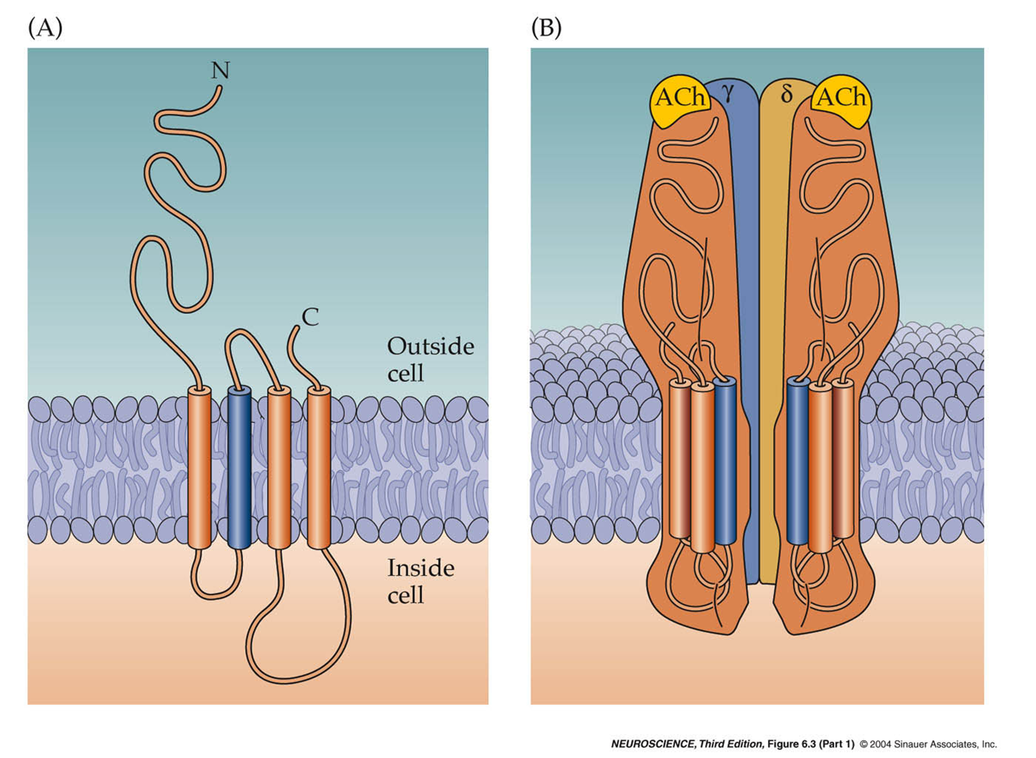
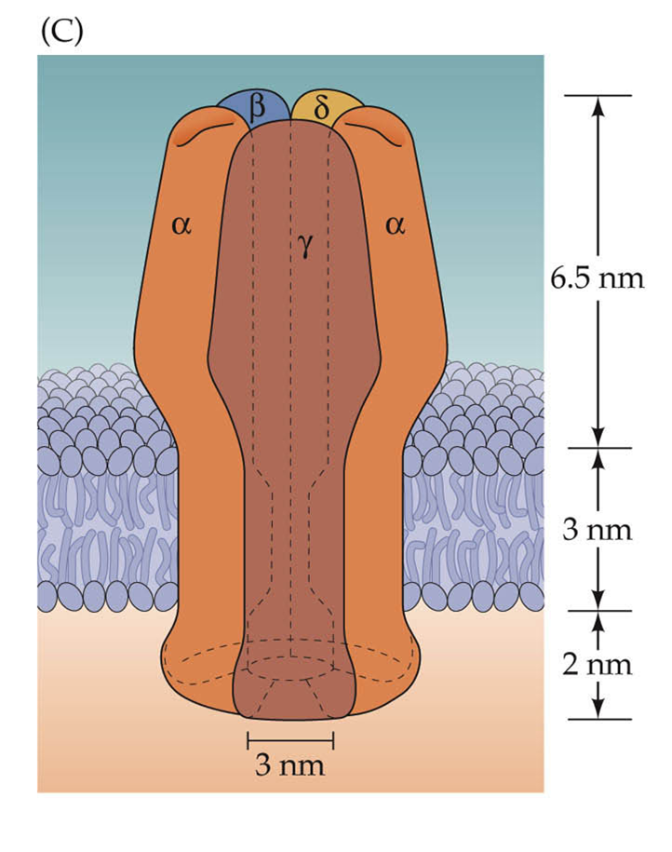
Acetylcholine Receptor

Slide 14
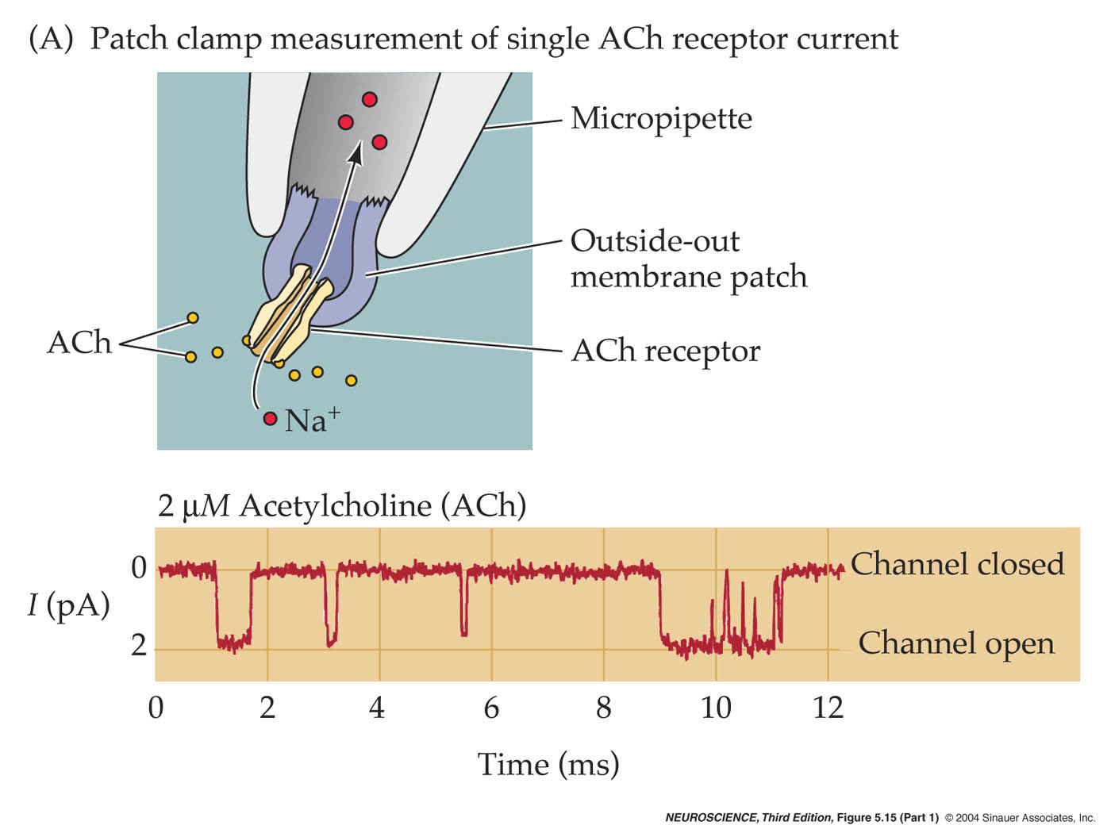
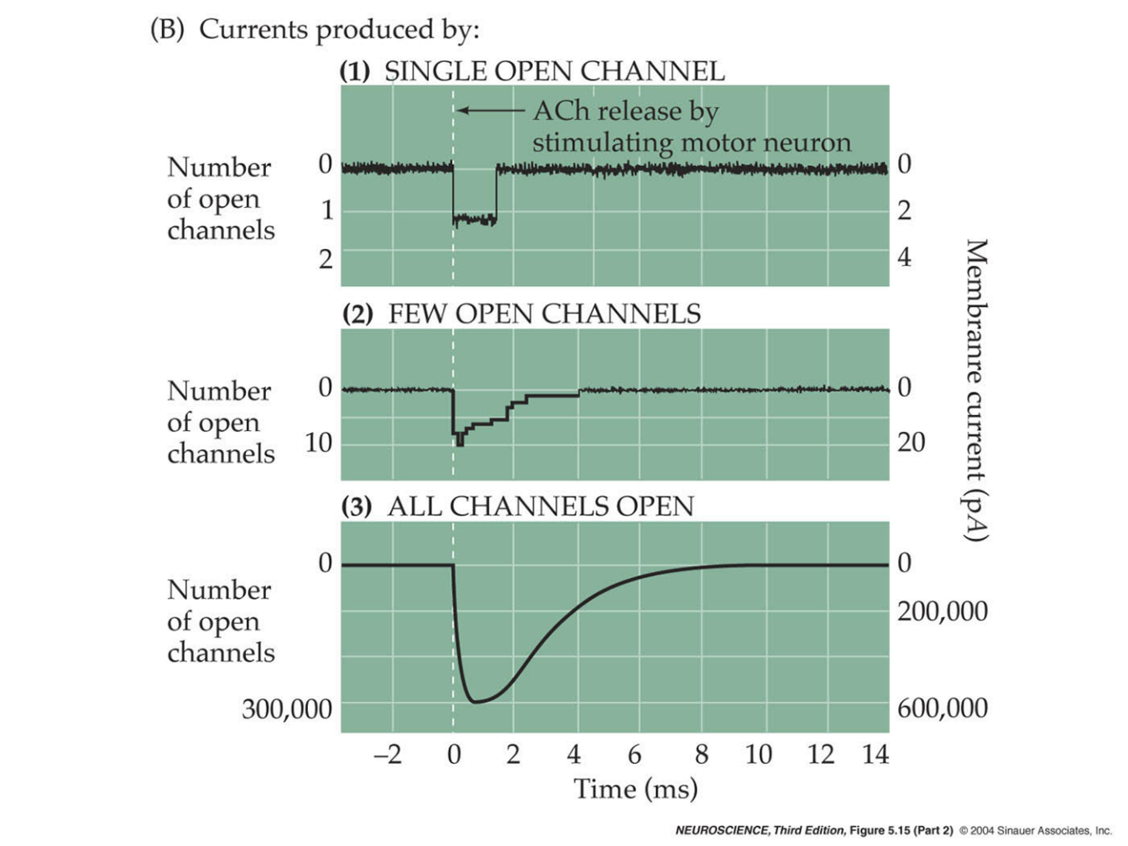
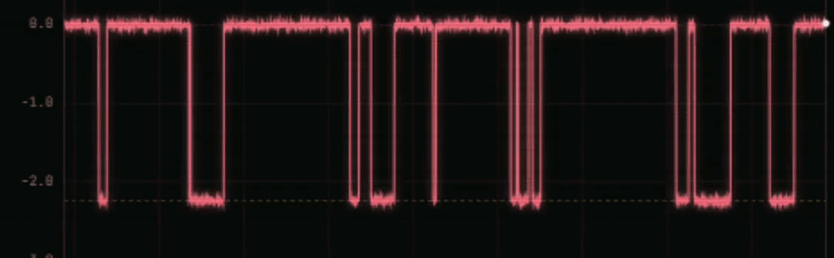
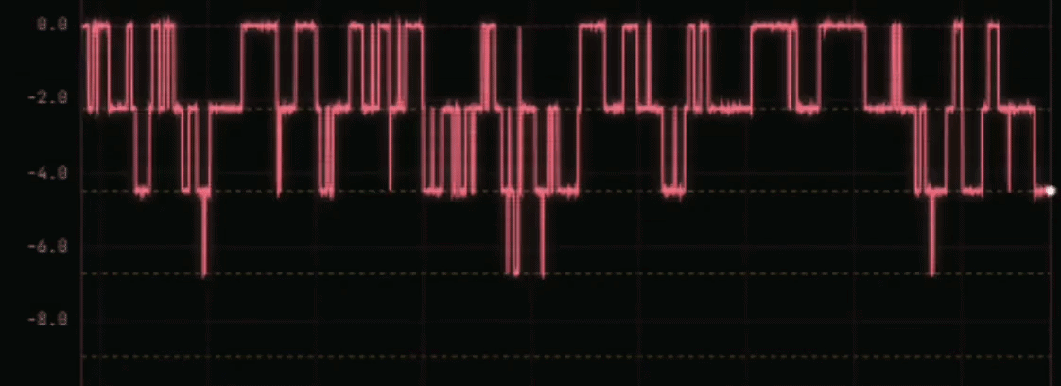
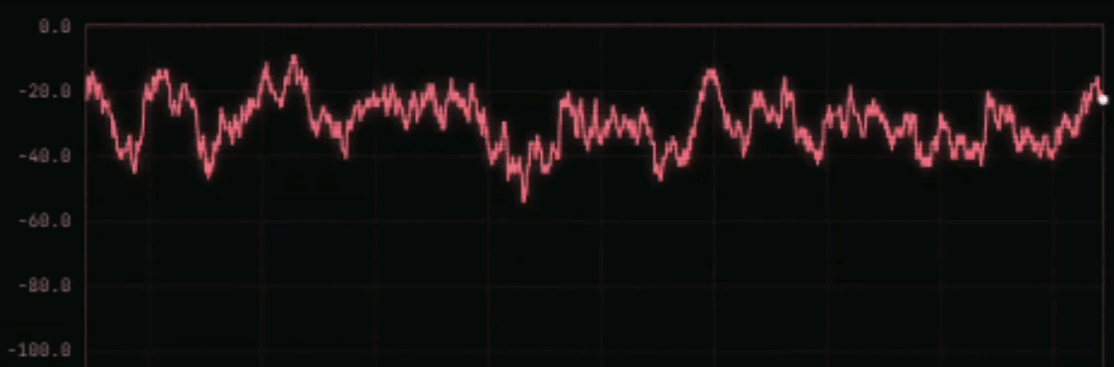
Cholinergic Currents

Slide 15
Cholinergic Currents

Slide 16
Recording Synapses
Presynaptic & Postsynaptic

Slide 17

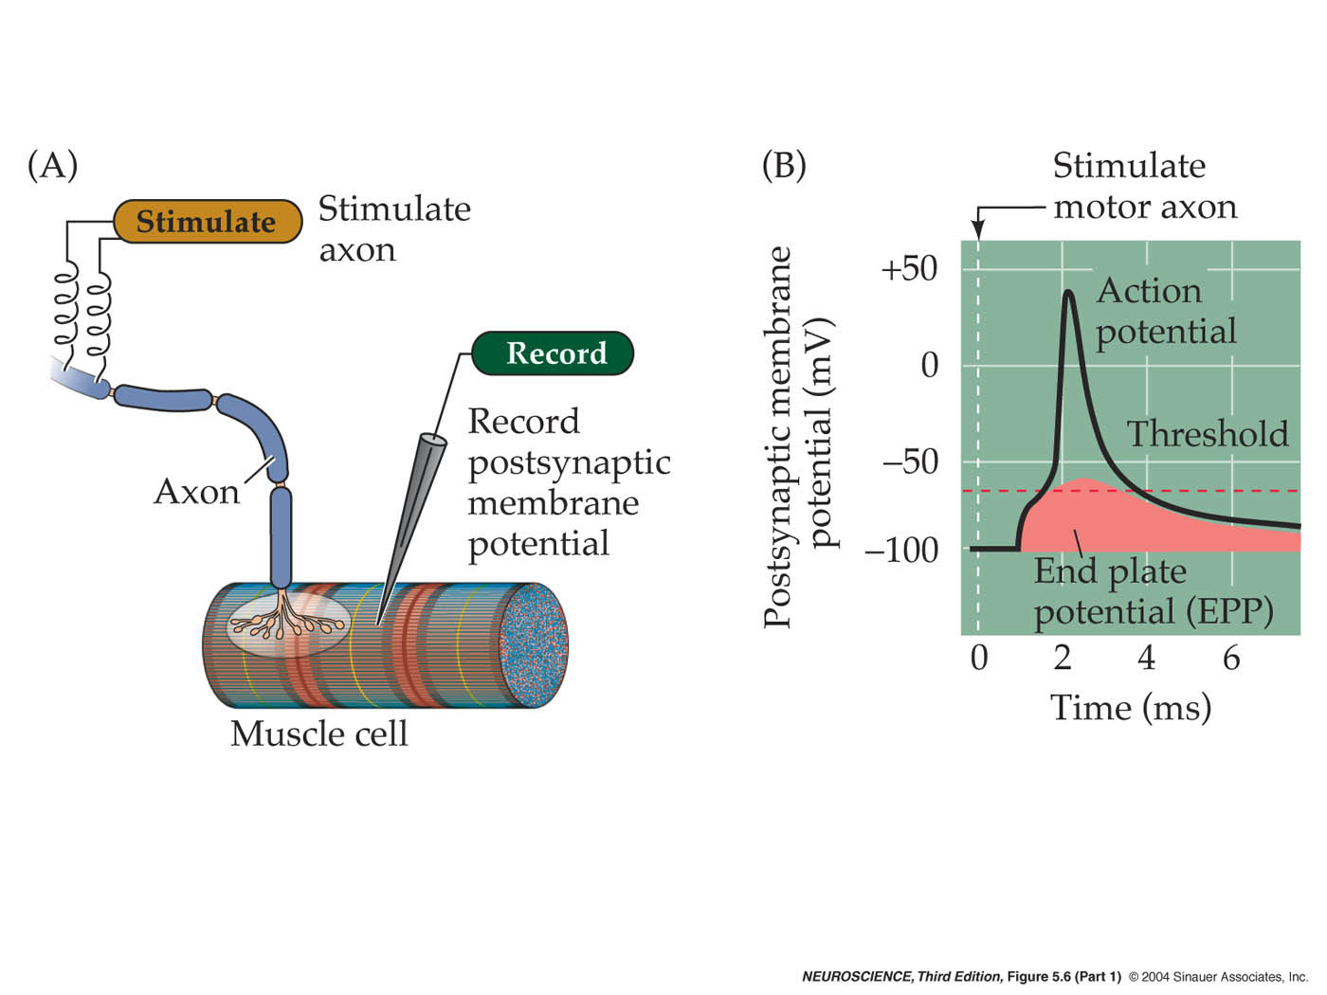
Recording Synapses
Presynaptic & Postsynaptic
Measure Voltage
Vesicular release is just
like ion channel activity…
one
channel
a few
channels

Slide 18
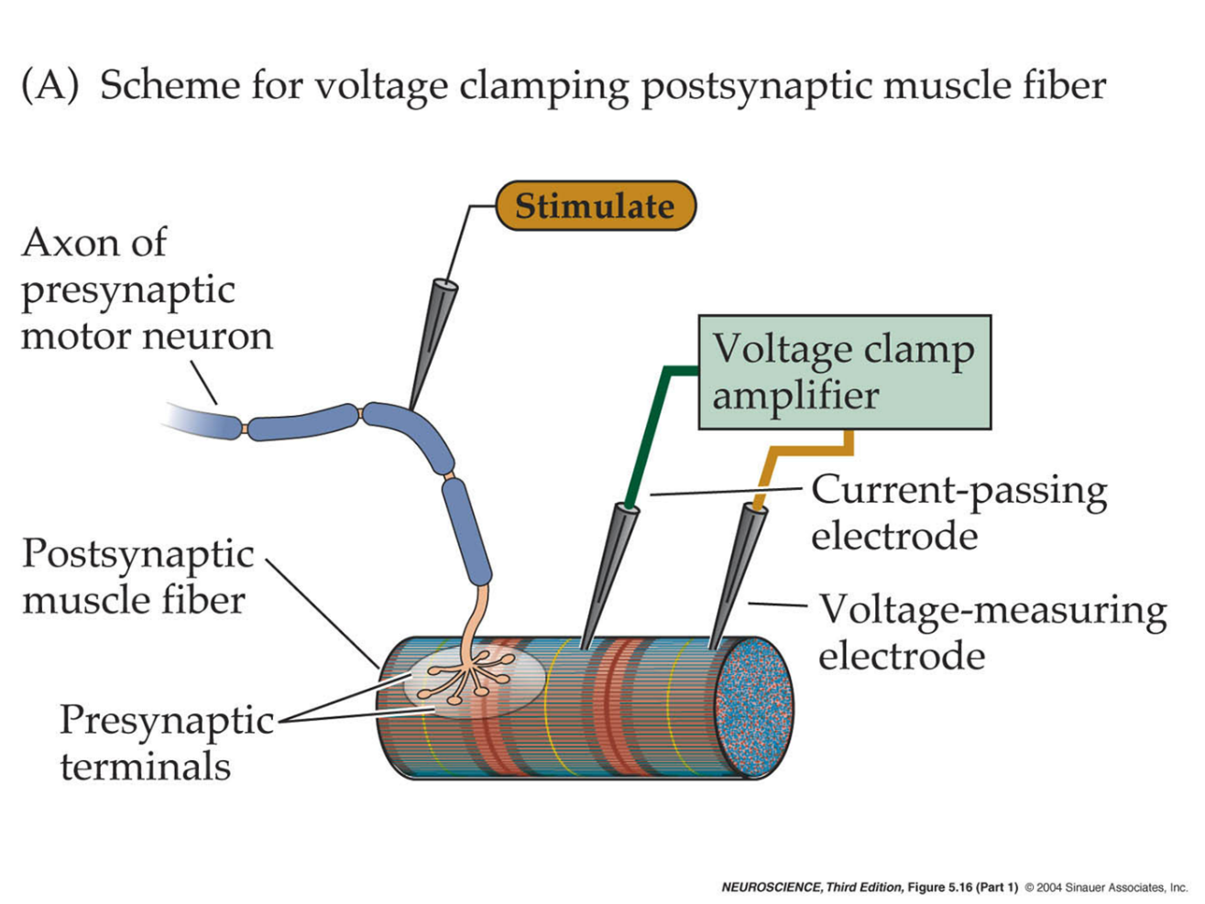
Recording Synapses
Presynaptic & Postsynaptic
Measure Current
Measure Voltage

Slide 19
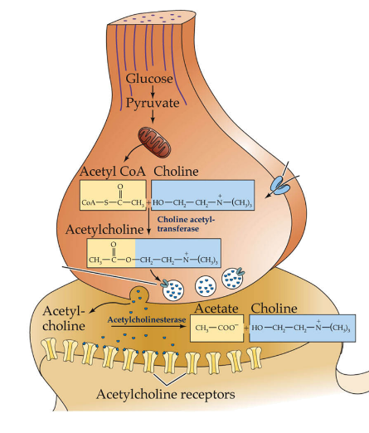
Neuromuscular Junction: Model for Synaptic Function
Vesicular release is just
like ion channel activity…
one
channel
a few
channels

Slide 20
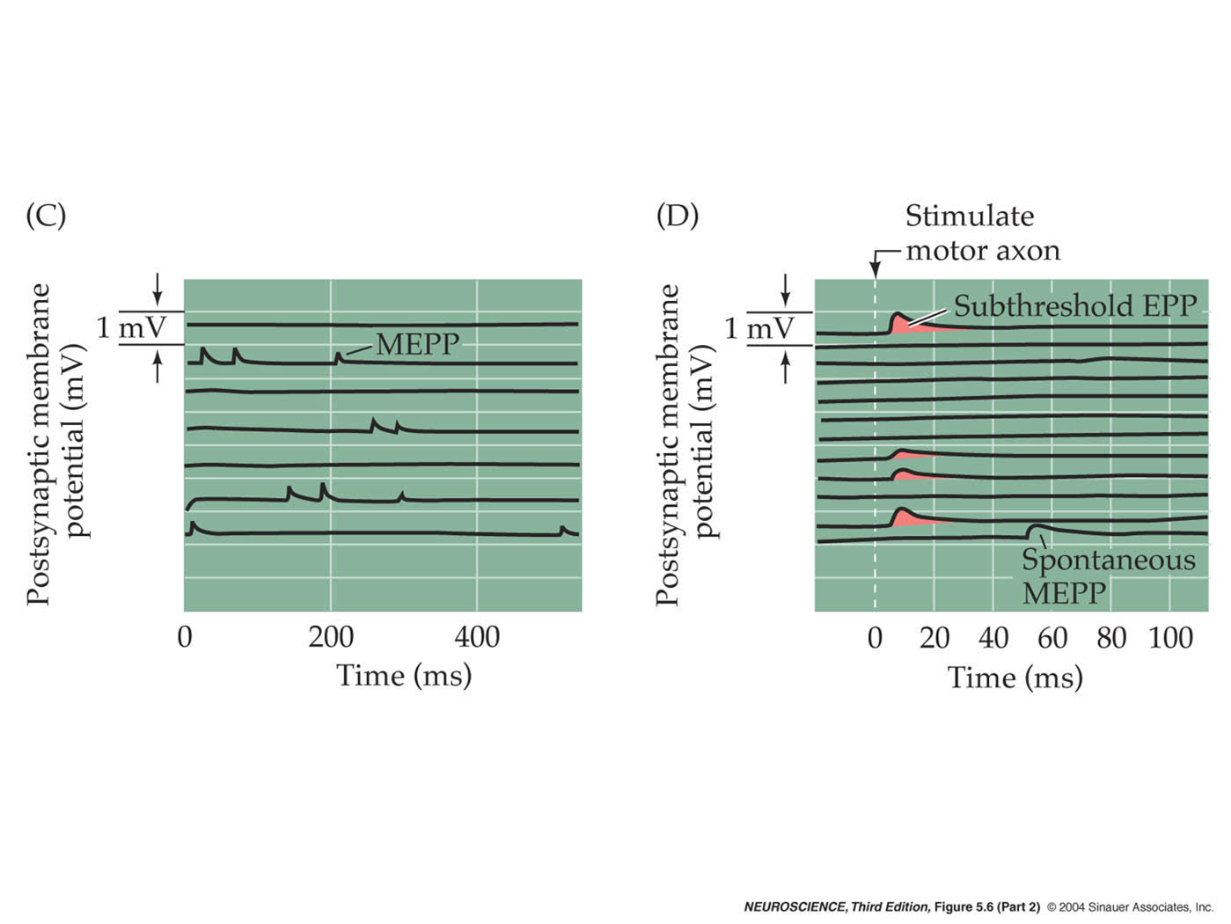
Muscle Recordings

Slide 21
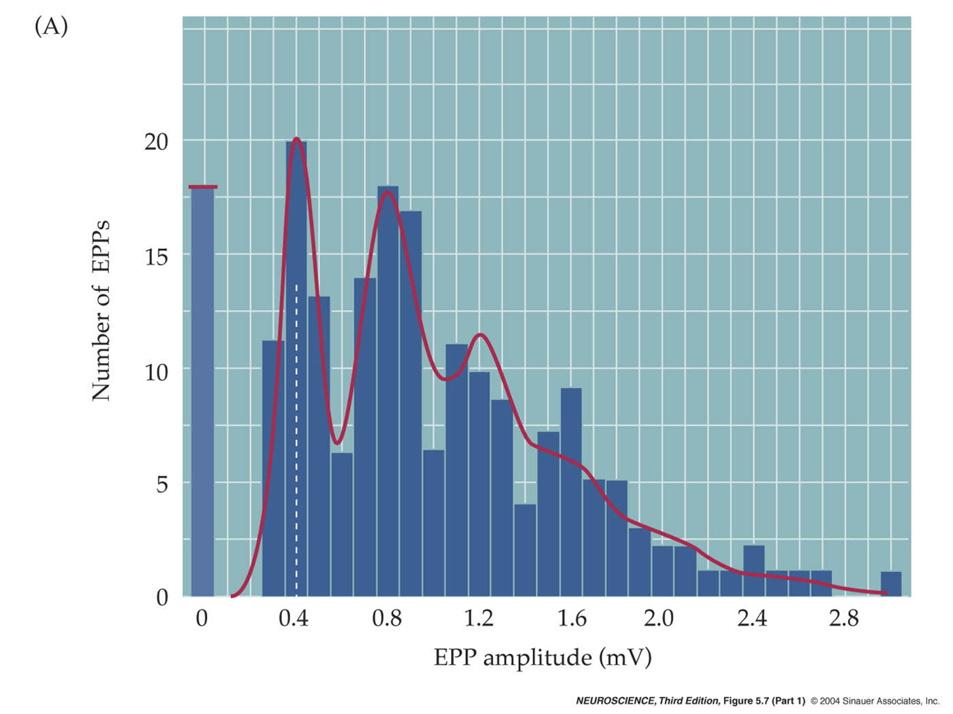
Distribution of EPP Amplitudes

Slide 22
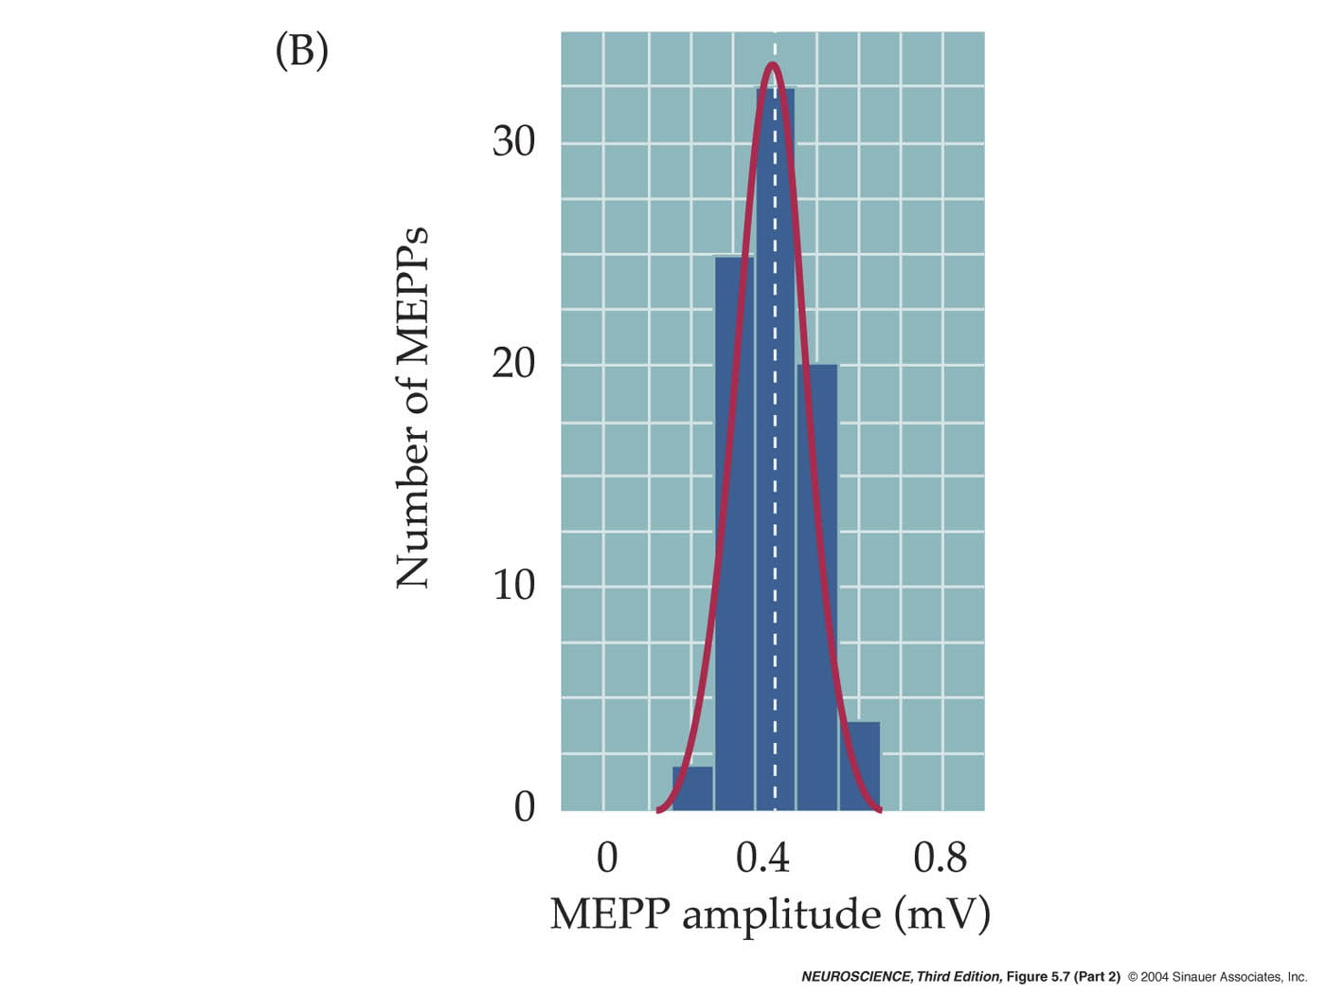
Quantal Transmission

Slide 23


Quanta Represent Single Vesicles

Slide 24
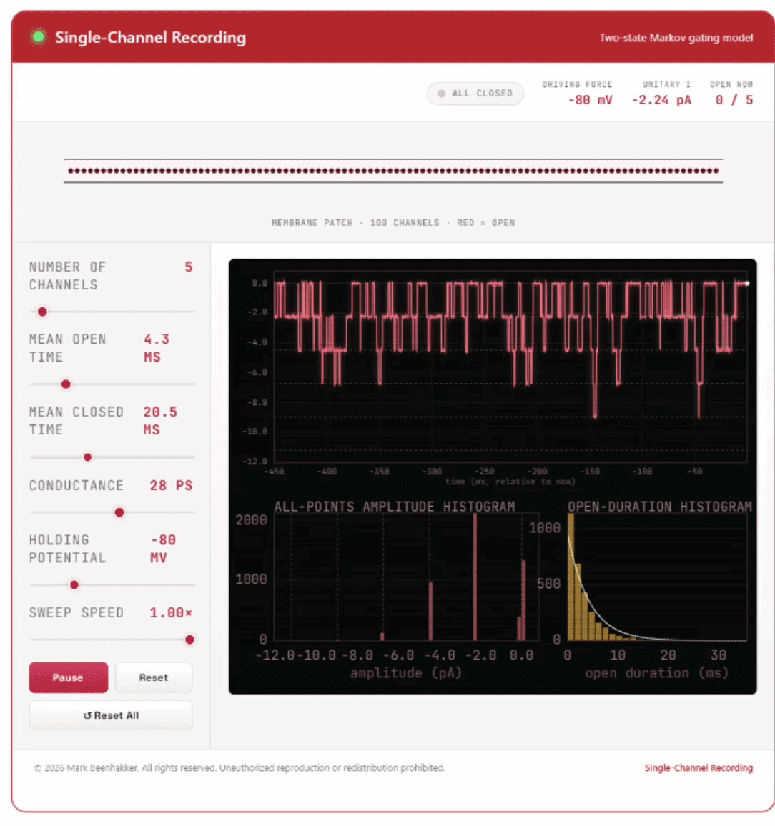
Quanta Represent Single Vesicles
Vesicular release is just
like ion channel activity…
one
channel
a few
channels

Slide 25
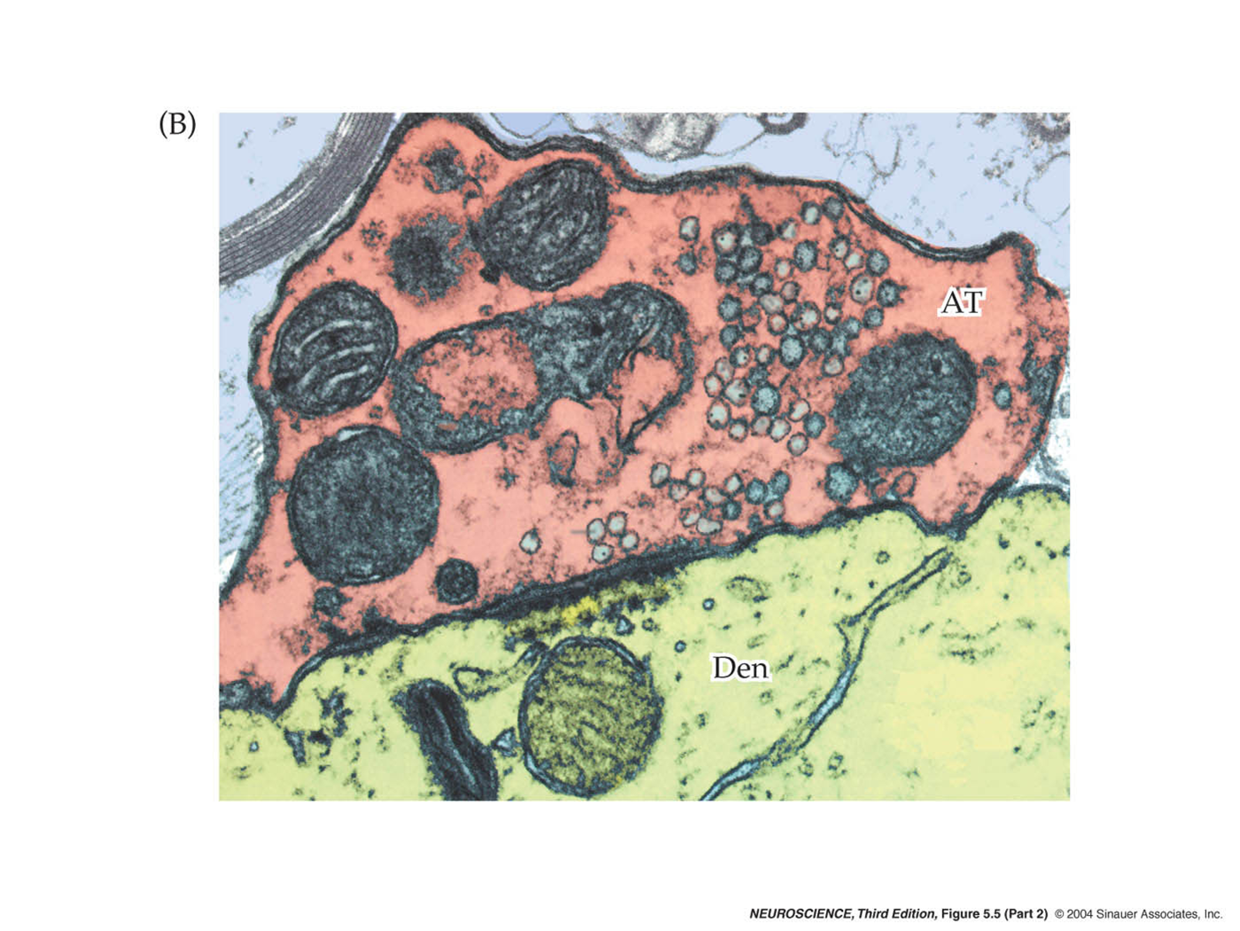
Vesicles at a Real Synapse

Slide 26
Cholinergic Synapse

Slide 27

Recording Synaptic Currents

Slide 28
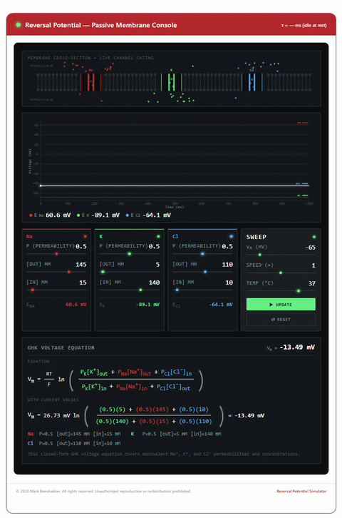
Excitatory & Inhibitory Currents
Always comes back to reversal potentials…

Slide 29
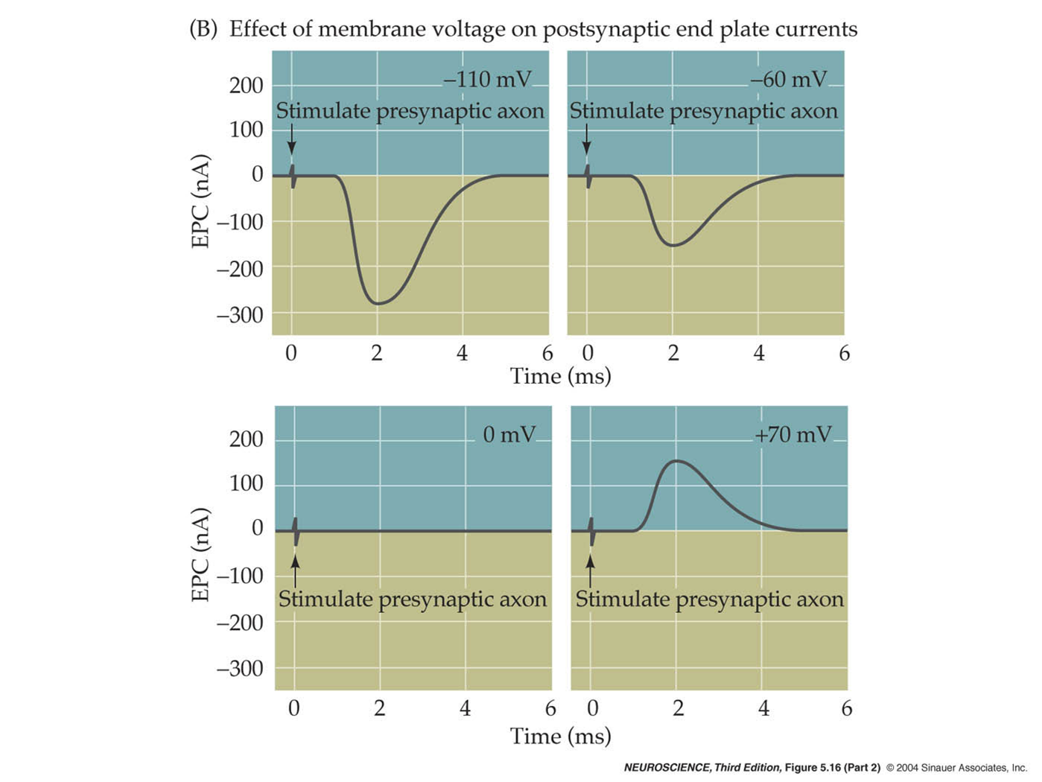
Membrane Potential Determines Current Flow

Slide 30
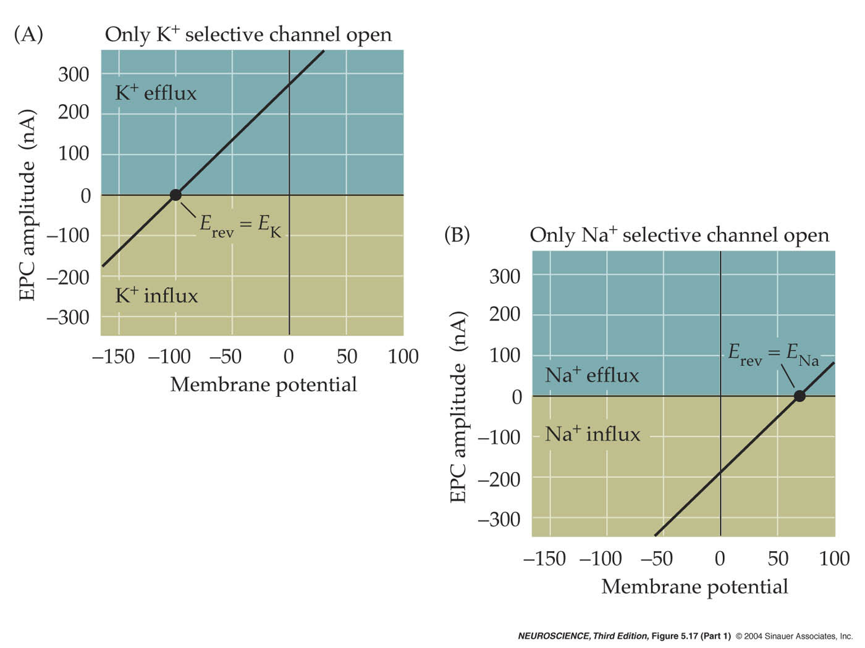
Equilibrium Potentials

Slide 31
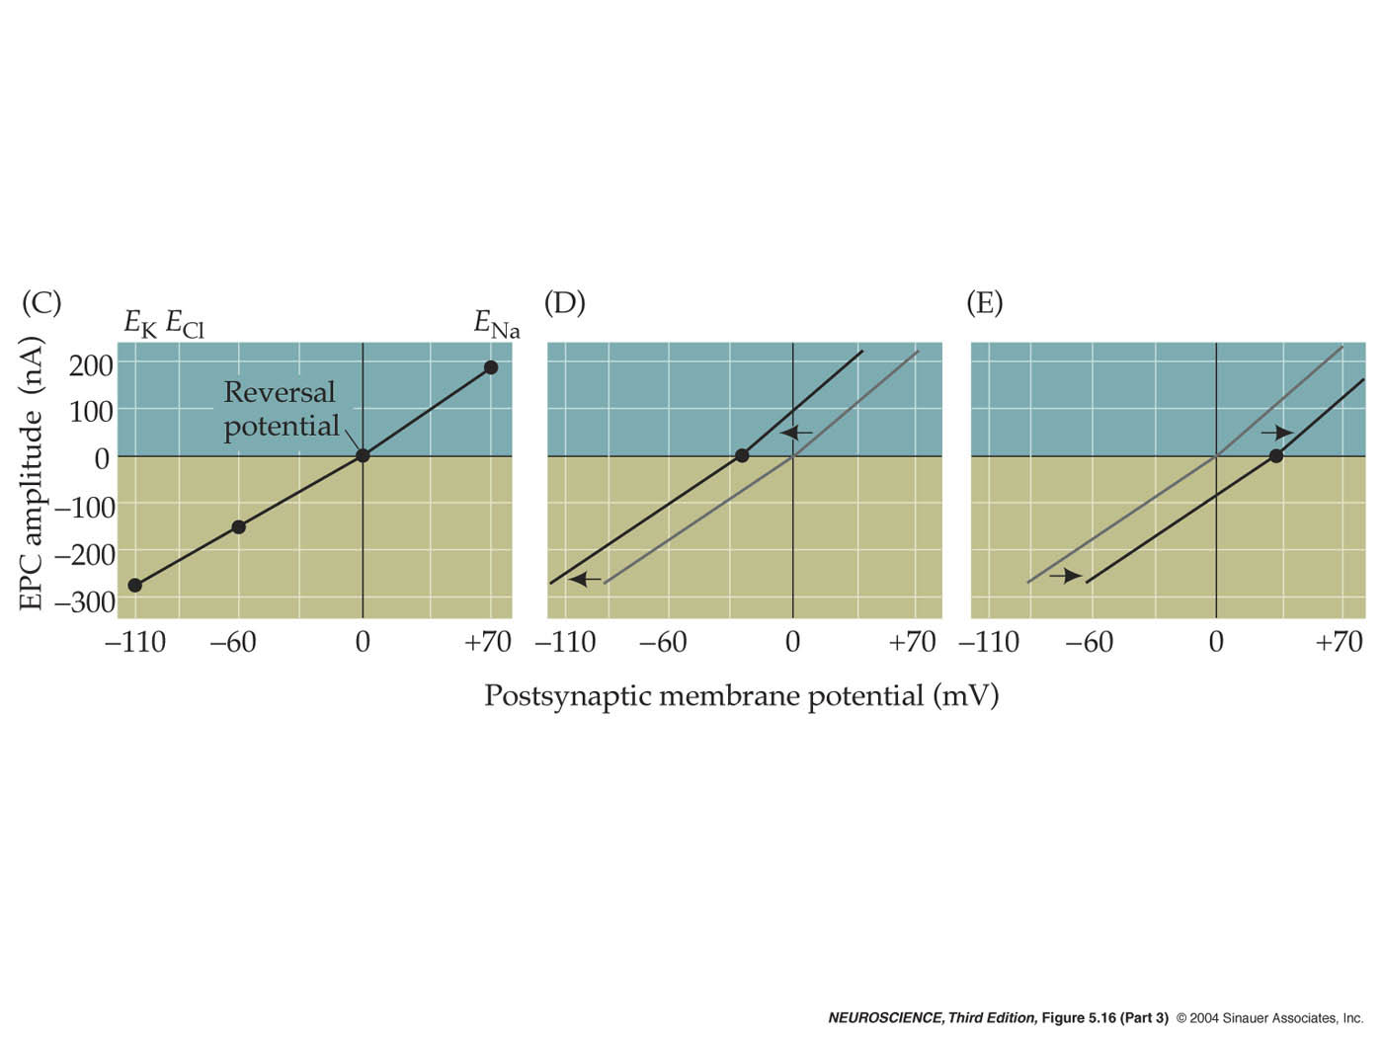
Test Your Hypothesis

Slide 32
Cholinergic Synapse

Slide 33
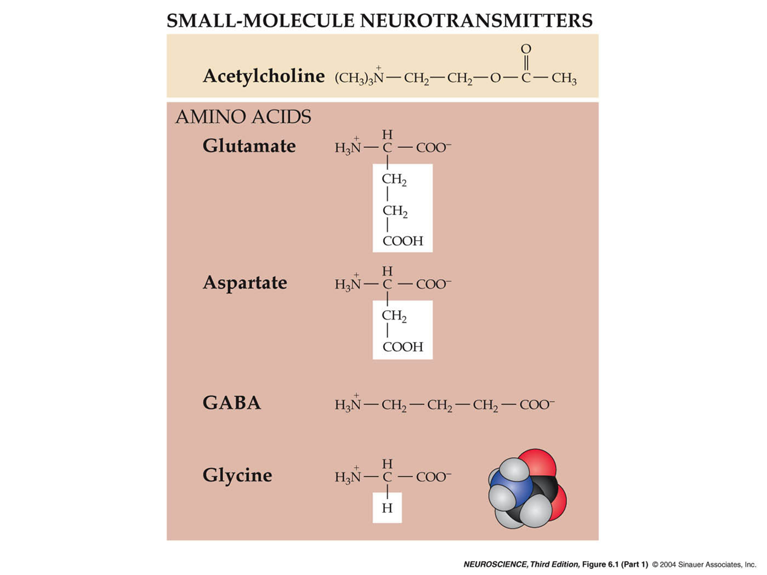
Neurotransmitters

Slide 34
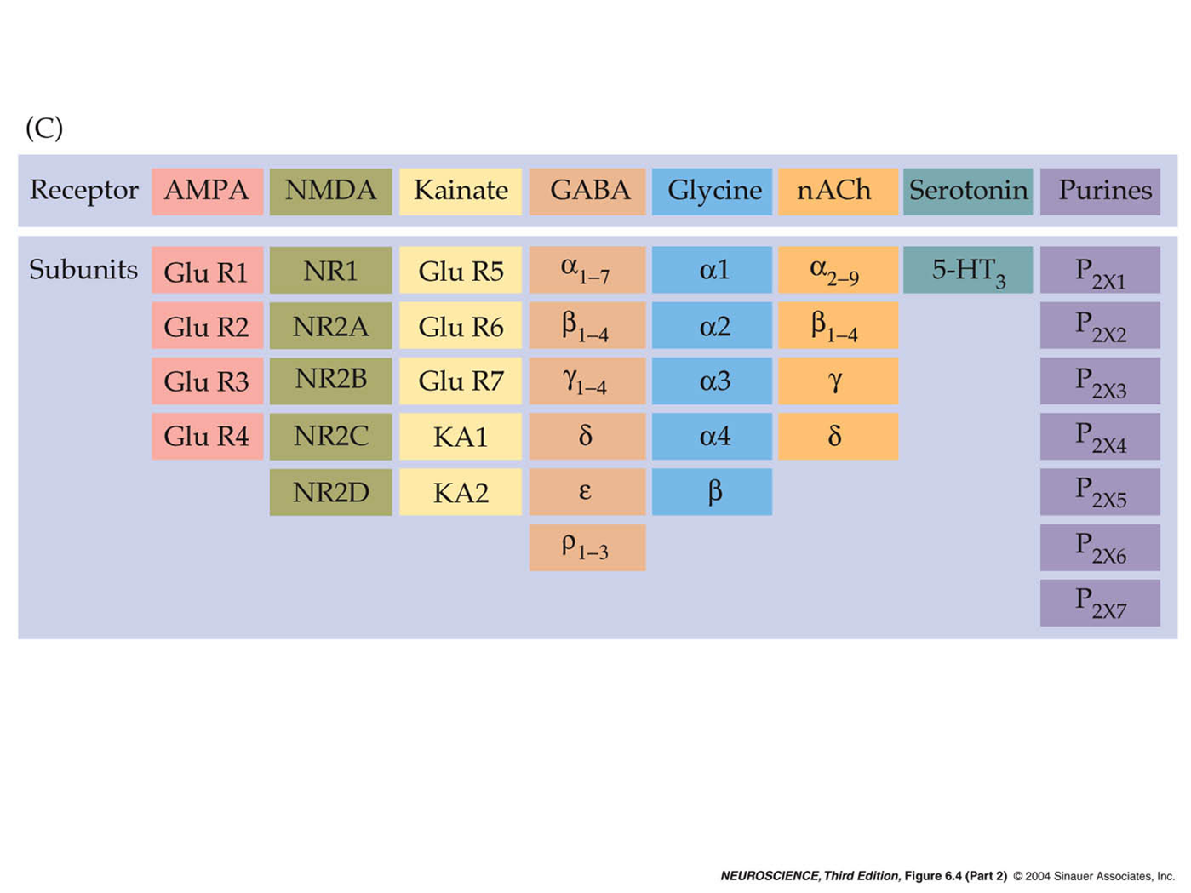
Neurotransmitters

Slide 35
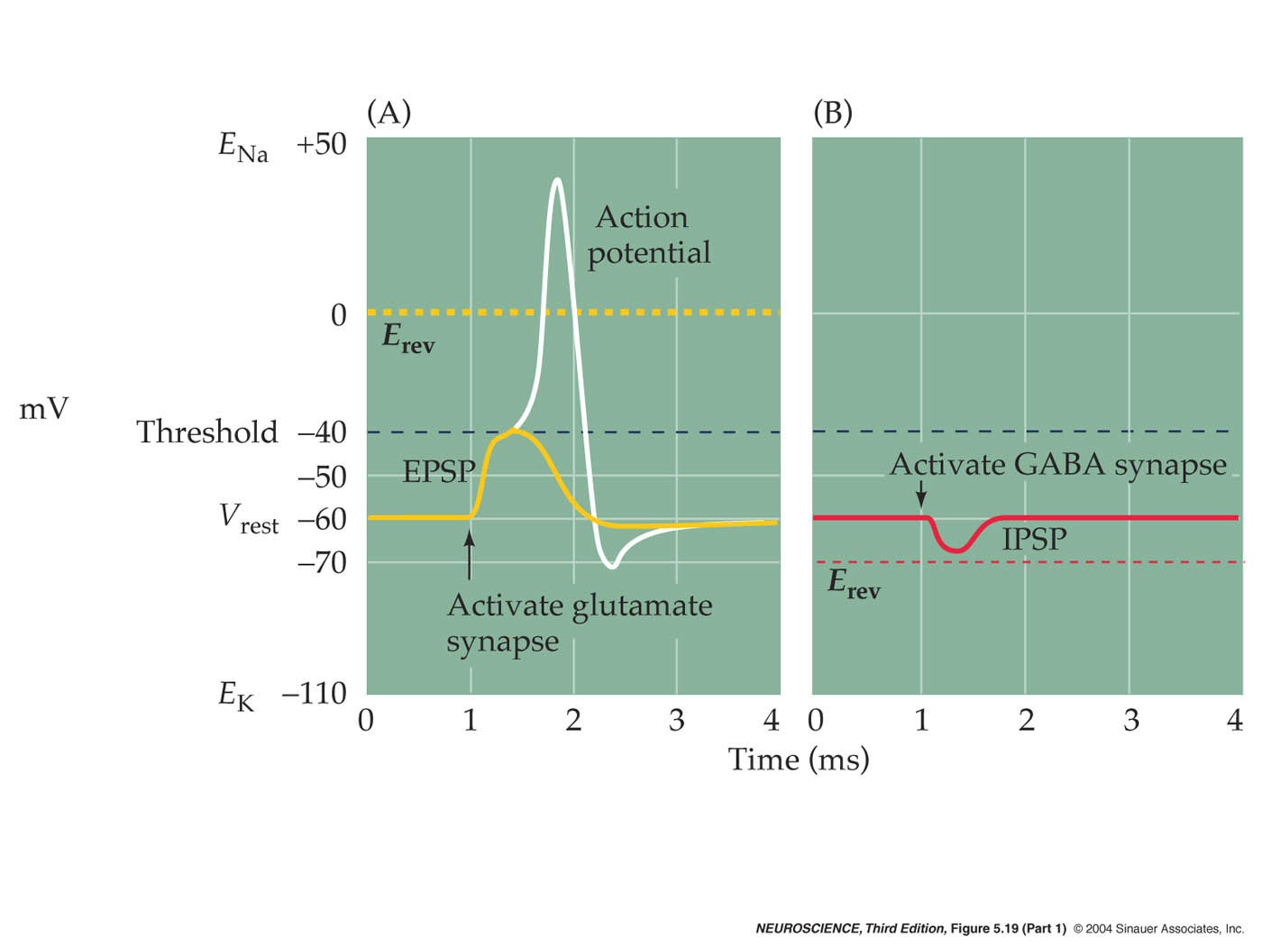
Excitatory & Inhibitory Currents

Slide 36
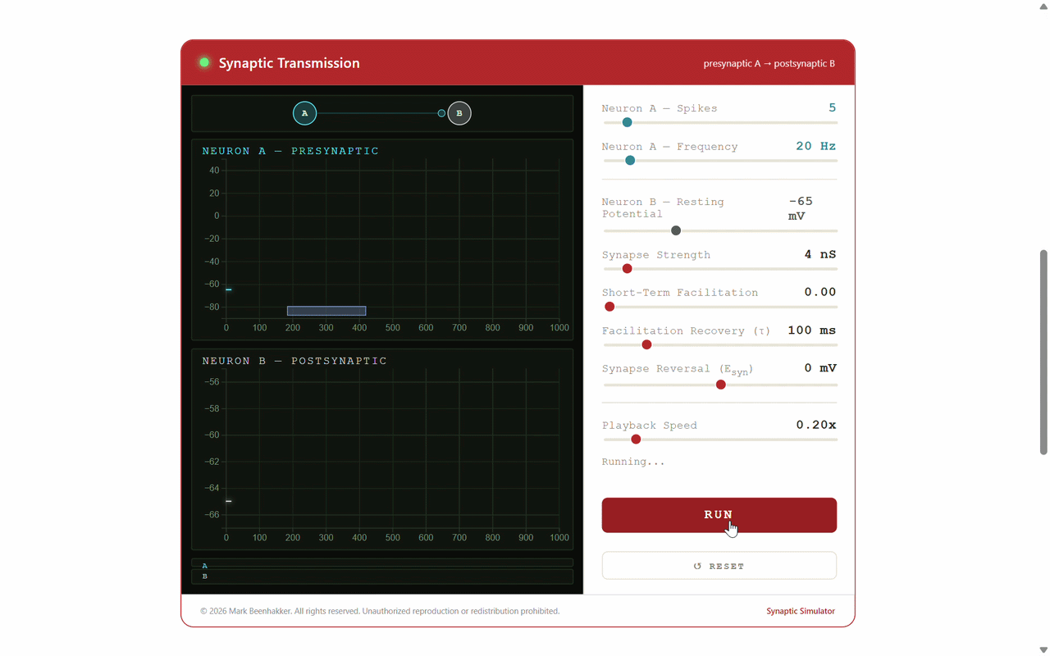
Excitatory & Inhibitory Currents
A. Synaptic Excitation (sub-threshold)

Slide 37
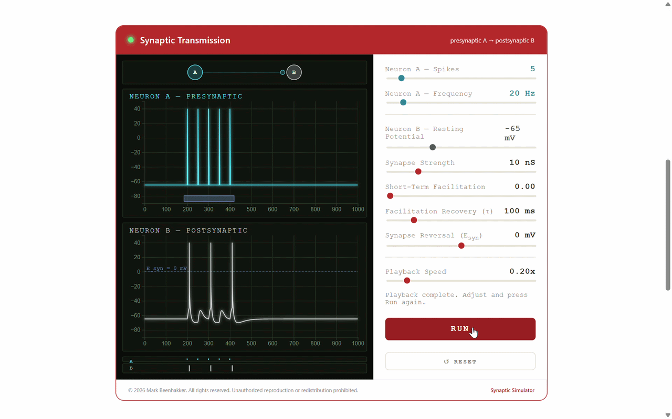
Excitatory & Inhibitory Currents
A. Synaptic Excitation (sub-threshold)
B. Synaptic Excitation (supra-threshold)

Slide 38

Excitatory & Inhibitory Currents
A. Synaptic Excitation (sub-threshold)
B. Synaptic Excitation (supra-threshold)
C. Synaptic Inhibition

Slide 39
Excitatory & Inhibitory Currents

Slide 40

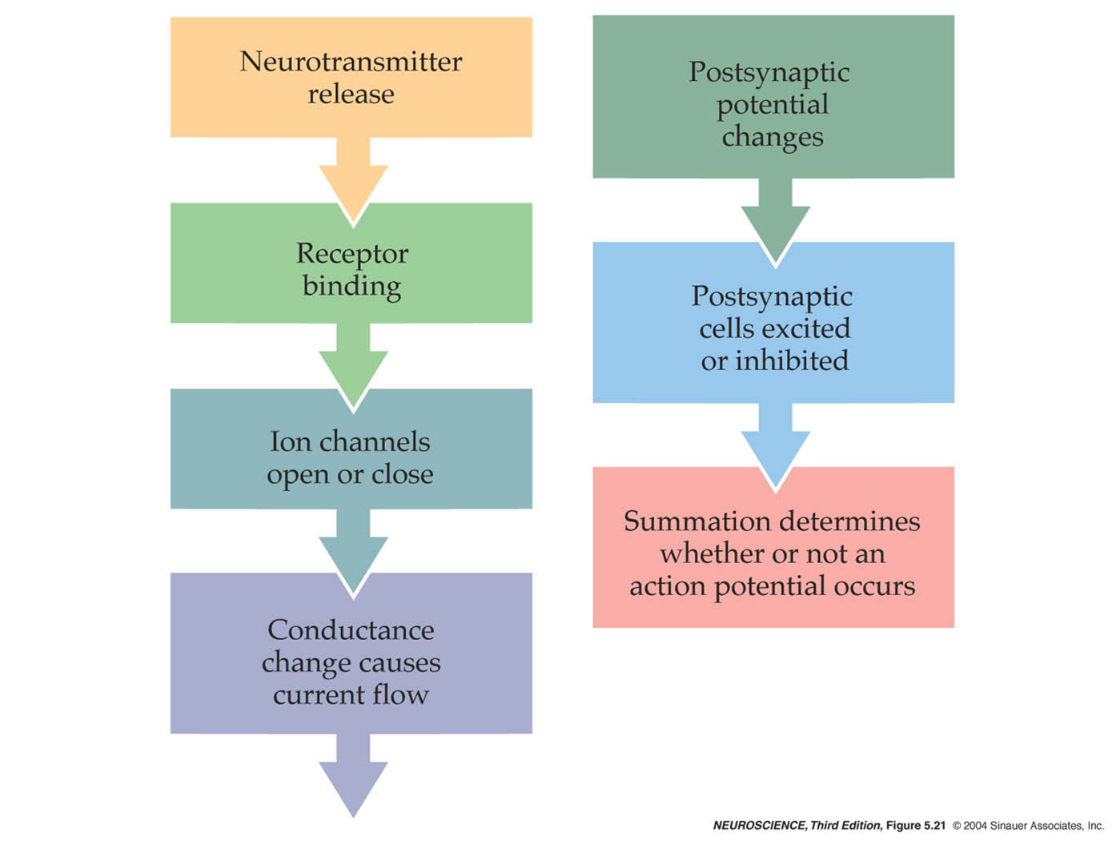
Excitatory & Inhibitory Currents

Slide 41





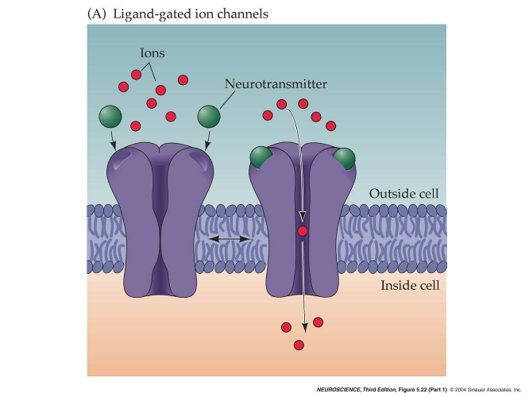


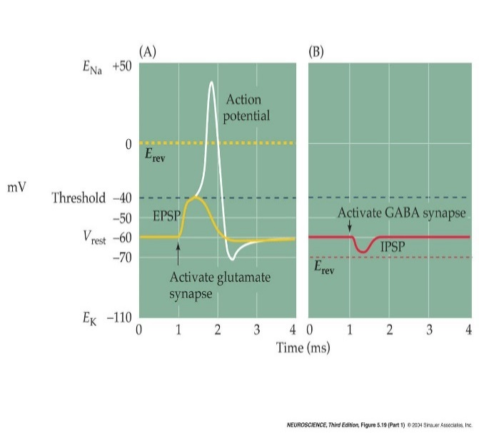
Summary

Slide 42
Ion Channels & Cellular Electrophysiology
Pumps
ATP-Driven Pumps
Na-K Pump
Na-K Gradients
Channels
Equilibrium Potential
Ion-Selective Channels
Channel Gating

