Slide 1

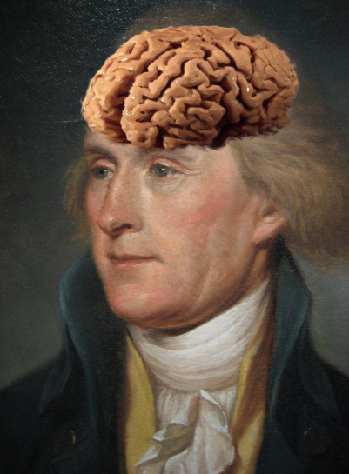
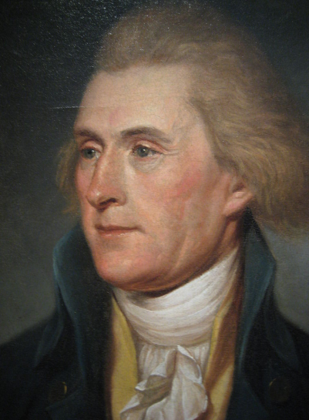

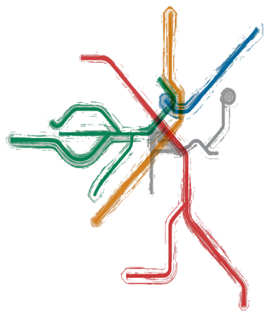
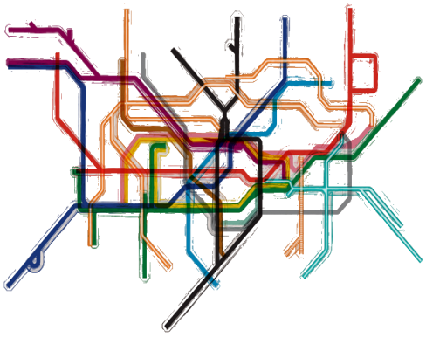
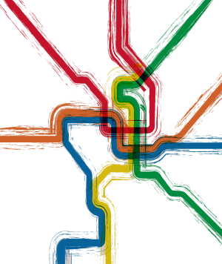
Neuronal Networks
So far: the building blocks of neurons/networks
ion channels
resting potential
action potential
synapses
Now: we build a network
networks in the thalamus
the importance of time (i.e. brain rhythms)
Boston
London
DC

Slide 2
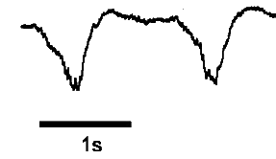
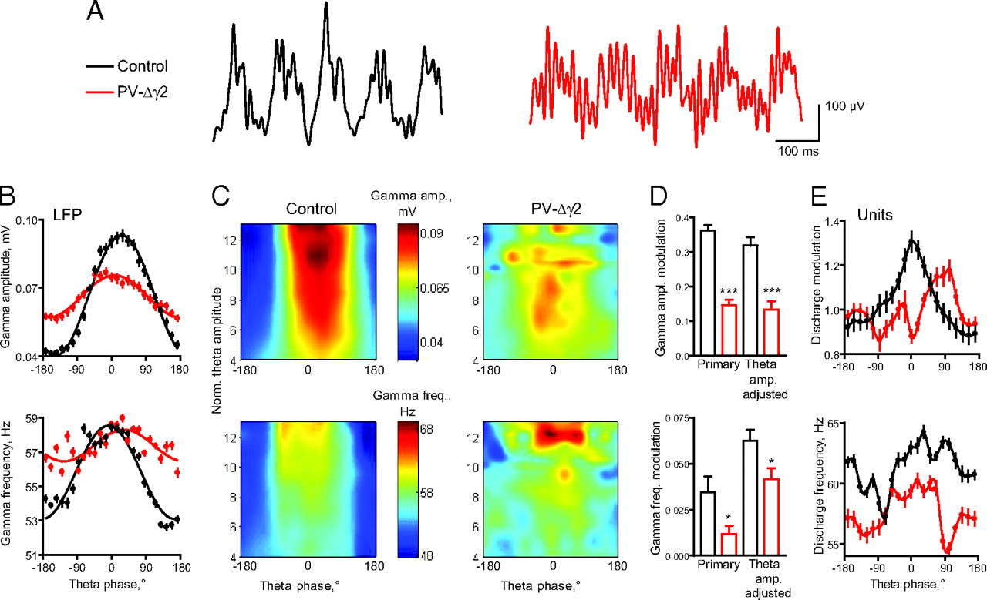

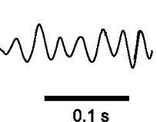
Neuronal Networks
Brain Rhythms
delta rhythm
So far: the building blocks of neurons/networks
1 sec
ion channels
theta rhythm
resting potential
action potential
synapses
100 millisec
beta rhythm
Now: we build a network
networks in the thalamus
the importance of time (i.e. brain rhythms)
100 millisec
gamma rhythm
10 millisec
combination
100 millisec

Slide 3
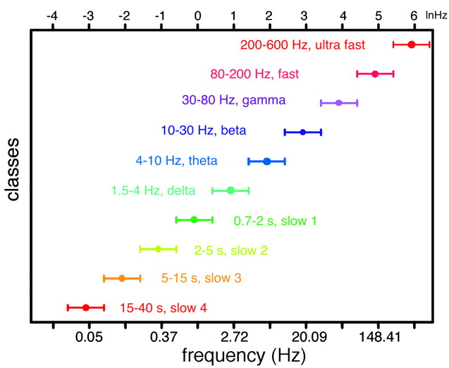
Neuronal Networks
Brain Rhythms
delta rhythm
1 sec
theta rhythm
100 millisec
beta rhythm
100 millisec
gamma rhythm
10 millisec
combination
Buzsaki & Draguhn, 2004
100 millisec

Slide 4
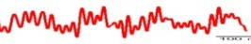
Neuronal Networks
Neuronal Networks
The Neuron
delta rhythm
Brain Rhythms
theta rhythm
1 sec
100 millisec
beta rhythm
100 millisec
gamma rhythm
10 millisec
combination
100 millisec
Buzsaki & Draguhn, 2004
why?
how?

Slide 5





Neuronal Networks
Neuronal Networks
delta rhythm
theta rhythm
1 sec
100 millisec
beta rhythm
100 millisec
gamma rhythm
10 millisec
combination
100 millisec
why?
how?

Slide 6
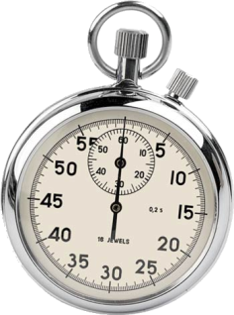
Neuronal Networks
Neuronal Networks
why?
rhythm = time

Slide 7
Neuronal Networks
Neuronal Networks
Brain Rhythms
Brain Rhythms
delta rhythm
delta rhythm
1 sec
1 sec
theta rhythm
theta rhythm
100 millisec
100 millisec
beta rhythm
beta rhythm
100 millisec
100 millisec
gamma rhythm
gamma rhythm
10 millisec
10 millisec
combination
combination
why?
how?
rhythm = time
100 millisec
100 millisec

Slide 8
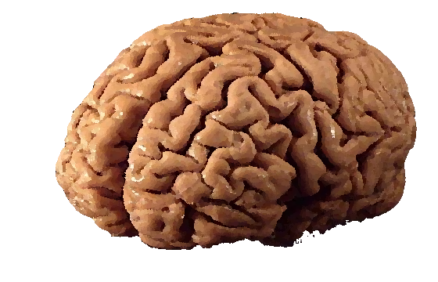
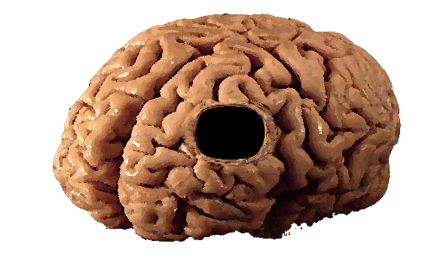


Neuronal Networks
Neuronal Networks
Brain
Brain Rhythms
delta rhythm
1 sec
thalamus
theta rhythm
100 millisec
Sleep Stages
beta rhythm
wake
100 millisec
N1
gamma rhythm
N2
N3
10 millisec
REM
combination
100 millisec

Slide 9
Neuronal Networks
Brain
Brain Rhythms
delta rhythm
1 sec
thalamus
theta rhythm
100 millisec
Sleep Stages
beta rhythm
wake
100 millisec
N1
gamma rhythm
N2
N3
10 millisec
REM
combination
100 millisec

Slide 10
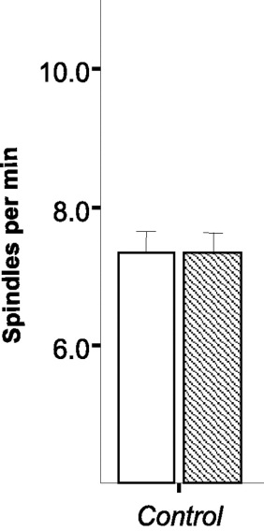

Neuronal Networks
Brain
Brain Rhythms
delta rhythm
1 sec
thalamus
theta rhythm
100 millisec
Sleep Spindles
beta rhythm
Sleep Stages
wake
100 millisec
N1
gamma rhythm
N2
N3
10 millisec
REM
combination
Eschenko et al., 2006
100 millisec

Slide 11
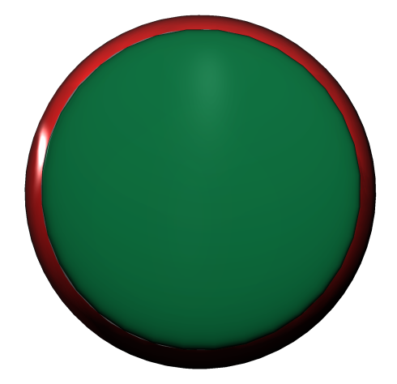
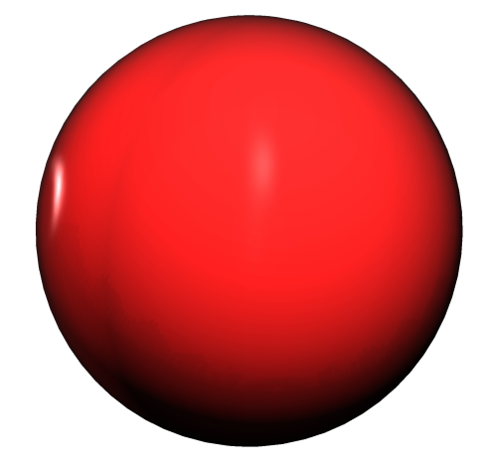


Neuronal Networks
Brain
Brain Rhythms
delta rhythm
reticular thalamic (RT) nucleus
1 sec
thalamus
thalamocortical (TC) nuclei
theta rhythm
100 millisec
Sleep Spindles
beta rhythm
100 millisec
sleep spindle (beta rhythm)
RT Neurons
gamma rhythm
100 millisec
10 millisec
TC Neurons
combination
Eschenko et al., 2006
100 millisec

Slide 12
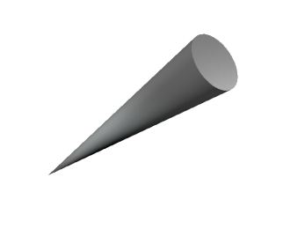
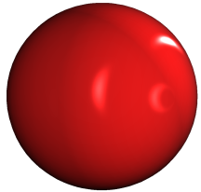
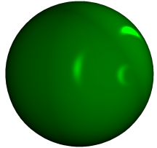



Spindle Circuit
Na⁺
K⁺
Cl⁻
soma
RT
resting
(cell body)
potential
axon
synapse
TC
resting
sodium channel
potential
potassium channel
chloride channel

Slide 13

Spindle Circuit
K⁺
action potential
Na⁺
Cl⁻
soma
RT
resting
(cell body)
potential
Na⁺
K⁺
axon
GABA
synapse
GABA receptor
TC
resting
sodium channel
potential
potassium channel
inhibitory
postsynaptic potential
(ipsp)
chloride channel

Slide 14

Spindle Circuit
K⁺
action potential
Na⁺
Cl⁻
soma
RT
resting
(cell body)
potential
Na⁺
K⁺
axon
GABA
synapse
GABA receptor
TC
resting
sodium channel
potential
potassium channel
inhibitory
postsynaptic potential
(ipsp)
chloride channel
low threshold calcium channel

Slide 15
Spindle Circuit
action potential
RT
resting
potential
GABA
GABA receptor
TC
resting
potential
inhibitory
postsynaptic potential
(ipsp)
chloride channel
low threshold calcium channel

Slide 16




Low Threshold Calcium Channel
0mV
open
(activated)
-25mV
membrane
potential
-50mV
closed
closed
rest
but ready
&
to open
inactivated
-75mV
(primed)
TC
-100mV
membrane
closed
potential
&
de-inactivated
opens with depolarization
low threshold calcium channel
inactivated state cannot open
de-inactivates (aka primes)
with hyperpolarization

Slide 17
?

Slide 18
Low Threshold Calcium Channels are called Low Threshold because:
A. They are primarily expressed in lower vertebrates.
B. Hyperpolarization lowers their threshold for activation.
C. They are activated at relatively hyperpolarized
membrane potentials.
D. They easily get angry.

Slide 19
Low Threshold Calcium Channel
0mV
open
(activated)
-25mV
membrane
potential
-50mV
closed
closed
rest
but ready
&
to open
inactivated
-75mV
(primed)
TC
-100mV
membrane
closed
potential
&
de-inactivated
Low Threshold Calcium Channels are called Low Threshold because:
A. They are primarily expressed in lower vertebrates.
B. Hyperpolarization lowers their threshold for activation.
C. They are activated at relatively hyperpolarized membrane potentials.
D. They get angry easily.

Slide 20
Which Statement is True?
A. A de-inactivated L-T Ca²⁺ channel is open.
B. If depolarized, an inactivated L-T Ca²⁺ channel will open.
C. Hyperpolarization de-inactivates L-T Ca²⁺ channels.
D. Hyperpolarization opens L-T Ca²⁺ channels.

Slide 21
Low Threshold Calcium Channel
0mV
open
(activated)
-25mV
membrane
potential
-50mV
closed
closed
rest
but ready
&
to open
inactivated
-75mV
(primed)
TC
-100mV
membrane
closed
potential
&
de-inactivated
Which Statement is true?
A. A de-inactivated L-T Ca²⁺ channel is open.
B. If depolarized, an inactivated L-T Ca²⁺ channel will open.
C. Hyperpolarization de-inactivates L-T Ca²⁺ channels.
D. Hyperpolarization opens L-T Ca²⁺ channels.

Slide 22
Low Threshold Calcium Channel
0mV
open
(activated)
-25mV
membrane
potential
-50mV
closed
closed
rest
but ready
&
to open
inactivated
-75mV
(primed)
TC
-100mV
membrane
closed
potential
&
de-inactivated
(brain.how)

Slide 23
Spindle Circuit
action potential
RT
resting
potential
GABA
GABA receptor
TC
resting
potential
inhibitory
postsynaptic potential
(ipsp)
low threshold calcium channel

Slide 24
Spindle Circuit
action potential
RT
resting
potential
action potential
GABA
low threshold
calcium spike
GABA receptor
TC
resting
potential
inhibitory
postsynaptic potential
(ipsp)
low threshold calcium channel

Slide 25
Spindle Circuit
action potential
RT
resting
potential
action potential
GABA
low threshold
calcium spike
GABA receptor
TC
resting
potential
inhibitory
postsynaptic potential
(ipsp)
low threshold calcium channel

Slide 26

Spindle Circuit
glutamate
action potential
glutamate receptor
RT
resting
potential
action potential
GABA
low threshold
calcium spike
GABA receptor
TC
resting
potential
inhibitory
postsynaptic potential
(ipsp)
low threshold calcium channel

Slide 27
Spindle Circuit
glutamate
action potential
glutamate receptor
RT
resting
potential
action potential
GABA
low threshold
calcium spike
GABA receptor
TC
resting
potential
inhibitory
postsynaptic potential
(ipsp)
low threshold calcium channel

Slide 28
?

Slide 29
Which statement is the most true?:
A. Neurons can turn on in response to excitation.
B. Neurons can turn on in response to inhibition.
C. Both A & B are false.
D. Both A & B are true.

Slide 30


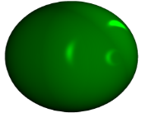

Spindle Circuit
glutamate
action potential
glutamate receptor
RT
resting
potential
action potential
GABA
low threshold
calcium spike
GABA receptor
TC
resting
potential
inhibitory
postsynaptic potential
low threshold calcium channel
(ipsp)
Which statement is the most true?:
A. Neurons can turn on in response to excitation.
B. Neurons can turn on in response to inhibition.
C. Both A & B are false.
D. Both A & B are true.

Slide 31
Spindle Circuit
glutamate
action potential
glutamate receptor
RT
resting
potential
action potential
GABA
low threshold
calcium spike
GABA receptor
TC
resting
potential
inhibitory
postsynaptic potential
(ipsp)
low threshold calcium channel

Slide 32
Spindle Circuit
glutamate
glutamate receptor
activation
RT
burst
inhibition
excitation
rebound
GABA
burst
GABA receptor
TC
Sleep Spindle
Sleep
wake
N1
N2
100 millisec
N3
REM

Slide 33
Spindle Circuit
glutamate
glutamate receptor
activation
RT
burst
inhibition
excitation
rebound
GABA
burst
GABA receptor
TC
Sleep Spindle
Sleep
wake
N1
N2
100 millisec
N3
REM

Slide 34
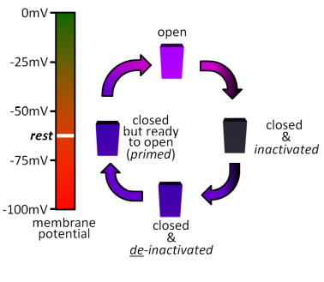
Spindle Circuit
activation
RT
burst
inhibition
excitation
rebound
burst
activation
TC
?
burst
low threshold calcium channel
inhibition
excitation
r e b o u n d
r e b o u n d
?
b u r s t
b u r s t

Slide 35
Spindle Circuit
activation
RT
burst
inhibition
excitation
rebound
burst
activation
TC
burst
low threshold calcium channel
inhibition
excitation
r e b o u n d
b u r s t
b u r s t

Slide 36
?

Slide 37
Prolonged inhibition of thalamocortical (TC) neurons will cause:
A. Weaker TC firing activity during the inhibition.
B. Weaker TC firing activity after the inhibition.
C. Stronger TC firing during the inhibition.
D. Stronger TC firing after the inhibition.
E. A & B.
F. A & D.

Slide 38



Spindle Circuit
activation
burst
RT
inhibition
excitation
rebound
burst
TC
activation
burst
low threshold calcium channel
inhibition
excitation
r e b o u n d
r e b o u n d
b u r s t
b u r s t
Prolonged inhibition of thalamocortical (TC) neurons will cause:
A. Weaker TC firing activity during the inhibition.
B. Weaker TC firing activity after the inhibition.
C. Stronger TC firing during the inhibition.
D. Stronger TC firing after the inhibition.
E. A & B
F. A & D

Slide 39
Spindle Circuit
activation
RT
burst
inhibition
excitation
rebound
burst
activation
TC
burst
low threshold calcium channel
inhibition
excitation
r e b o u n d
r e b o u n d
b u r s t
b u r s t

Slide 40
Spindle Circuit
activation
RT
burst
inhibition
excitation
rebound
burst
activation
TC
burst
low threshold calcium channel
inhibition
excitation
r e b o u n d
b u r s t

Slide 41
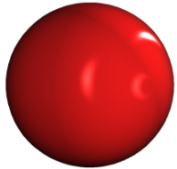










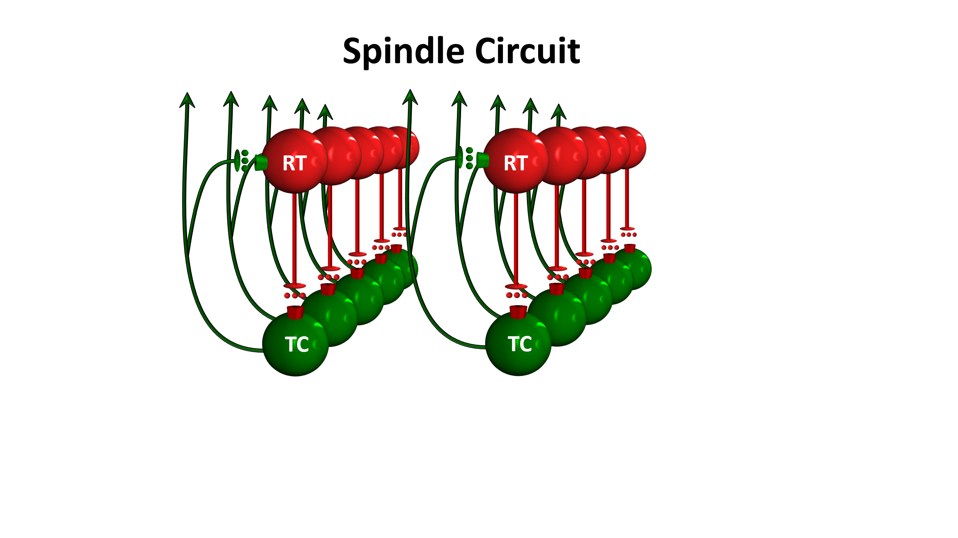
Spindle Circuit
RT
RT
inhibition
TC
TC
inhibition

Slide 42
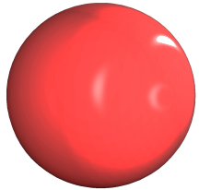
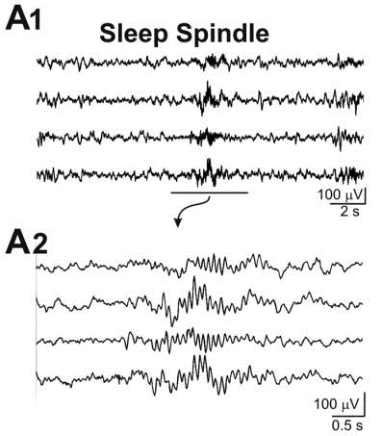
Spindle Circuit
Network
RT
activation
RT
RT
burst
inhibition
excitation
rebound
burst
TC
TC
TC
Sleep Spindle
Sleep Spindle
100 millisec
100μV
0.5s

Slide 43
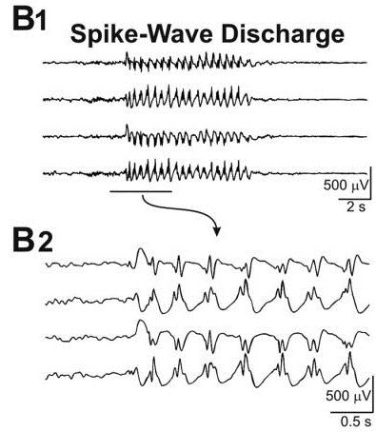
Spindle Circuit
Network
RT
activation
RT
RT
burst
inhibition
excitation
rebound
burst
activation
burst
inhibition
excitation
TC
TC
TC
r e b o u n d
b u r s t
Sleep Spindle
Sleep Spindle
Seizure
100 millisec
100μV
500μV
0.5s
0.5s

Slide 44
Spindle Circuit
Na⁺
K⁺
Cl⁻
Na⁺
K⁺
Cl⁻
Network
RT
RT
activation
burst
inhibition
excitation
Na⁺
Na⁺
rebound
K⁺
K⁺
burst
activation
receptor
burst
receptor
inhibition
excitation
TC
TC
r e b o u n d
Ca²⁺
Ca²⁺
b u r s t
Sleep Spindle
Sleep Spindle
Seizure
100 millisec
100μV
500μV
0.5s
0.5s

Slide 45
Spindle Circuit
Na⁺
K⁺
Cl⁻
Na⁺
K⁺
Cl⁻
Network
RT
RT
activation
burst
inhibition
excitation
Na⁺
Na⁺
rebound
K⁺
K⁺
burst
activation
receptor
burst
receptor
inhibition
excitation
TC
TC
r e b o u n d
Ca²⁺
Ca²⁺
b u r s t
Sleep Spindle
Sleep Spindle
Seizure
100 millisec
100μV
500μV
0.5s
0.5s

Slide 46
?

Slide 47
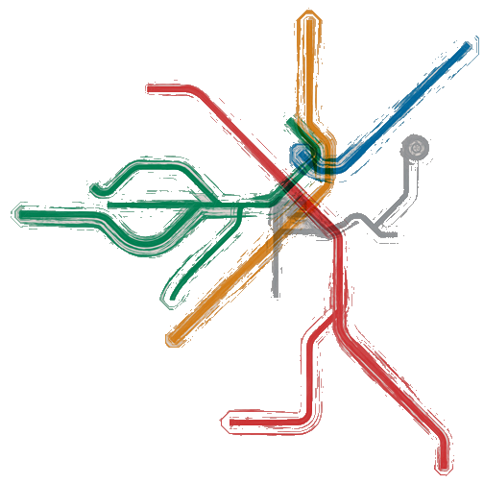
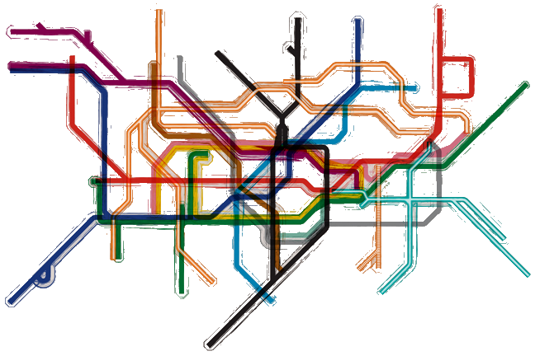
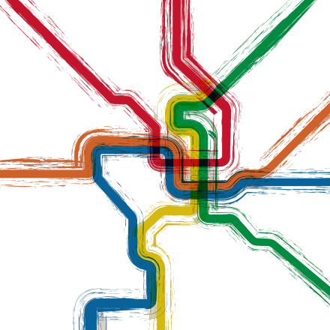
Which one is Boston?:

Slide 48



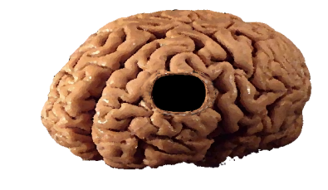






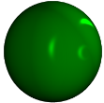

Neuronal Networks: Summary
Brain Rhythms
delta rhythm
Sleep Spindle
1 sec
theta rhythm
Channels are Everywhere
wake
100 millisec
100 millisec
K⁺
Low Threshold Calcium Channel
beta rhythm
Na⁺
Cl⁻
N1
100 millisec
N2
RT
Channels Drive Activity
gamma rhythm
N3
0mV
Na⁺
open
action potential
REM
-25mV
Connections Modulate Networks
10 millisec
K⁺
RT
combination
membrane
potential
-50mV
closed
rest
but ready
closed
thalamus
to open
&
100 millisec
inactivated
receptor
action potential
-75mV
(primed)
RT
RT
TC
low threshold
TC
-100mV
GABA
calcium spike
membrane
closed
potential
&
Ca²⁺
GABA receptor
TC
de-inactivated
inhibitory
postsynaptic potential
TC
(ipsp)
TC

