Slide 1
Ionic Basis of Neuronal Excitability
Synapses & Circuits
Lecture One

Slide 2
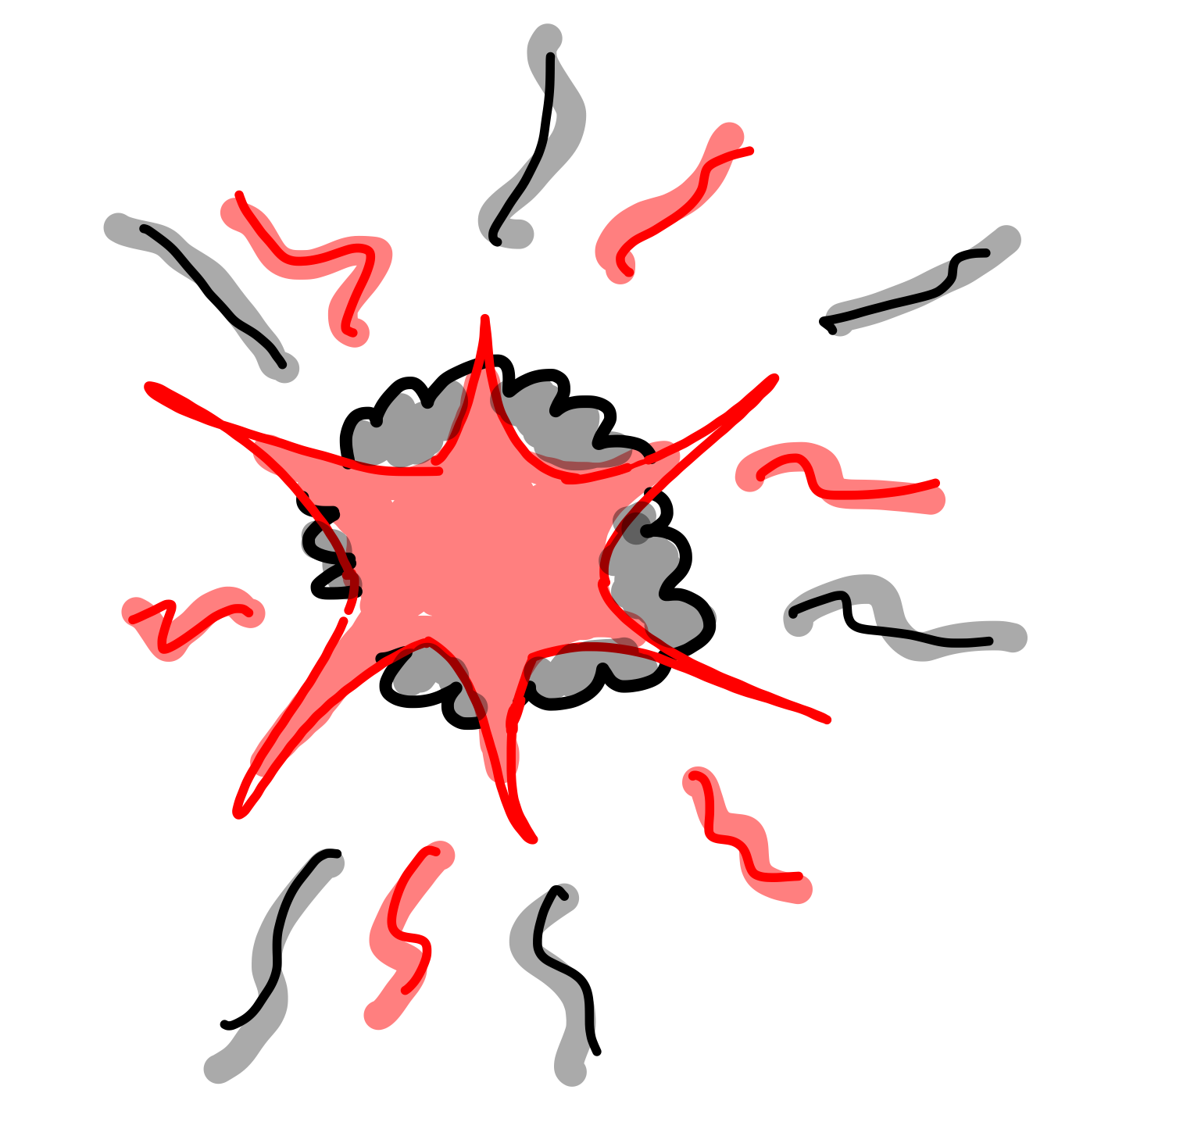

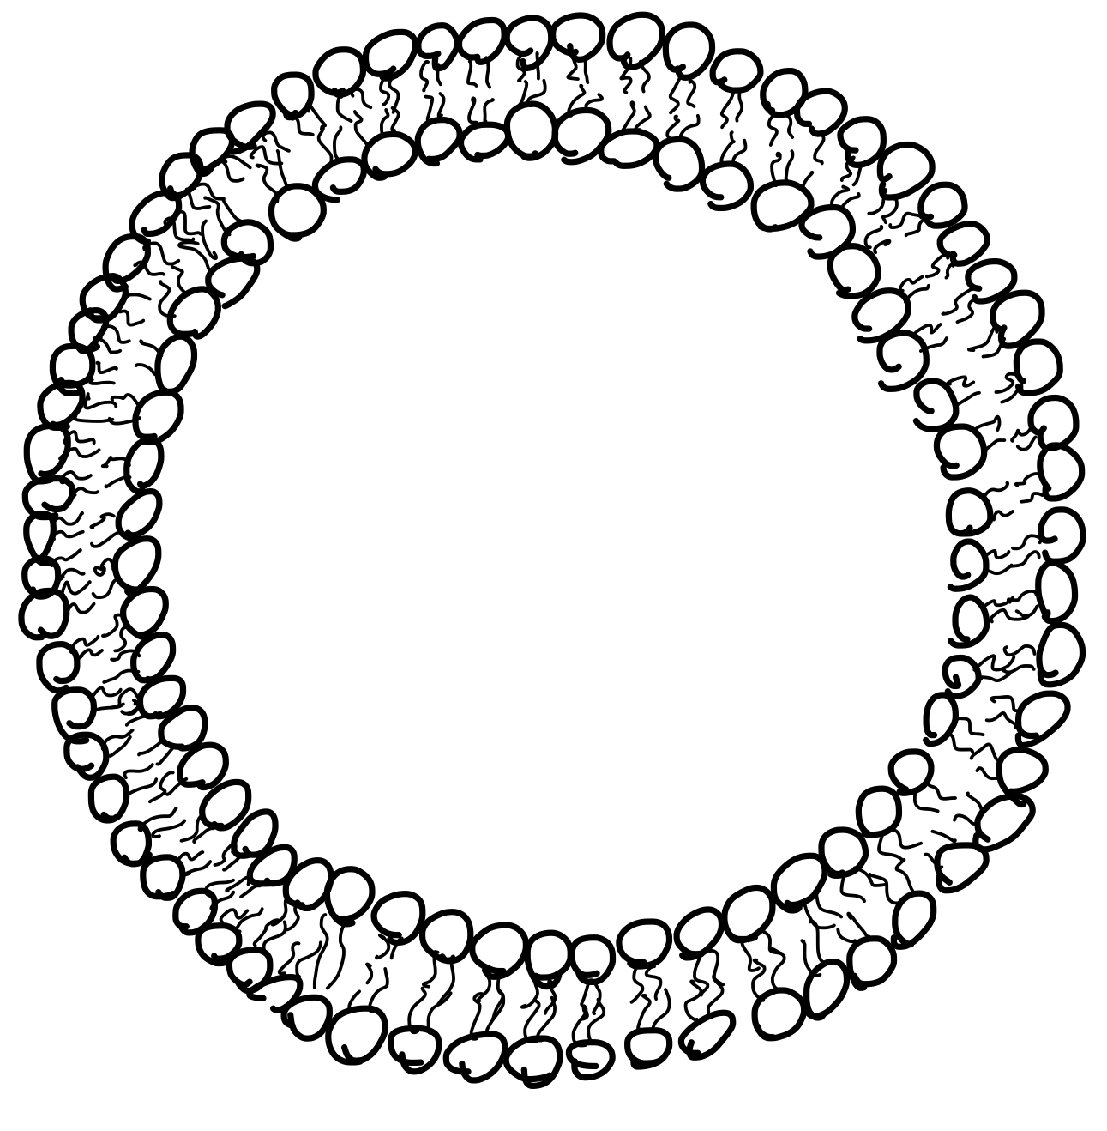




In the beginning…
A Big Bang
Earth
Cell
Channel

Slide 3

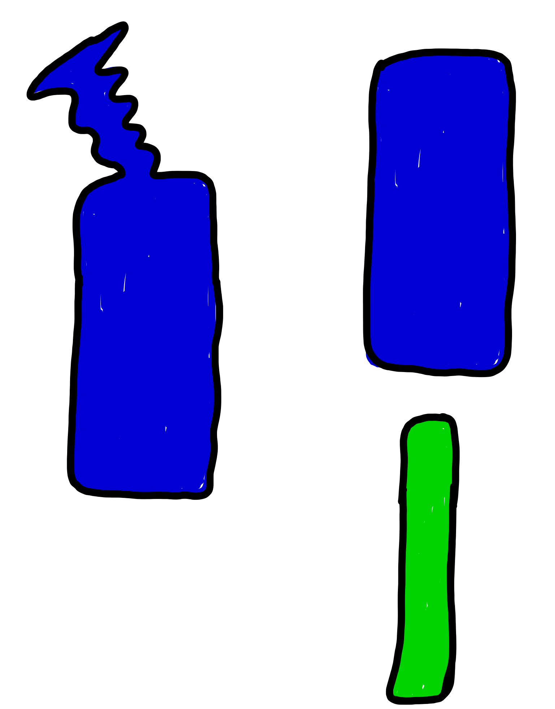
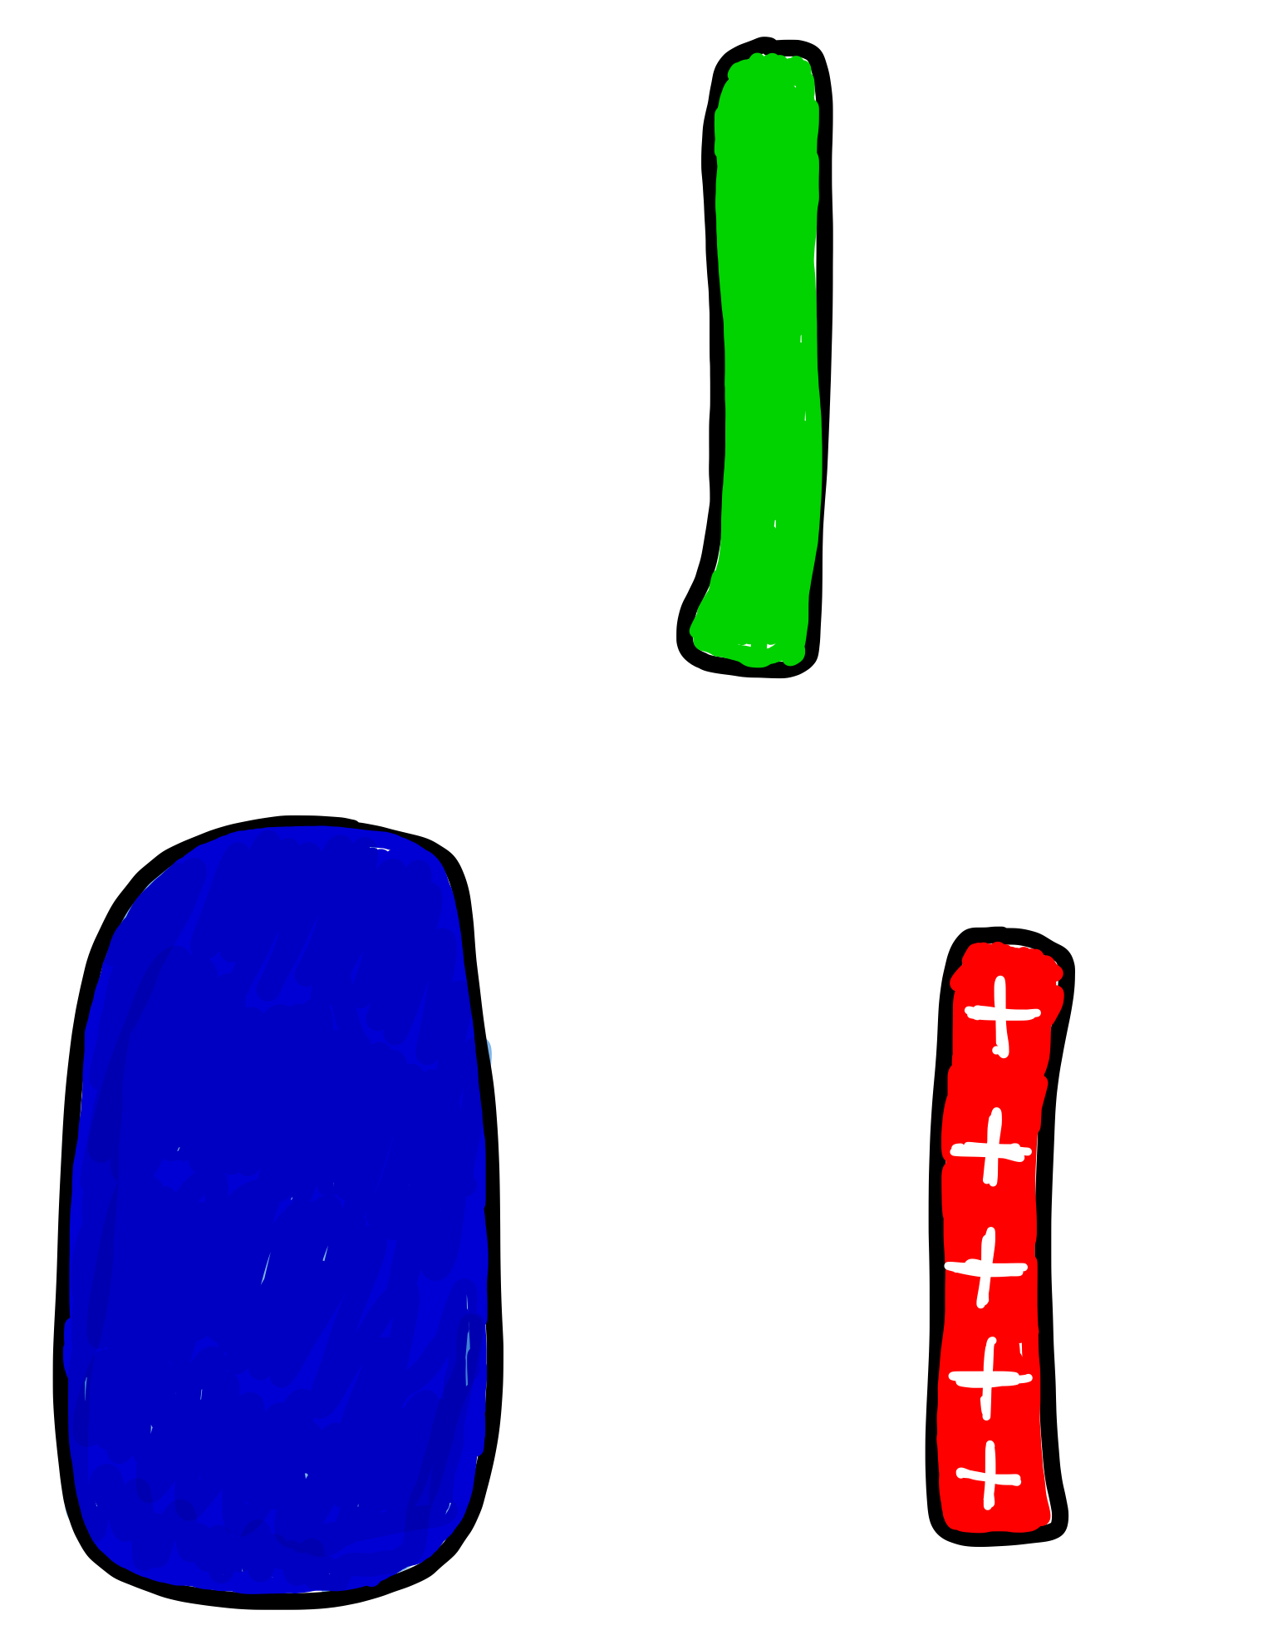
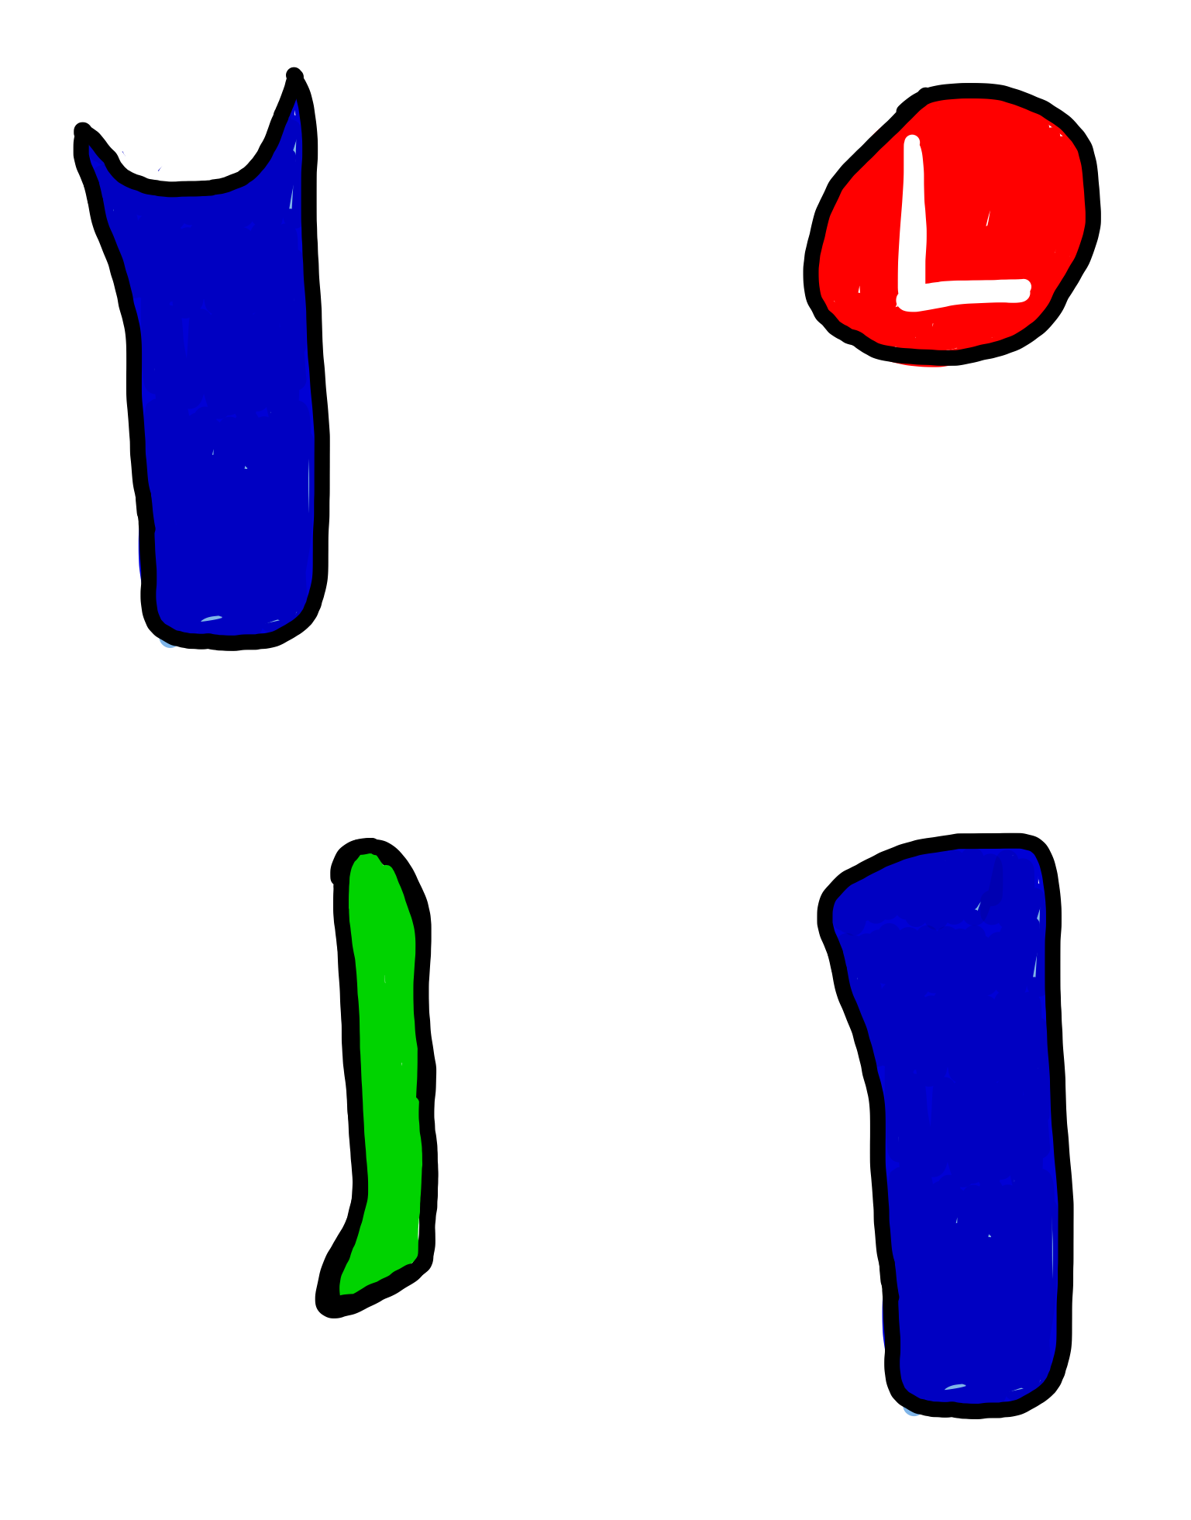
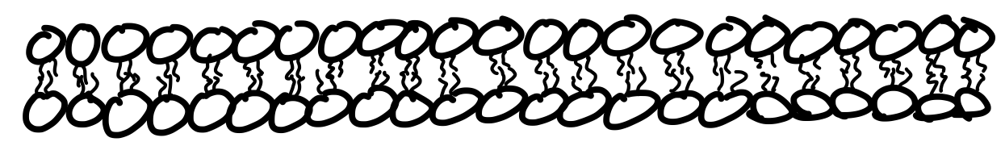
Ion Channel Gating
Voltage-Gated
Ligand-Gated
Mechanically-
Gated

Slide 4
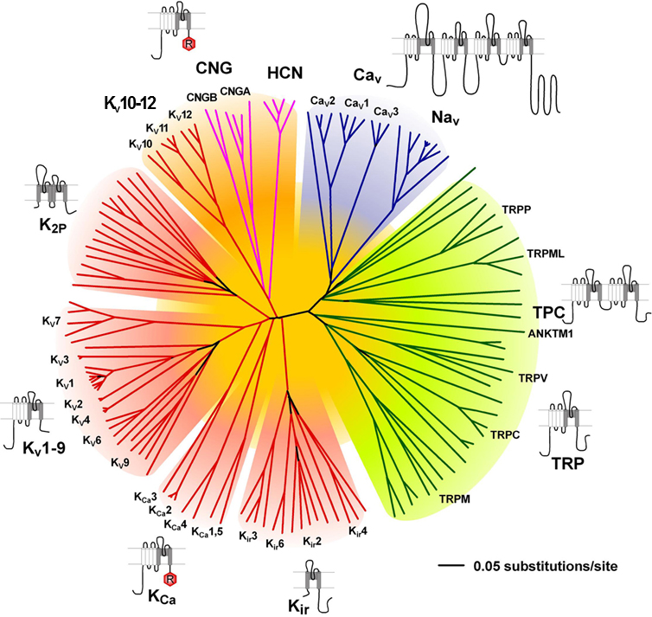
Ion Channel Diversity

Slide 5
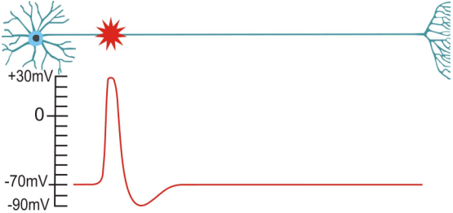
The Action Potential

Slide 6

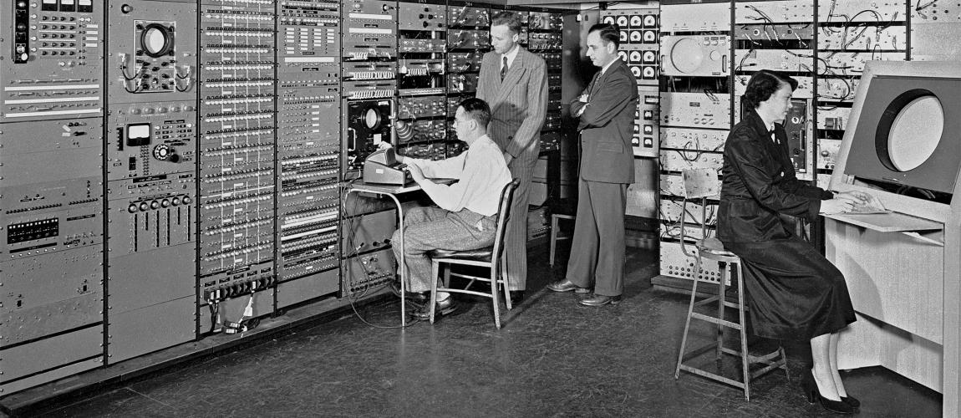


What happened in 1952
Average Cost of new house $9,050
Average wages per year $3,850
Cost of a gallon of Gas 20 cents

Slide 7

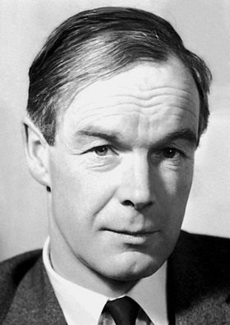
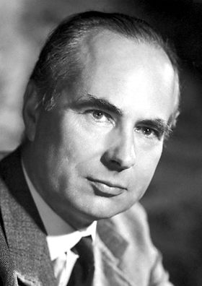
A Model for the Action Potential
Alan Lloyd Hodgkin
Andrew Fielding Huxley
HH

Slide 8
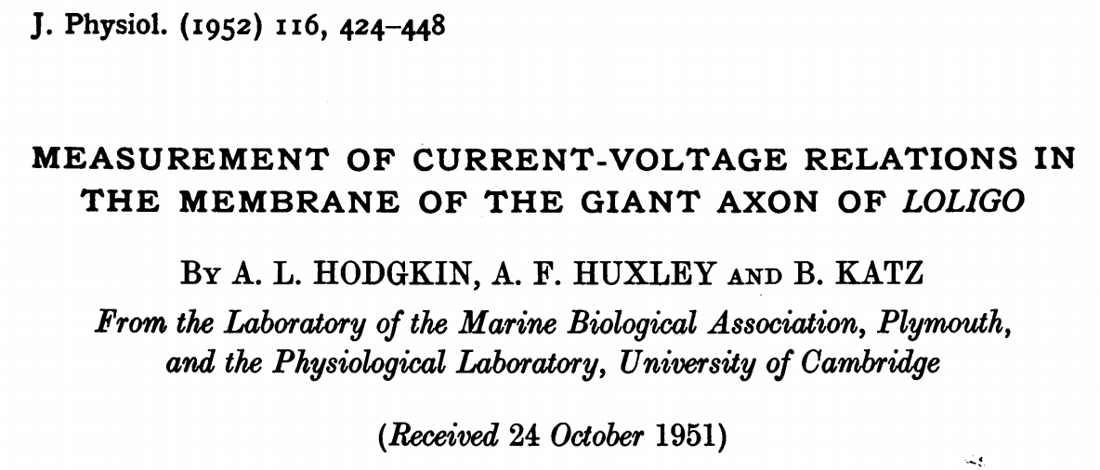
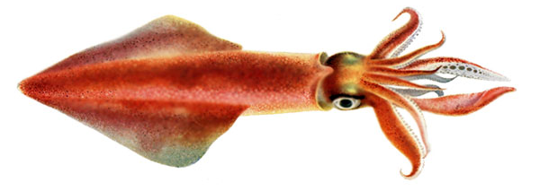

Slide 9
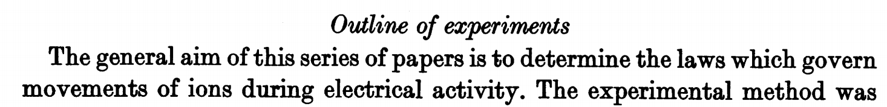

Slide 10
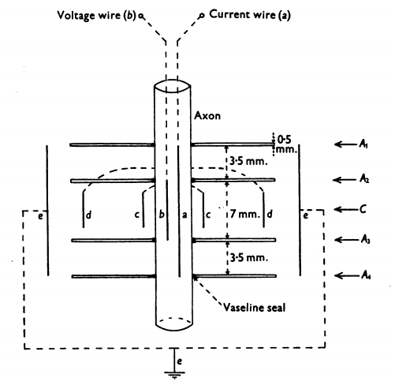
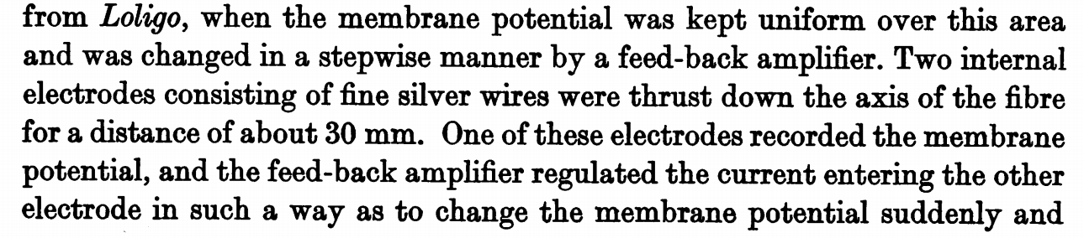
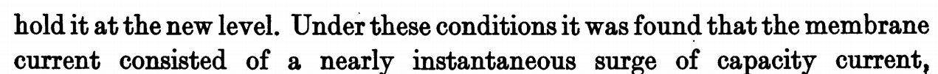

Slide 11
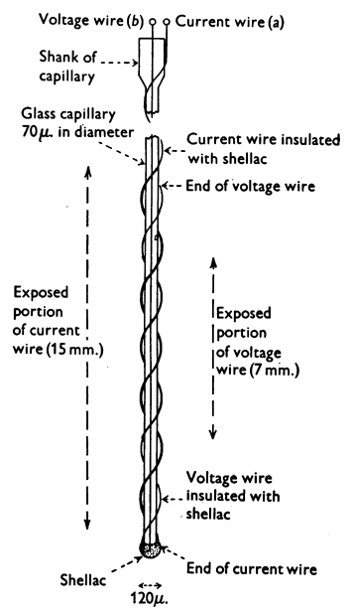
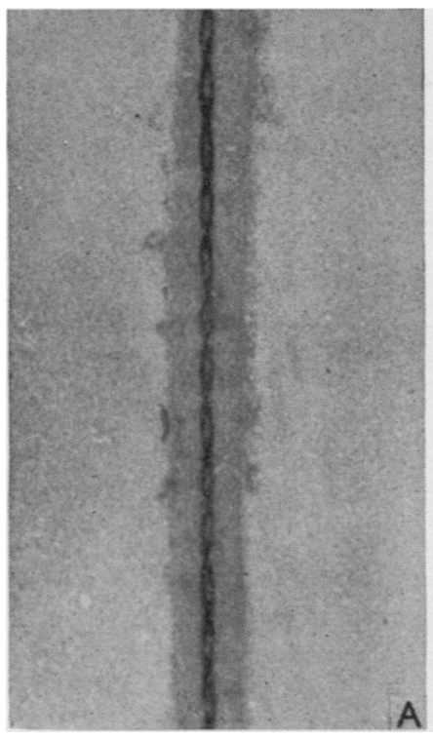

Slide 12
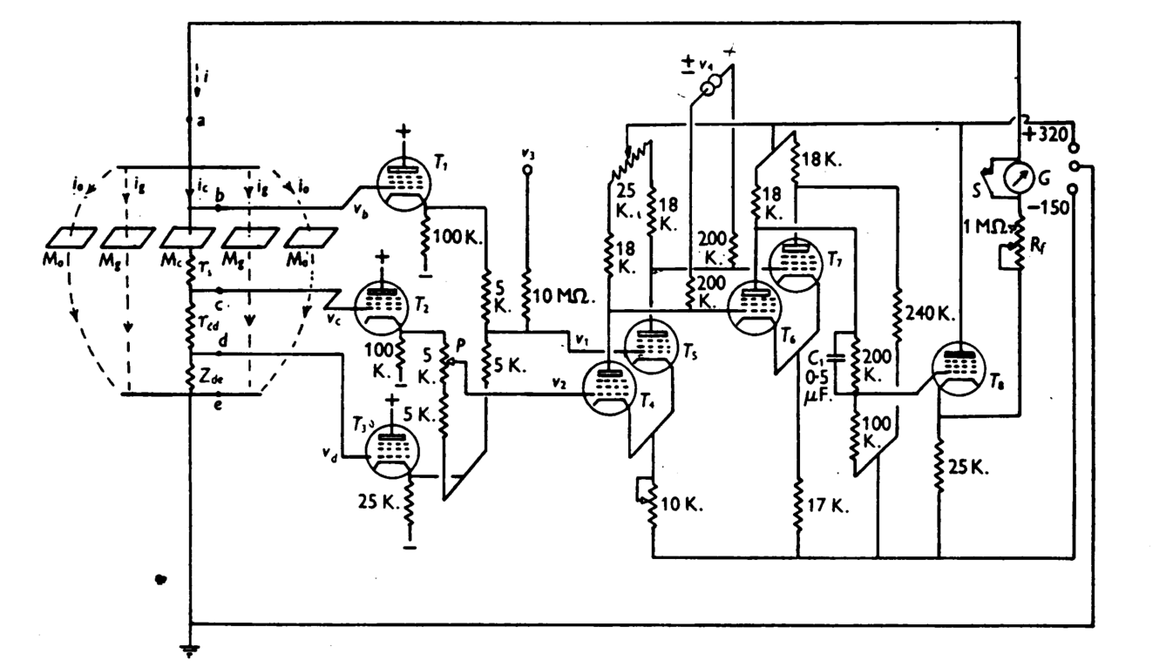
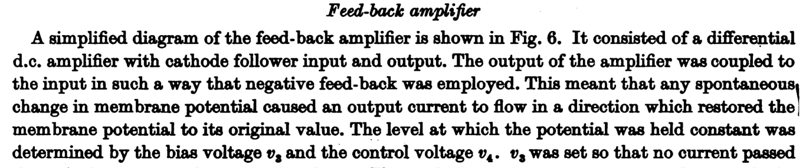

Slide 14
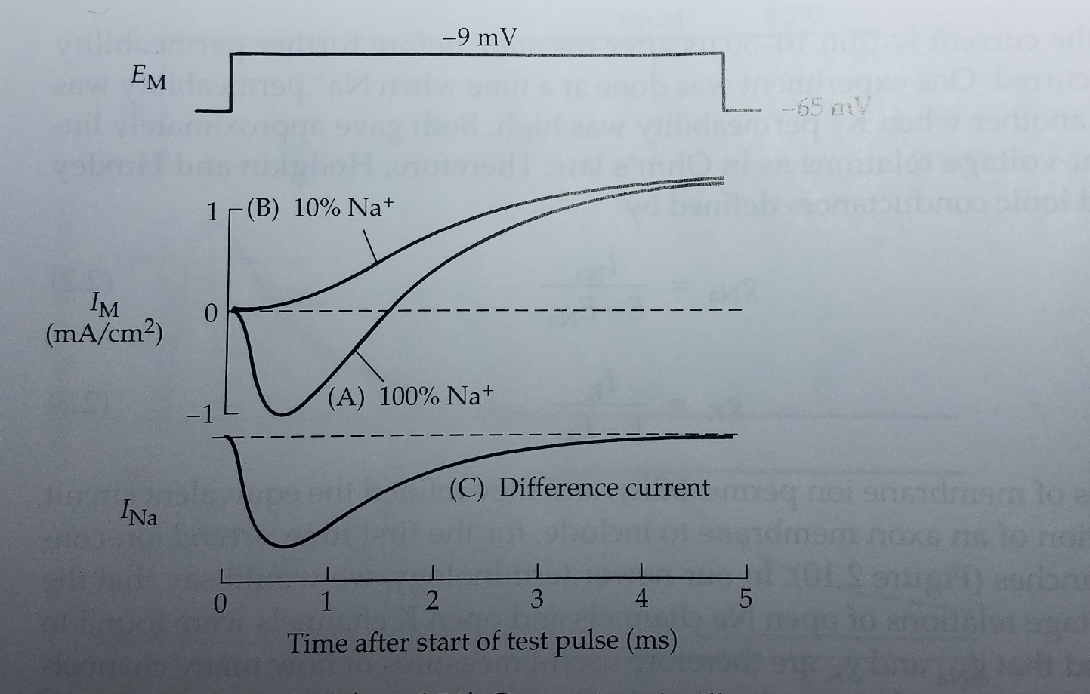
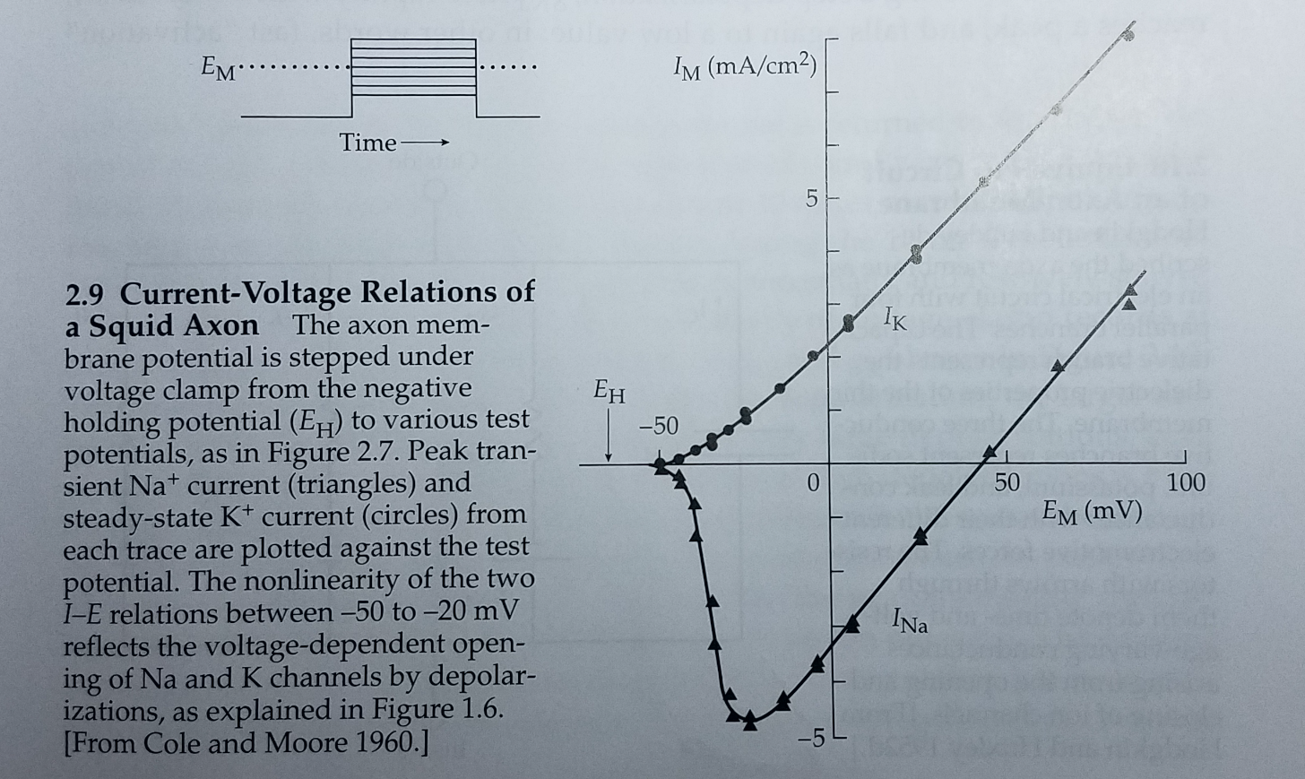
First of all….is the sodium current ohmic?
(everything is easier if it is)
V=IR
or I=V/R
or R=V/I
or 1/R=I/V
Ohmic?

Slide 15

First of all….is the sodium current ohmic?
(everything is easier if it is)
V=IR
or I=V/R
or R=V/I
or 1/R=I/V
VS
Ohmic?

Slide 16
First of all….is the sodium current ohmic?
(everything is easier if it is)
V=IR
or I=V/R
or R=V/I
or 1/R=I/V
Ohmic?

Slide 17
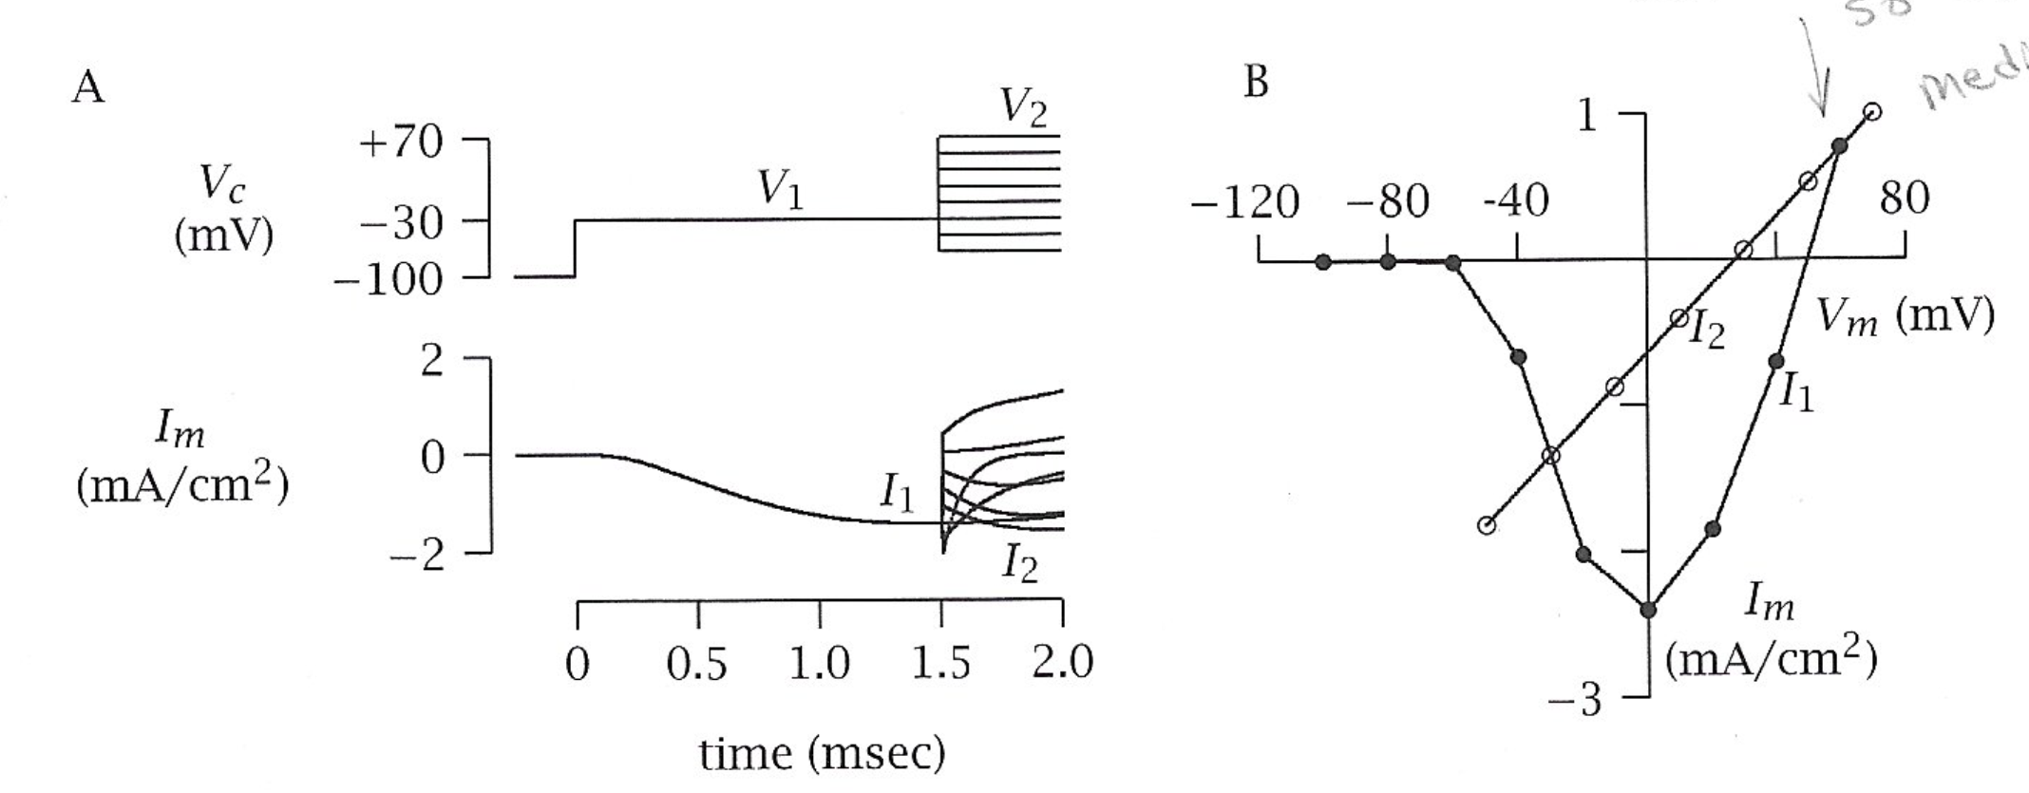
First of all….is the sodium current ohmic?
(everything is easier if it is)
V=IR
or I=V/R
or R=V/I
or 1/R=I/V
Ohmic!
Ohmic?

Slide 18
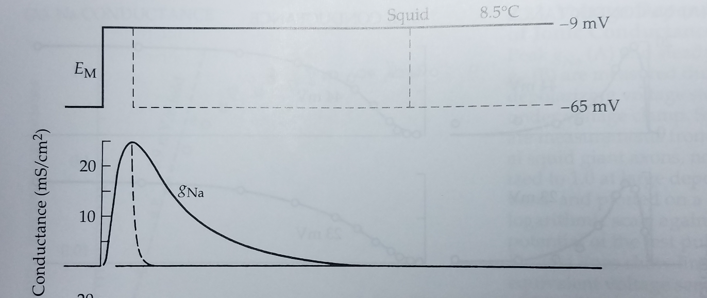
First of all….is the sodium current ohmic?
(everything is easier if it is)
V=IR
or I=V/R
or R=V/I
or 1/R=I/V
Ohmic!
Express current
in terms of conductance (g)…
g = 1/R
g = I/V
g_{Na} = I_{Na}/(V_{m}-E_{Na})

Slide 19
First of all….is the sodium current ohmic?
(everything is easier if it is)
V=IR
or I=V/R
or R=V/I
or 1/R=I/V
sigmoidal
exponential

Slide 20
Channel Basics
Channel
Gate

Slide 21
Channel Basics
Channel
Gate

Slide 22
First of all….is the sodium current ohmic?
(everything is easier if it is)
V=IR
or I=V/R
or R=V/I
or 1/R=I/V
The Shape Tells
You Something
About Gates!
sigmoidal
exponential

Slide 23
Gate Kinetics
Activation Gate (m)
Inactivation Gate (h)
Sodium
Channel
inside
outside

Slide 24
Gate Kinetics
open
closed

Slide 25
Gate Kinetics
open
closed

Slide 26
Gate Kinetics
transition rate
constants
open
α
β
In reality…
α & β constants = # of times per second
a gate changes
closed
What is the proportion of gates that are open?
At Equilibrium?
What is the proportion of gates that are closed?
α (1-P)
β P
Proportion that are open
Proportion that are closed
=
P
1-P
α
Fraction that are opening
Fraction that are closing
P =
α + β
α (1-P)
β P

Slide 27
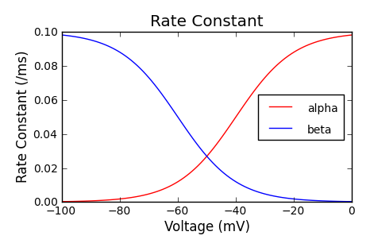
Gate Kinetics
transition rate
constants
open
α
β
In reality…
α & β constants = # of times per second
a gate changes
closed
At Equilibrium?
α (1-P)
β P
=
α
P =
α + β

Slide 28
Gate Kinetics
transition rate
constants
open
α
β
In reality…
α & β constants = # of times per second
a gate changes
closed
V₂
At Equilibrium?
P₂
P₂
α (1-P)
β P
V₁
=
P₁
P₂
α
τ₁
τ₂
P =
1
α + β
P₁
=
τ₂
α + β
V₁
V₂

Slide 29
Gate Kinetics
transition rate
constants
open
α
β
In reality…
α & β constants = # of times per second
a gate changes
closed
It takes time to reach P
V₂
At Equilibrium?
P₂
P₂
α (1-P)
β P
V₁
=
P₁
P₂
α
τ₁
τ₂
P =
1
α + β
P₁
=
τ₂
α + β
V₁
V₂

Slide 30
Sodium Channel Opening
+
-
-
+
-
+
Activation Gate (m)
Inactivation Gate (h)
1
Sodium
Channel
+
-
0
+
-
+
-
1
inside
outside
0

Slide 31
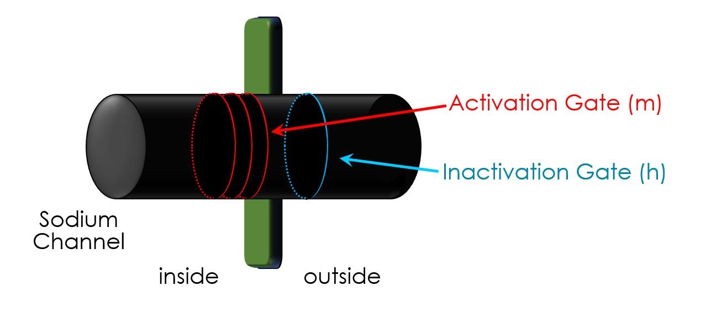
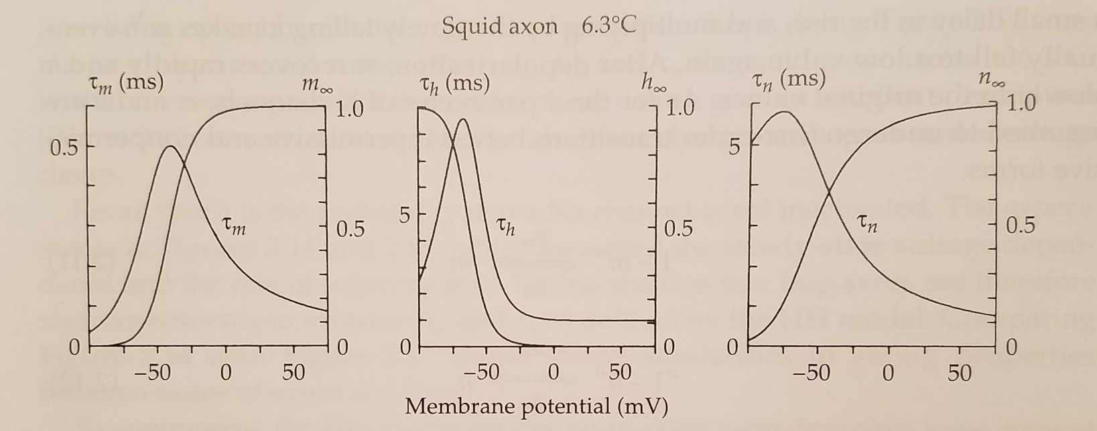
Sodium Channel Opening
α
m
α
h
m =
h =
α + β
α + β
m
m
h
h
1
1
τ
m
τ
h
=
=
α + β
α + β
m
m
h
h
At Equilibrium?
α
P =
α + β
1
τ
=
α + β

Slide 32
Sodium Channel Opening
inside
outside
+
-70mV
+
-
+
-
+
-
-
+
Activation Gate (m)
-30mV
time
+
-
Inactivation Gate (h)
+
Sodium
Channel
+
-
+
-
-30mV
+
-
inside
outside
+
-30mV

Slide 33
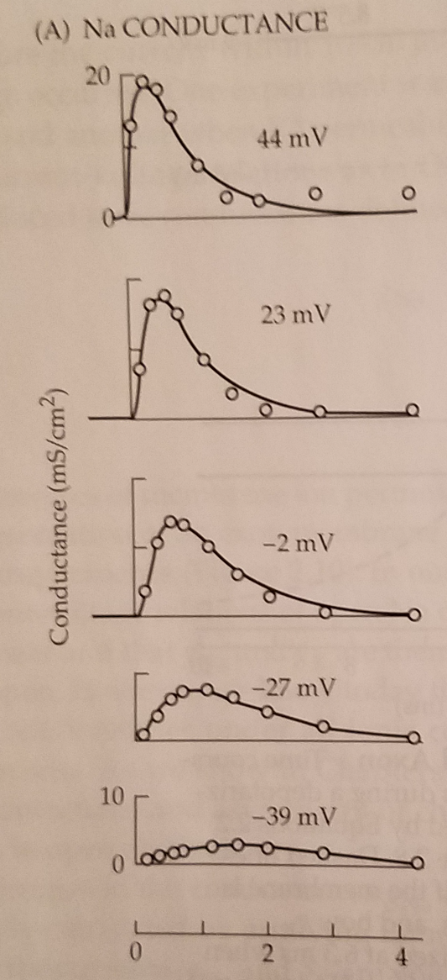
Sodium Channel Opening
inside
outside
+
α
m
α
h
-70mV
m =
h =
+
α + β
α + β
-
m
m
h
h
+
1
1
τ
m
τ
h
=
=
-30mV
α + β
α + β
m
m
h
h
time
+
-
+
At Equilibrium?
α
-30mV
P =
α + β
+
1
τ
=
α + β
-30mV

Slide 34
Channel Opening
Sodium
Channel
Potassium
Channel

Slide 35
The end

