Slide 1
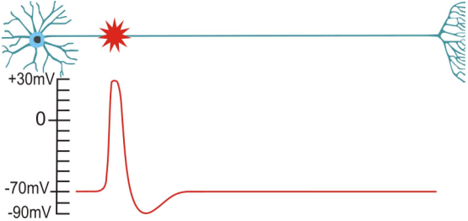
Vesicular Release
Synapses & Circuits
Lecture Two
Lecture One

Slide 2
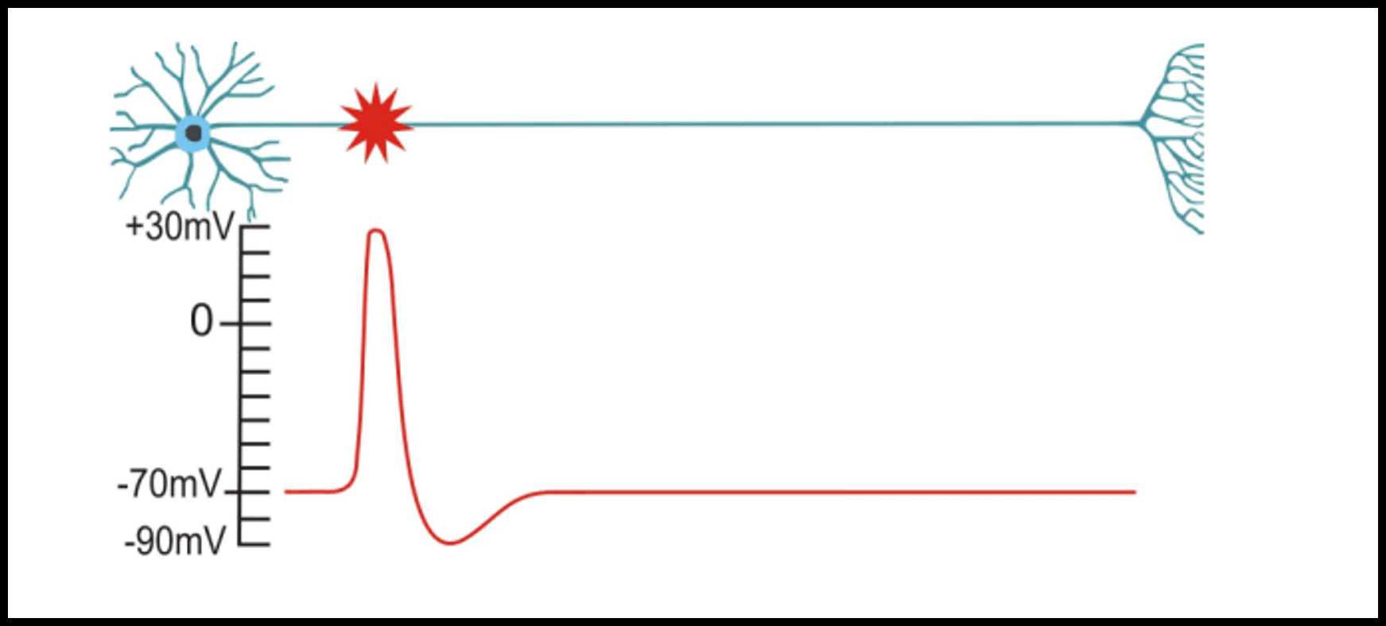
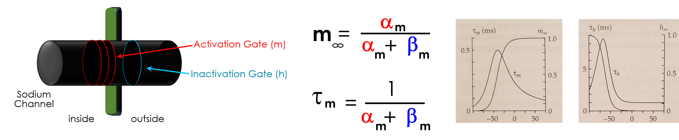
Vesicular Release
Synapses & Circuits
Lecture Three
Lecture One
Activation
Gates
Inactivation
Gate
Na⁺

Slide 3
Vesicular Release
Synapses & Circuits
Lecture Three
Lecture One
Activation
Gates
Inactivation
Gate
Na⁺
E_{Na}

Slide 4
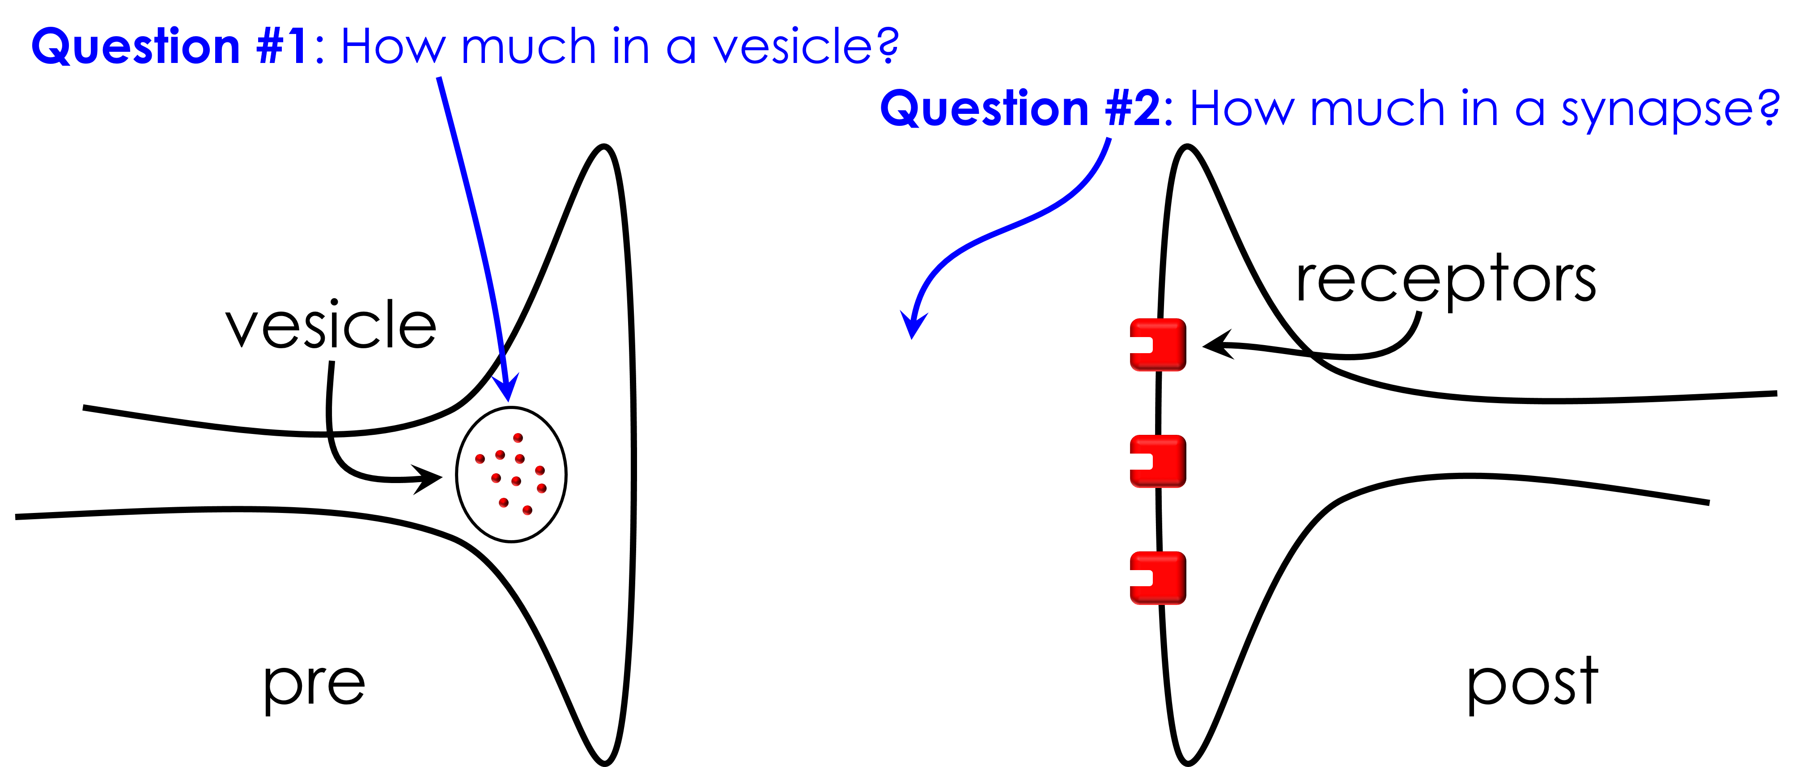
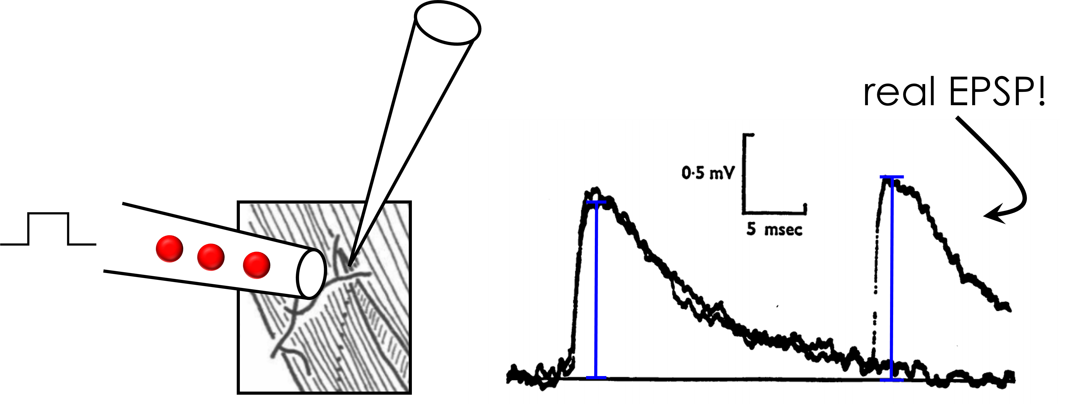
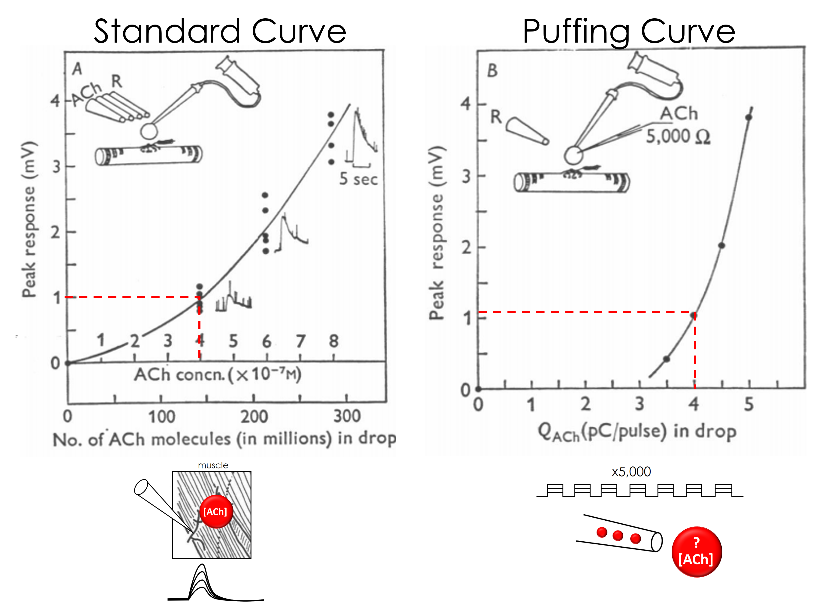
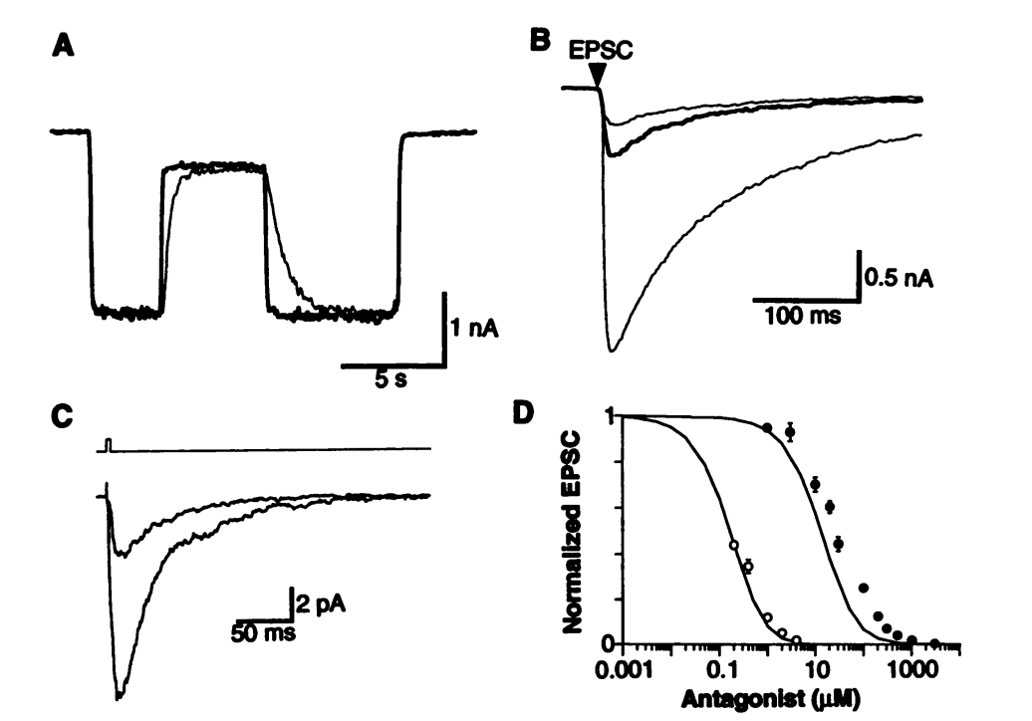
Vesicular Release
Synapses & Circuits
Lecture Three
Lecture One
Next Lecture
Activation
Gates
Inactivation
Gate
Na⁺
E_{Na}

Slide 5
The Synapse
receptors
vesicle
pre
post

Slide 6
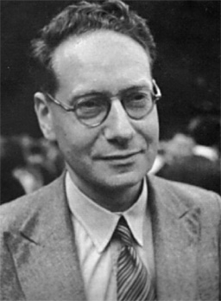
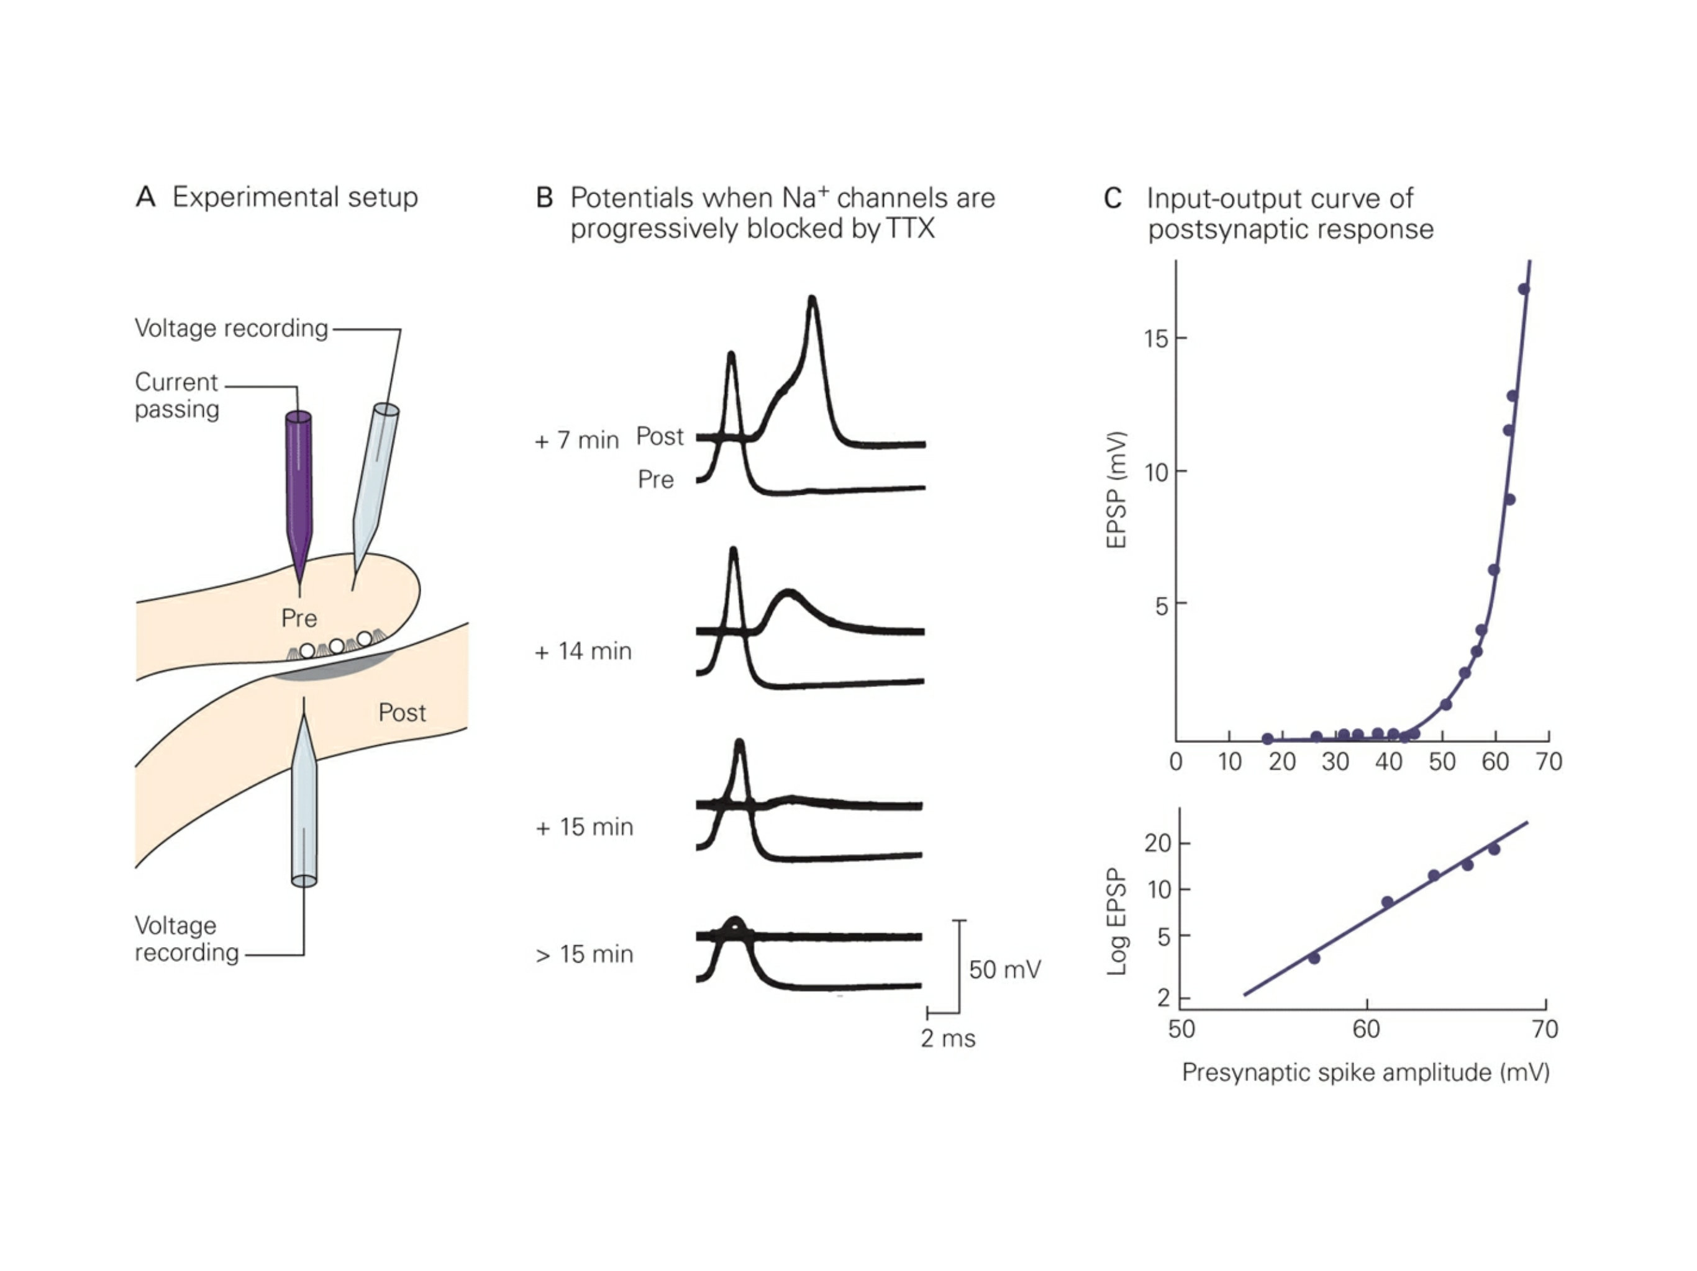
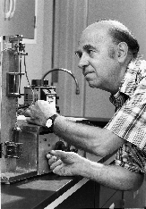
Postsynaptic Response Depends
On Presynaptic Voltage
Bernard Katz
Ricardo Miledi

Slide 7
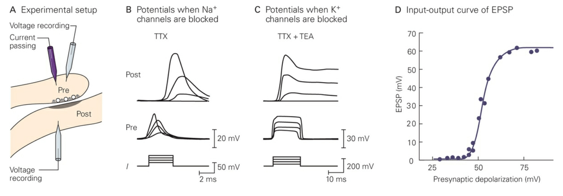
Postsynaptic Response Does Not Depend
On Na⁺ or K⁺ Channels
Bernard Katz
Ricardo Miledi

Slide 8
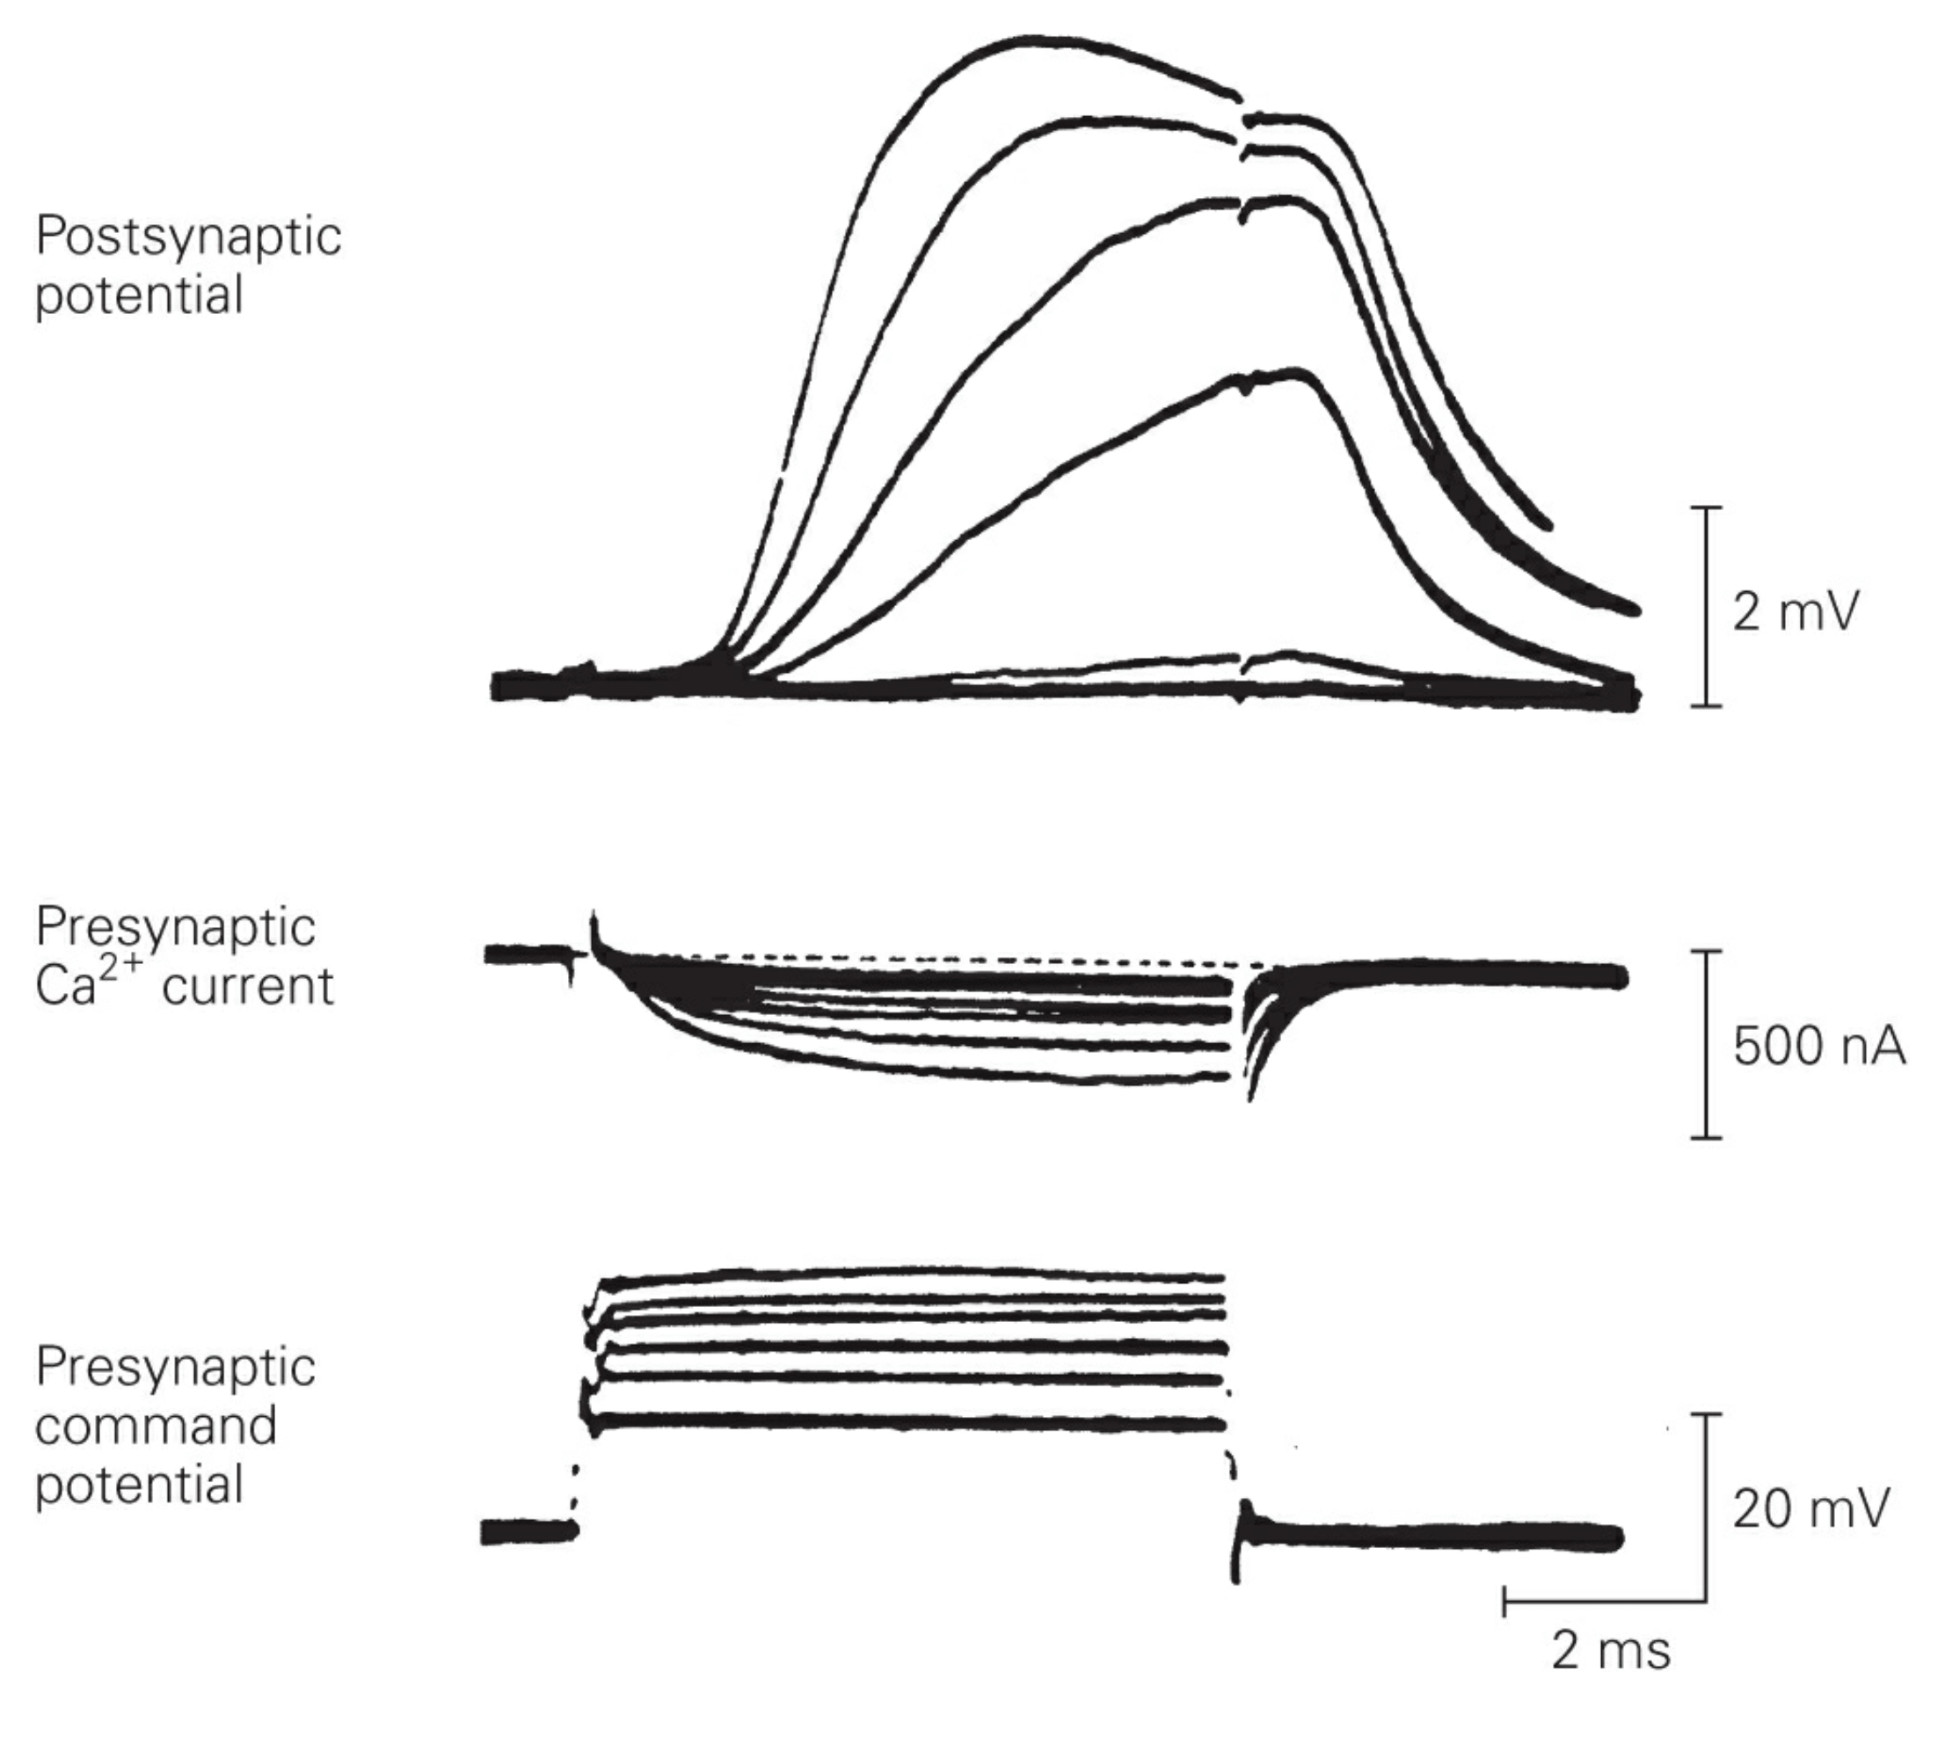
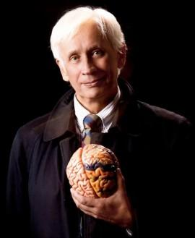
Postsynaptic Response Does Depend
On Ca²⁺ Channels
Rudolfo Llinas

Slide 9
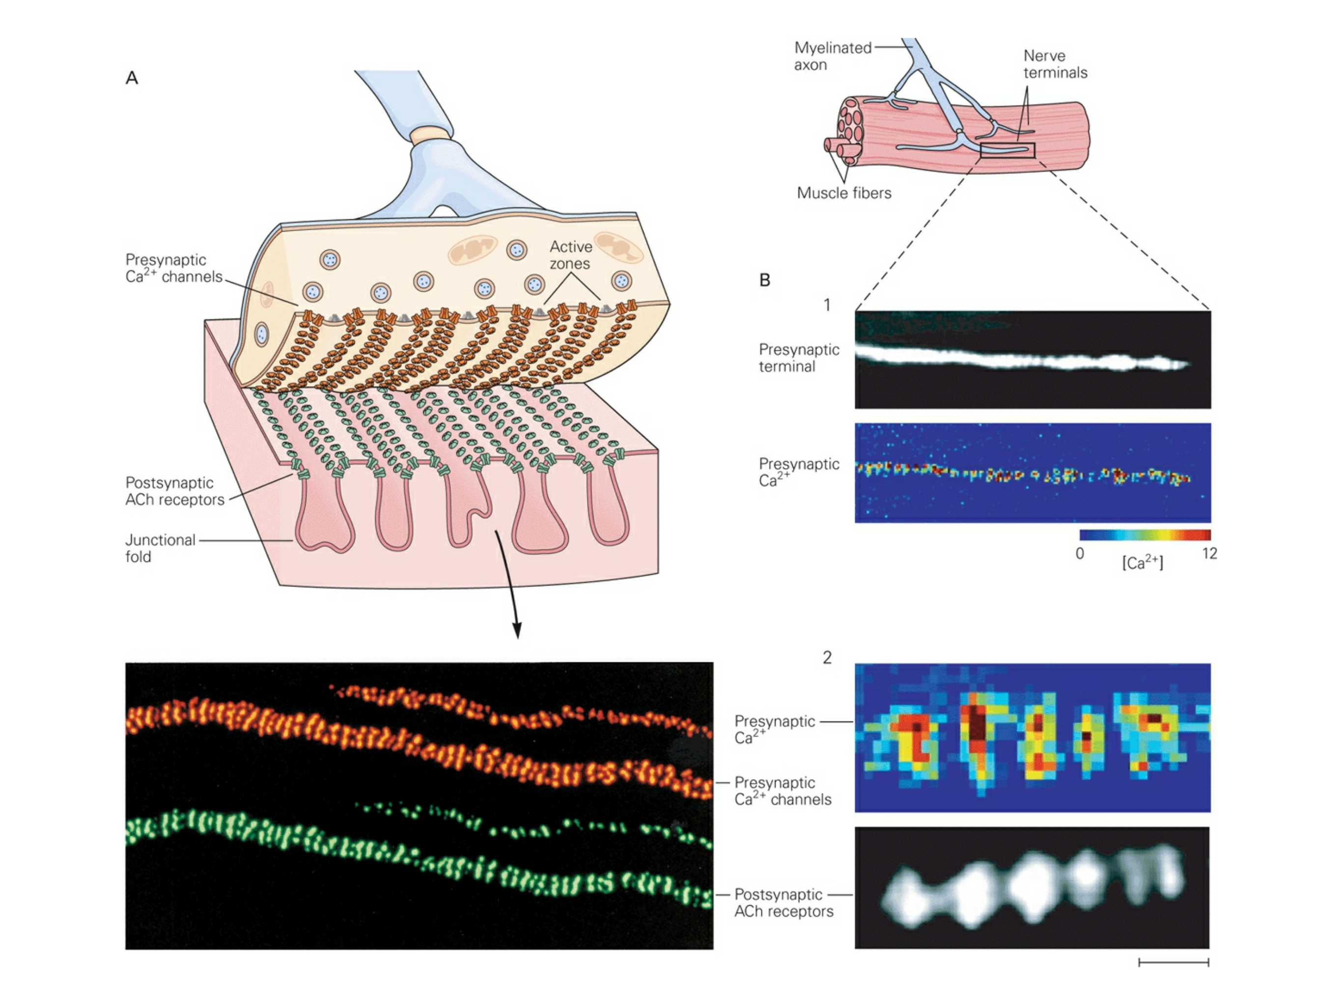
Tight Spatial Relationship Between Ca²⁺ Channels and Postsynaptic Receptors

Slide 10
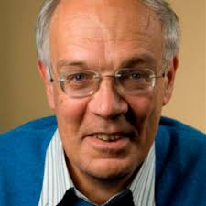
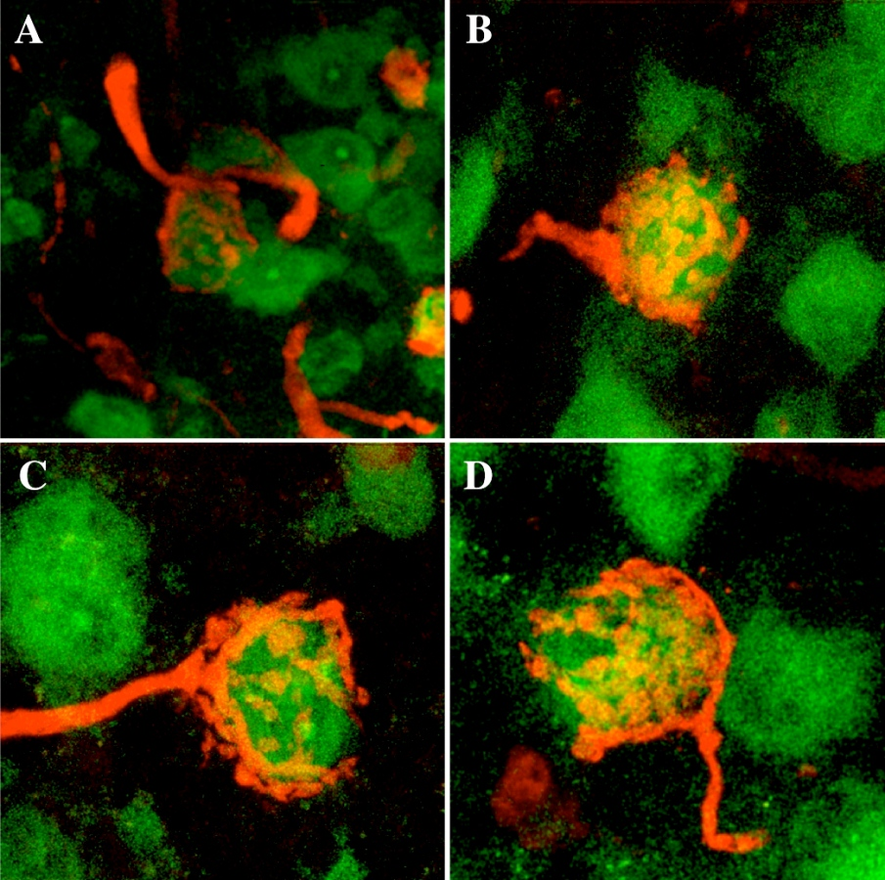
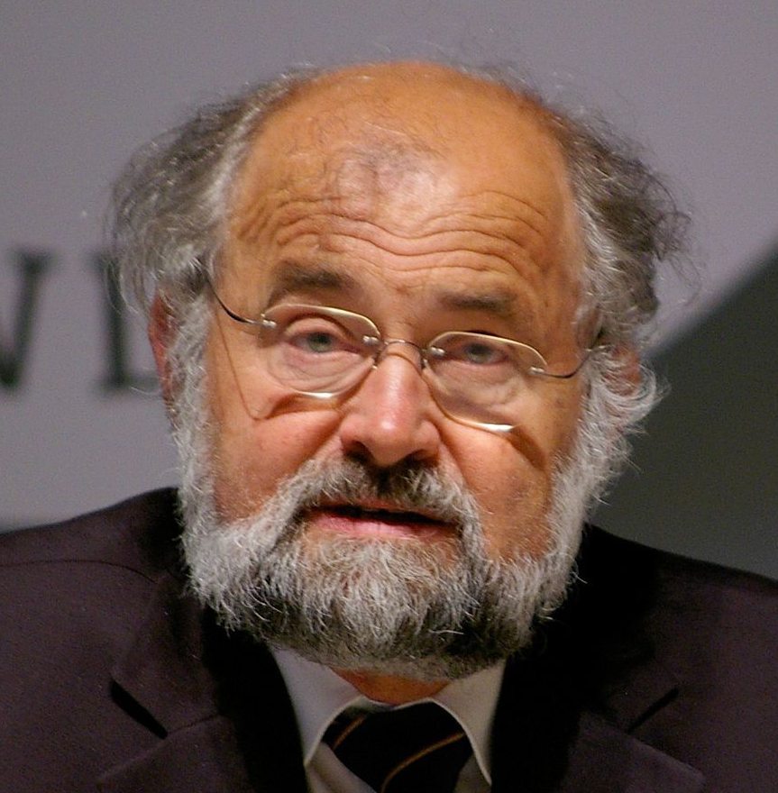
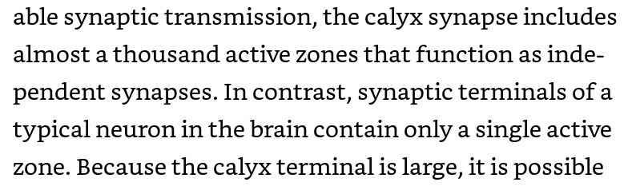
How Much Presynaptic Ca²⁺ is Needed?
Calyx of Held
Bert Sakmann
Erin Neher
Notes:
Calyx of Held: giant central synapse in the auditory pathway.

Slide 11
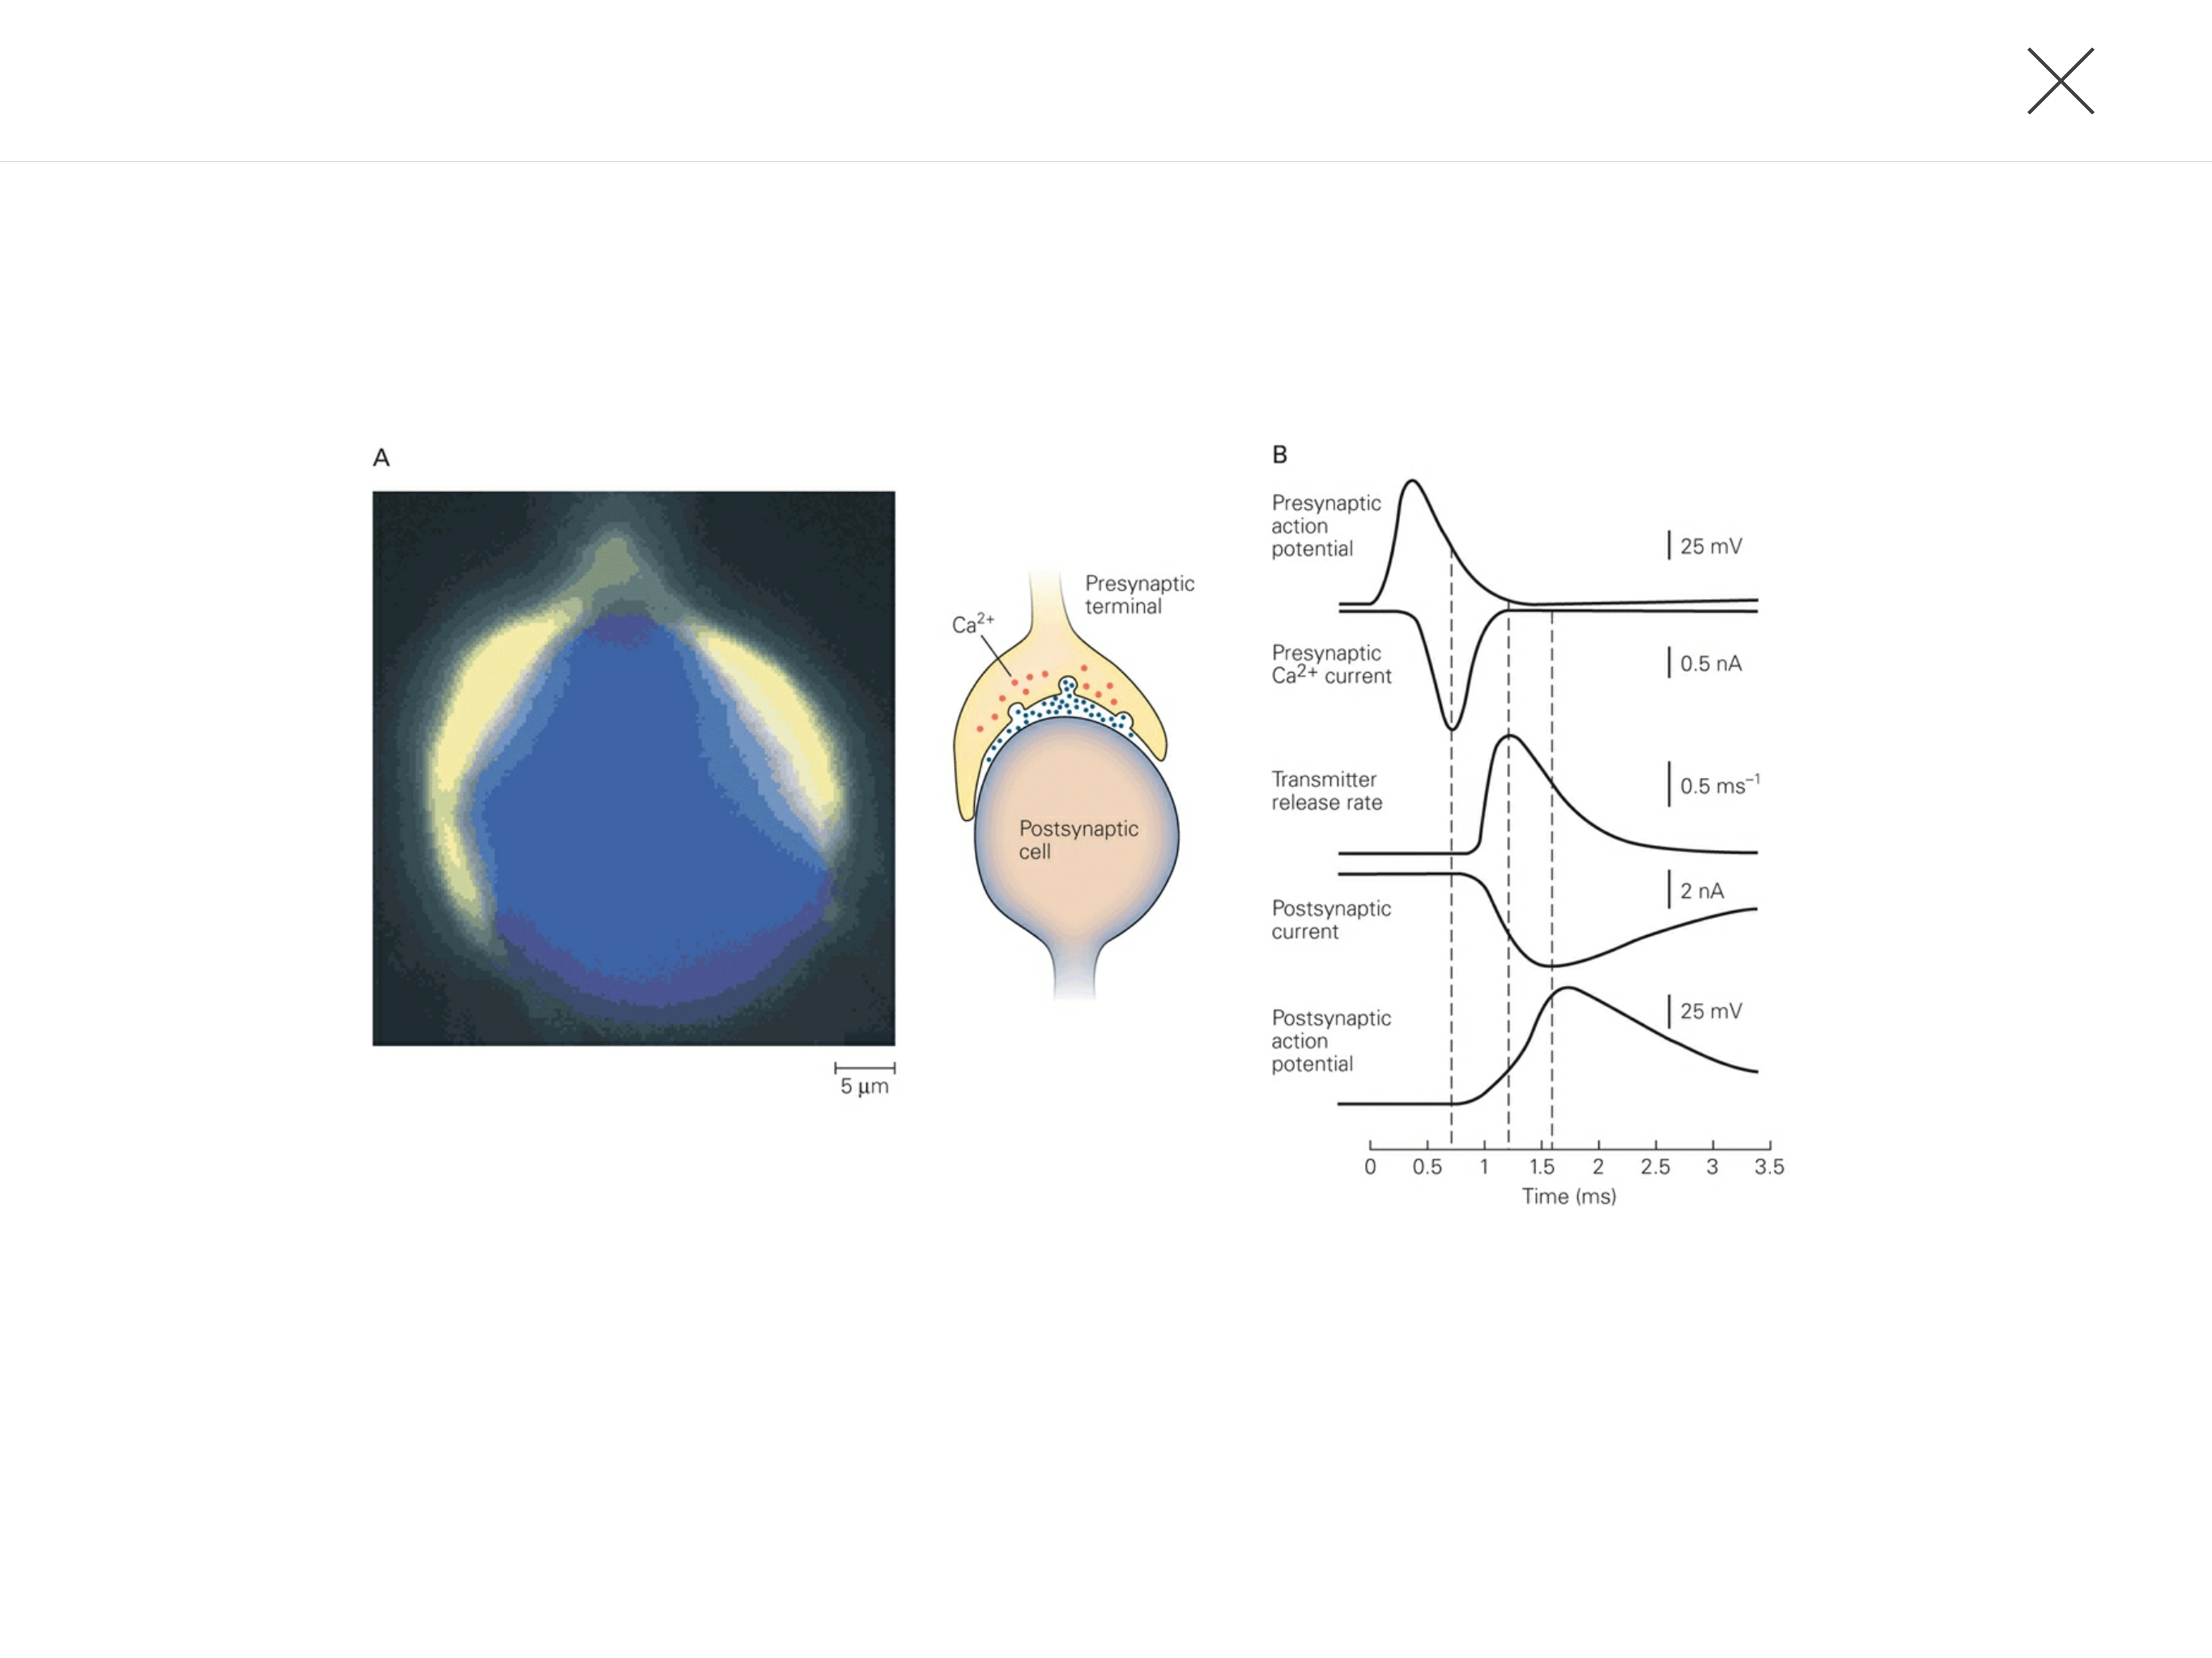
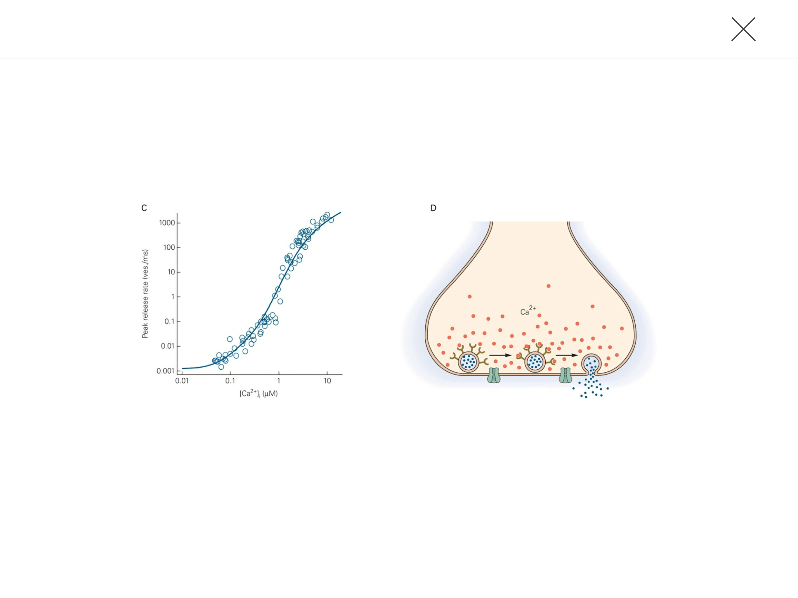
How Much Presynaptic Ca²⁺ is Needed?
Bert Sakmann
Erin Neher
Notes:
Calyx of Held: giant central synapse in the auditory pathway.

Slide 12
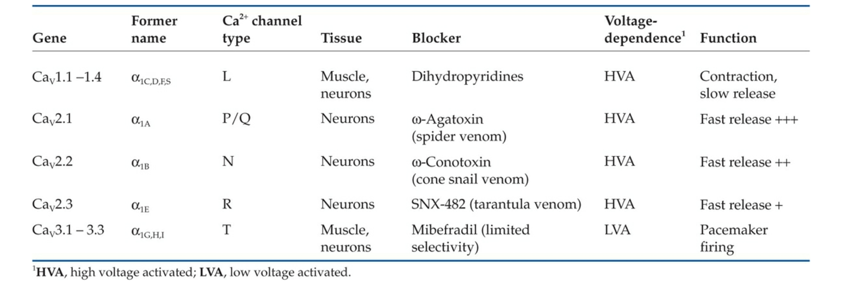
What Type of Ca²⁺ Channels?
Notes:
Generally, Ca2+ channels are either high voltage- or low voltage-activated. Those that mediate release are high voltage-activated Ca2+ channels.

Slide 13
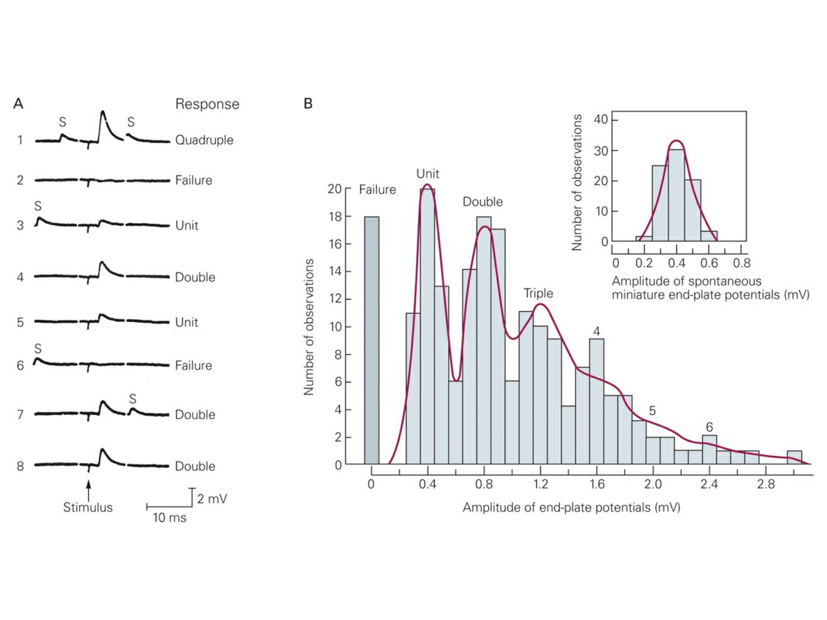
Neurotransmitter Release is Quantal
(but you already know that)
Notes:
Quantal transmission has been demonstrated at all chemical synapses examined thus far, with the exception of the synapse between photoreceptors and bipolar neurons in the retina.

Slide 14
In The CNS…
Most presynaptic terminals have only a single active zone.
An action potential usually releases at most a single quantum of transmitter in an all-or-none manner.
The probability of release at CNS synapses can range from 0.1 to 0.9 (most are low probability)
AND, most central neurons form only a few synapses with their postsynaptic targets.
Exception: Purkinje Cells receive ~10,000 synapse from a single climbing fiber.
Is Release Probability Static?

Slide 15
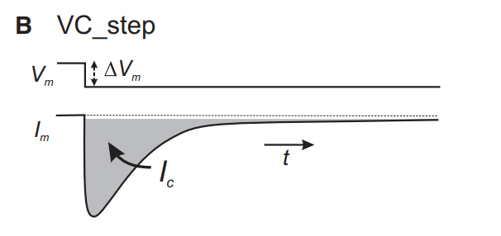
Detecting Release Events
Small Cell
Big Cell
Cell
Low Capacitance
High Capacitance

Slide 16
Detecting Release Events
Bigger Cell
Small Cell
Low Capacitance

Slide 17
Detecting Release Events
Bigger Cell
Small Cell
Low Capacitance

Slide 18
Detecting Release Events
Small Cell
Low Capacitance
Low Capacitance
Little Bit Higher Capacitance

Slide 19
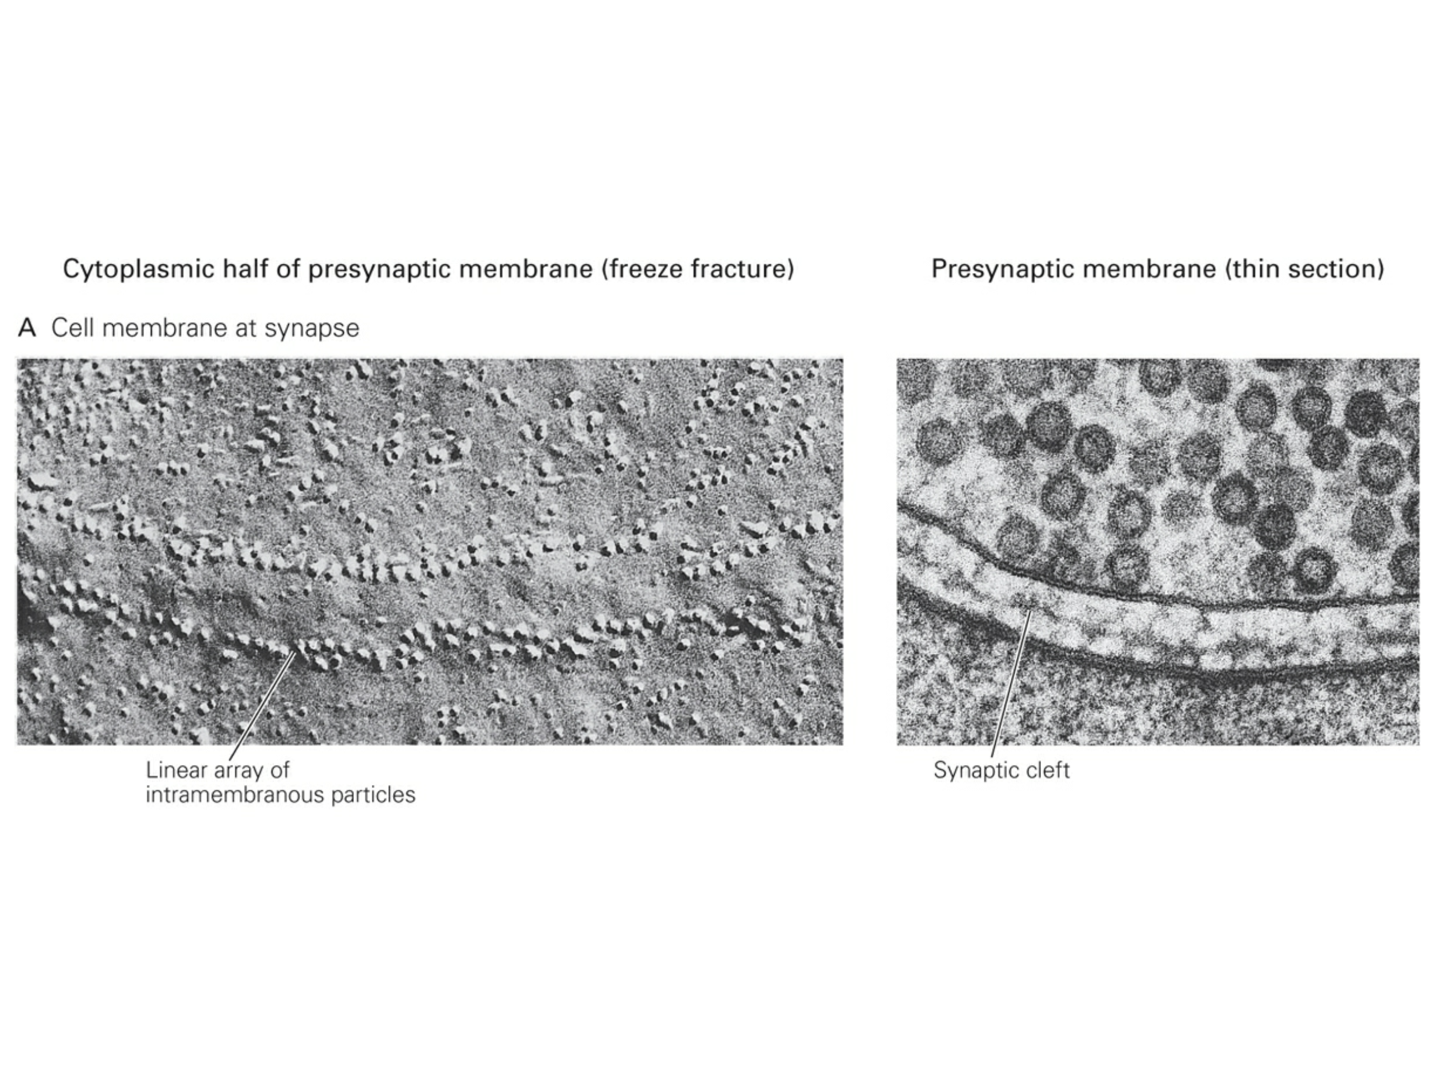
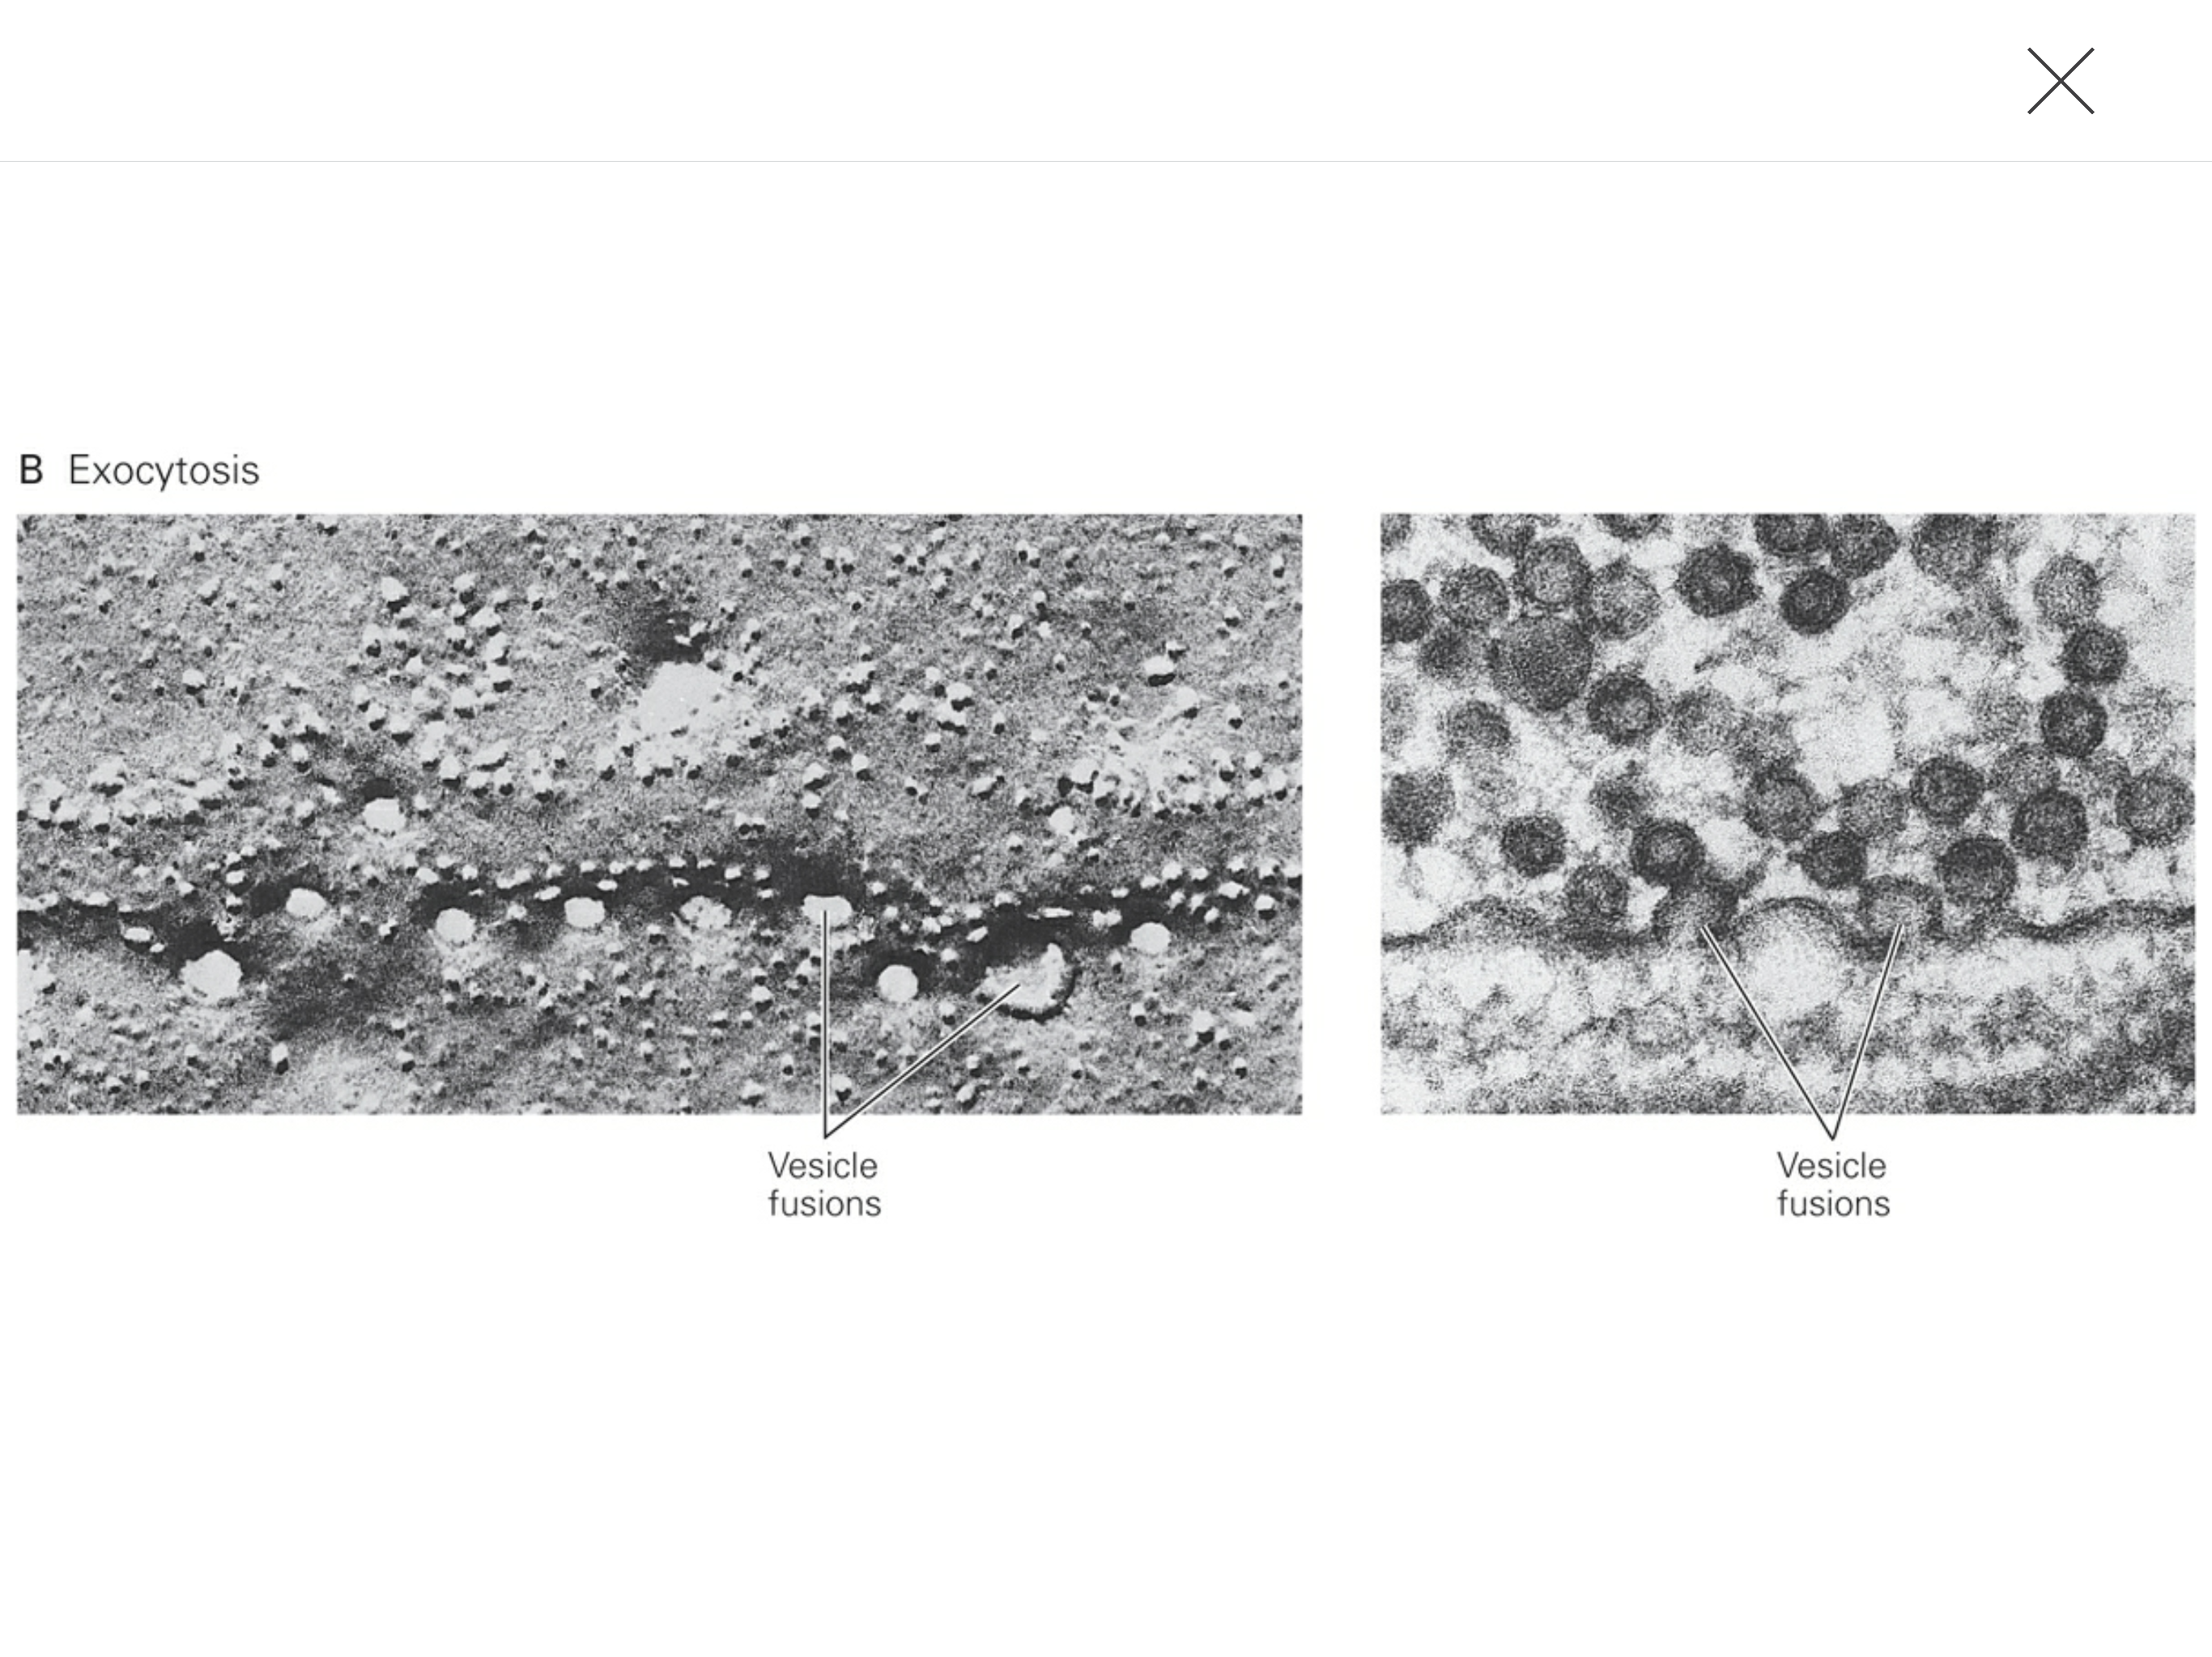
Detecting Release Events

Slide 20
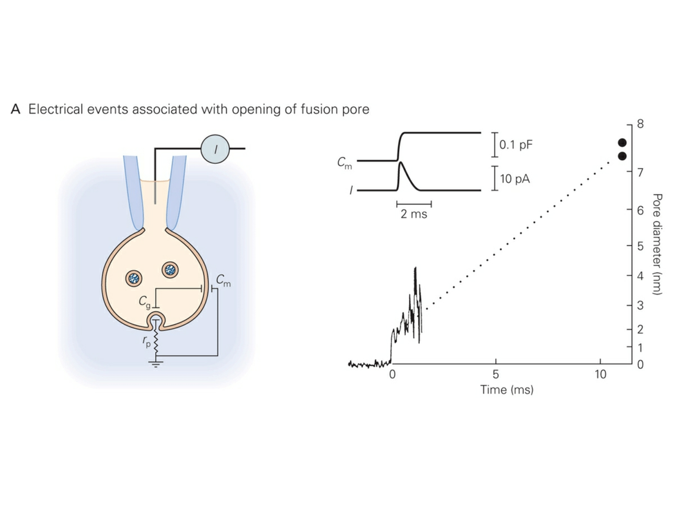
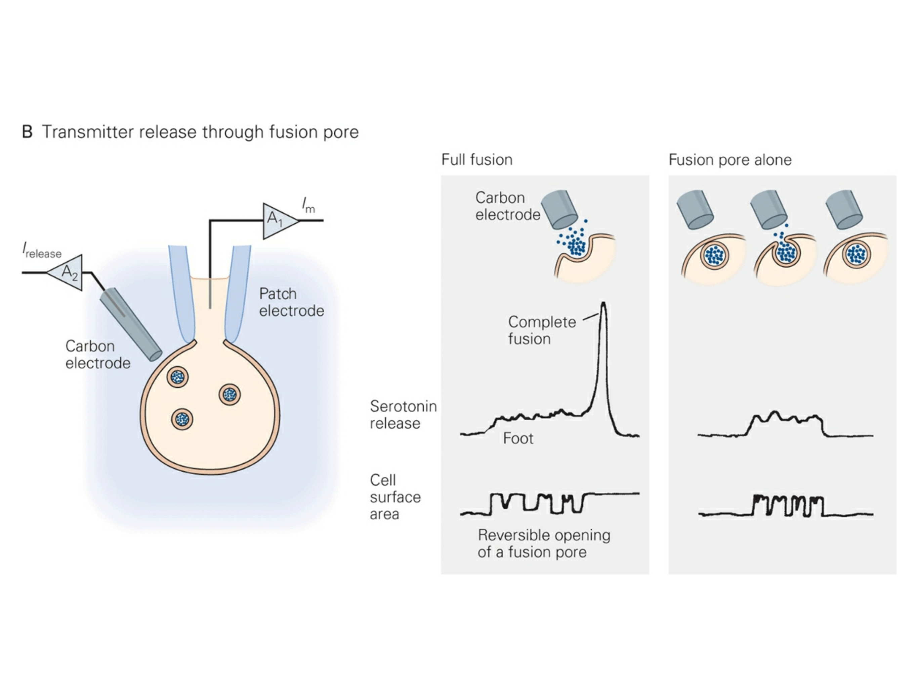
Detecting Release Events

Slide 21
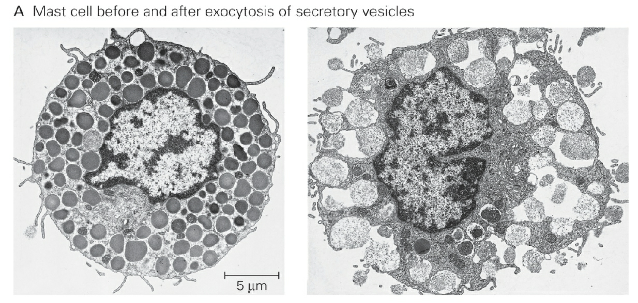
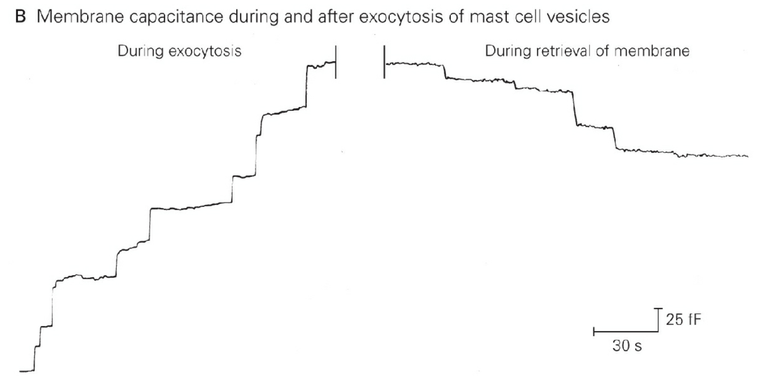
Detecting Release Events

Slide 22
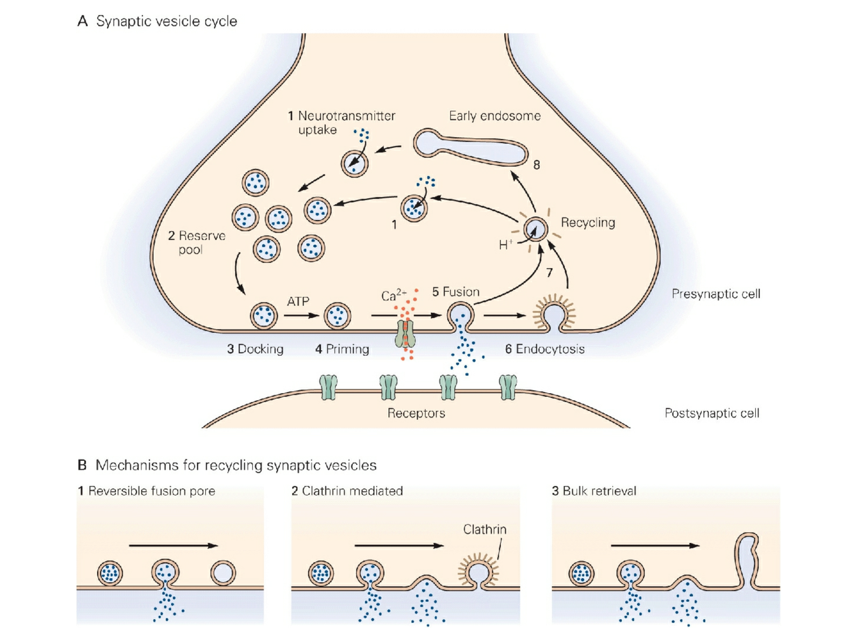
The Synaptic Vesicle Cycle: Exo- and Endocytosis
Notes:
ATP-dependent priming reaction makes vesicle competent for calcium-triggered fusion.
Clatherin-mediated endocytosis is common route of vesicle retrieval. Clatherin-coated pits are found throughout the terminal, except at the active zones.

Slide 23
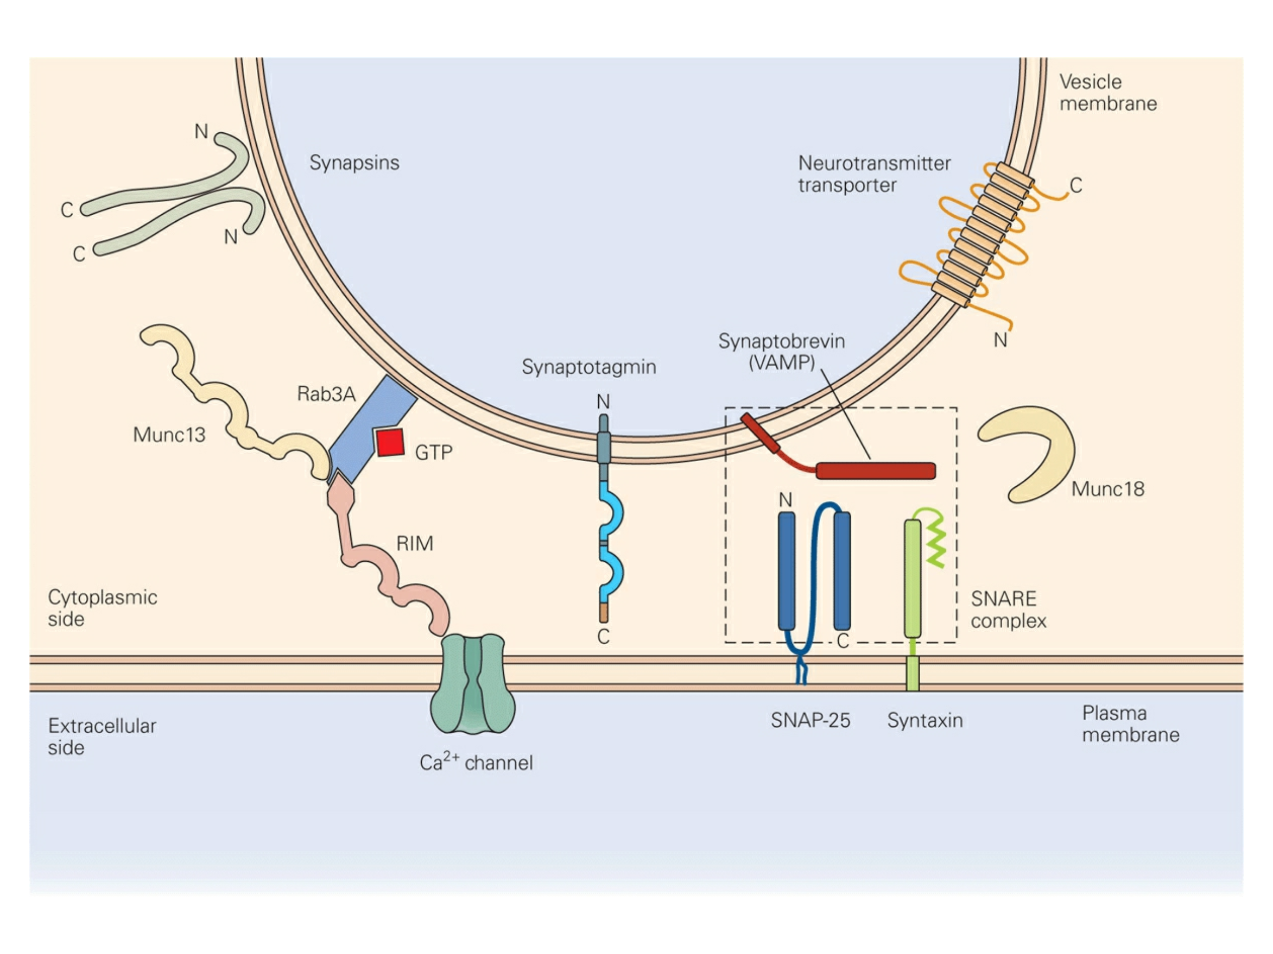
Soluble NSF attachment receptor proteins
Vesicle Release: It Takes A Village
Rab3
Complex
SNARE
Complex
v-SNAREs
t-SNAREs
Notes:
Two big protein complexes.
Left complex: SNARE complex. Munc18 interaction with SNARE is essential for vesicle fusion.
Right complex: Rab3 Complex
SNARE & Rab3 are functionally linked b/c of an interaction between syntaxin and Munc13 (interaction likely inhibits SNARE complex).
Synapsins become phosphorylated upon Ca2+ entry and are then released from the vesicle to likely promote vesicle mobility.

Slide 24
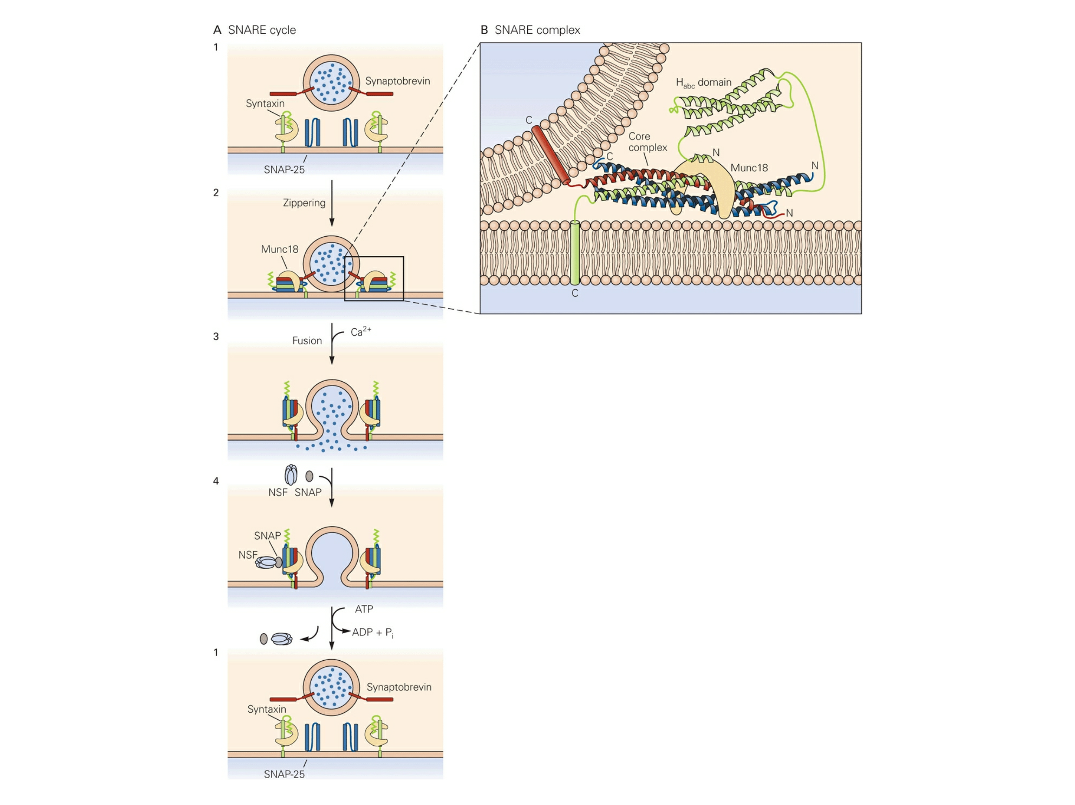
Vesicle Release: It Takes A Village
Notes:
Two big protein complexes.
Left complex: SNARE complex. Munc18 interaction with SNARE is essential for vesicle fusion.
Right complex: Rab3 Complex
SNARE & Rab3 are functionally linked b/c of an interaction between syntaxin and Munc13 (interaction likely inhibits SNARE complex).
Synapsins become phosphorylated upon Ca2+ entry and are then released from the vesicle to likely promote vesicle mobility.
4 SNARE motifs (60 residues long), 1 from Synaptotagmin, 1 Syntaxin, 2 from SNAP-25, bind tightly to make the SNARE complex.
NSF: Cytoplasmic ATPase that uses the energy of ATP hydrolysis to dissociate SNARE complexes.

Slide 25
Vesicle Release: It Takes A Village
Notes:
Two big protein complexes.
Left complex: SNARE complex. Munc18 interaction with SNARE is essential for vesicle fusion.
Right complex: Rab3 Complex
SNARE & Rab3 are functionally linked b/c of an interaction between syntaxin and Munc13 (interaction likely inhibits SNARE complex).
Synapsins become phosphorylated upon Ca2+ entry and are then released from the vesicle to likely promote vesicle mobility.
4 SNARE motifs (60 residues long), 1 from Synaptotagmin, 1 Syntaxin, 2 from SNAP-25, bind tightly to make the SNARE complex.
NSF: Cytoplasmic ATPase that uses the energy of ATP hydrolysis to dissociate SNARE complexes.

Slide 26
Vesicle Release: It Takes A Village
Notes:
Two big protein complexes.
Left complex: SNARE complex. Munc18 interaction with SNARE is essential for vesicle fusion.
Right complex: Rab3 Complex
SNARE & Rab3 are functionally linked b/c of an interaction between syntaxin and Munc13 (interaction likely inhibits SNARE complex).
Synapsins become phosphorylated upon Ca2+ entry and are then released from the vesicle to likely promote vesicle mobility.
4 SNARE motifs (60 residues long), 1 from Synaptotagmin, 1 Syntaxin, 2 from SNAP-25, bind tightly to make the SNARE complex.
NSF: Cytoplasmic ATPase that uses the energy of ATP hydrolysis to dissociate SNARE complexes.

Slide 27
Vesicle Release: It Takes A Village
Notes:
Two big protein complexes.
Left complex: SNARE complex. Munc18 [“SM” protein (Sec1/Munc18-like proteins)] interaction with SNARE is essential for vesicle fusion.
Right complex: Rab3 Complex
SNARE & Rab3 are functionally linked b/c of an interaction between syntaxin and Munc13 (interaction likely inhibits SNARE complex).
Synapsins become phosphorylated upon Ca2+ entry and are then released from the vesicle to likely promote vesicle mobility.
4 SNARE motifs (60 residues long), 1 from Synaptotagmin, 1 Syntaxin, 2 from SNAP-25, bind tightly to make the SNARE complex.
NSF: Cytoplasmic ATPase that uses the energy of ATP hydrolysis to dissociate SNARE complexes.

Slide 28
Vesicle Release: It Takes A Village
Ca²⁺ Sensor

Slide 29
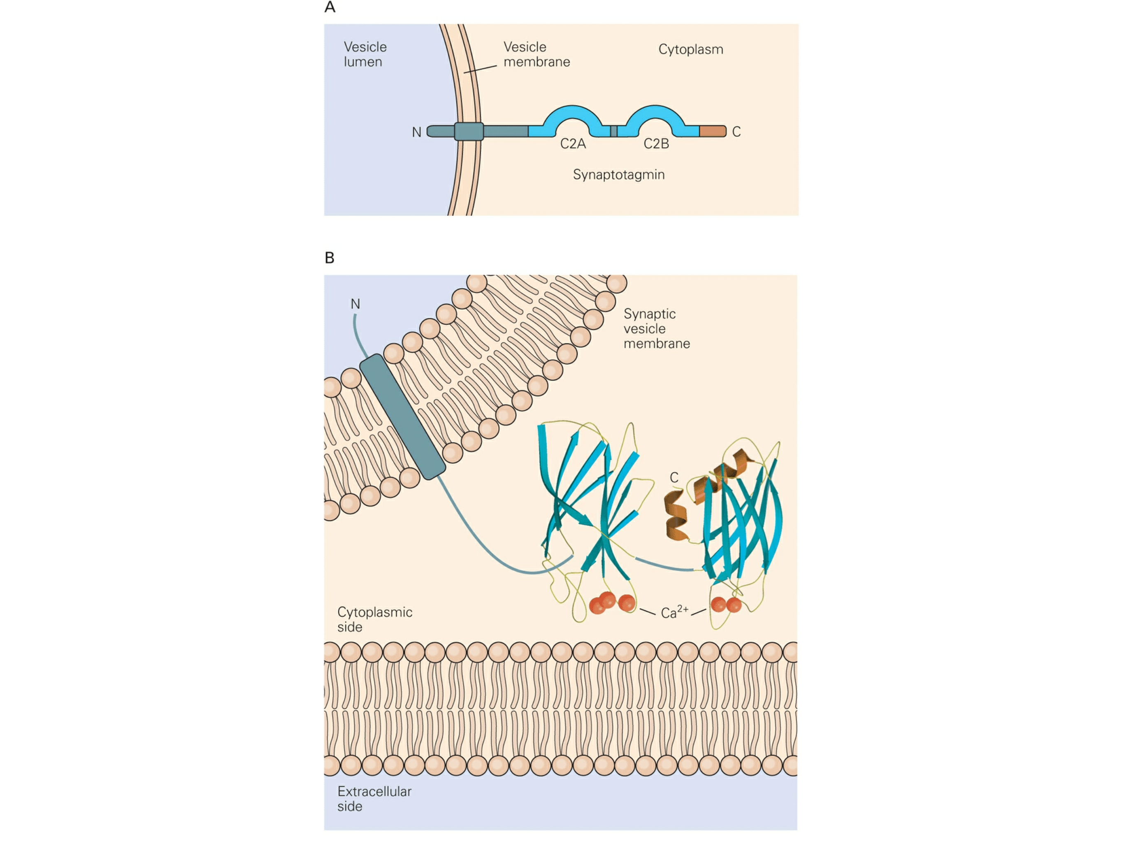
Vesicle Release: It Takes A Village
Notes:
5 Ca2+ bind

Slide 30
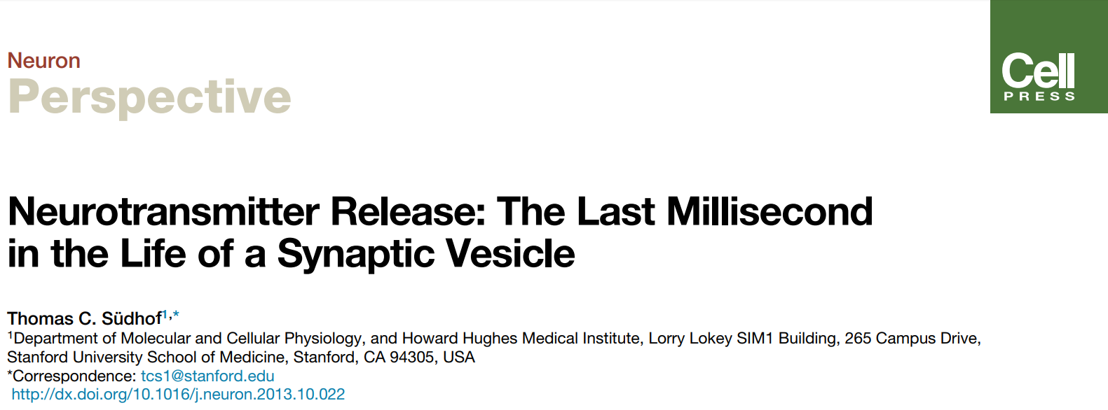
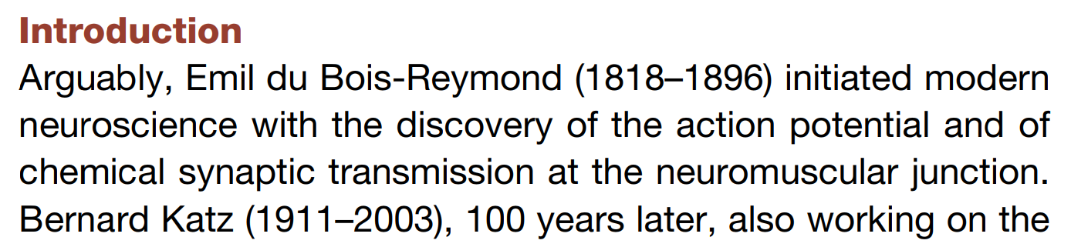
Where are We Now?

Slide 31
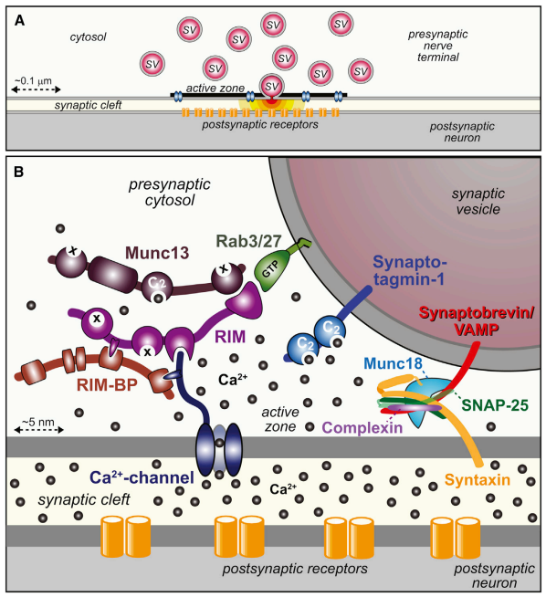
Machinery Revisited

Slide 32
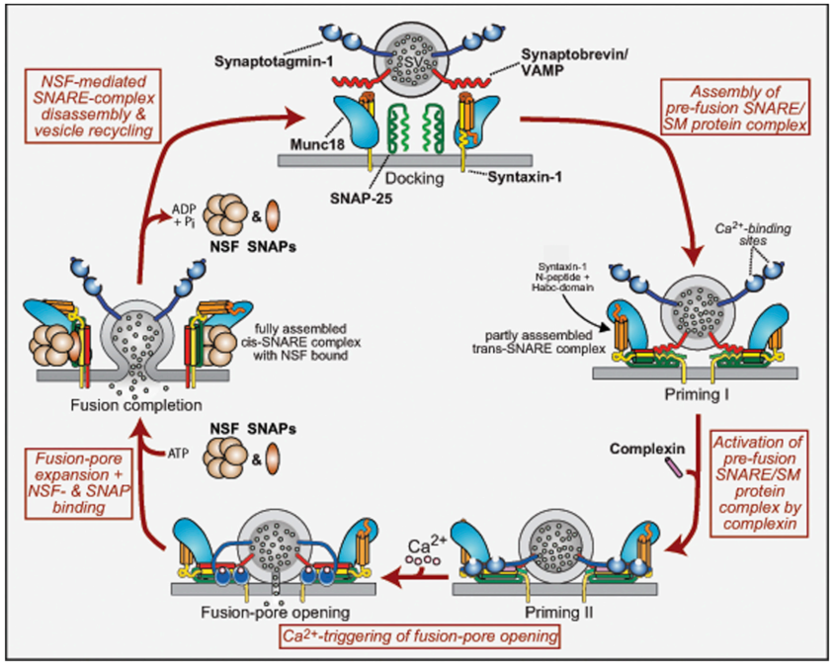
Machinery Revisited

Slide 33
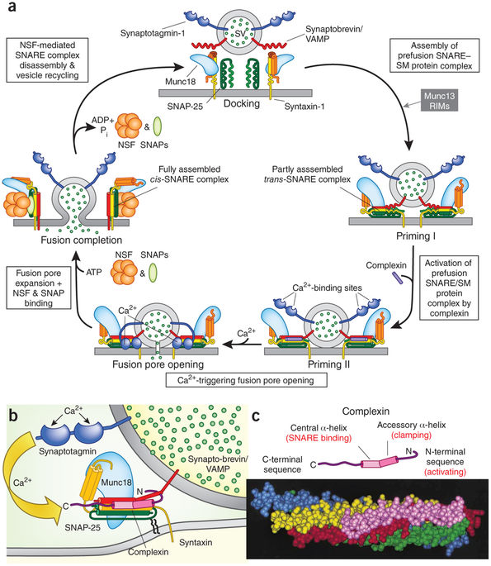
And Another Schematic of the Same Thing…

Slide 34
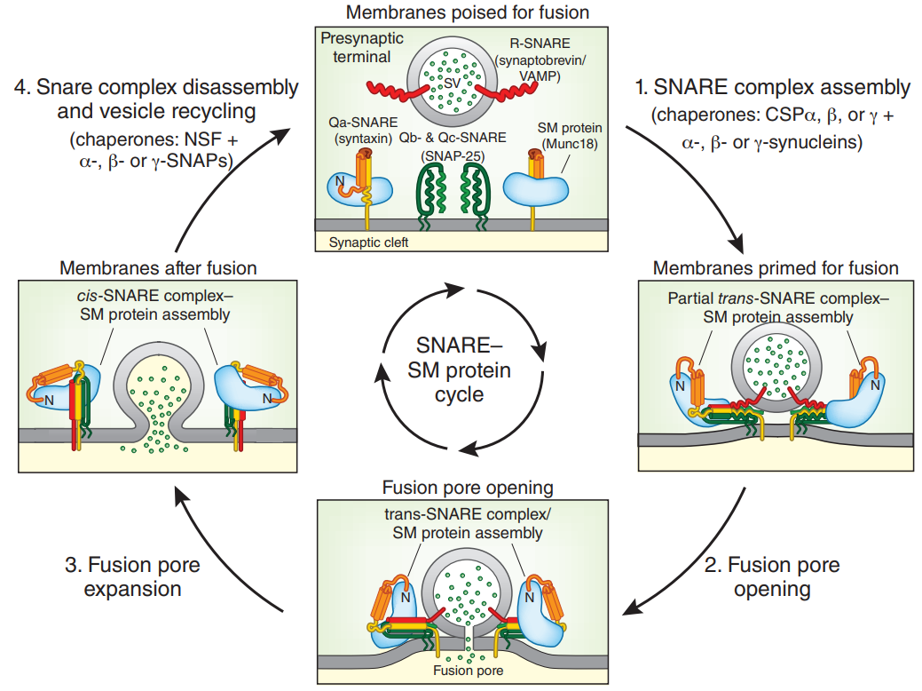
One More? Yes!!!

Slide 35
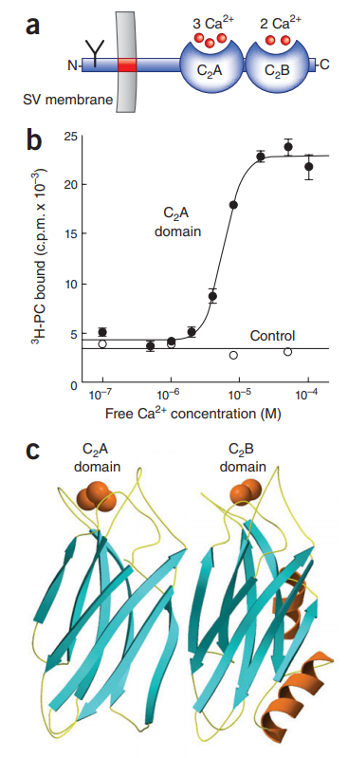
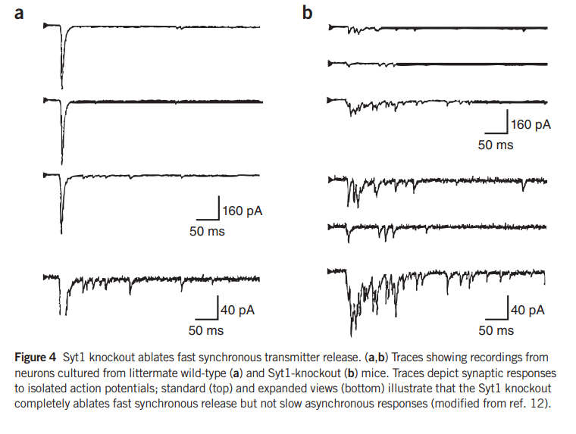
Synaptotagmin: the Ca²⁺ Sensor

Slide 36
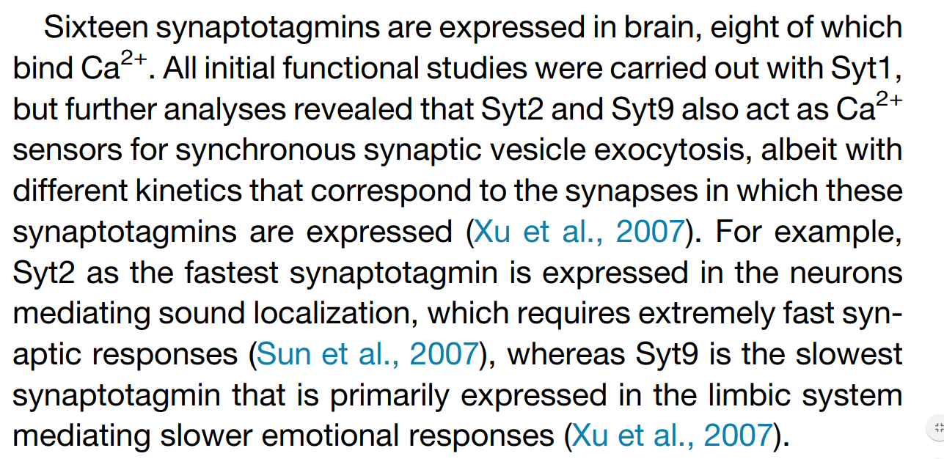
Synaptotagmin: the Ca²⁺ Sensor

Slide 37
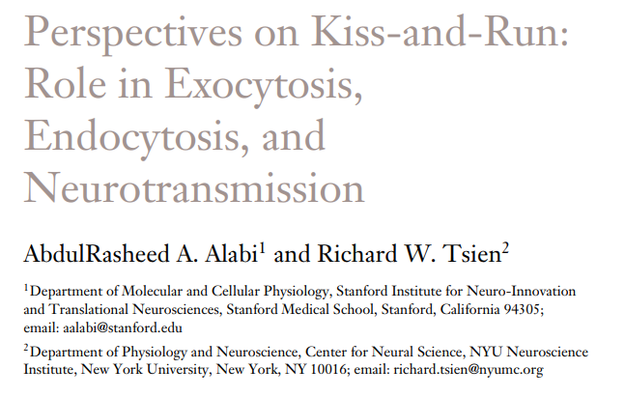
The Fusion Pore

Slide 38
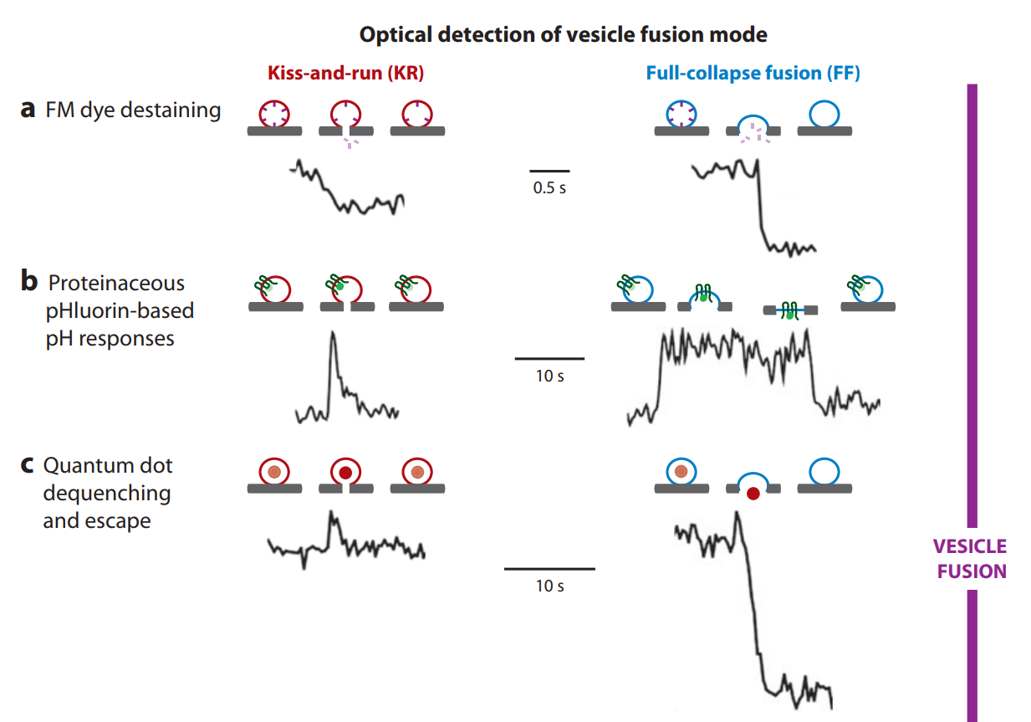
The Fusion Pore

Slide 39
The Fusion Pore

Slide 40
The Fusion Pore

Slide 41
The Fusion Pore

Slide 42
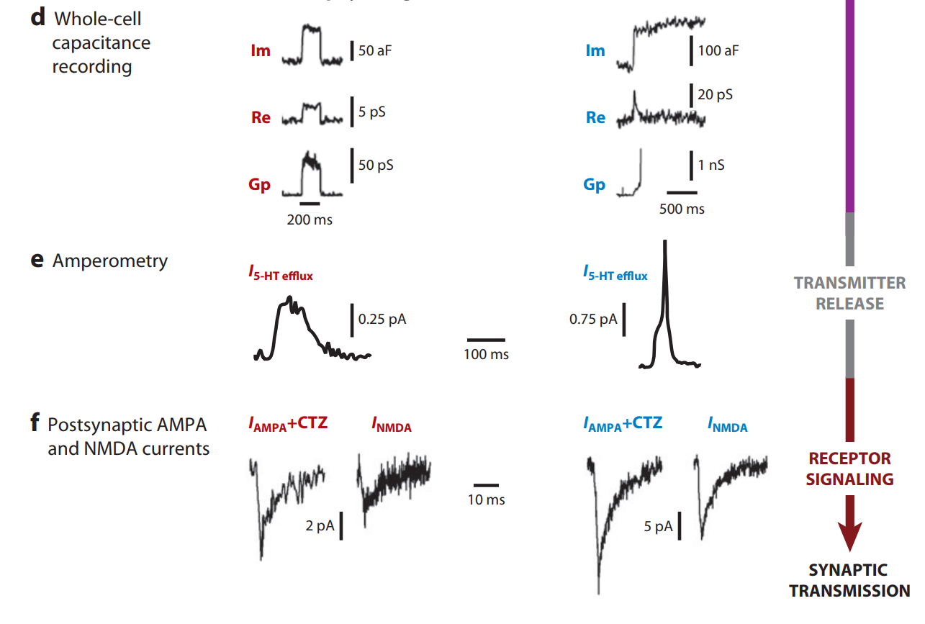
The Fusion Pore

Slide 43
The Fusion Pore

Slide 44
The Fusion Pore

Slide 45
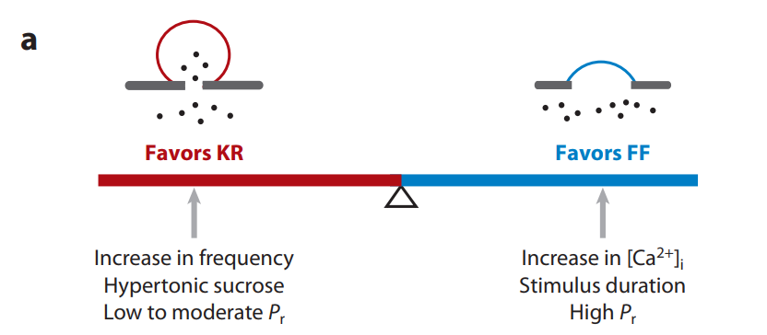
Kiss, Run & Fuse

Slide 46
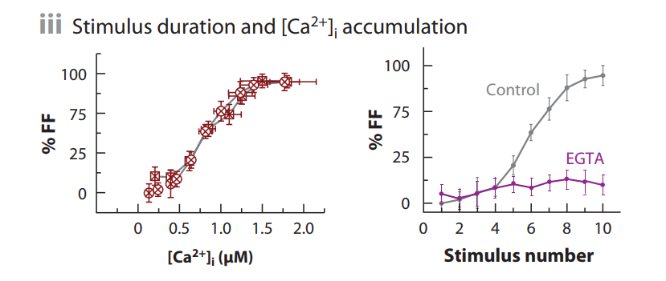
Kiss, Run & Fuse

Slide 47
Lots to Consider

