Slide 1
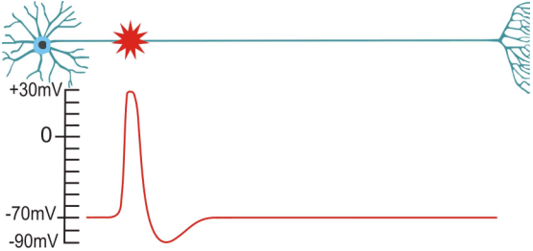
In & Around the Synapse
Synapses & Circuits
Lecture Three

Slide 2
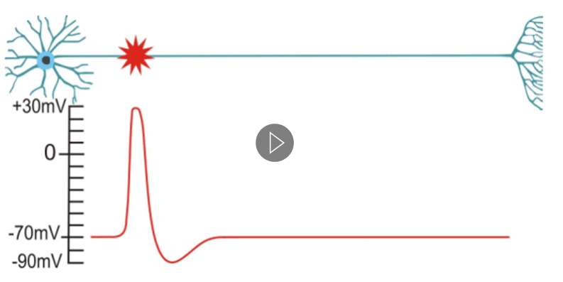
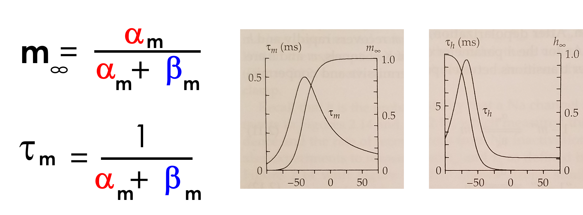
In & Around the Synapse
Synapses & Circuits
Lecture Three
Activation
Gates
Inactivation
Gate
Na⁺
E_{Na}

Slide 3
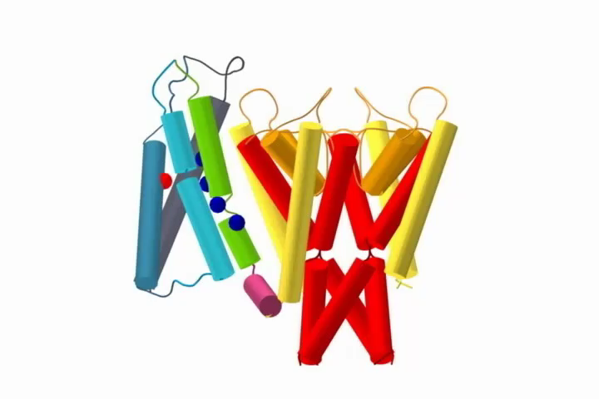
Voltage-Gated Sodium Channel:
Side View

Slide 4
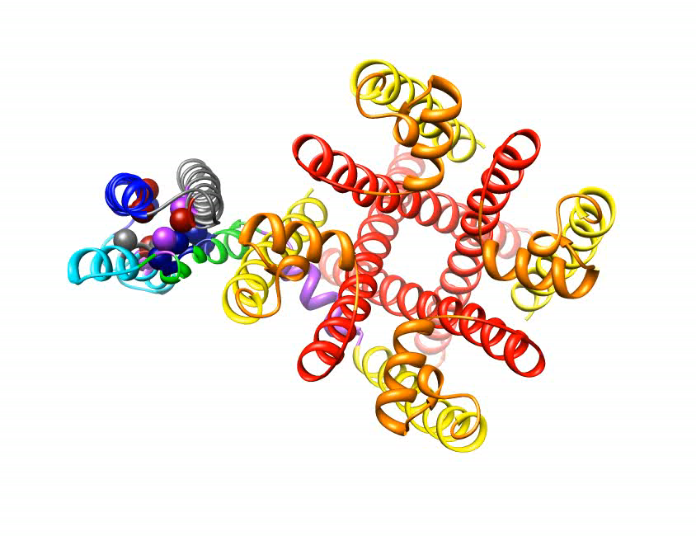
Voltage-Gated Sodium Channel:
Extracellular View

Slide 5
Voltage-Gated Sodium Channel:
Both Views

Slide 6
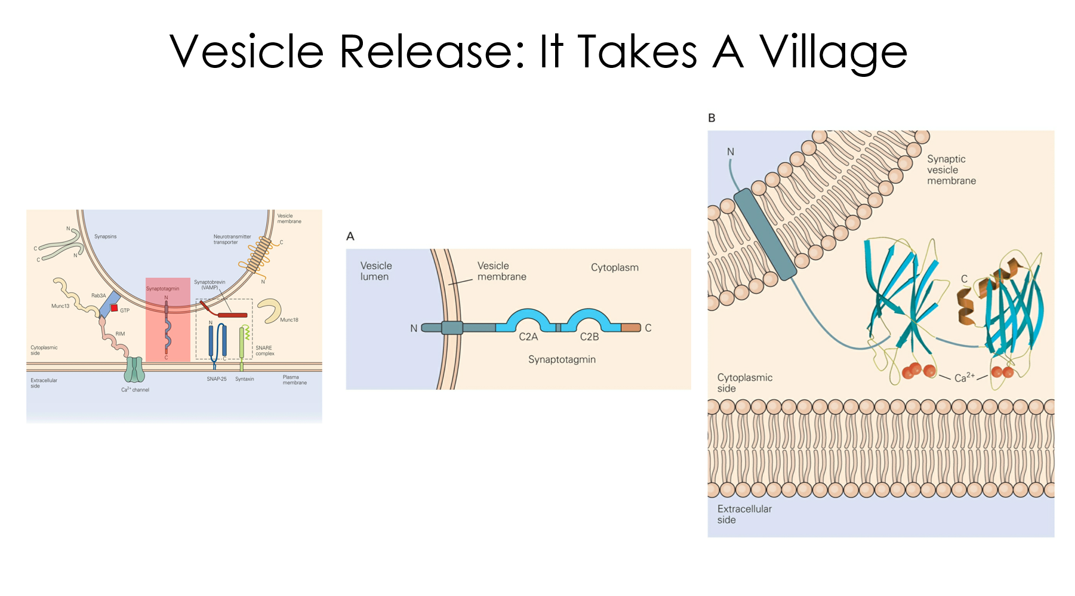
The Synapse
receptors
vesicle
pre
post

Slide 7
The Synapse
Question #1: How much in a vesicle?
Question #2: How much in a synapse?
receptors
vesicle
pre
post

Slide 8
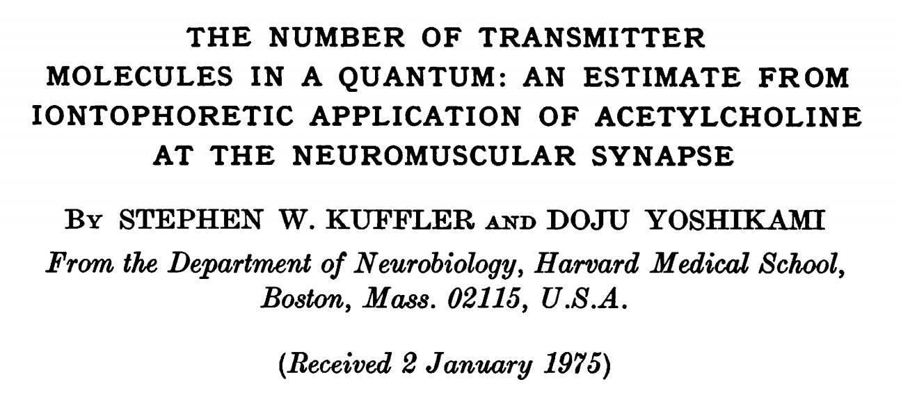
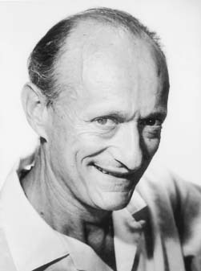
The Paper

Slide 9
The Goal

Slide 10
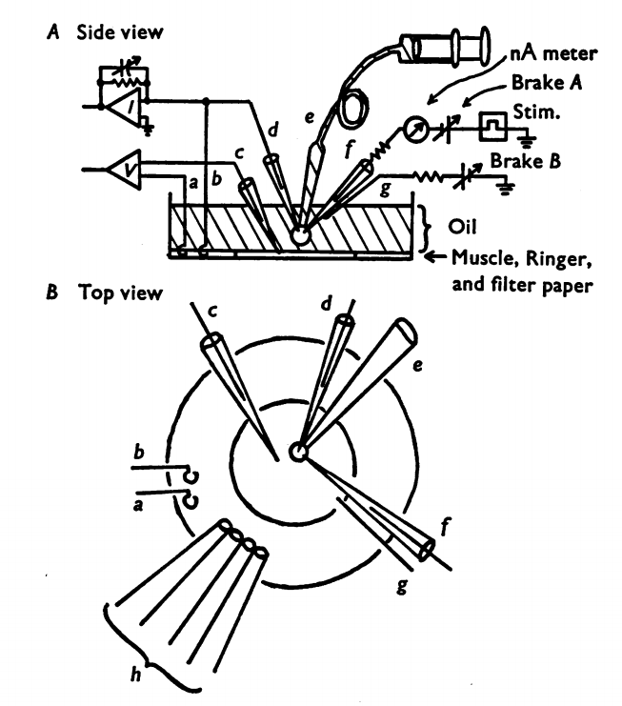
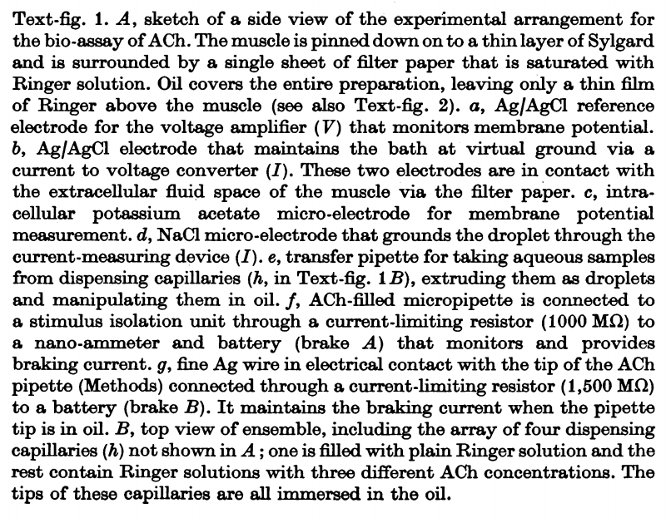
The Preparation

Slide 11
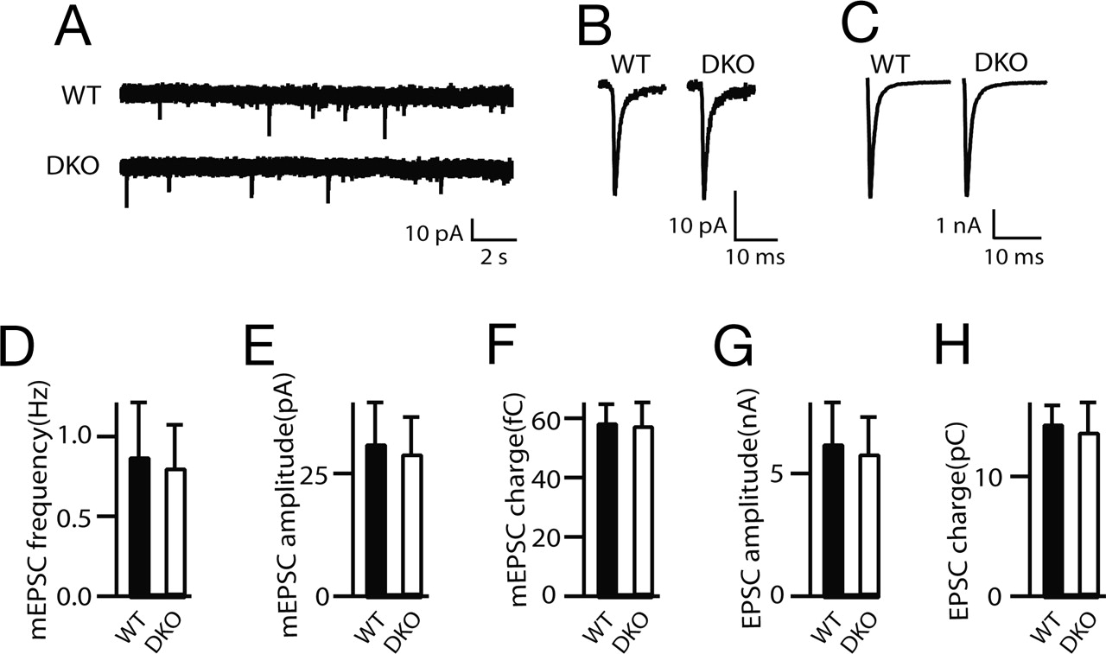
Iontophoresis
What is it?
+
How does it work?
(or is it?)
How much stuff comes out?
Unknowable
How to quantify?
Charge: dose is proportional to charge.
What’s charge?
charge = current x time
Q = I x t

Slide 12
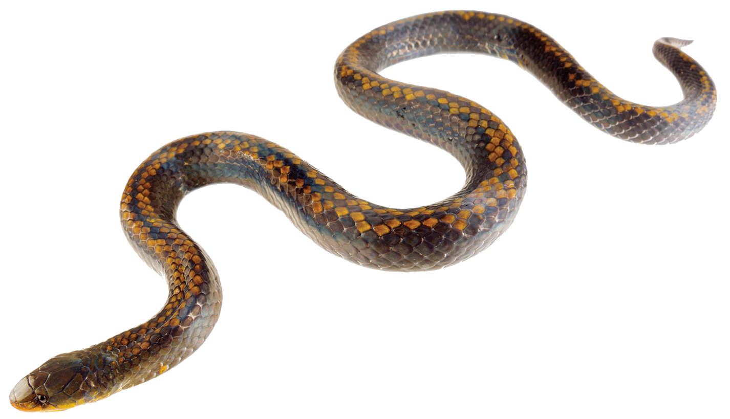
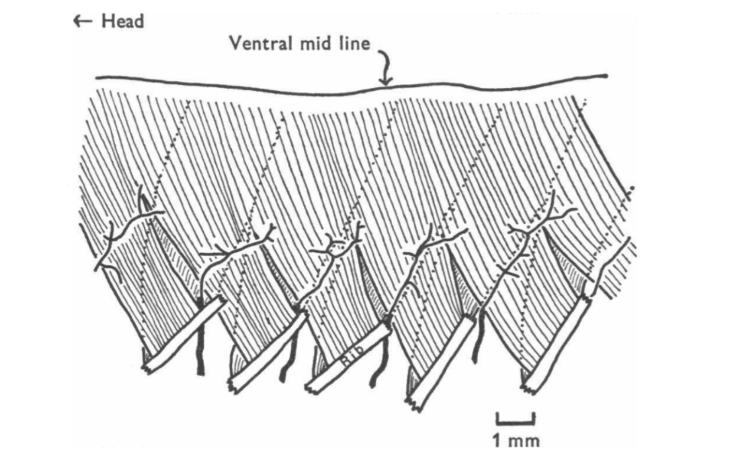
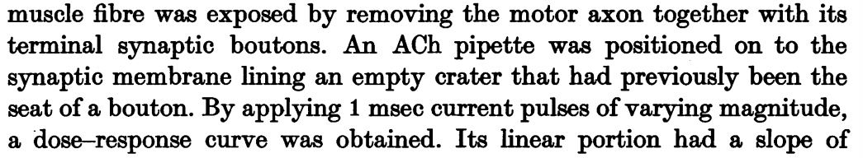
Snakes on a Strain

Slide 13
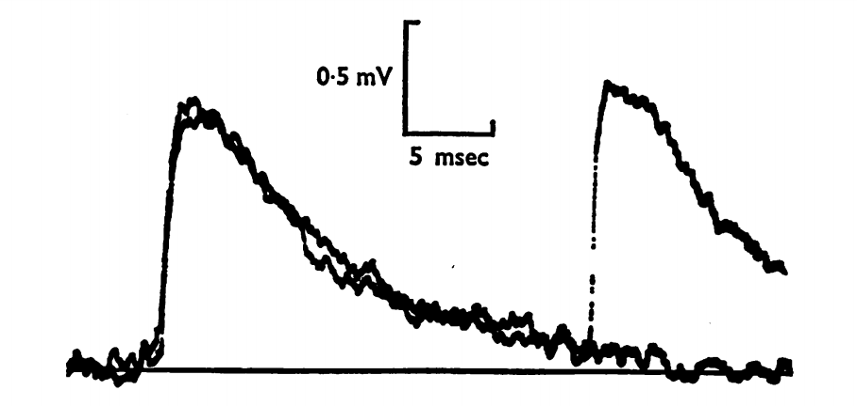
Fake EPSPs
real EPSP!

Slide 14
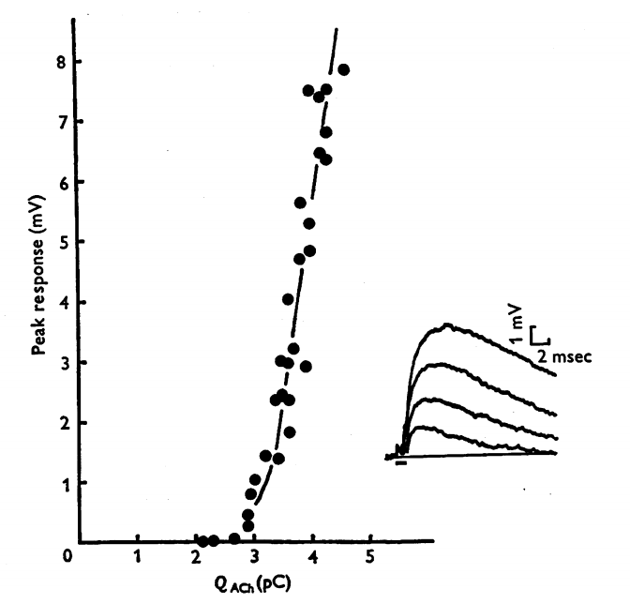
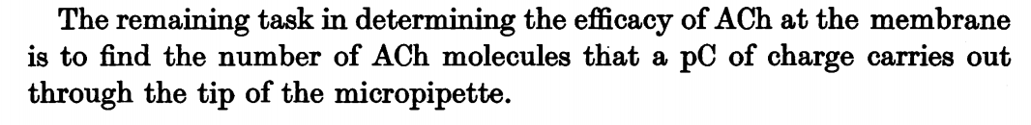
Fake EPSP Dose-Response
muscle
please remember this number.

Slide 15
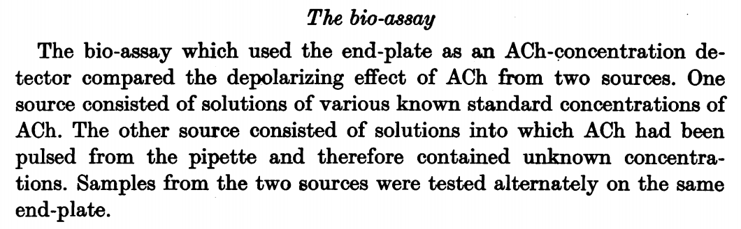
The Bio-Assay
Compare responses from two sources:
(1) Standard Curve
(2) Pulsed Acetylcholine

Slide 16
The Bio-Assay: Drip & Puff
[ACh]
Step One
Step Two
muscle
x5,000
?
[ACh]

Slide 17
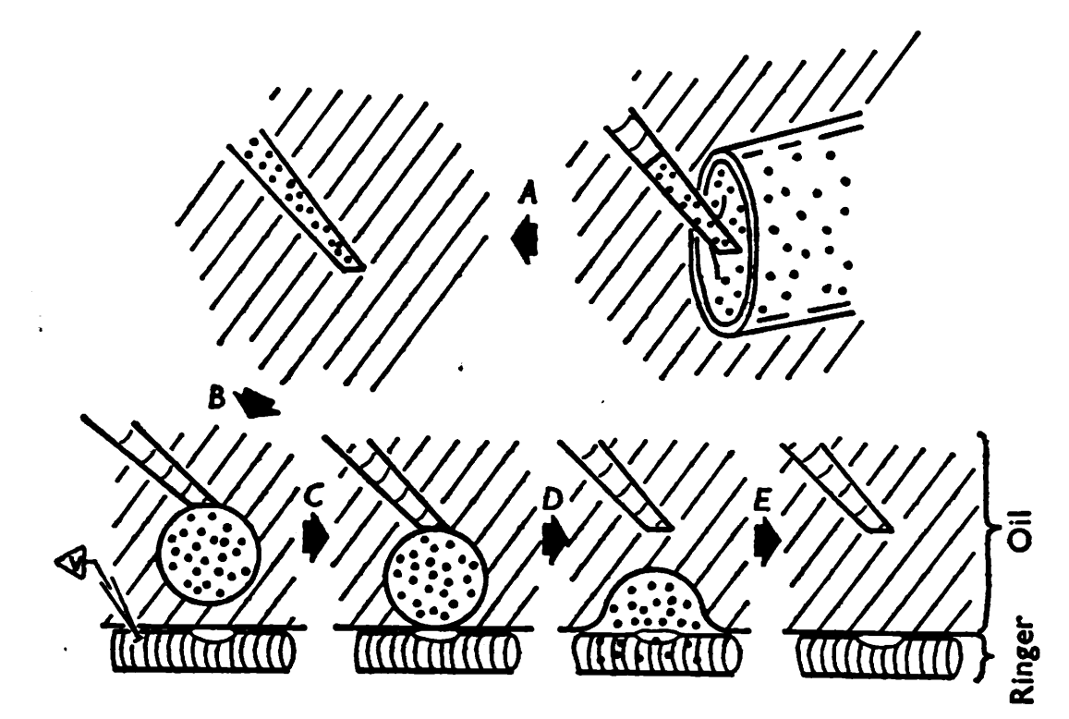
The Bio-Assay: Drip & Puff
[ACh]
Step One
muscle

Slide 18
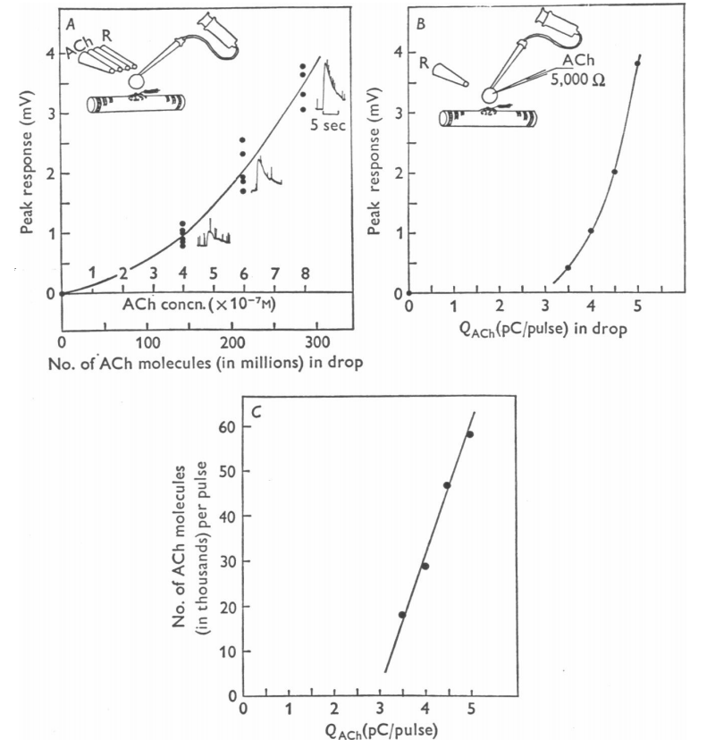
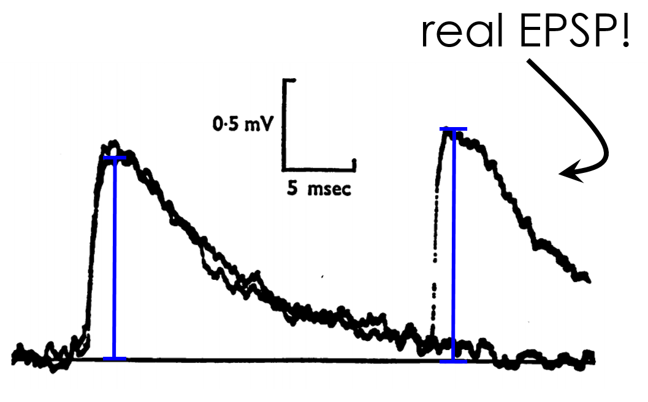
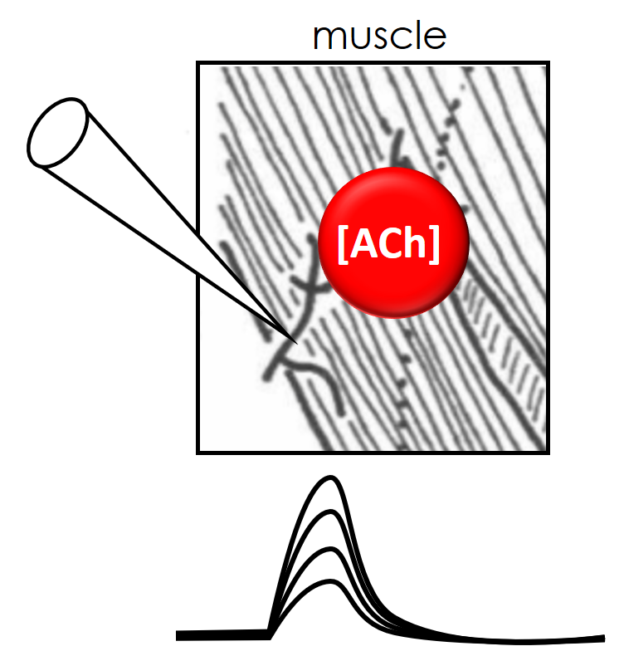
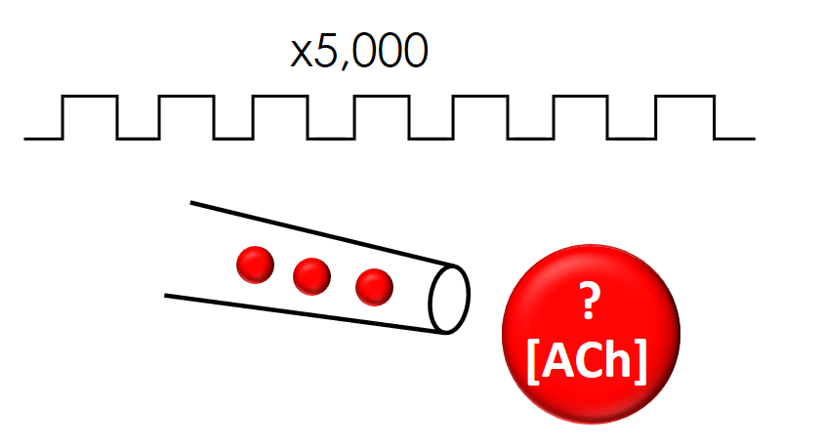
Drip & Puff
Standard Curve
Puffing Curve
# ACh Molecules/Pulse
6,000 ACh molecules/Pulse

Slide 19
Fake EPSPs
real EPSP!
please remember this number.
6,000 ACh molecules/3pC

Slide 20
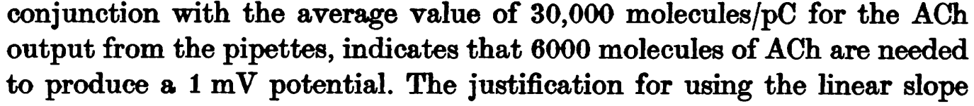
How Much Is In A Vesicle?

Slide 21
The Synapse
Question #1: How much in a vesicle?
Question #2: How much in a synapse?
receptors
vesicle
pre
post

Slide 22
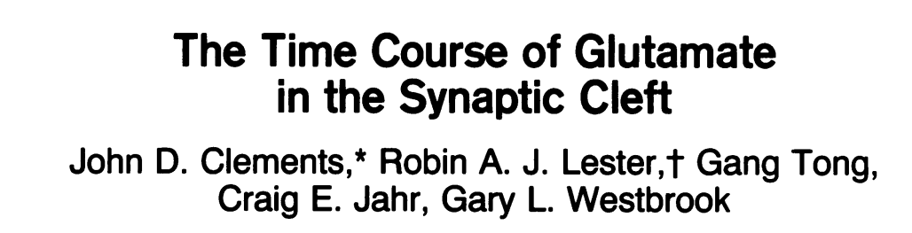
The Paper

Slide 23
The Synapse
Question #3: What’s different here?
Question #1: How much in a vesicle?
Question #2: How much in a synapse?
receptors
vesicle
pre
post
Notes:
Transmitter clearance: NMJ vs central

Slide 24
The Trick
Pharmacology
Ligand
Receptor
What’s k_{d}?
k_{on}
L + R LR
What’s Affinity?
k_{off}

Slide 25
The Trick
Pharmacology
Ligand #2
Ligand #1
Receptor
What’s k_{d}?
k_{on}
L + R LR
What’s Affinity?
k_{off}

Slide 26
The Trick
Pharmacology
Ligand #2
Blocker
Ligand #1
Receptor
What’s k_{d}?
k_{on}
L + R LR
What’s Affinity?
k_{off}

Slide 27
The Trick
Experiment
Pharmacology
Ligand #2
Blocker
Ligand #1
Receptor
What’s k_{d}?
k_{on}
L + R LR
What’s Affinity?
k_{off}

Slide 28
The Trick
Pharmacology
Ligand #2
Blocker
Ligand #1
Receptor
What’s k_{d}?
k_{on}
L + R LR
What’s Affinity?
k_{off}

Slide 29
The Trick
Pharmacology
Ligand #2
Blocker
Ligand #1
Receptor
What’s k_{d}?
k_{on}
L + R LR
What’s Affinity?
k_{off}

Slide 30
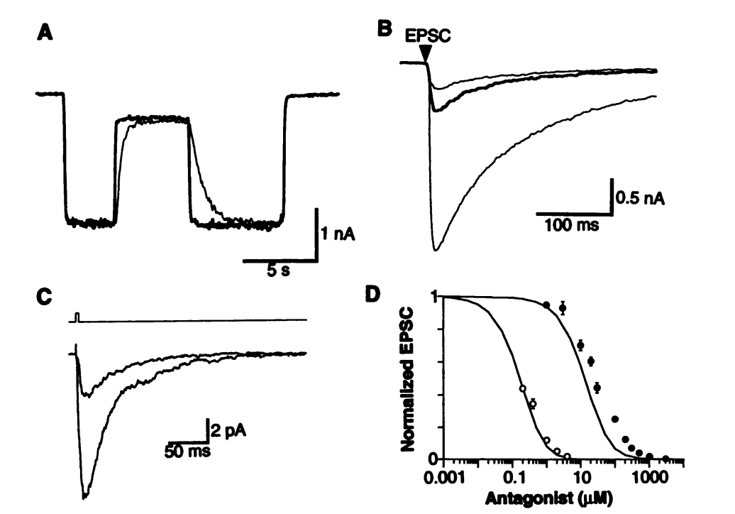
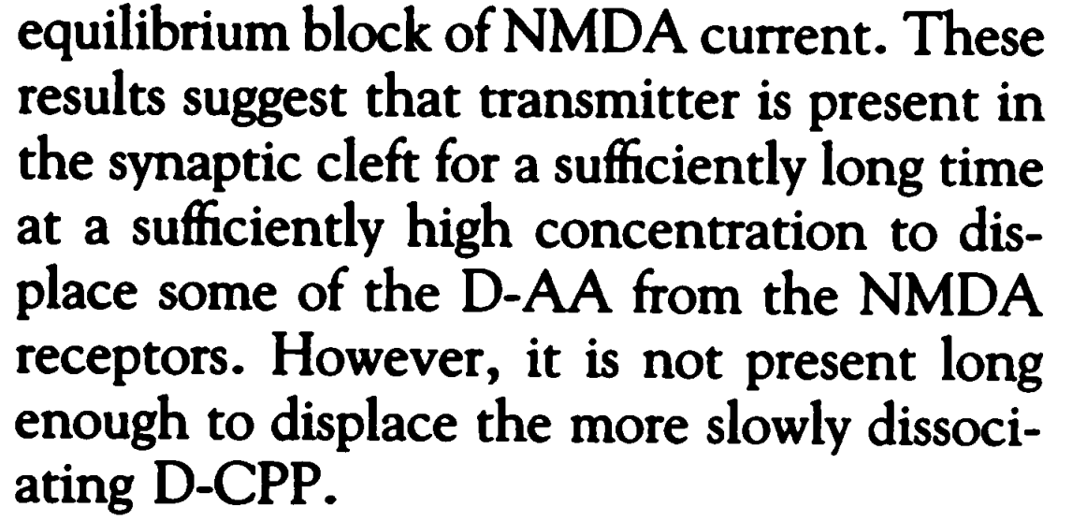
Equilibrium VS Non-Equilibrium
antagonist
glutamate
1μM D-CPP
100μM D-AA
equilibrium

Slide 31
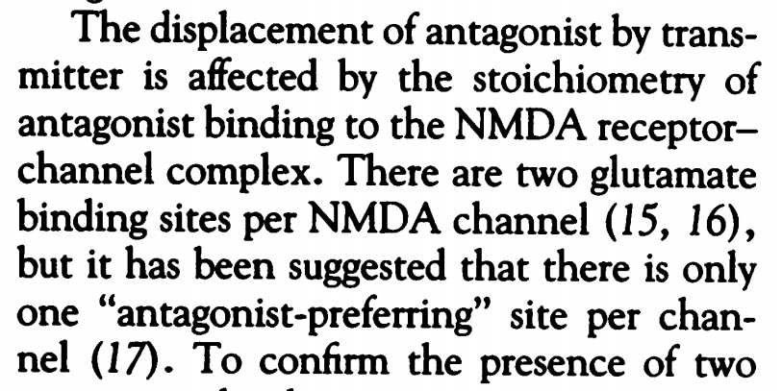
How Many Binding Sites on the NMDA Receptor?
antagonist
glutamate
1μM D-CPP
100μM D-AA
equilibrium

Slide 32
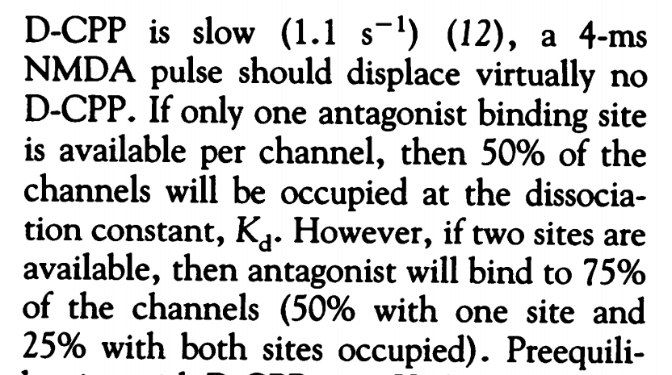
How Many Binding Sites on the NMDA Receptor?
antagonist
glutamate
1μM D-CPP
100μM D-AA
equilibrium
25%
50%
25%

Slide 33
Equilibrium VS Non-Equilibrium
antagonist
glutamate
1μM D-CPP
100μM D-AA
equilibrium
25%
50%
25%

Slide 34
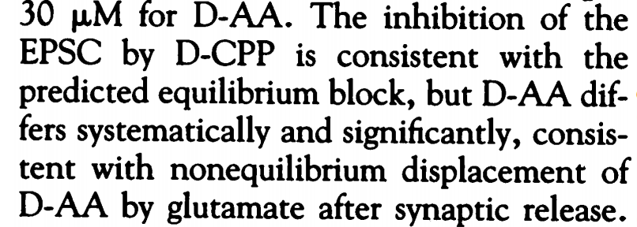
Equilibrium VS Non-Equilibrium
antagonist
glutamate
1μM D-CPP
100μM D-AA
equilibrium
25%
50%
25%

Slide 35
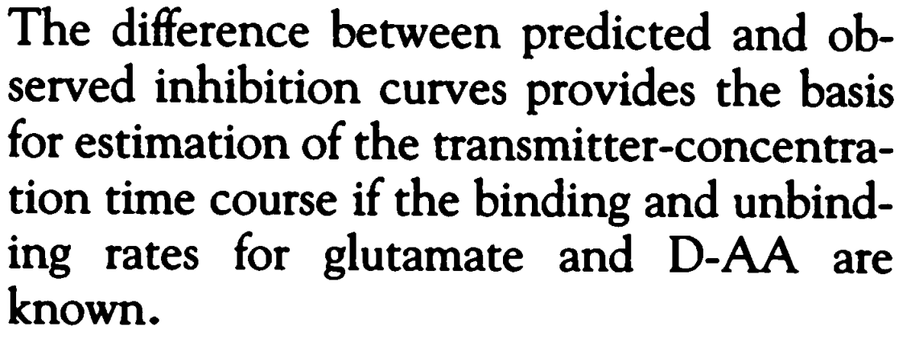
Equilibrium VS Non-Equilibrium
antagonist
glutamate
1μM D-CPP
100μM D-AA
equilibrium
25%
50%
25%

Slide 36
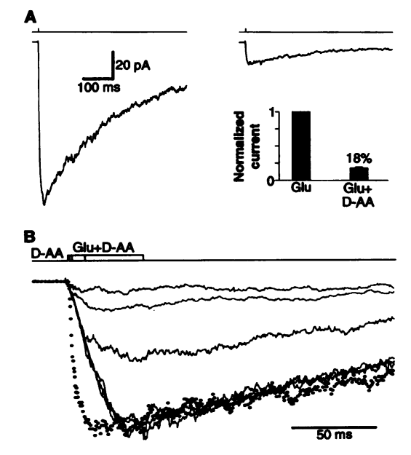
Kinetics of D-AA
glutamate k_{on}:
5μM⁻¹s⁻¹

Slide 37
Kinetics of D-AA
Kon Race
glutamate k_{on}:
5μM⁻¹s⁻¹
D-AA k_{on}:
?

Slide 38
Kinetics of D-AA
Kon Race
glutamate k_{on}:
5μM⁻¹s⁻¹
D-AA k_{on}:
?
8μM⁻¹s⁻¹
D-AA on-rate faster than
glutamate on-rate

Slide 39
Koff Race
Kinetics of D-AA

Slide 40
Koff Race
Kinetics of D-AA
glutamate k_{off}:
5s⁻¹
D-AA k_{off}:
160s⁻¹
D-AA off-rate faster than
glutamate off-rate

Slide 41
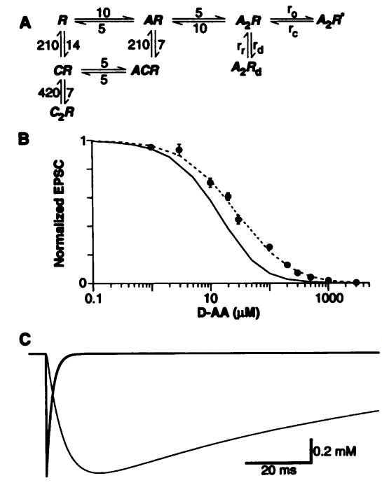
A Model

Slide 42
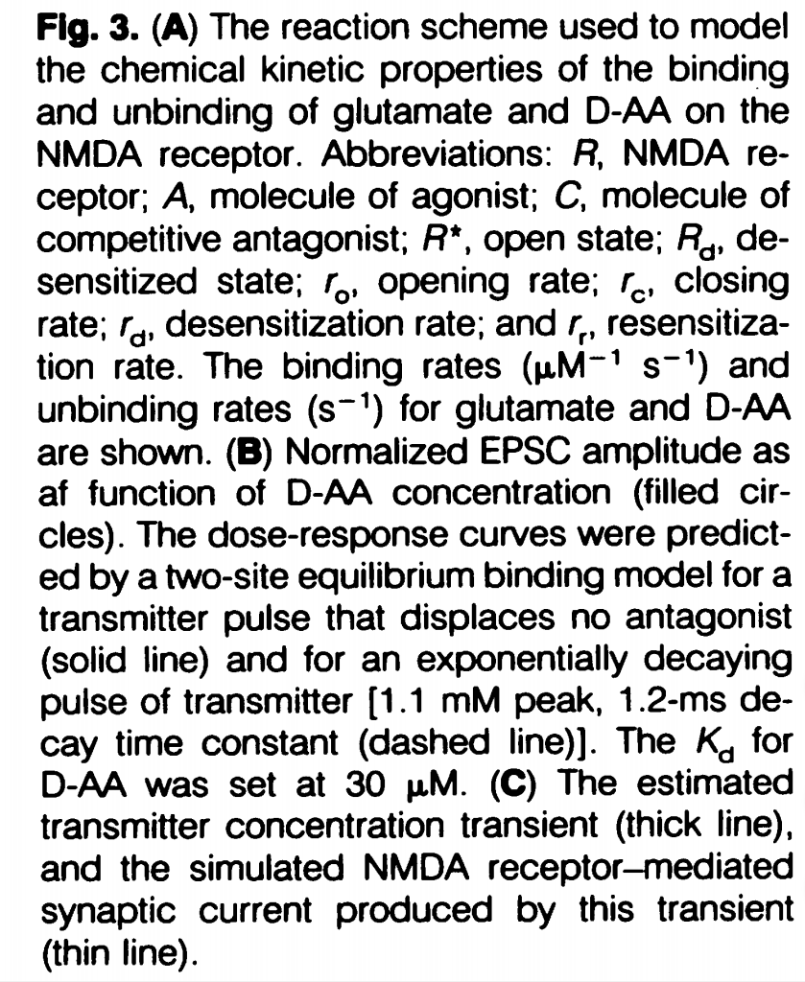
A Model

Slide 43
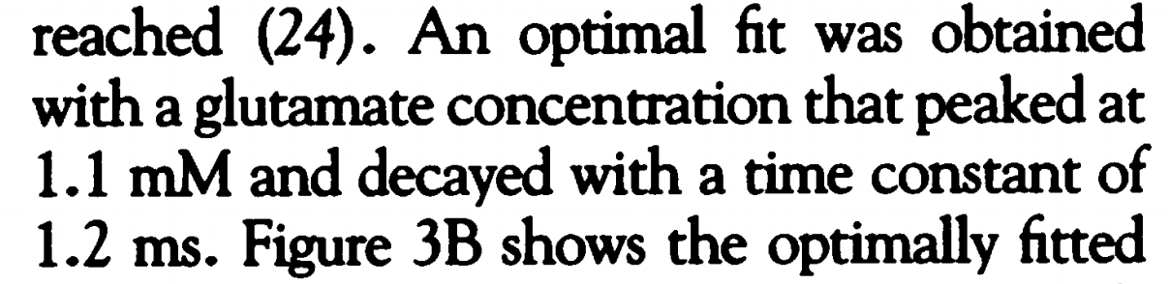
A Model

Slide 44
A Model

Slide 45
The Synapse
Question #1: How much in a vesicle?
Question #2: How much in a synapse?
receptors
vesicle
pre
post

Slide 46
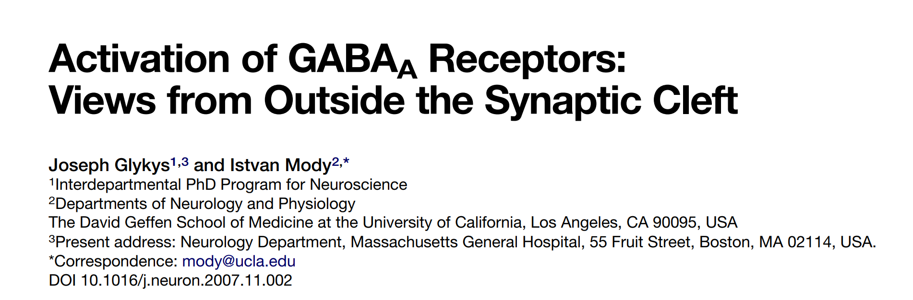
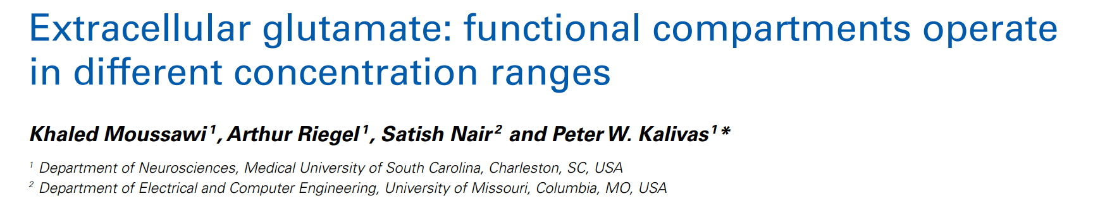
Not Just In The Synapse

