Slide 1
Transmitters & Receptors
Synapses & Circuits
Lecture Four

Slide 2
Synaptic Connections
Notables
An average neuron forms &receives
1,000 to 10,000 synaptic connections
Two general types of synapse:
chemical & electrical
Two general classes of receptors for chemical synapses:
ionotropic & metabotropic
Pop Quiz!

Slide 3
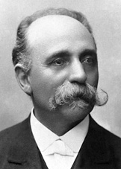
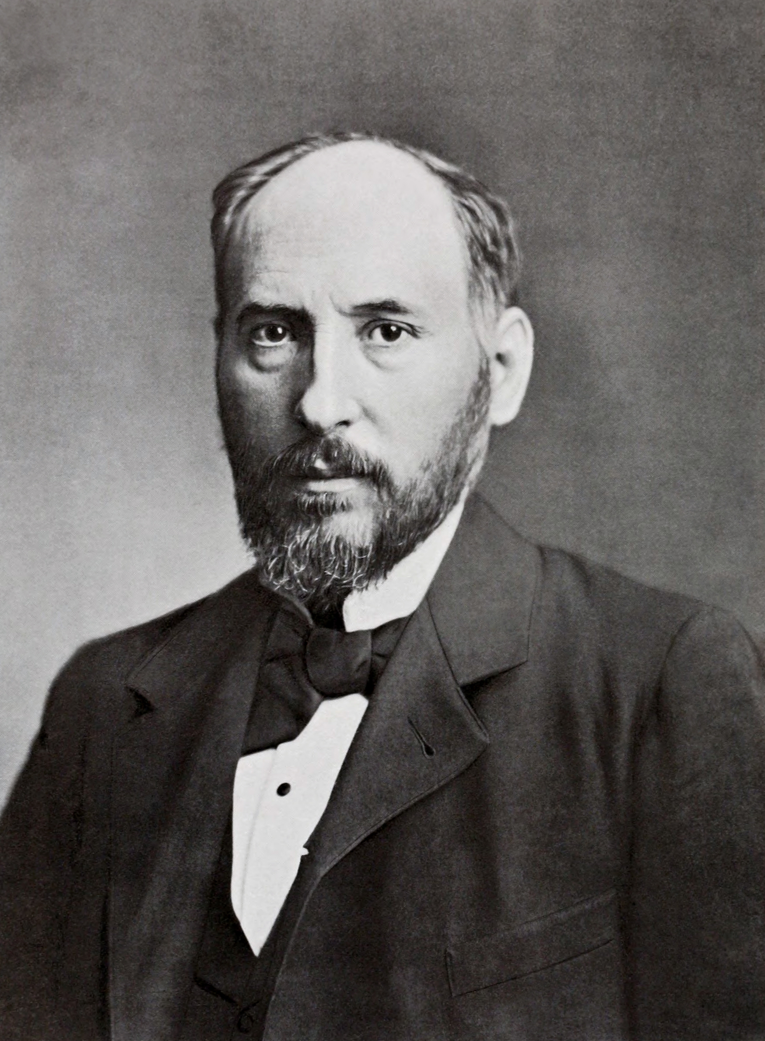
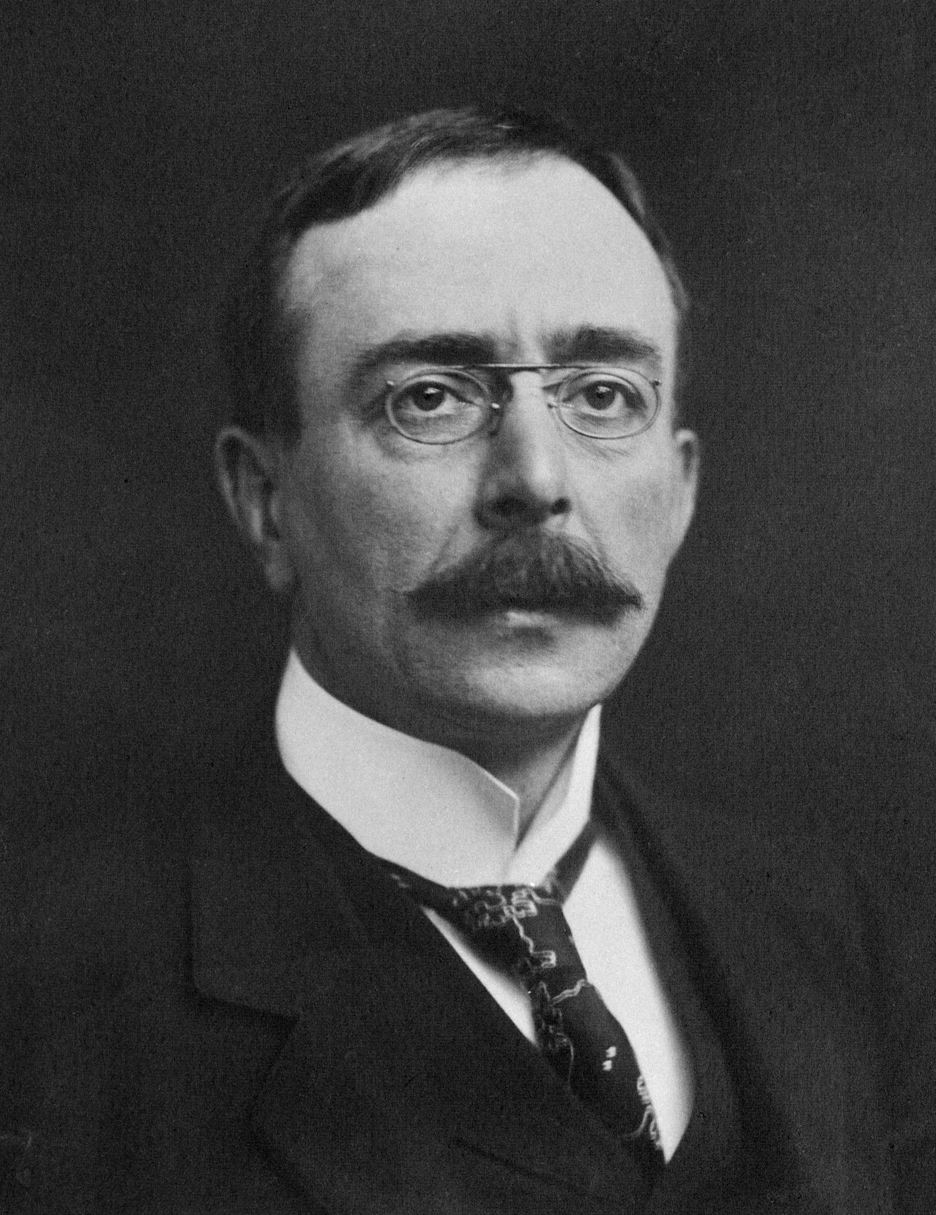
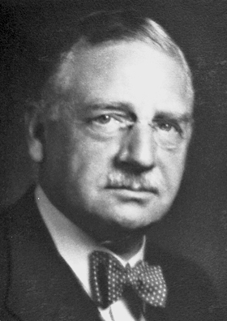
The Synapse: Historical Perspective
Camillo Golgi
Ramon y Cajal
Charles Sherrington
Otto Loewi

Slide 4

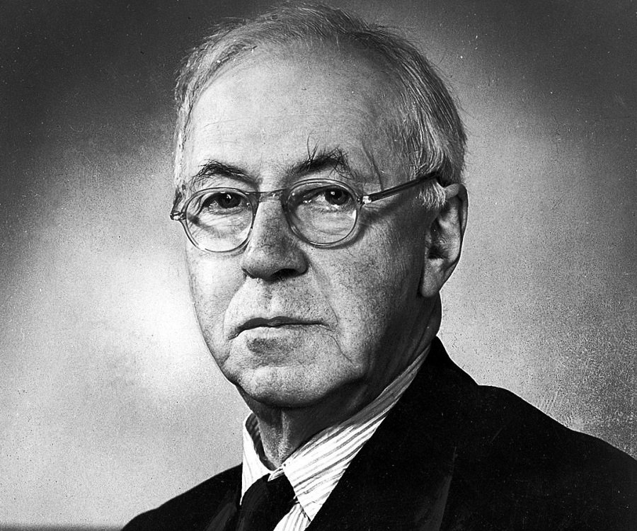
The Synapse: Historical Perspective
John Eccles
Henry Dale
Notes:
Eccles: Electrical
Dale: Chemical

Slide 5
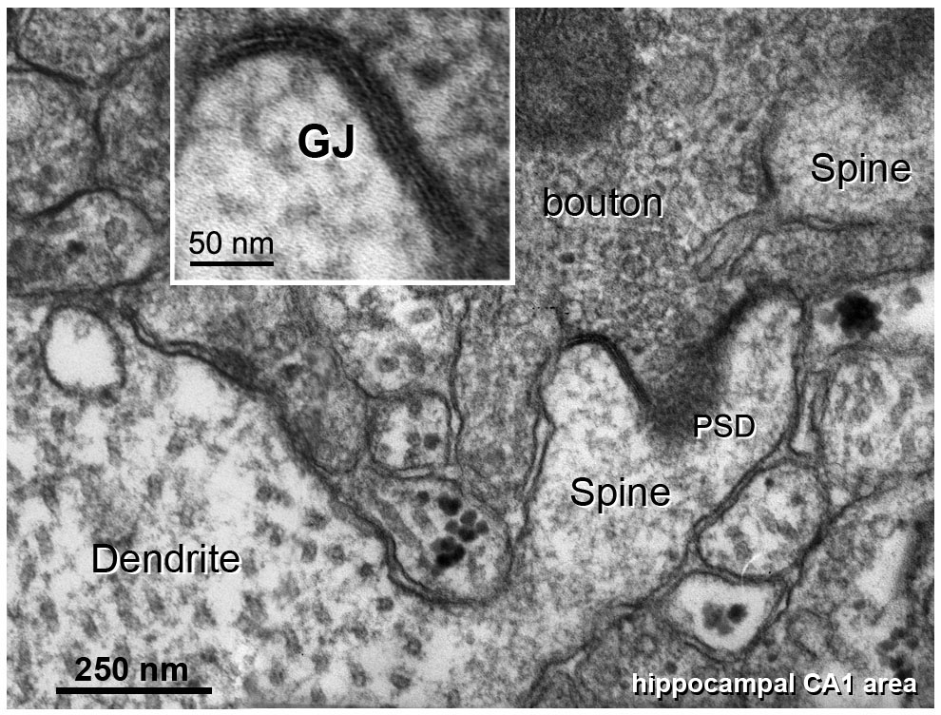

The Truth Comes Out

Slide 6
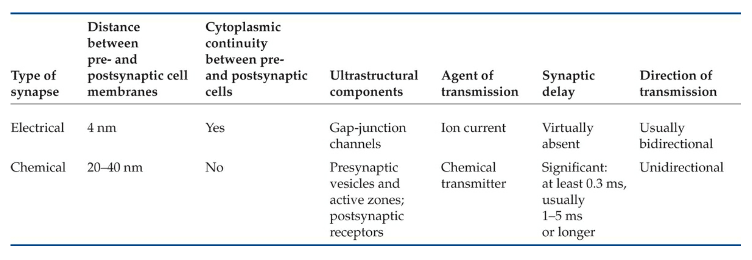
Chemical VS Electrical

Slide 7
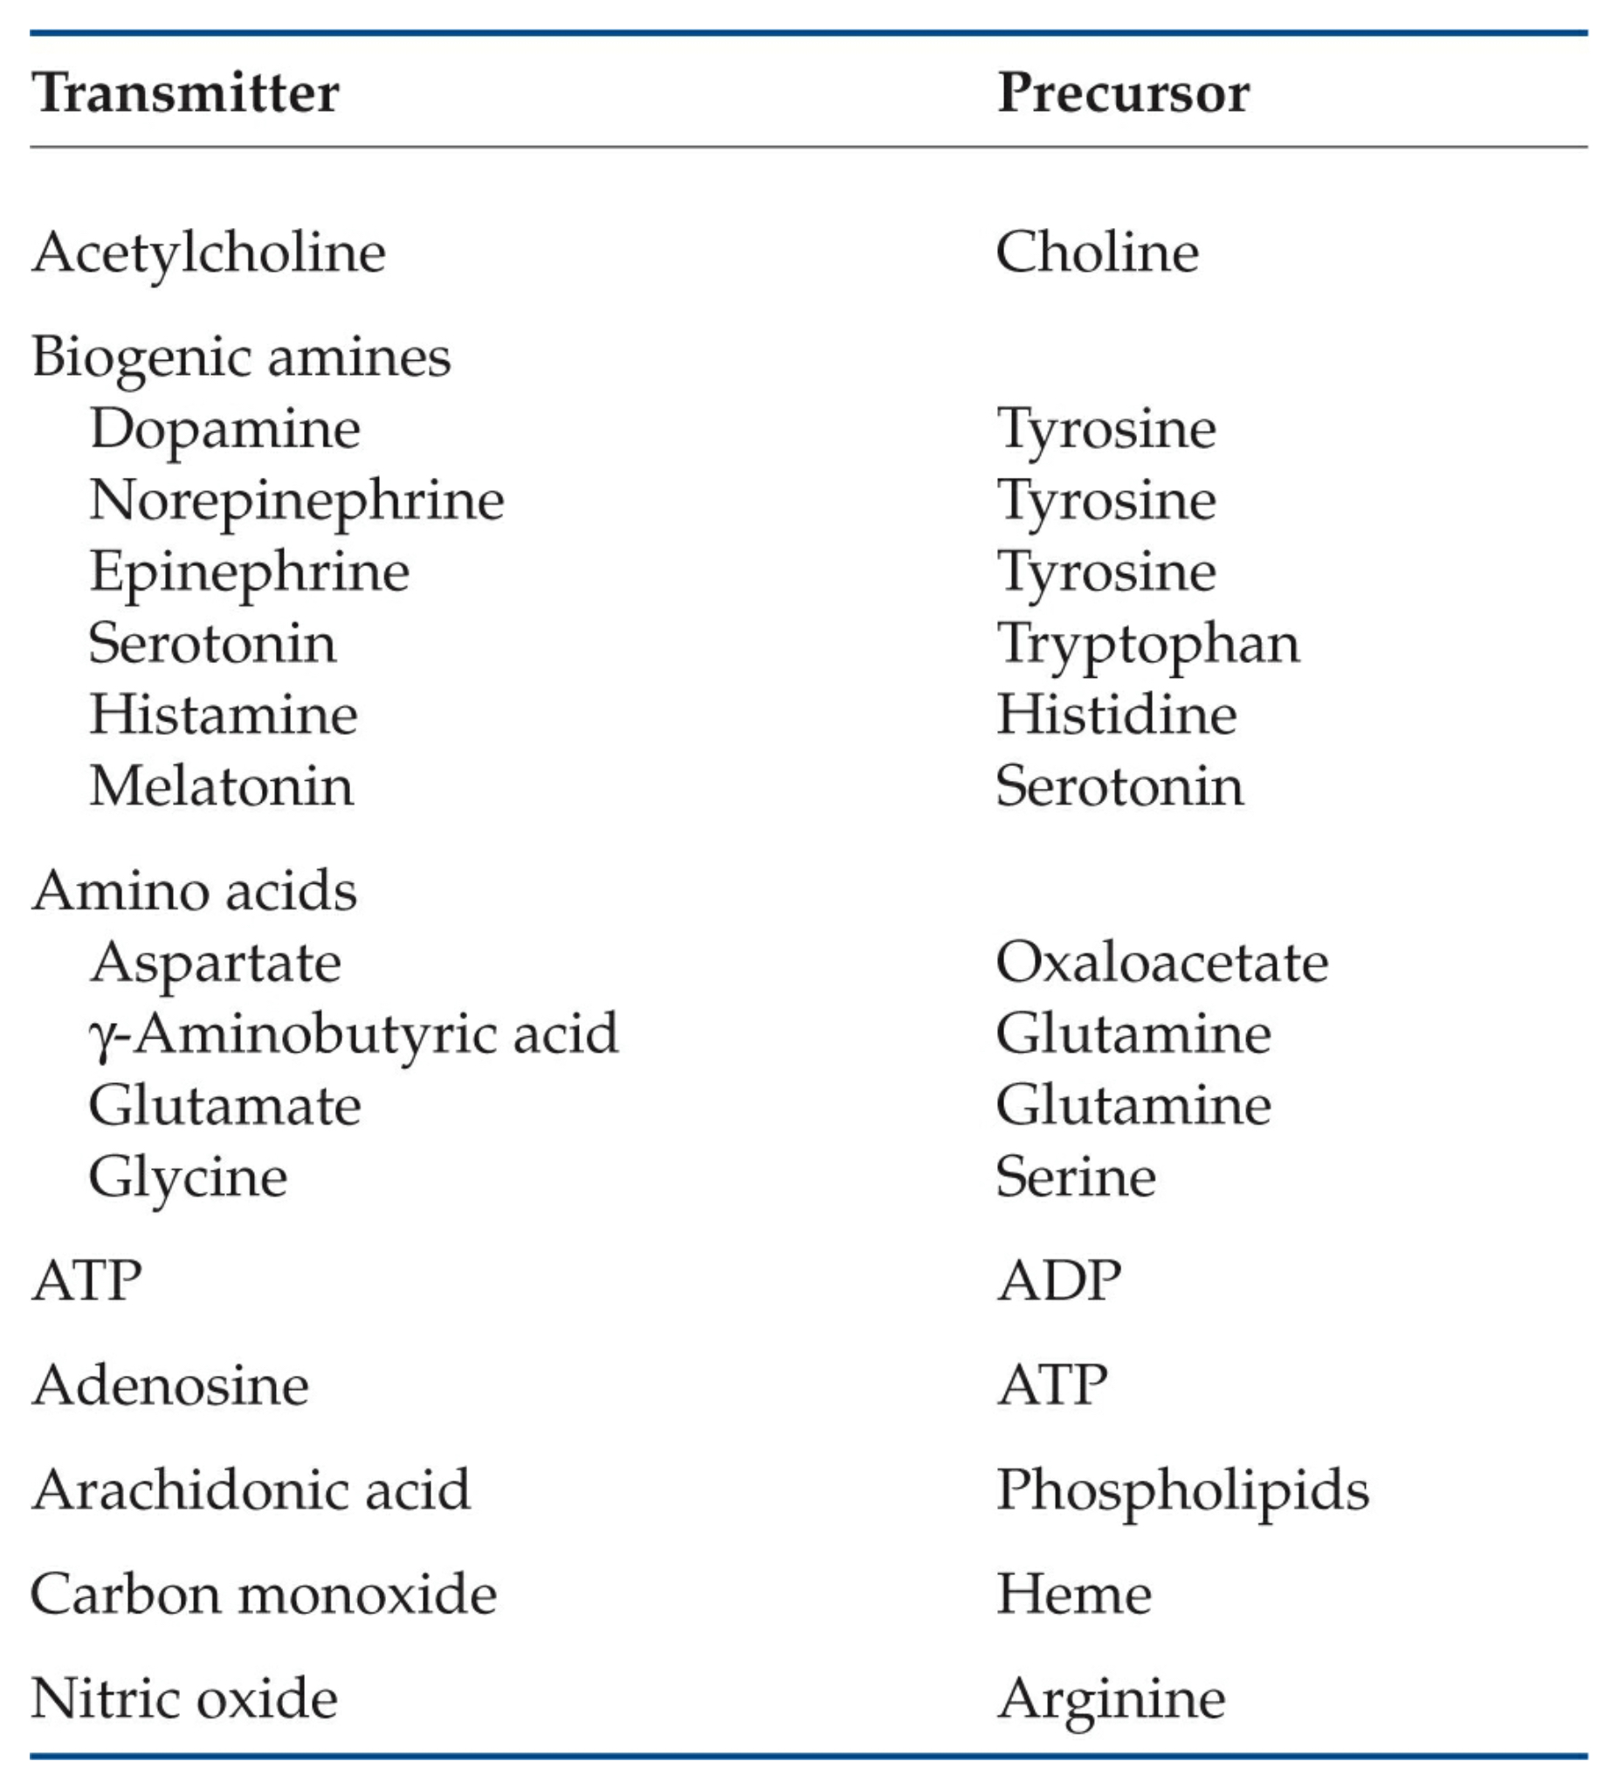
Outline: Transmitters & Receptors
Gap Junctions: direct electrical connections.
Chemical Transmission.
Ionotropic VS Metabotropic
The Neuromuscular Junction (NMJ): cholinergic transmission
Central synapses
Excitatory transmission
Inhibitory transmission
Neuroactive peptides
Transcellular

Slide 8
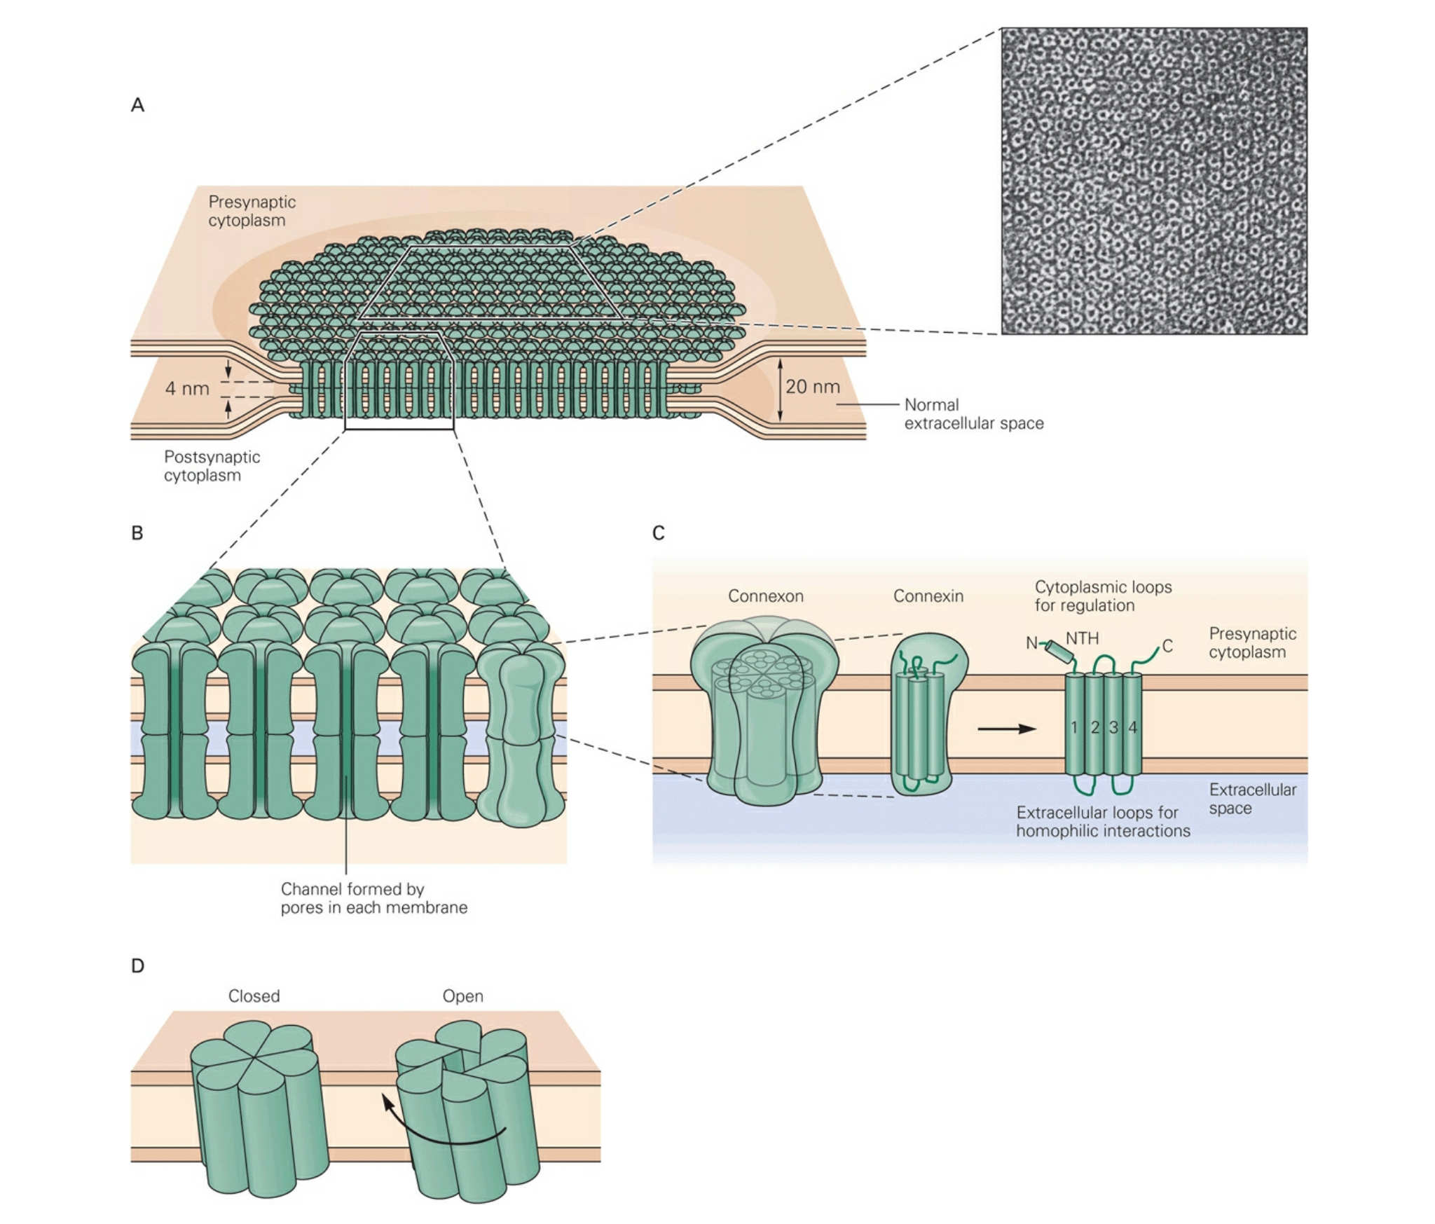
Electrical: The Gap Junction
Notes:
EM from rat liver

Slide 9
Electrical: The Gap Junction
Notes:
EM from rat liver

Slide 10
Electrical: The Gap Junction
Notes:
EM from rat liver

Slide 11
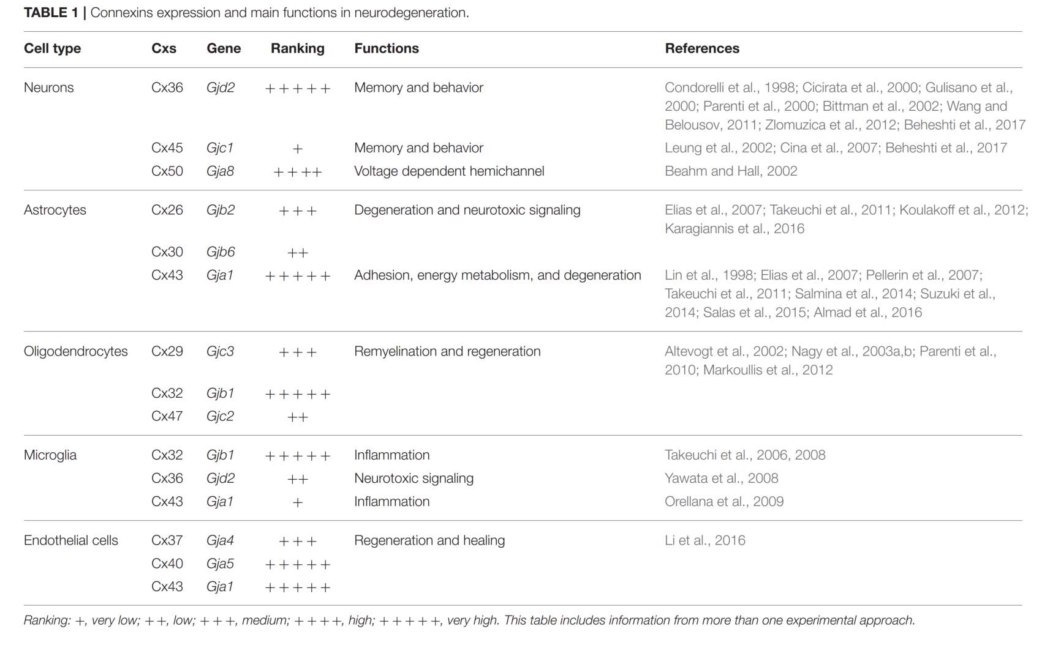
Many Connexins

Slide 12
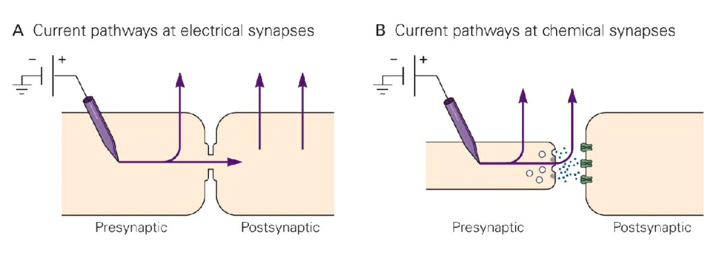
Gap Junctions: Electrical Properties

Slide 13
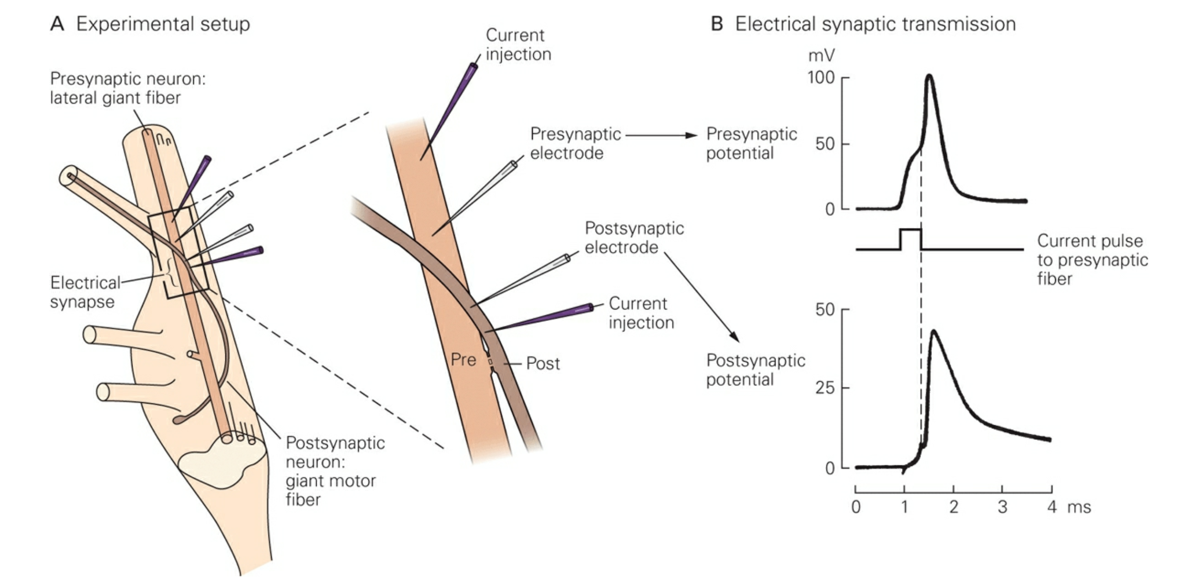
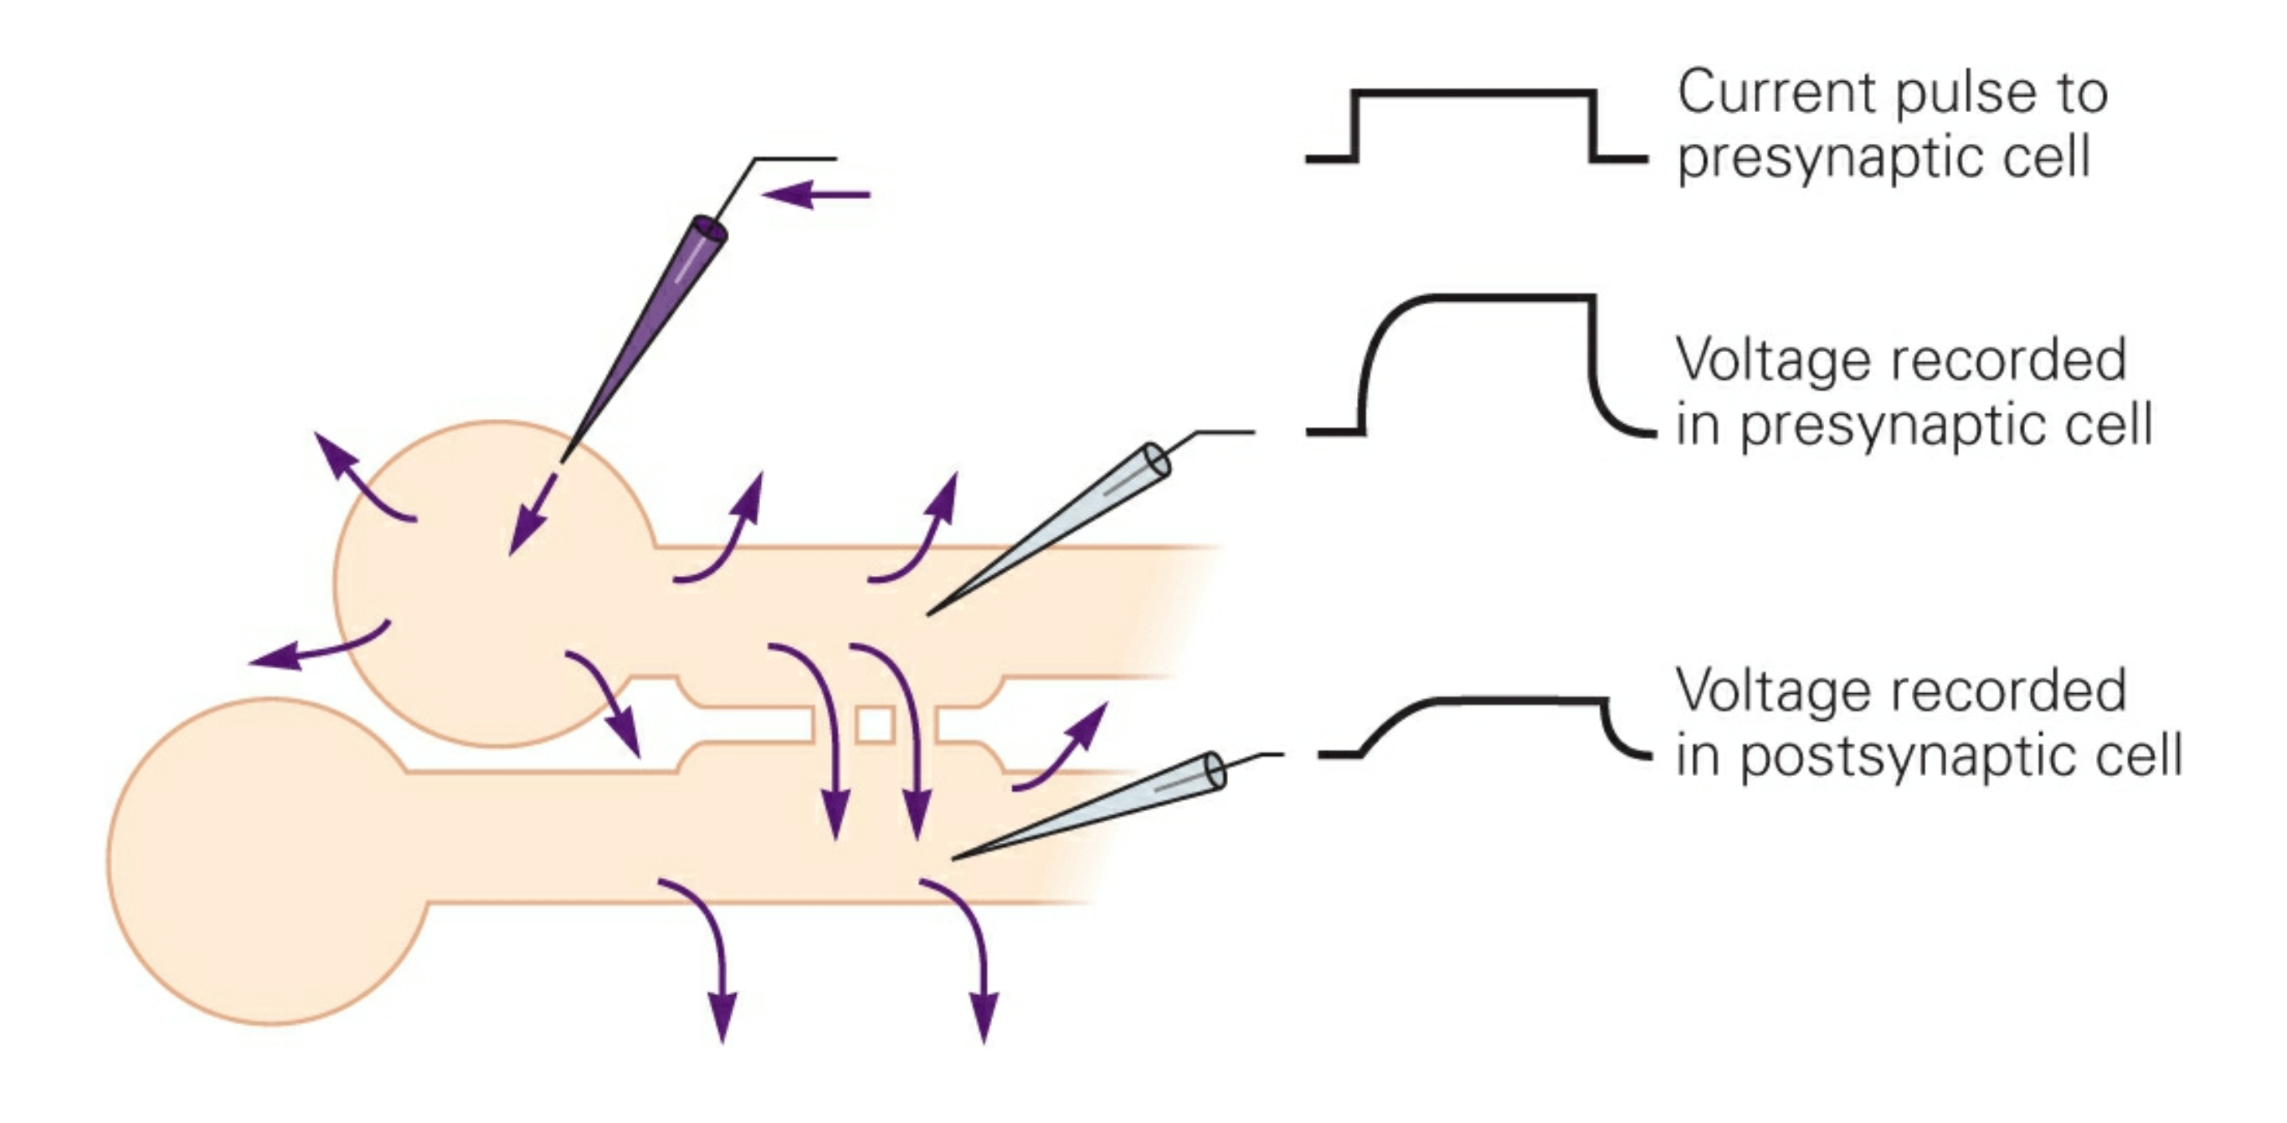
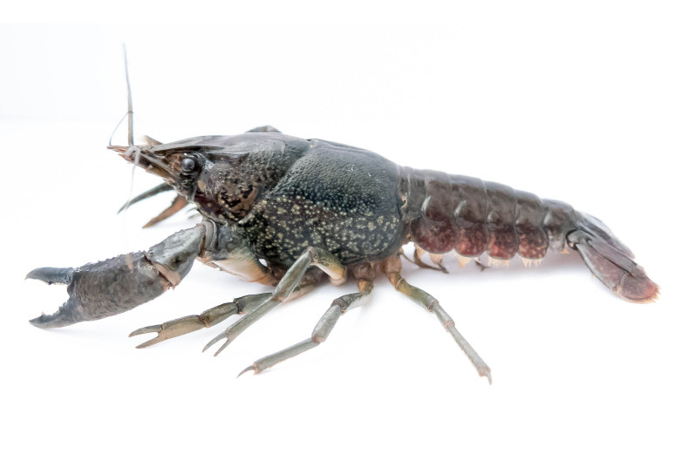
Gap Junctions: Electrical Properties
Fast
Graded

Slide 14
Gap Junctions: Electrical Properties
Pop Quiz!
Electrically coupled cells usually have a higher firing threshold.
But when they fire, they do
so synchronously.
And often explosively.
Kapow!!!

Slide 15
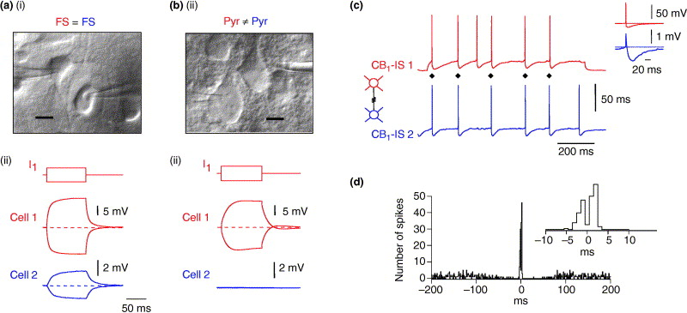
Gap Junctions: Electrical Properties
Synchronization
Trends in Neurosciences 2005 28, 304-309DOI: (10.1016/j.tins.2005.04.001)

Slide 16
Gap Junctions: Electrical Properties
Synchronization
Trends in Neurosciences 2005 28, 304-309DOI: (10.1016/j.tins.2005.04.001)

Slide 17
Gap Junctions: Electrical Properties
Synchronization
Trends in Neurosciences 2005 28, 304-309DOI: (10.1016/j.tins.2005.04.001)

Slide 18
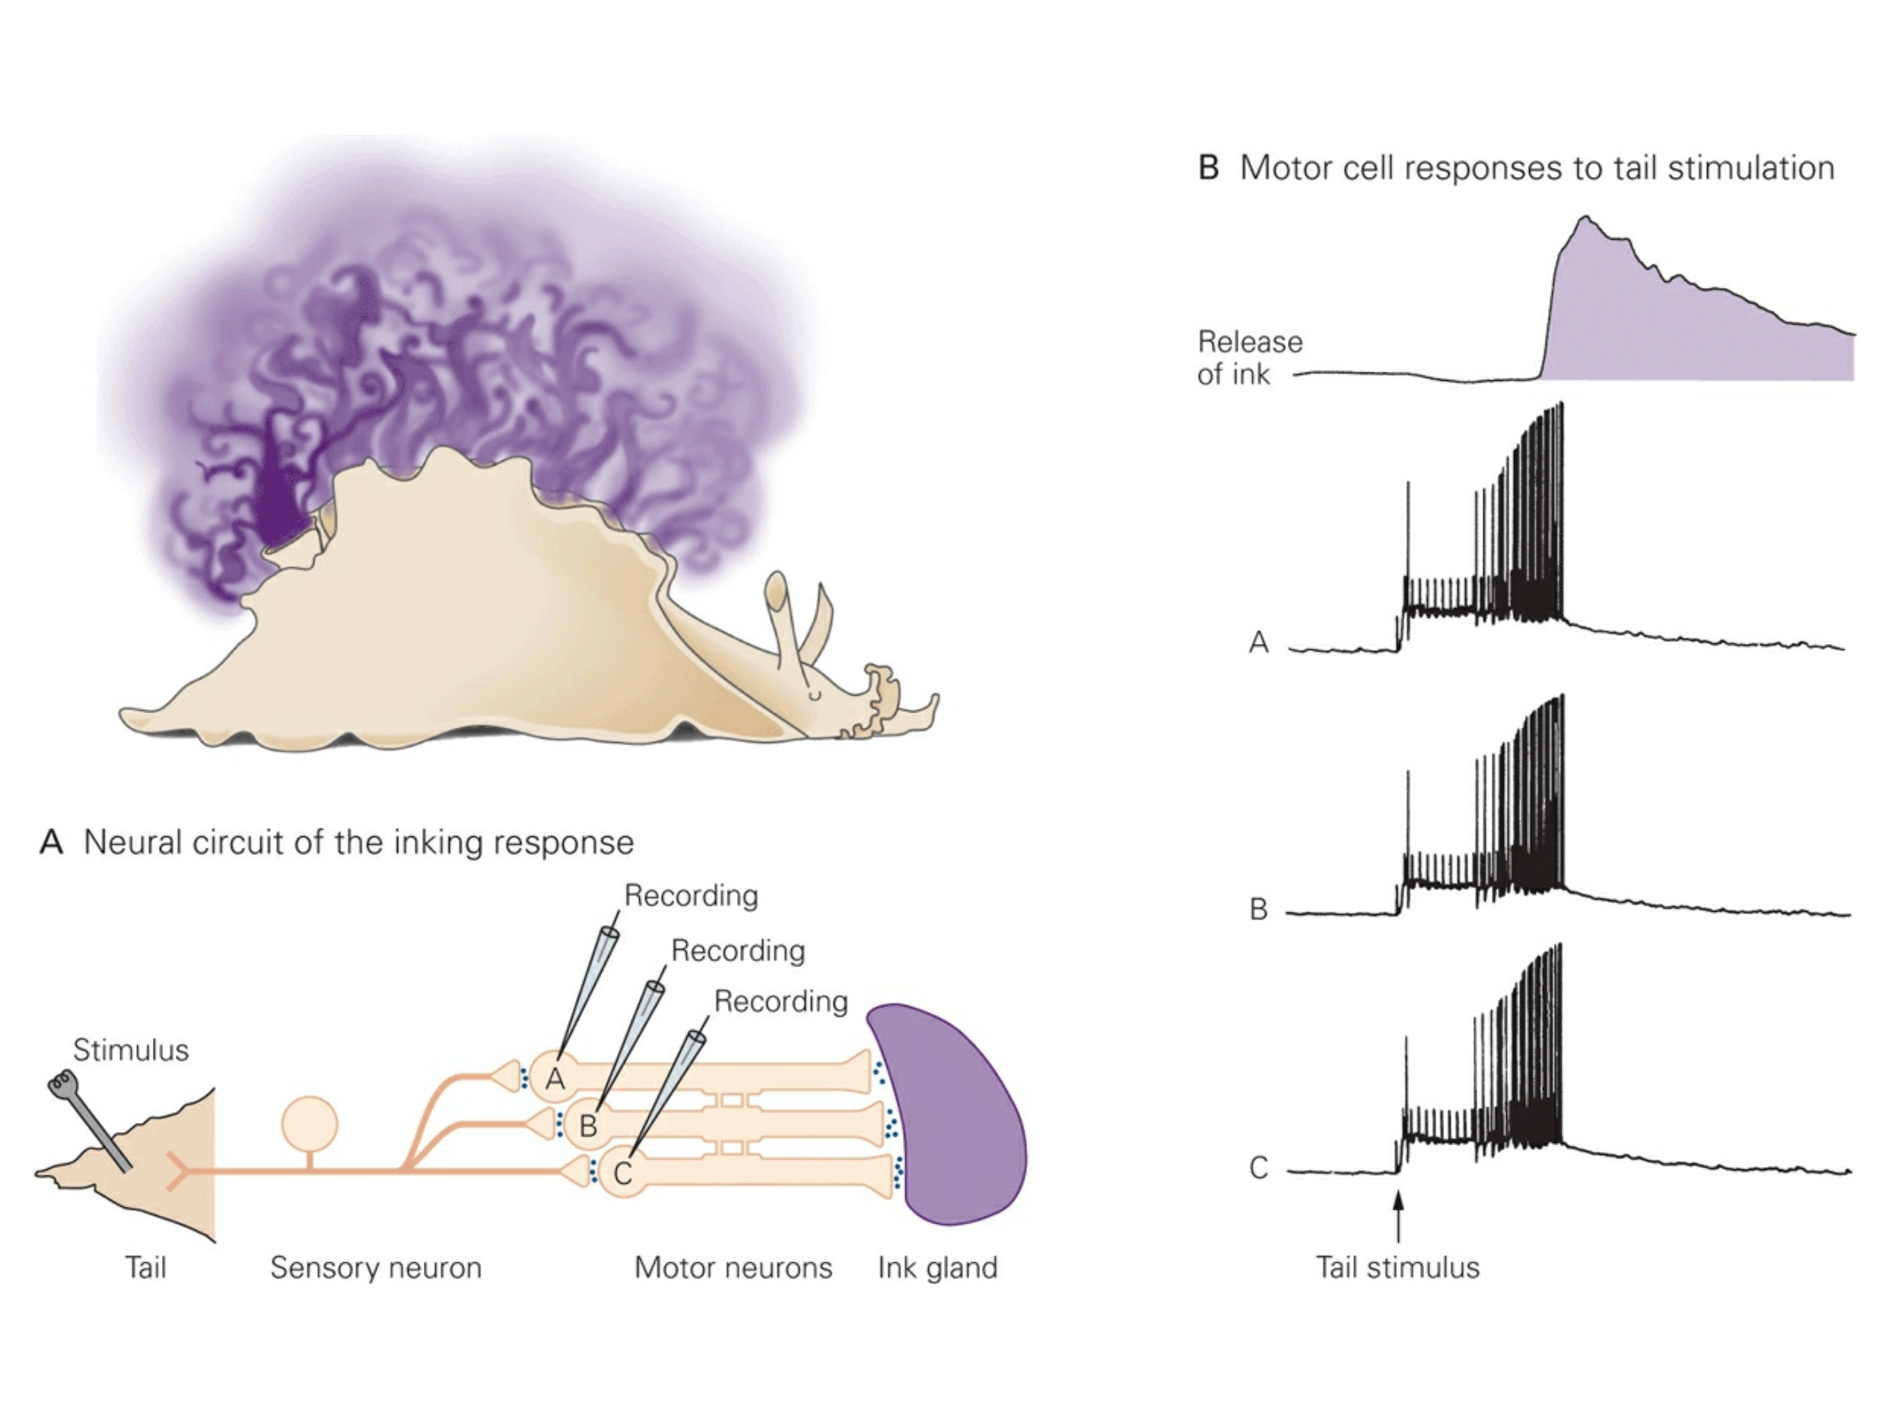
Kapow!!!

Slide 19
Kapow!!!

Slide 20
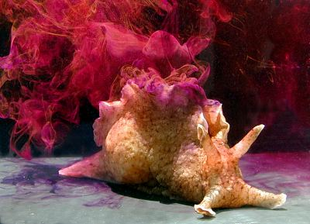
Kapow!!!

Slide 21
Gap Junctions: Cellular Properties
Gap junctions are relatively large and nonselective.
Can pass inorganic ions (e.g. Ca²⁺), as well as organic compounds (e.g. IP₃ & cAMP).
link

Slide 22
Outline
Gap Junctions: direct electrical connections.
Chemical Transmission.
Ionotropic VS Metabotropic

Slide 23
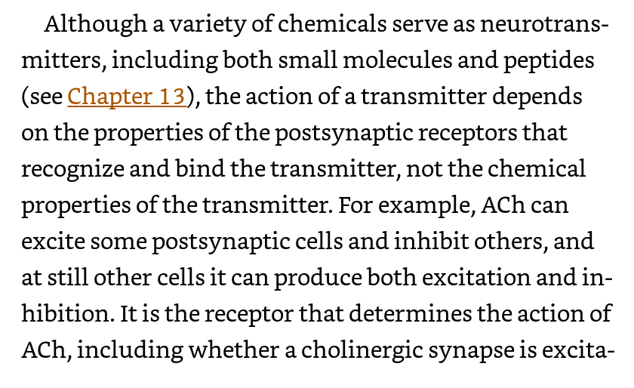
Chemical Synapses

Slide 24
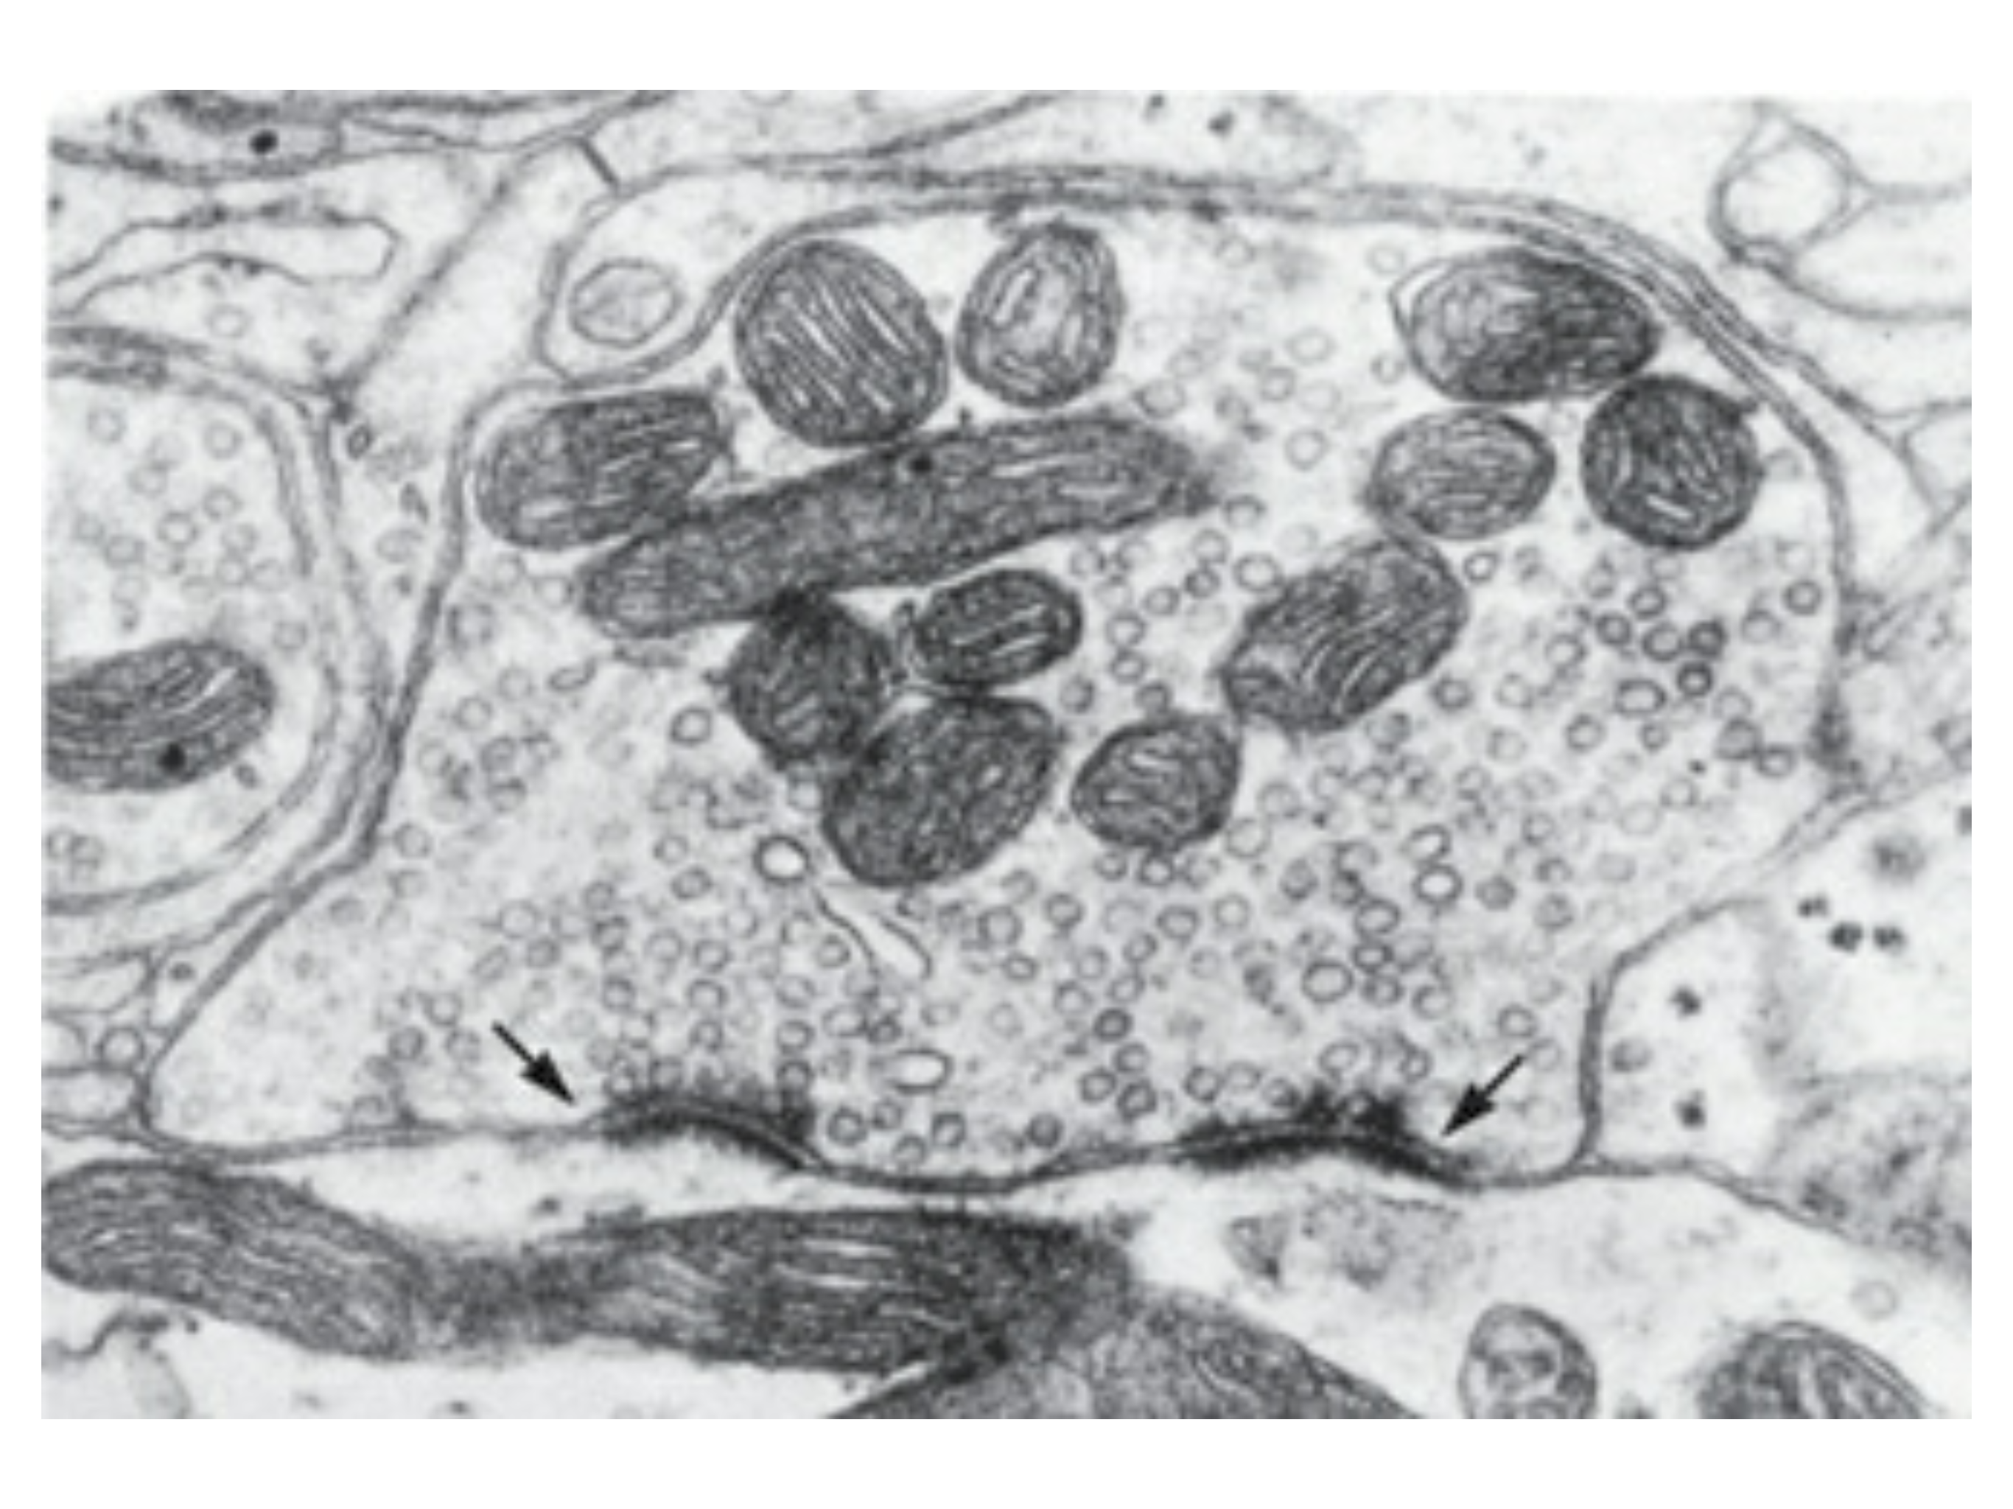
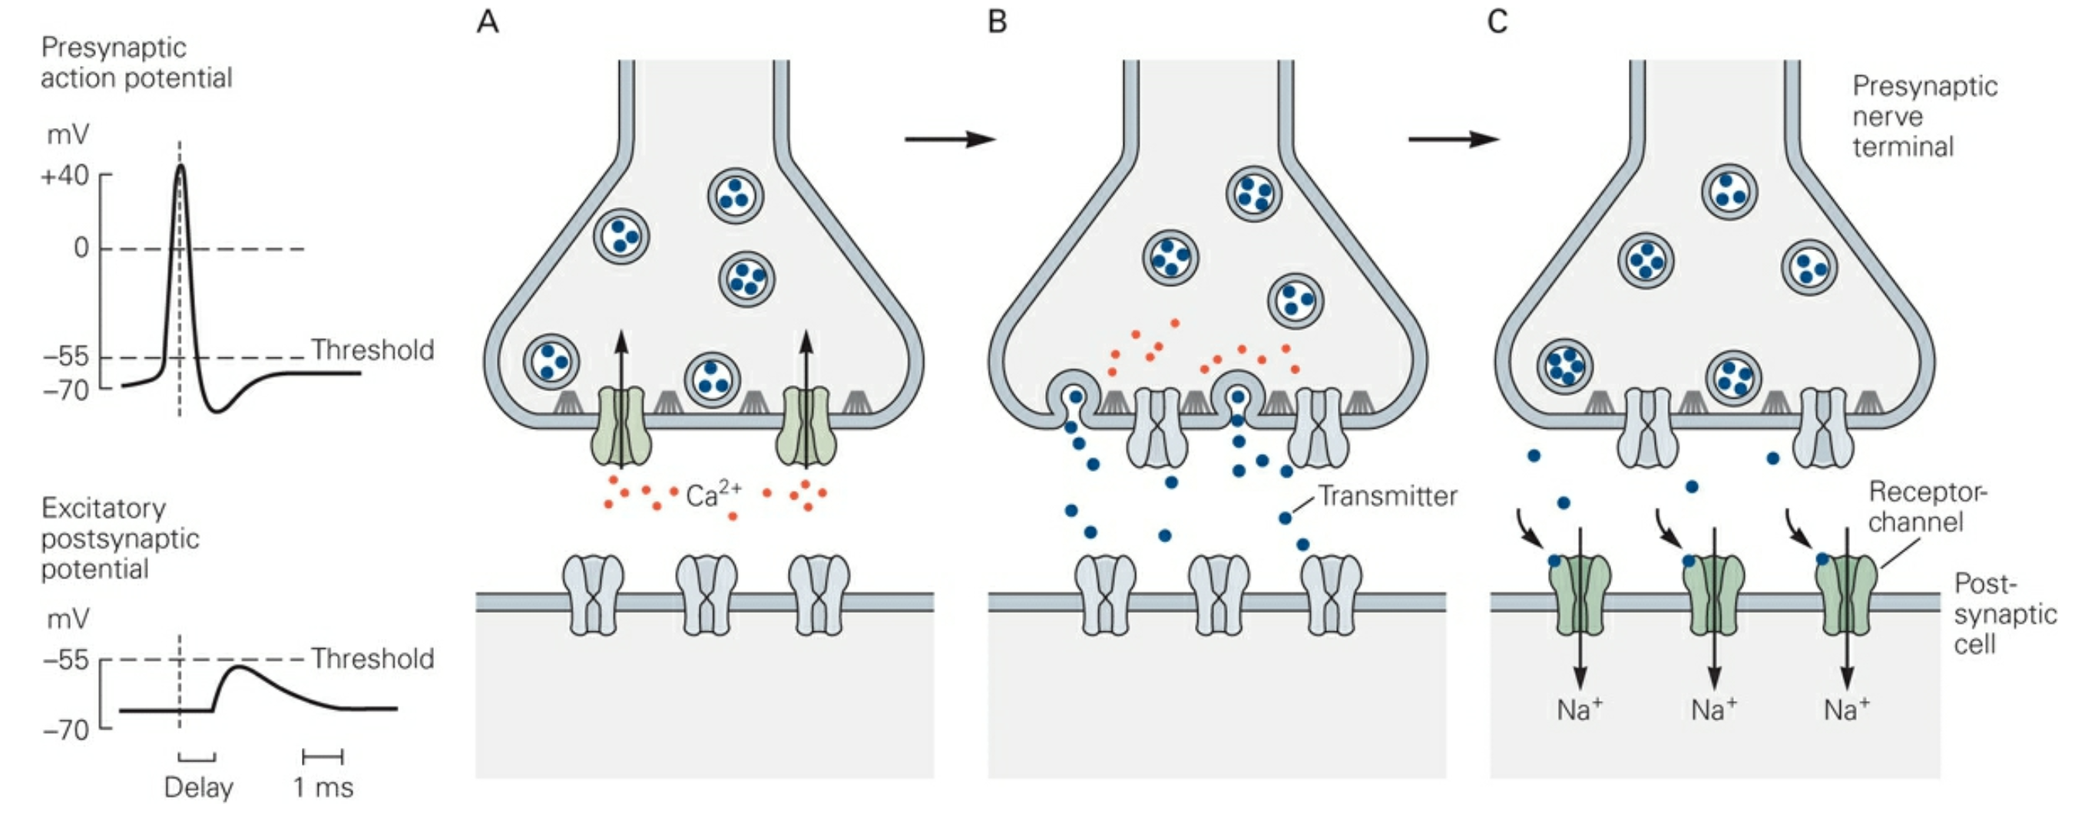
Chemical Synapses
Chemical synapses can amplify.
Synaptic vesicles clustered at specialized regions called active zones.
Active zones are the sites of neurotransmitter release.

Slide 25
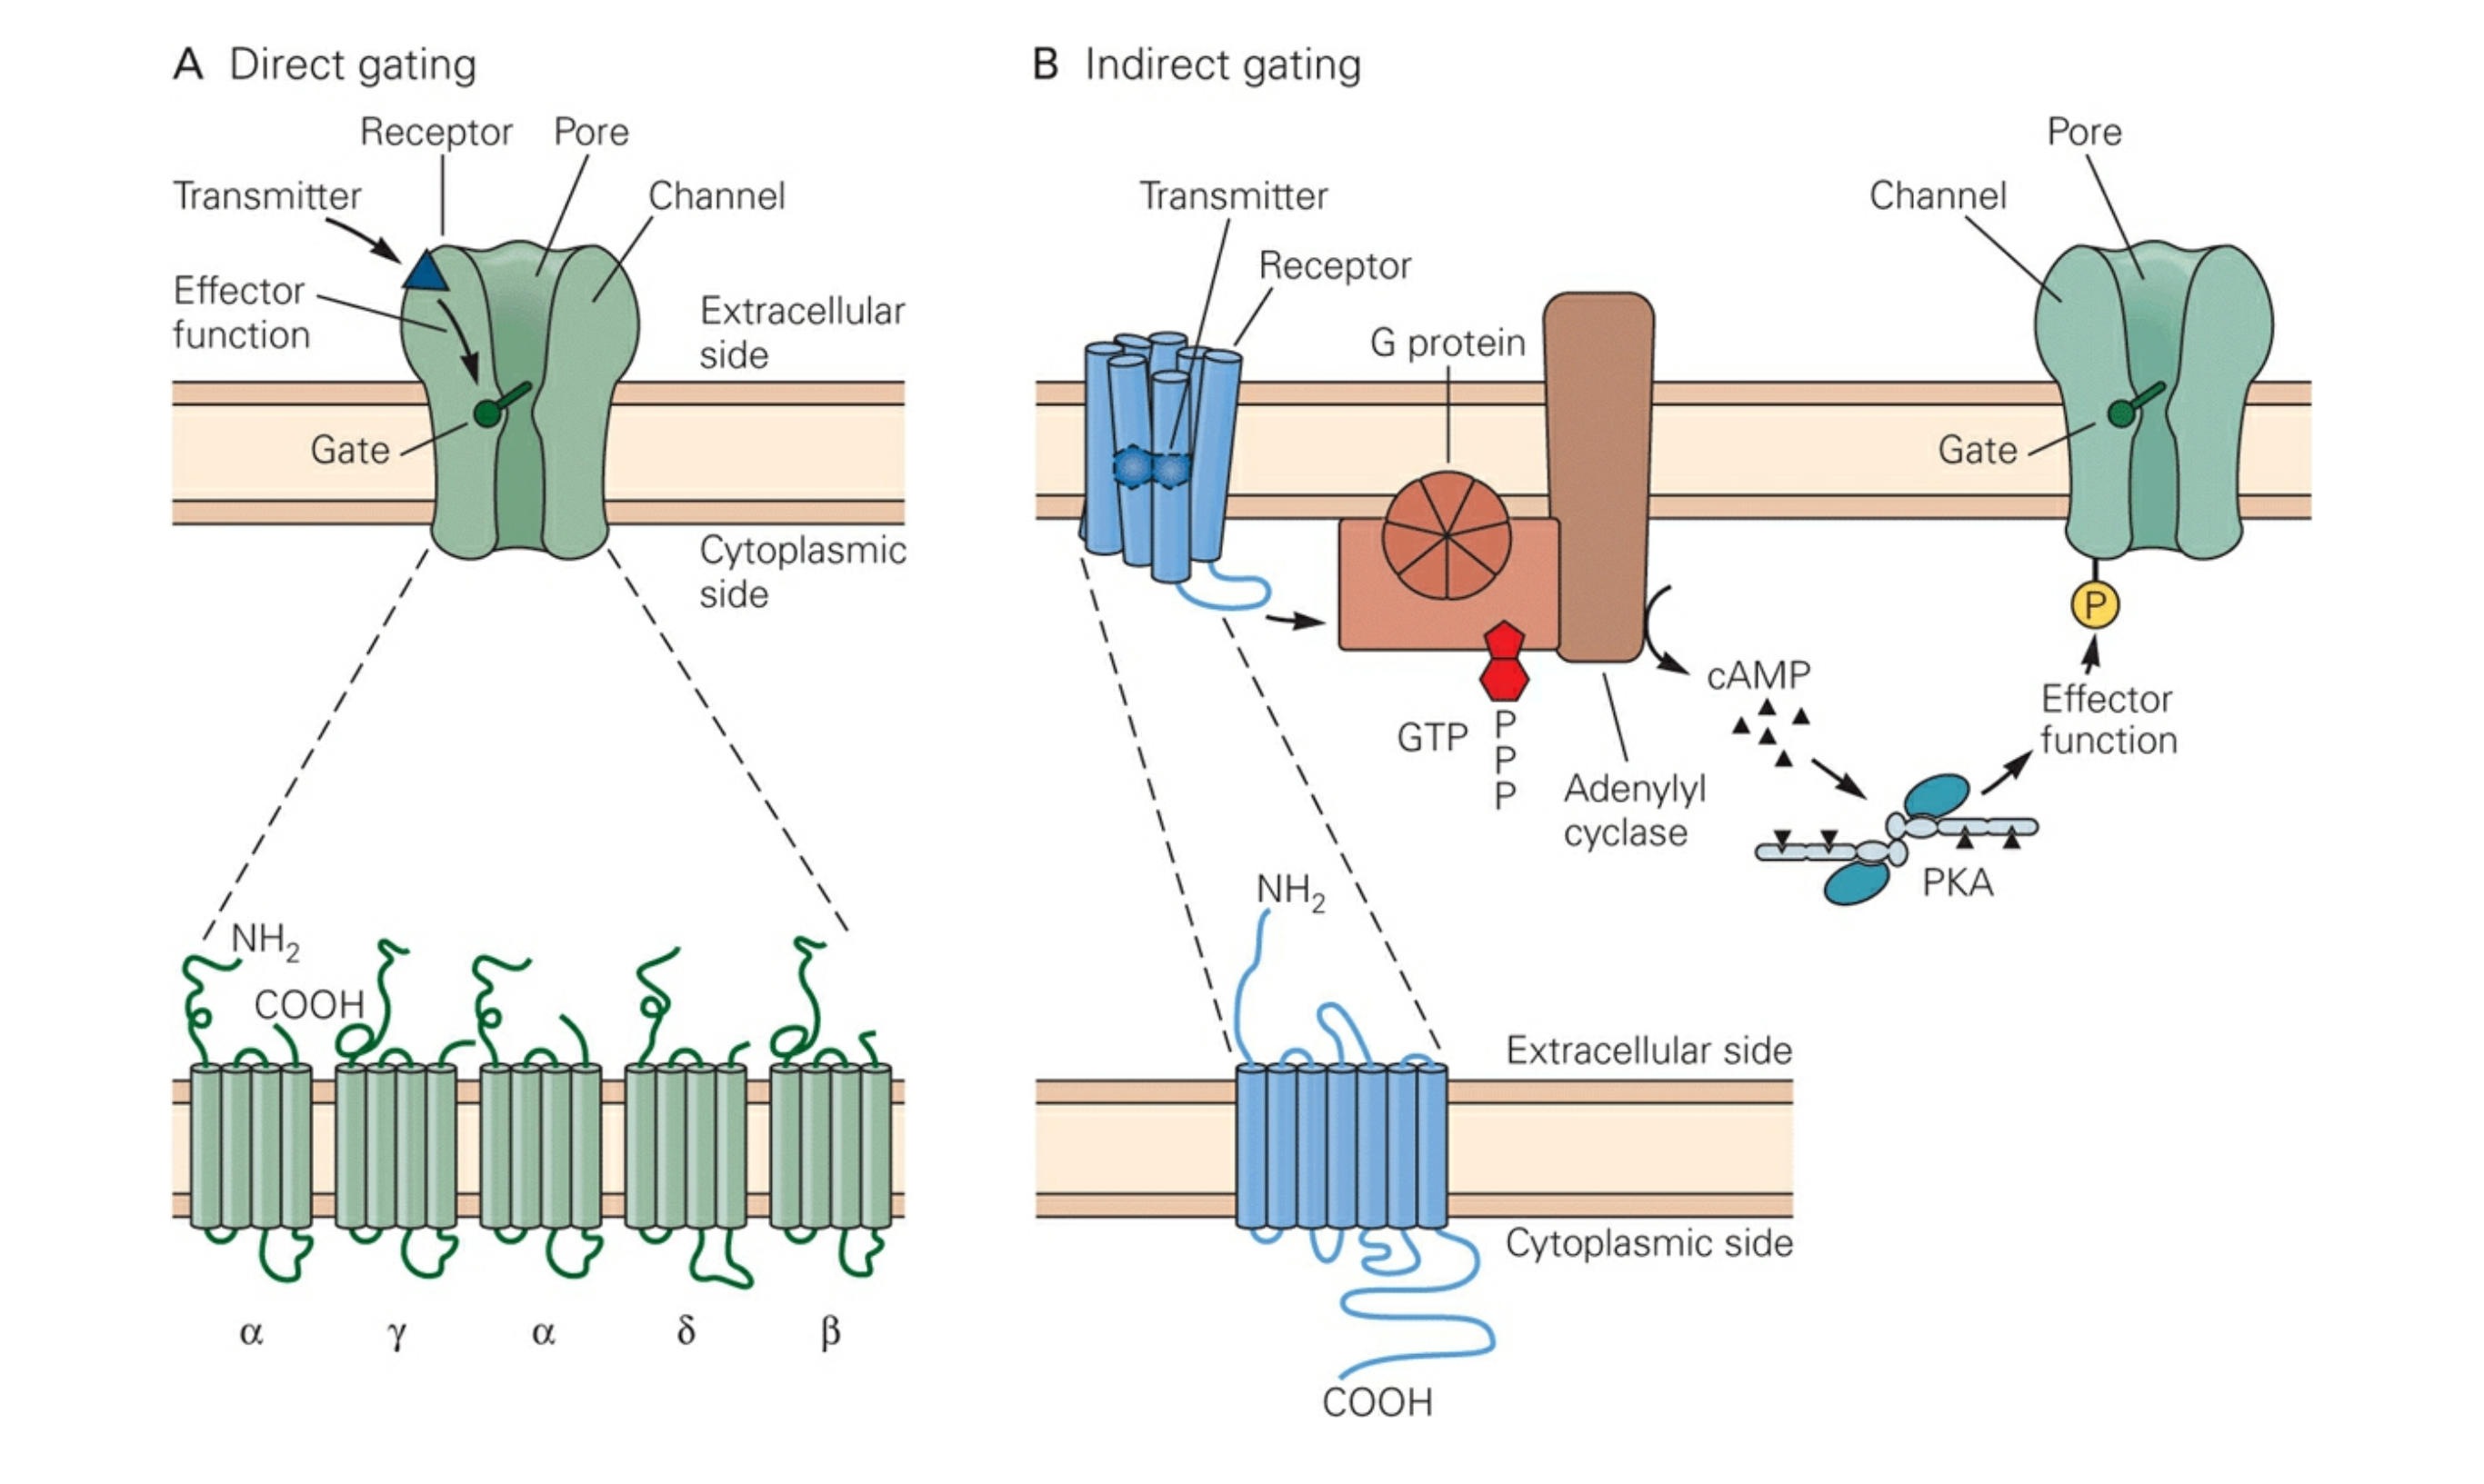
Ionotropic VS Metabotropic

Slide 26
Ionotropic VS Metabotropic

Slide 27
Outline
Gap Junctions: direct electrical connections.
Chemical Transmission.
Ionotropic VS Metabotropic
The Neuromuscular Junction (NMJ): cholinergic transmission

Slide 28
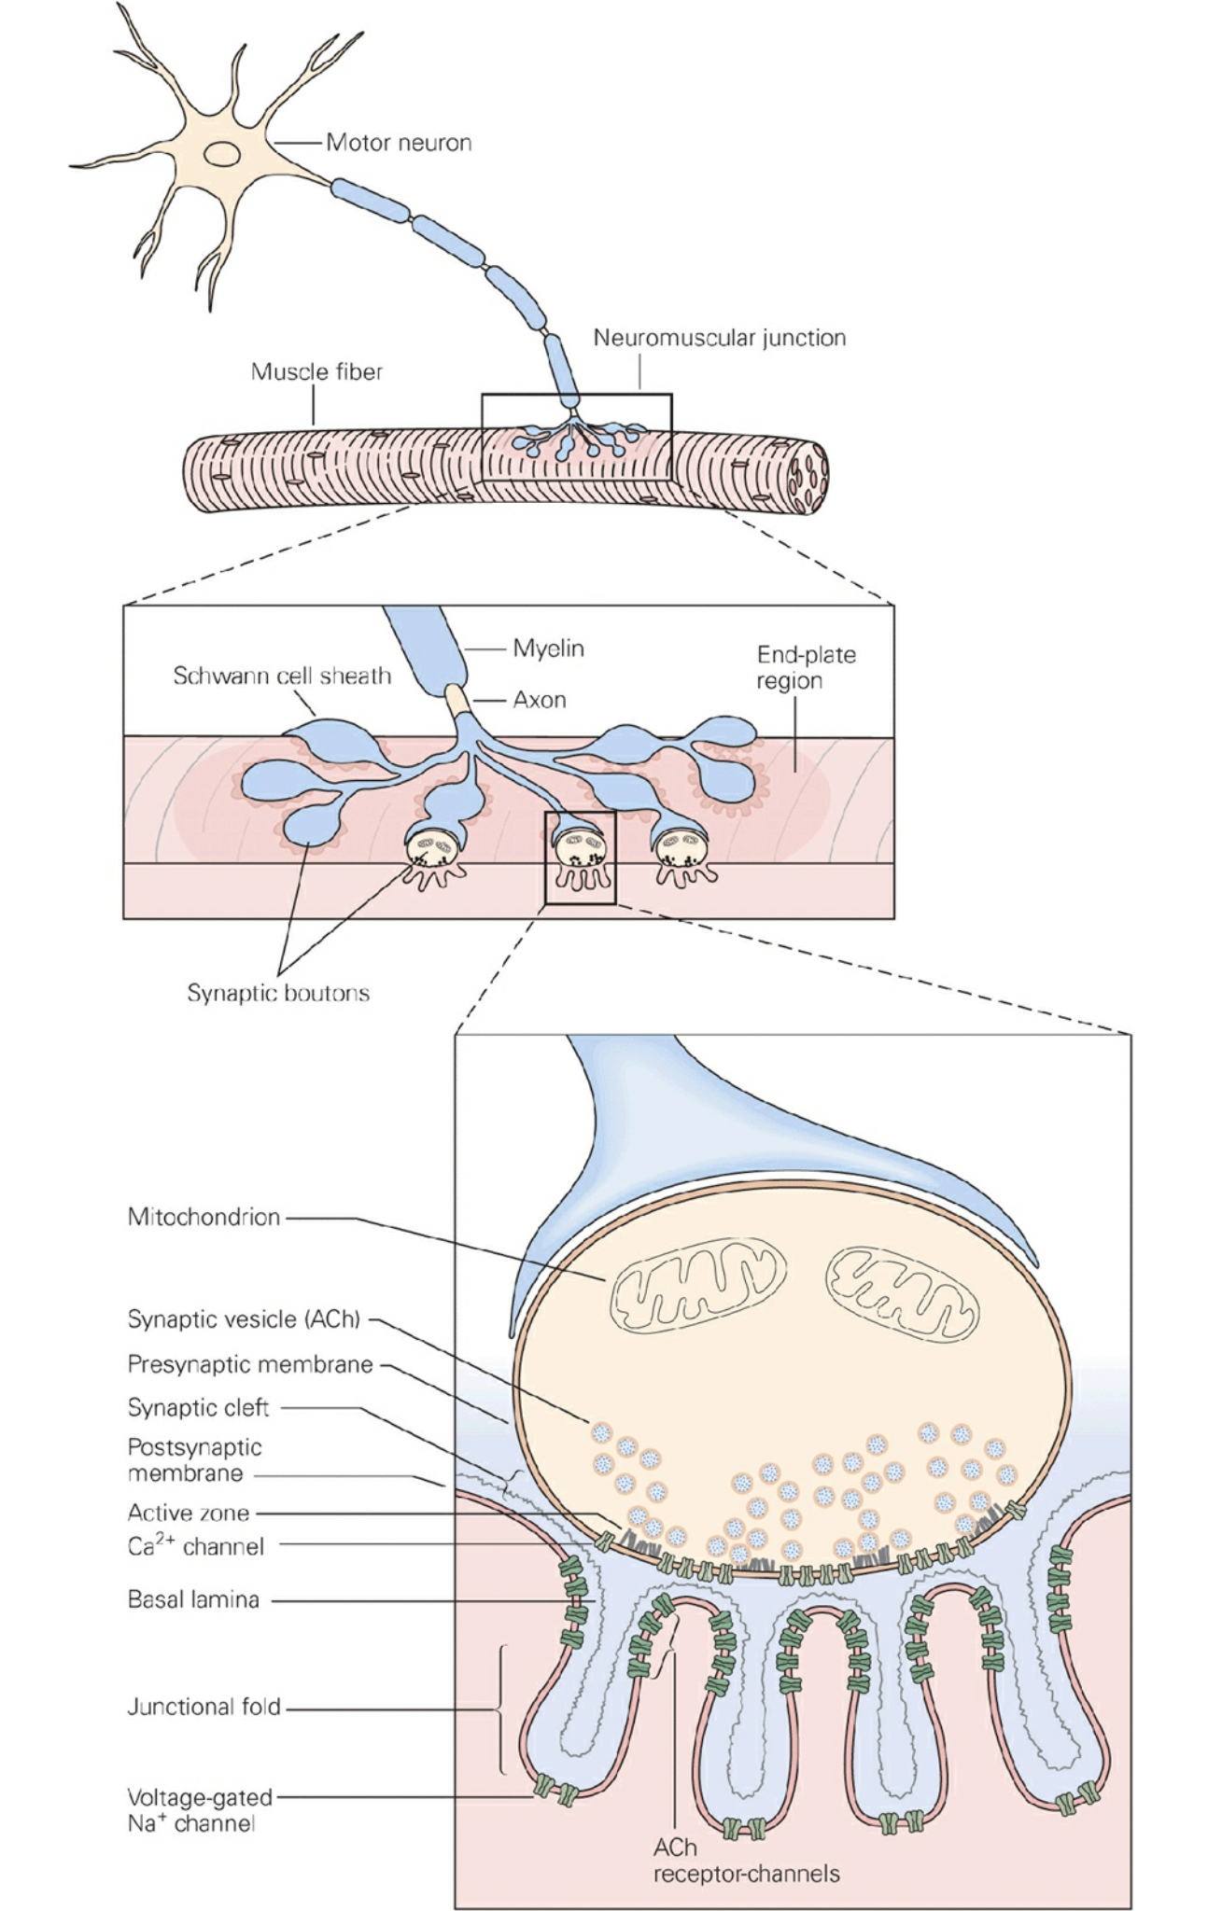
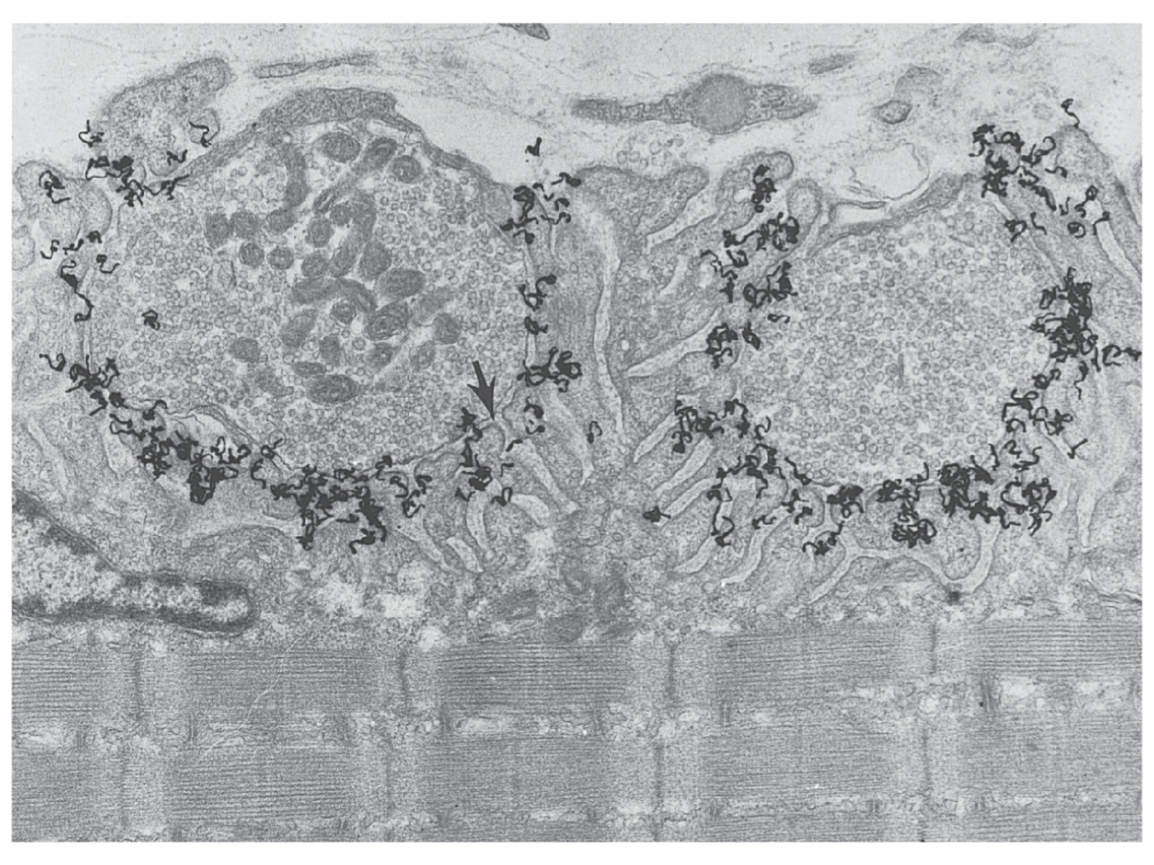
NMJ: You’re still the best!
(for helping us understanding chemical transmission)

Slide 29
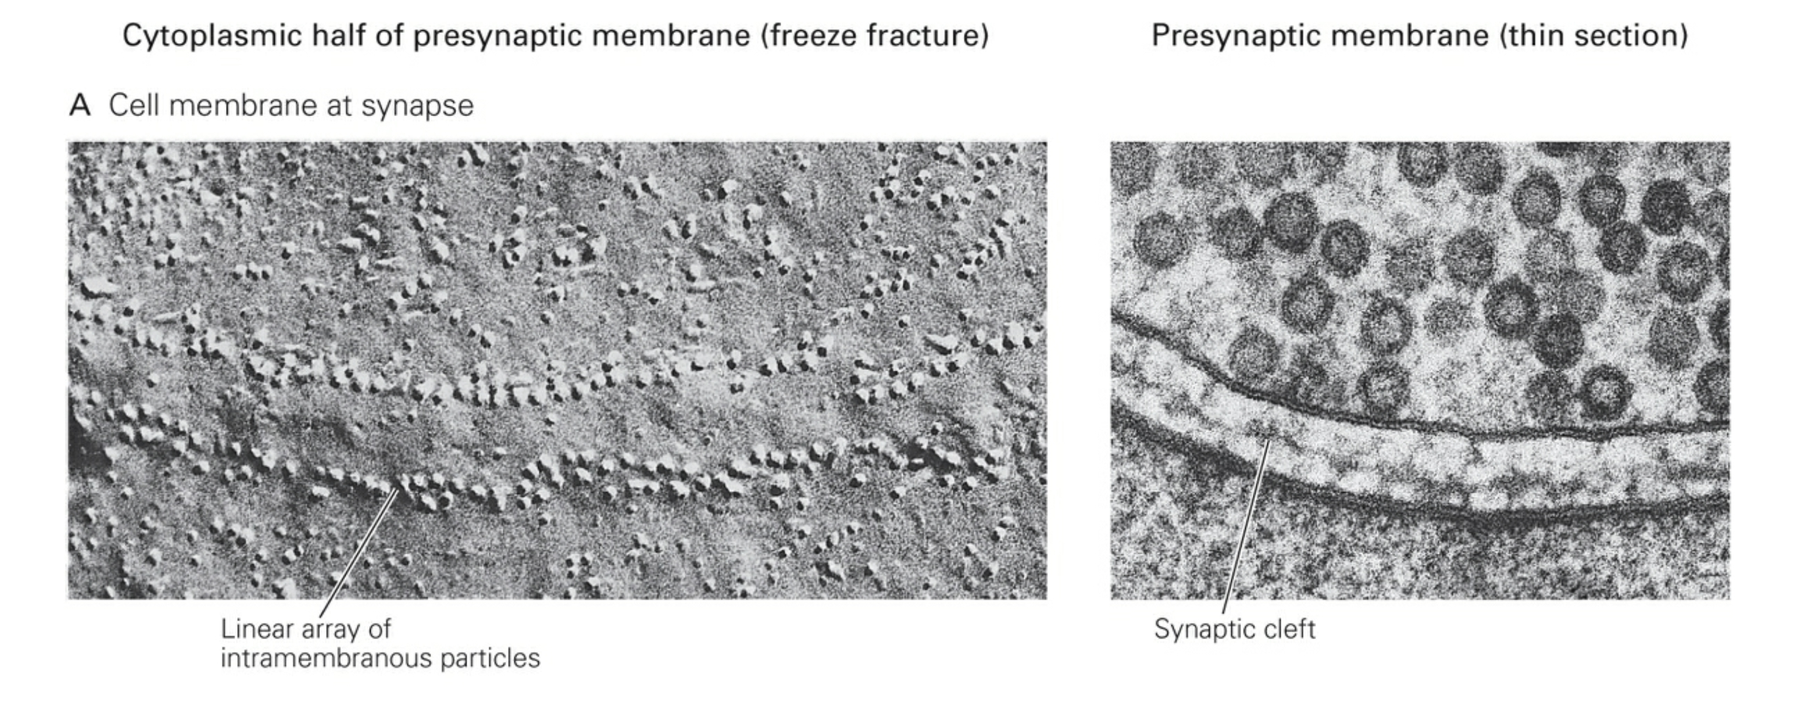
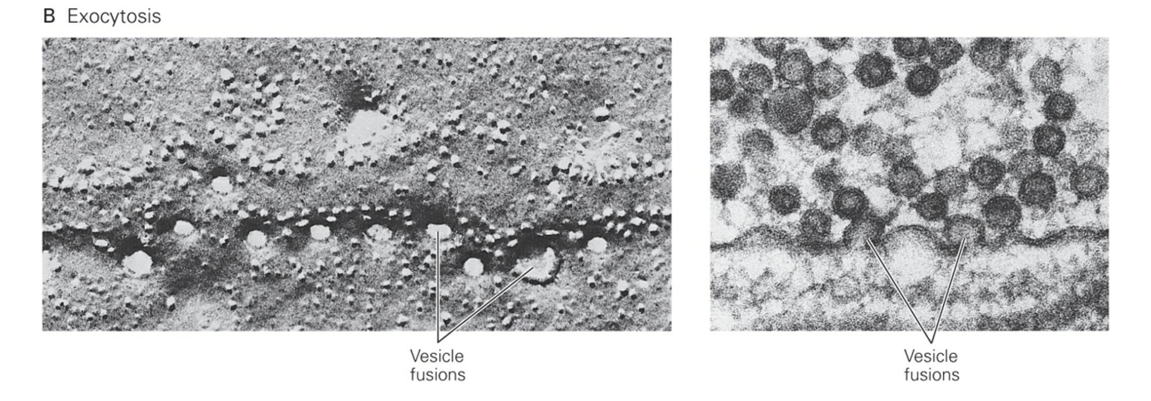
NMJ: You’re still the best!
(for helping us understanding chemical transmission)

Slide 30
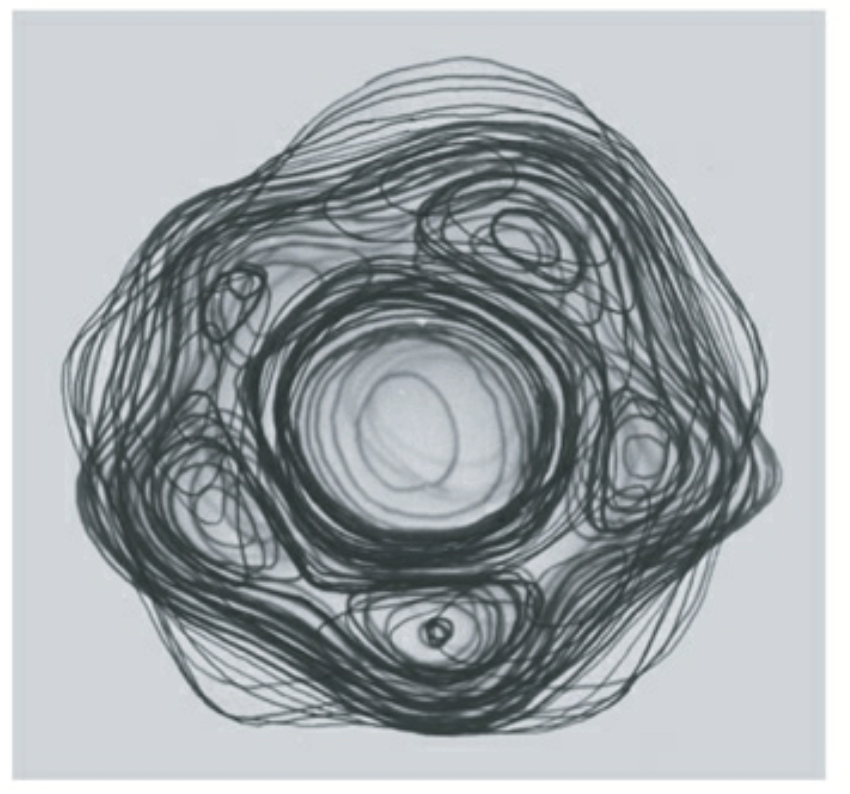
NMJ: You’re still the best!
(for helping us understanding chemical transmission)
Low-resolution structure of ACh receptor.
Looking down from the extracellular space.

Slide 31
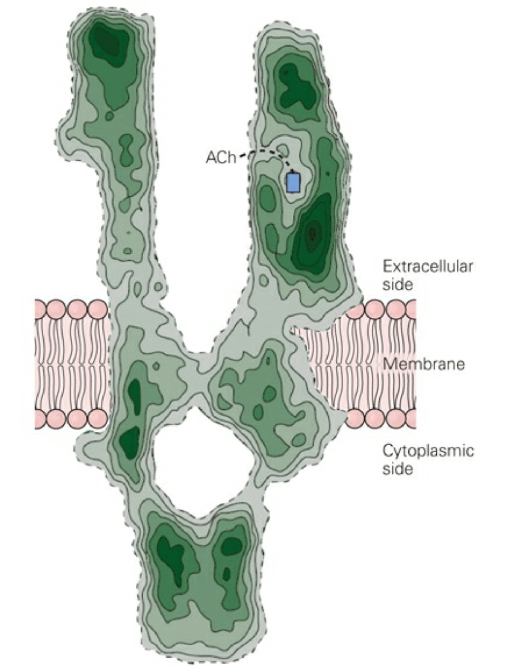
NMJ: You’re still the best!
(for helping us understanding chemical transmission)
Side view of receptor in membrane.

Slide 32
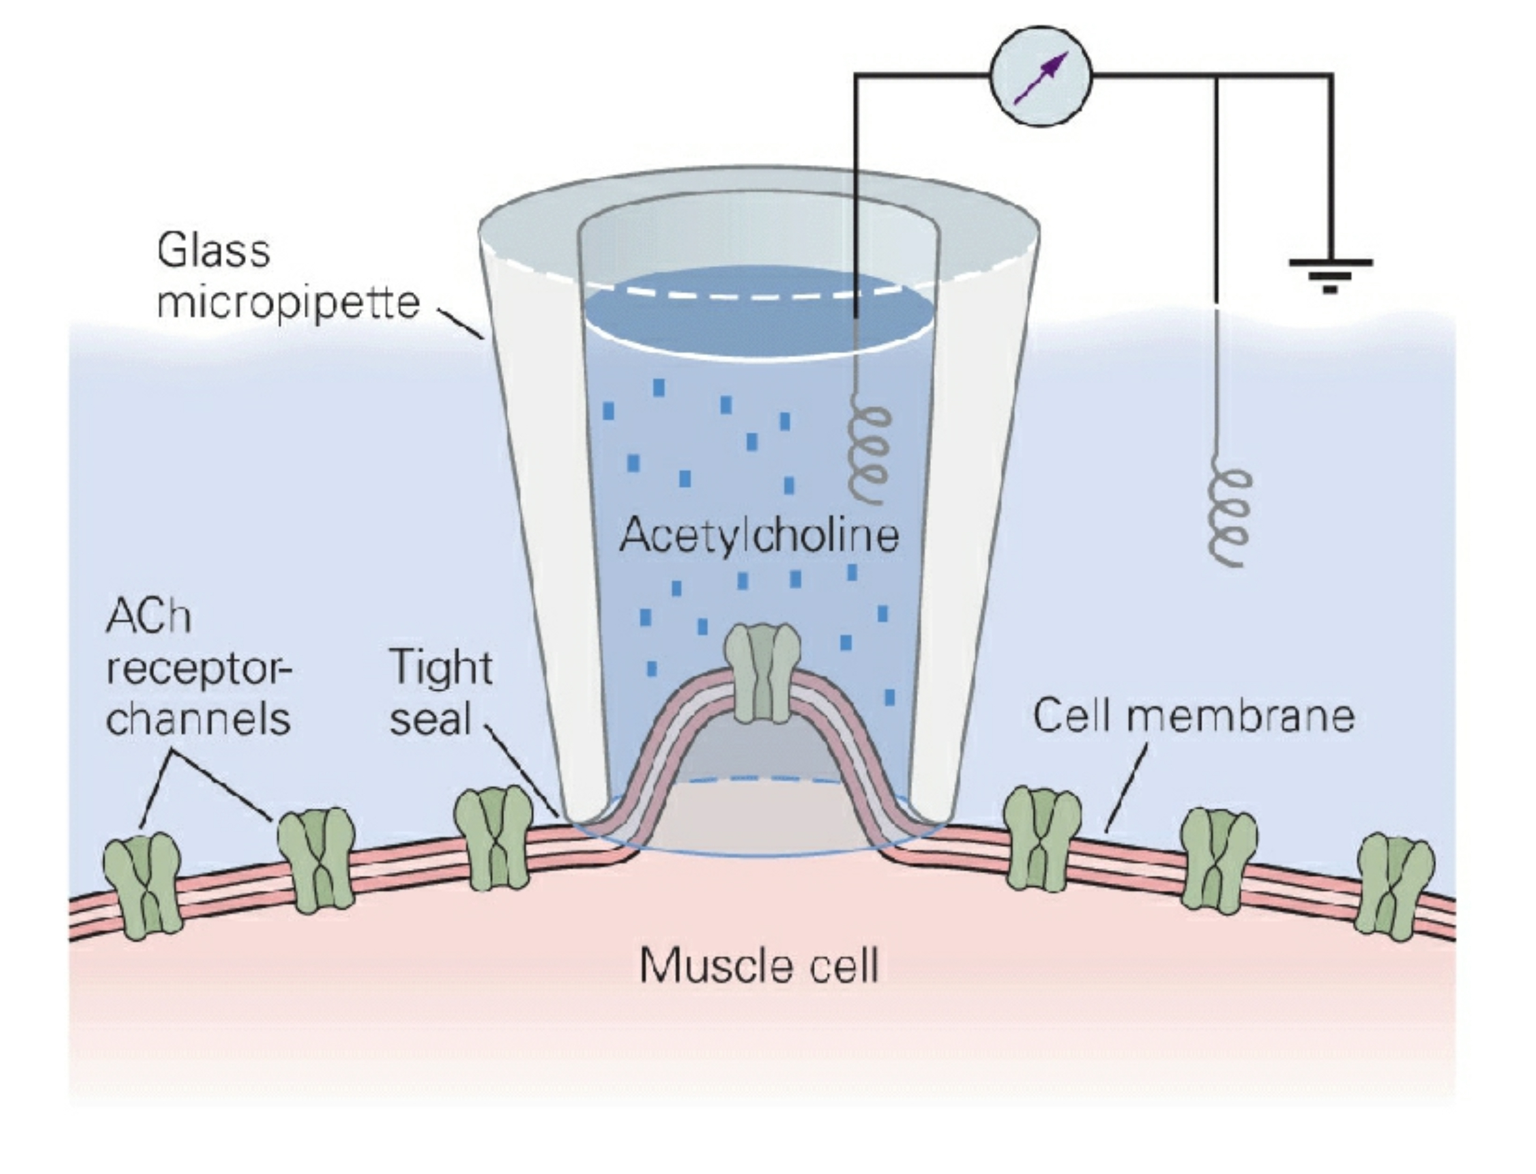
NMJ: You’re still the best!
(for helping us understanding chemical transmission)
Side view of receptor in membrane.

Slide 33
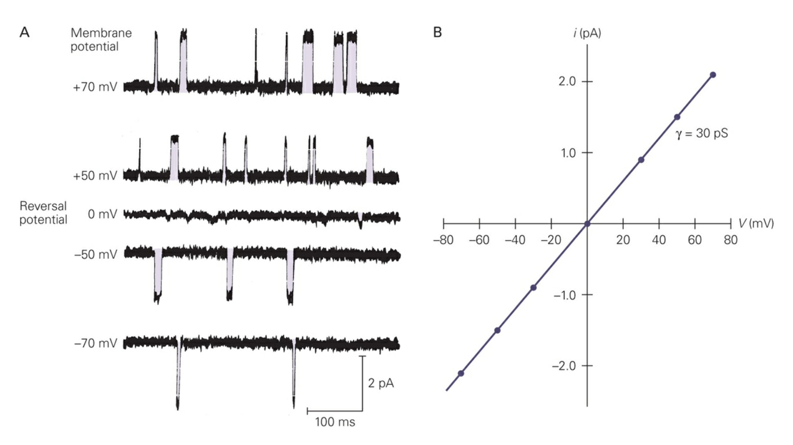
NMJ: You’re still the best!
(for helping us understanding chemical transmission)
Side view of receptor in membrane.

Slide 34
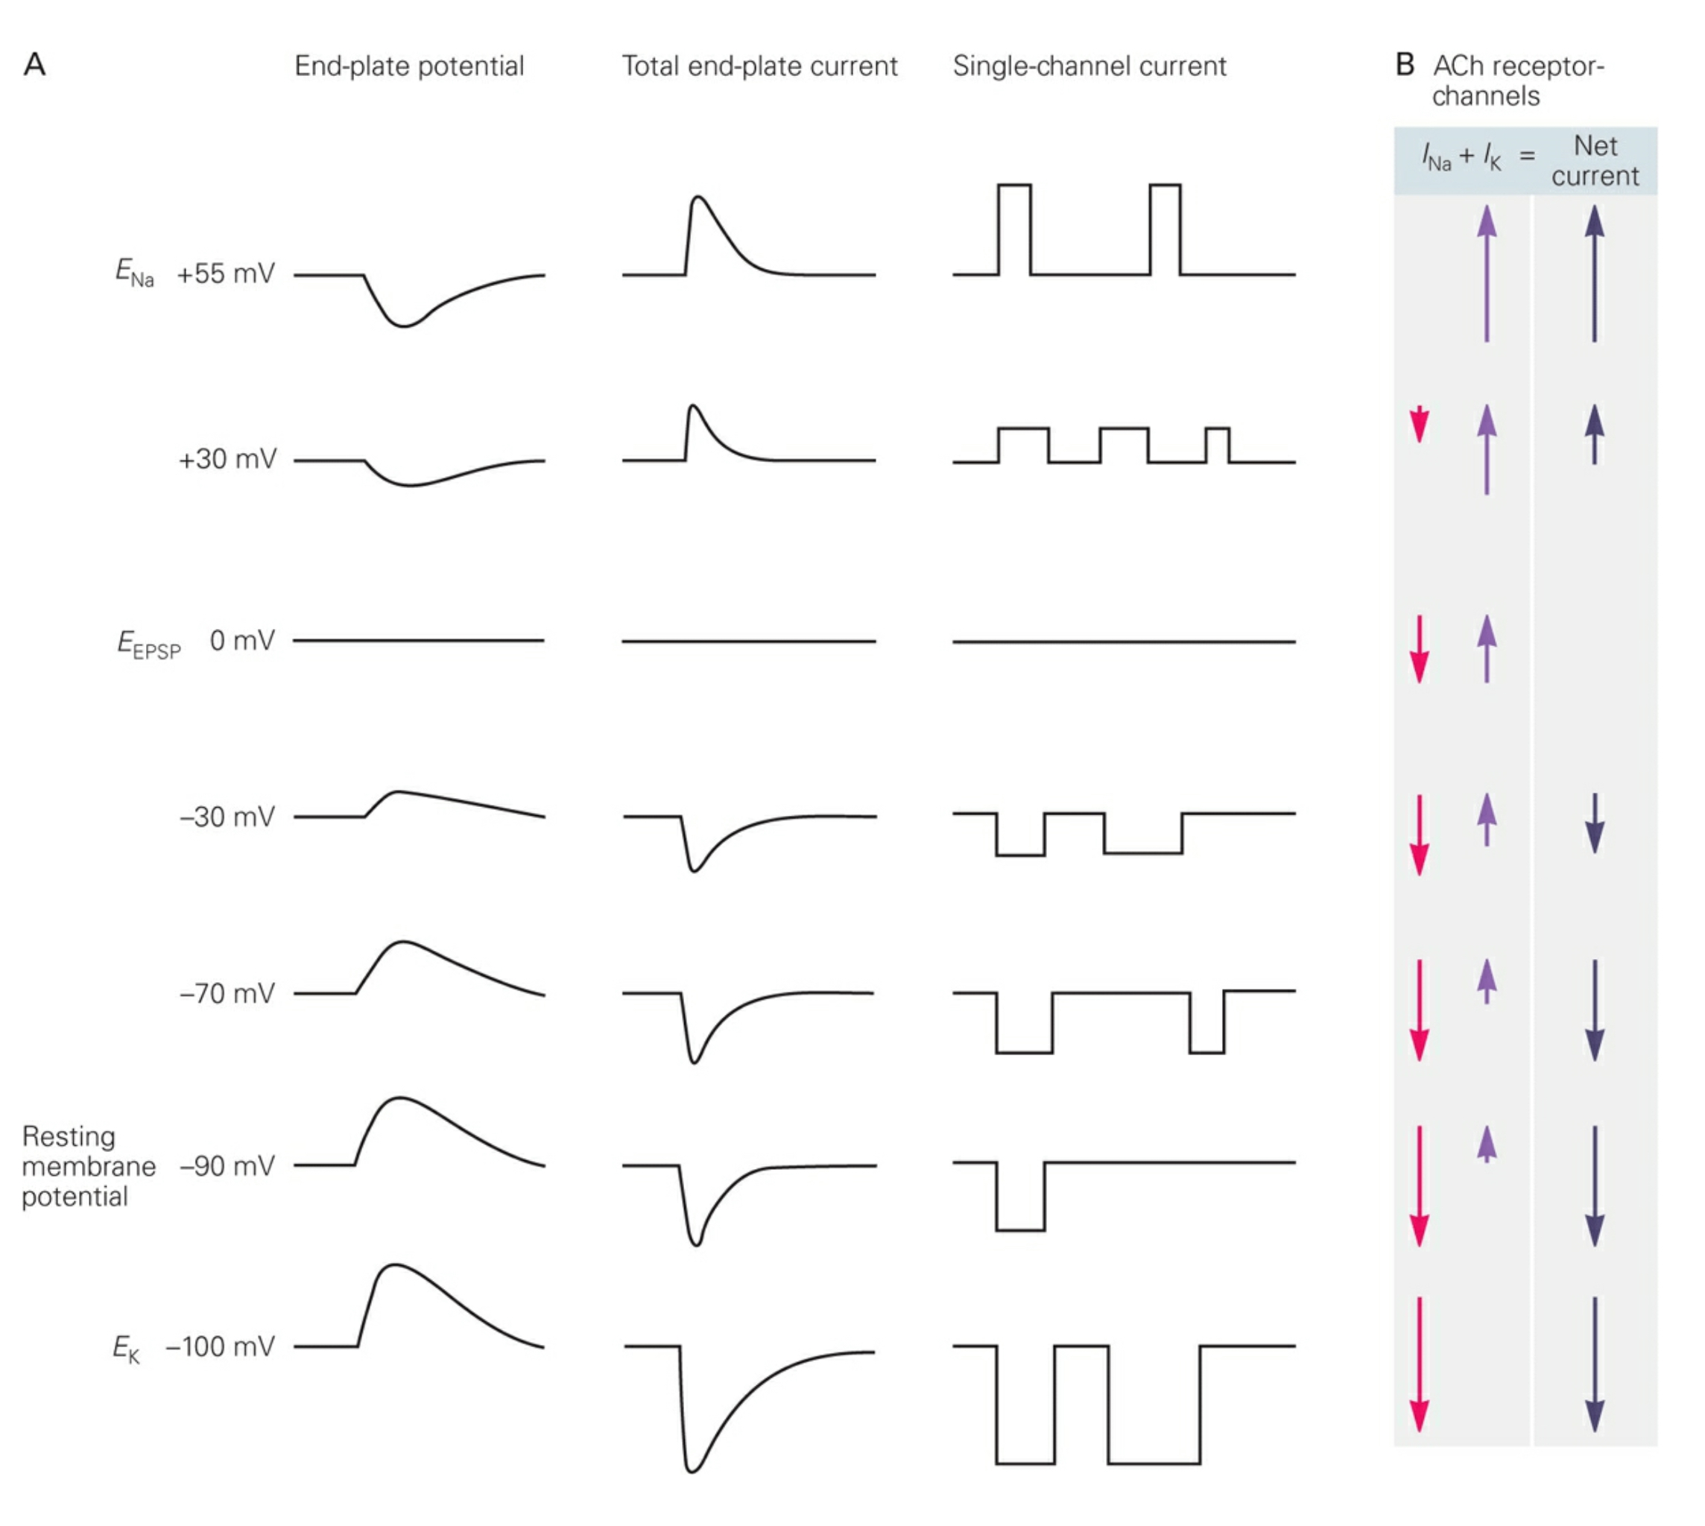
NMJ: You’re still the best!
(for helping us understanding chemical transmission)
Side view of receptor in membrane.

Slide 35
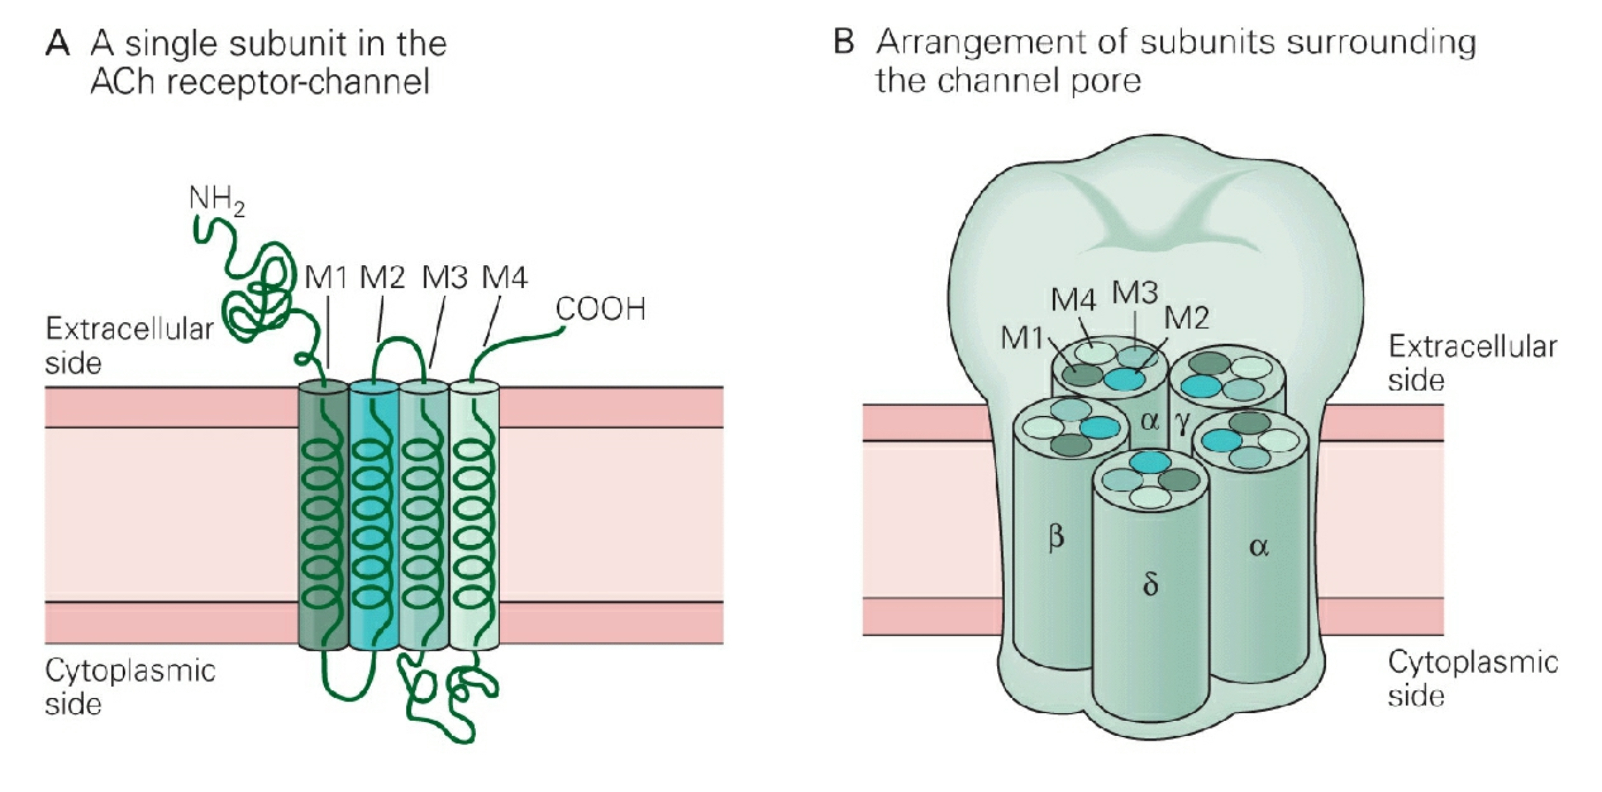
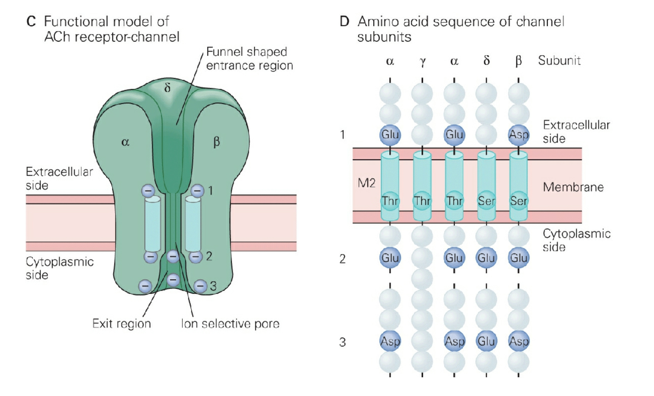
NMJ: You’re still the best!
(for helping us understanding chemical transmission)
Side view of receptor in membrane.
Notes:
M1-M4: 4 membrane spanning alpha helixes. N terminus contains ACh binding site. M2 segment forms the pore.

Slide 36
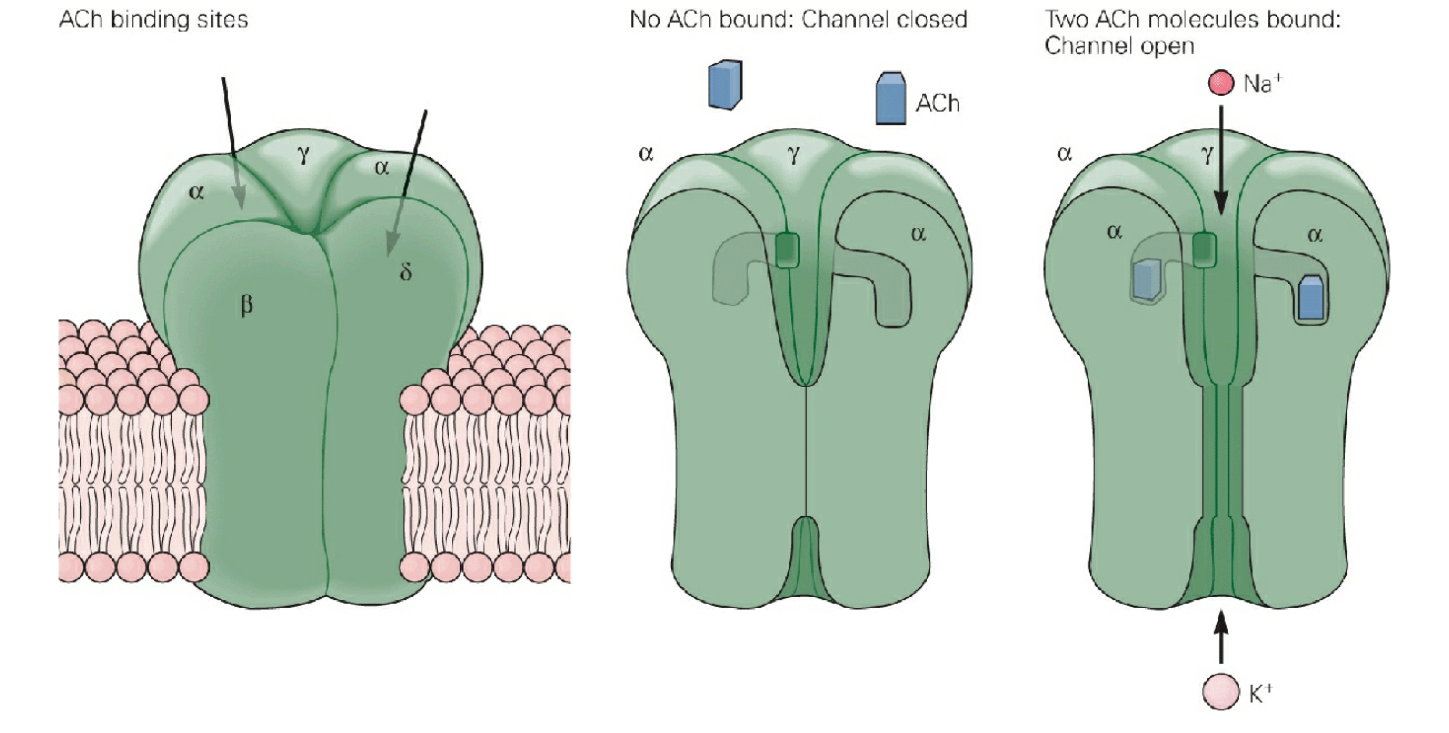
NMJ: You’re still the best!
(for helping us understanding chemical transmission)
Notes:
M1-M4: 4 membrane spanning alpha helixes. N terminus contains ACh binding site. M2 segment forms the pore.

Slide 37

NMJ: You’re still the best!
(for helping us understanding chemical transmission)
Notes:
M1-M4: 4 membrane spanning alpha helixes. N terminus contains ACh binding site. M2 segment forms the pore.

Slide 38
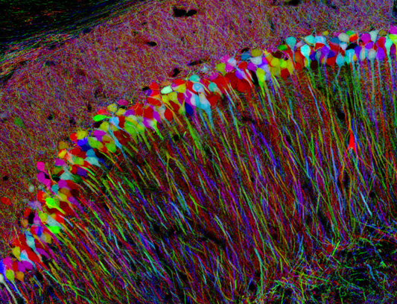
But sorry,NMJ:
You’re simply not that interesting!

Slide 39
Outline
Gap Junctions: direct electrical connections.
Chemical Transmission.
Ionotropic VS Metabotropic
The Neuromuscular Junction (NMJ): cholinergic transmission
Central synapses
Excitatory transmission

Slide 40
Central Synapses
More complicated.
Muscles are innervated by only one motor neuron. Central neurons can receive hundreds-thousands of inputs.
Muscles are only excited. Central neurons can be excited and inhibited.
NMJ’s only got one transmitter: ACh. Many transmitters in the brain.

Slide 41
Central Synapses
John Eccles
Notes:
Stretch reflex

Slide 42
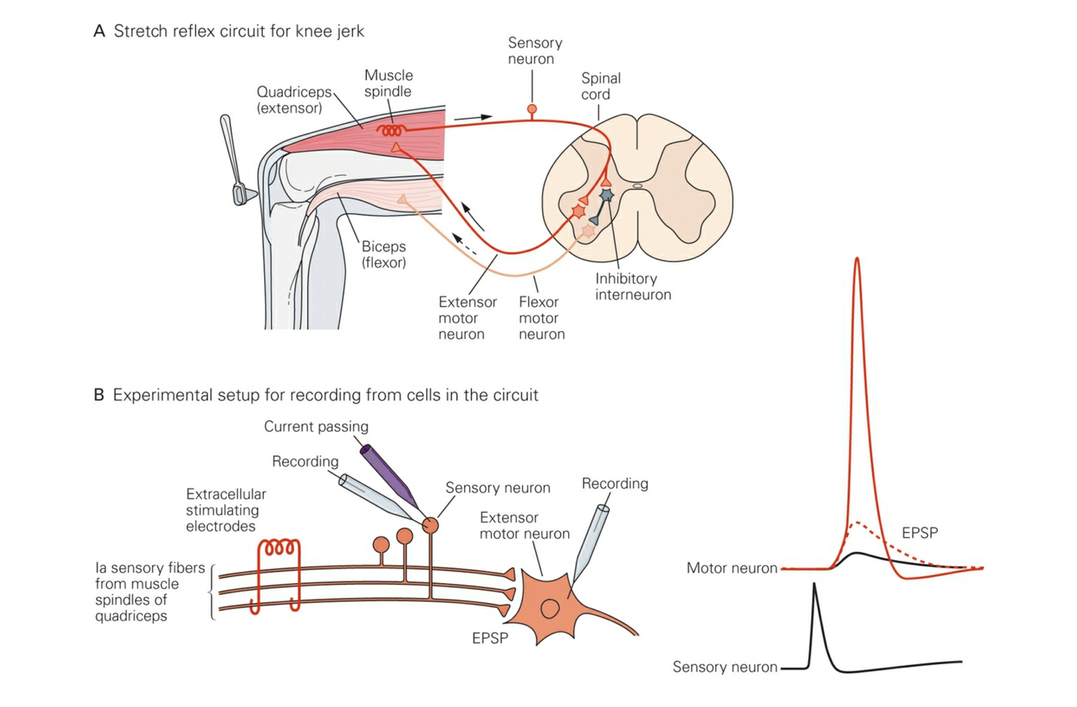
Stretch Reflex: Excitation & Inhibition
Notes:
Stretch reflex

Slide 43
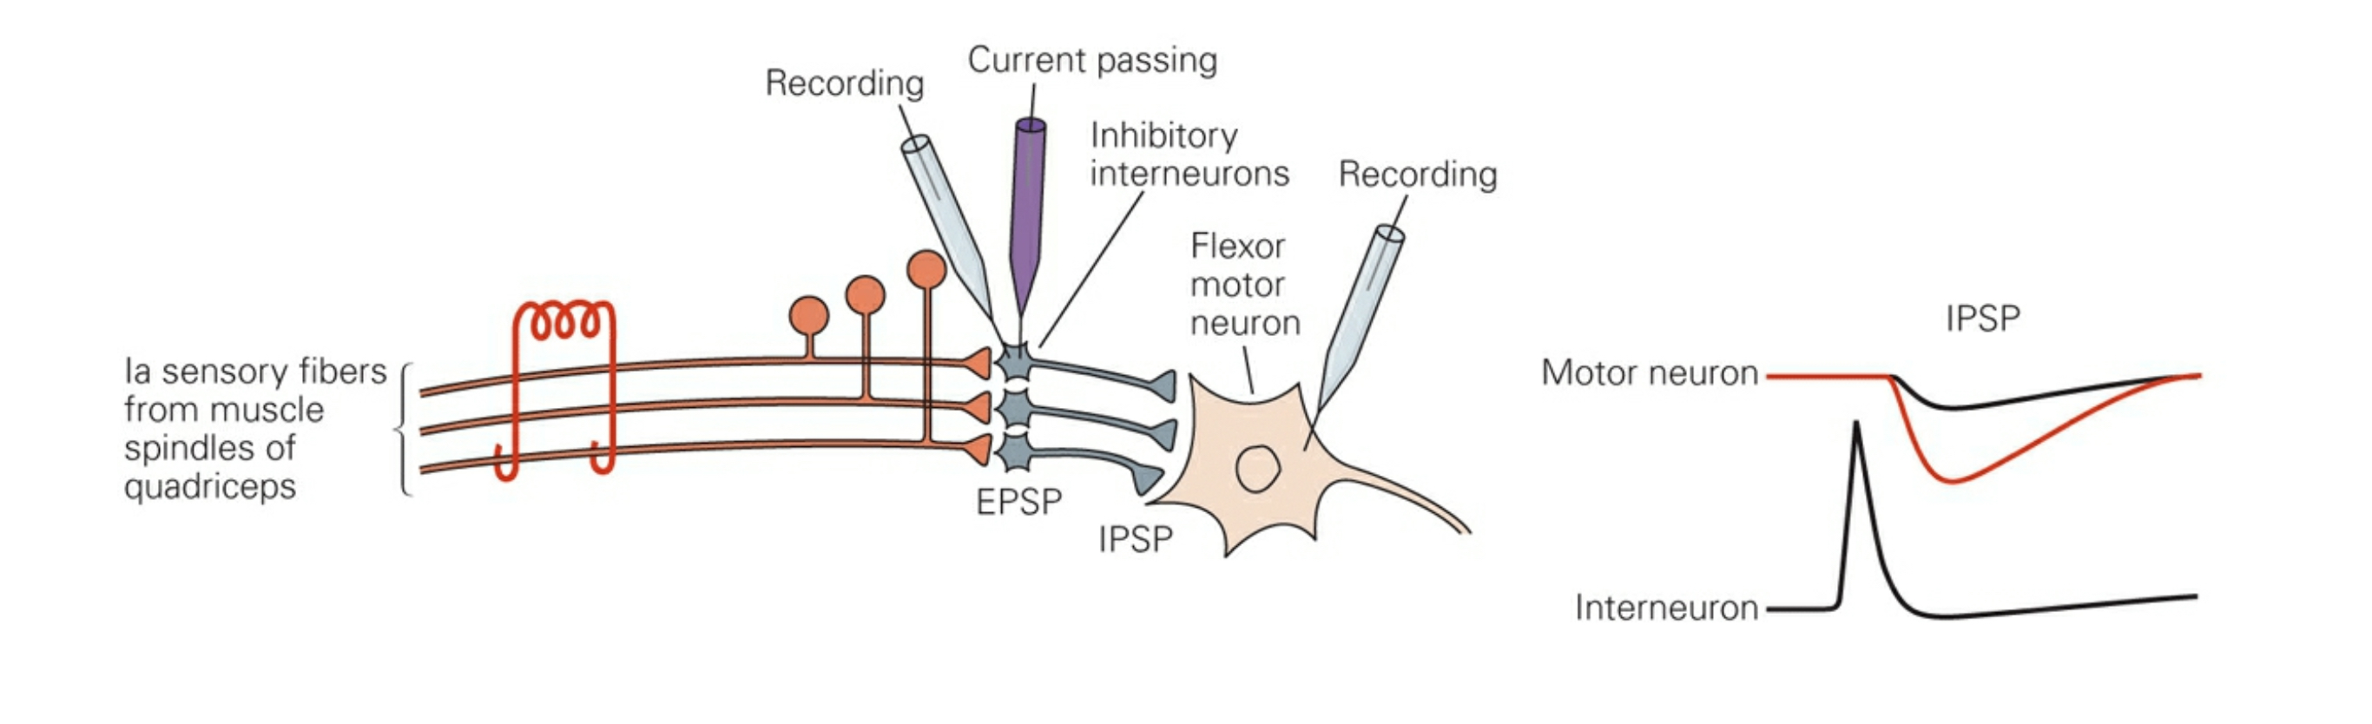
Stretch Reflex: Excitation & Inhibition
Notes:
Stretch reflex

Slide 44
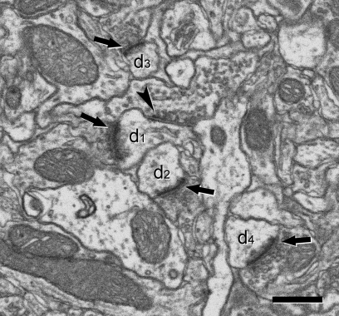
Excitatory VS Inhibitory: Structural Differences

Slide 45
Excitatory VS Inhibitory: Structural Differences
Symmetric VS Asymmetric Synapses
Also called Gray Type I & Type II.
Most asymmetric synapses are glutamatergic (i.e. excitatory).
Round synaptic vesicles
Electron-dense region at the active zone (presynaptic region).
Even larger electron-dense region in PSD.
Most symmetric synapses are GABAergic (i.e. inhibitory).
Oval/flattened synaptic vesicles.
Less obvious presynaptic membrane specializations and PSD.

Slide 46
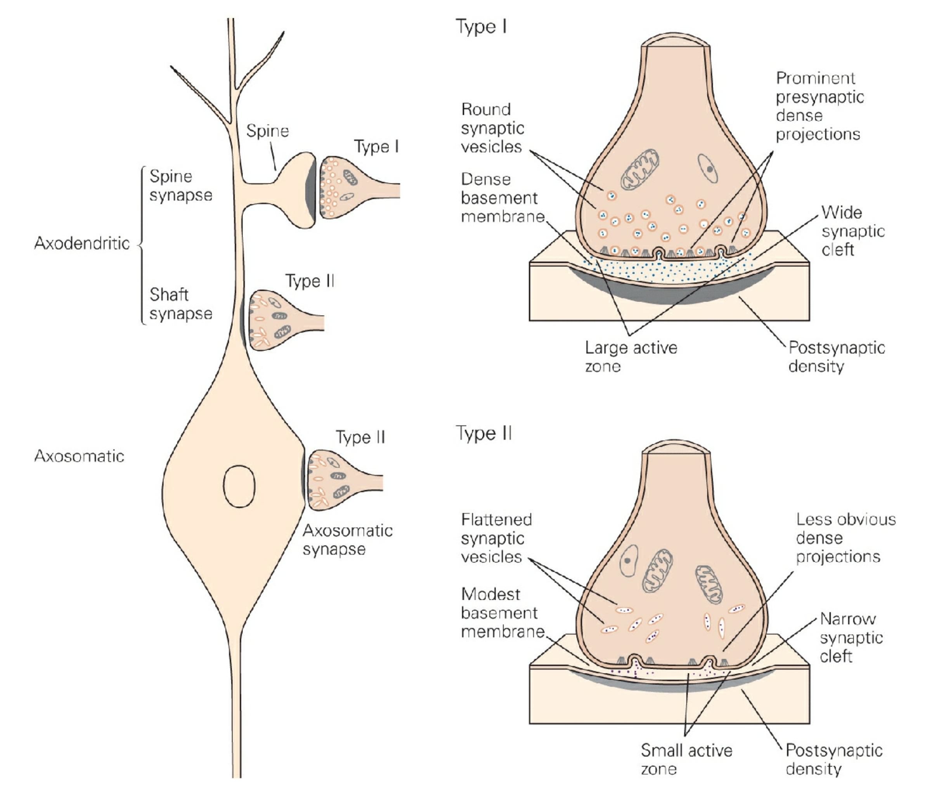
Excitatory VS Inhibitory: Structural Differences
Symmetric VS Asymmetric Synapses
Also called Gray Type I & Type II.
Most asymmetric synapses are glutamatergic (i.e. excitatory).
Round synaptic vesicles
Electron-dense region at the active zone (presynaptic region).
Even larger electron-dense region in PSD.
Most symmetric synapses are GABAergic (i.e. inhibitory).
Oval/flattened synaptic vesicles.
Less obvious presynaptic membrane specializations and PSD.

Slide 47
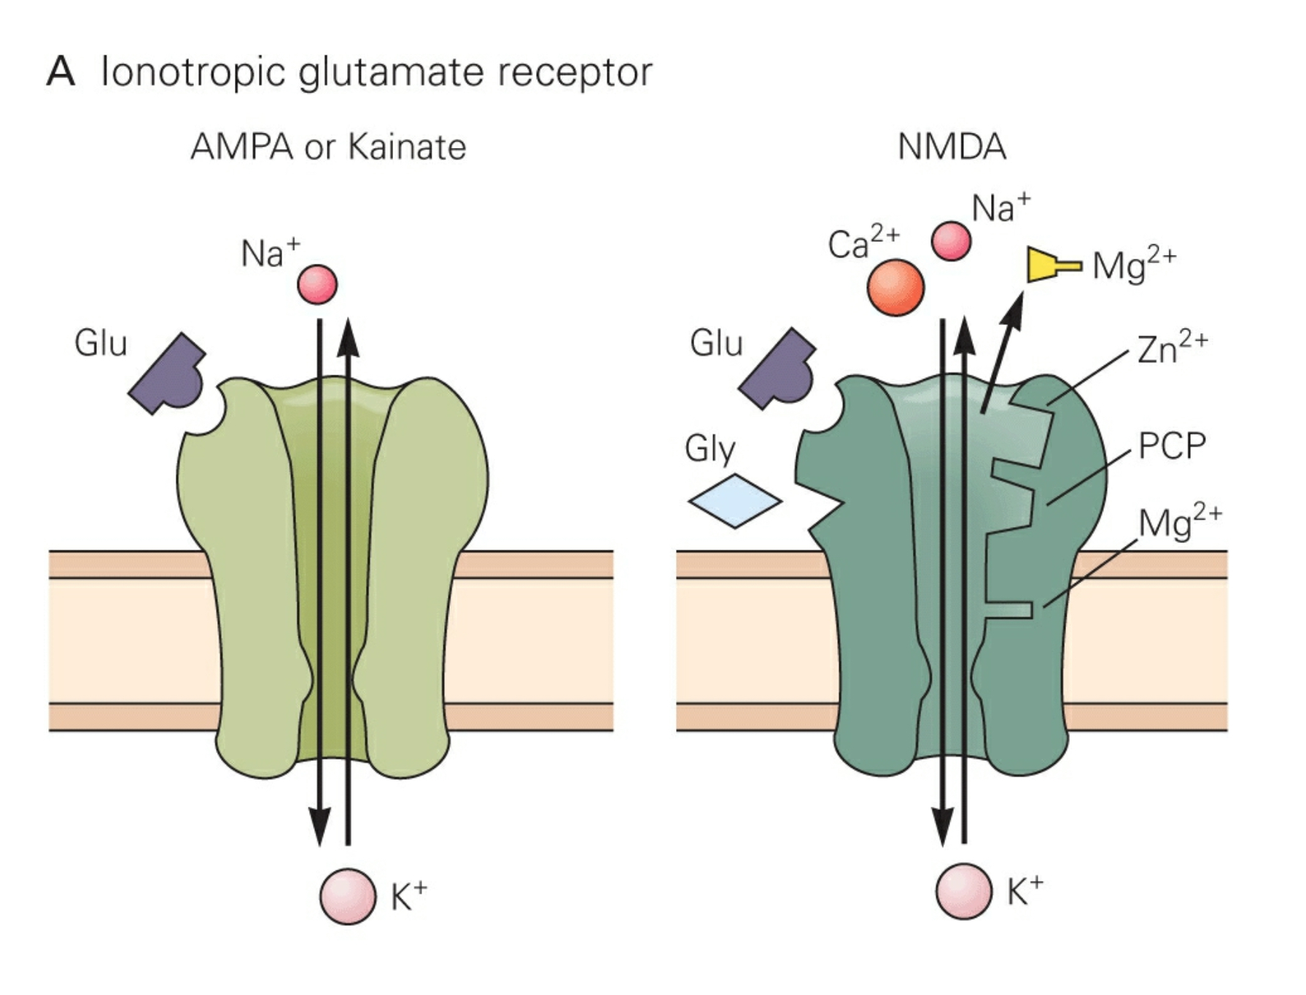
Glutamate Receptors
Ionotropic
Metabotropic

Slide 48
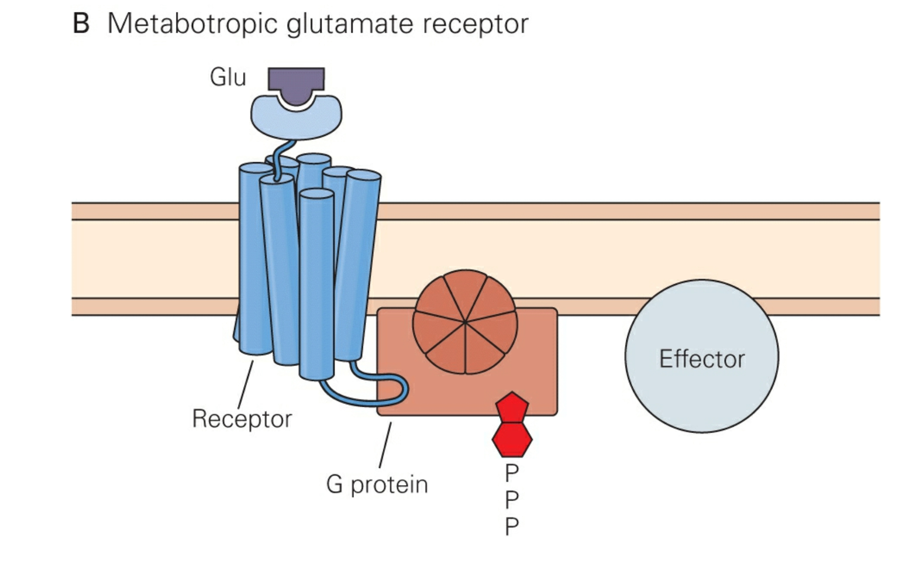
Glutamate Receptors
Ionotropic
Metabotropic
Always Excitatory!
Excitatory or Inhibitory!

Slide 49
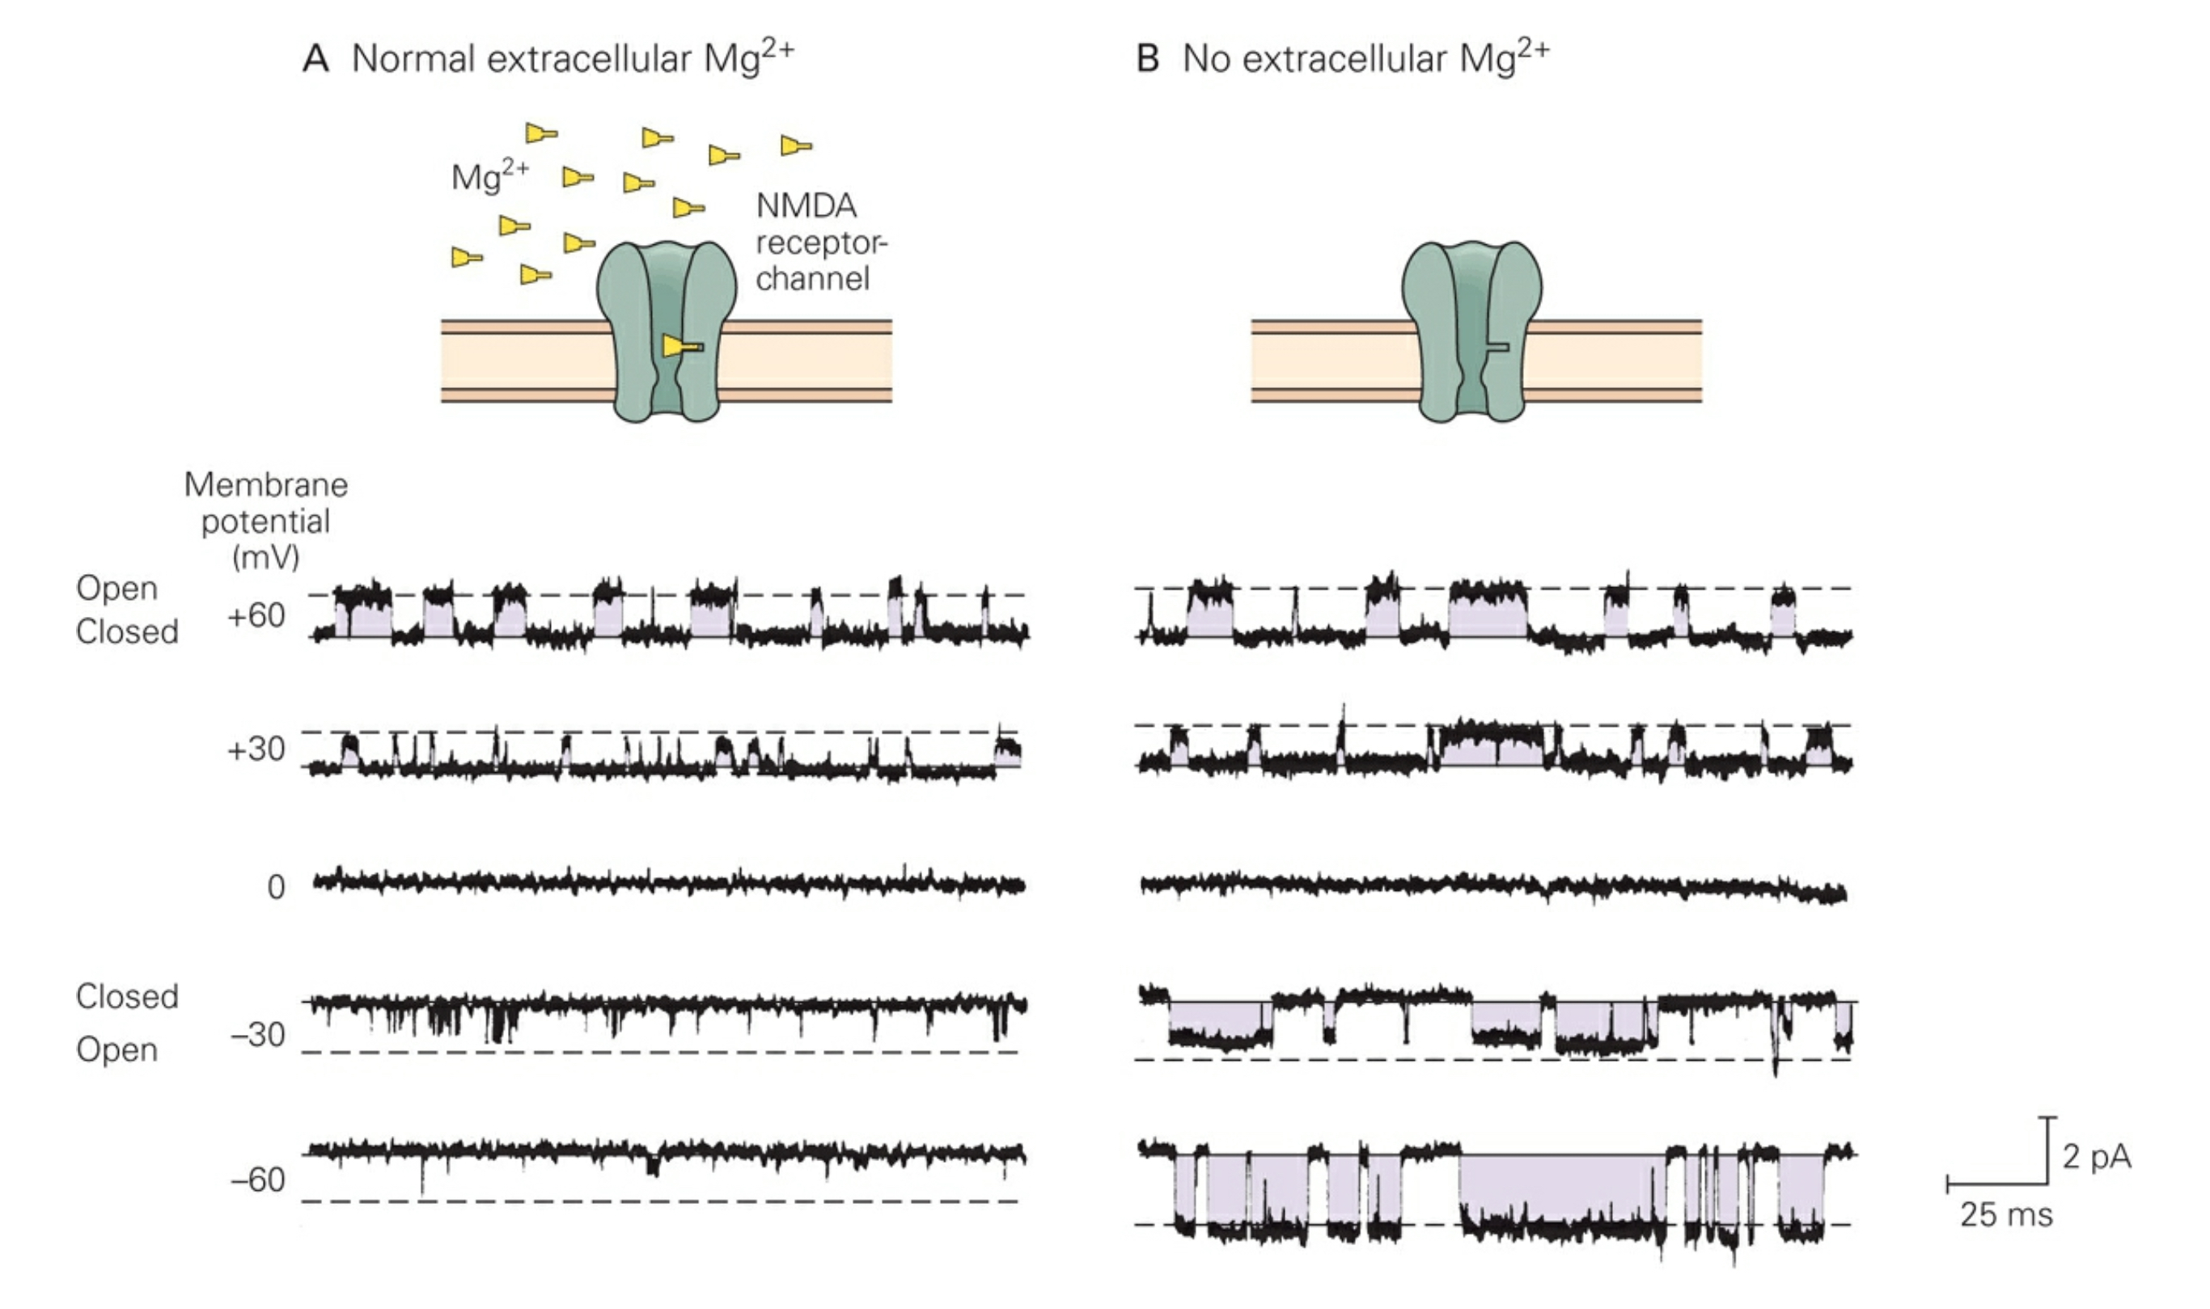
Glutamate Receptors: NMDAR
Ionotropic
Always Excitatory!
Notes:
Extracellular glycine usually sufficient to allow NMDA receptor to be activated efficiently by glutamate

Slide 50
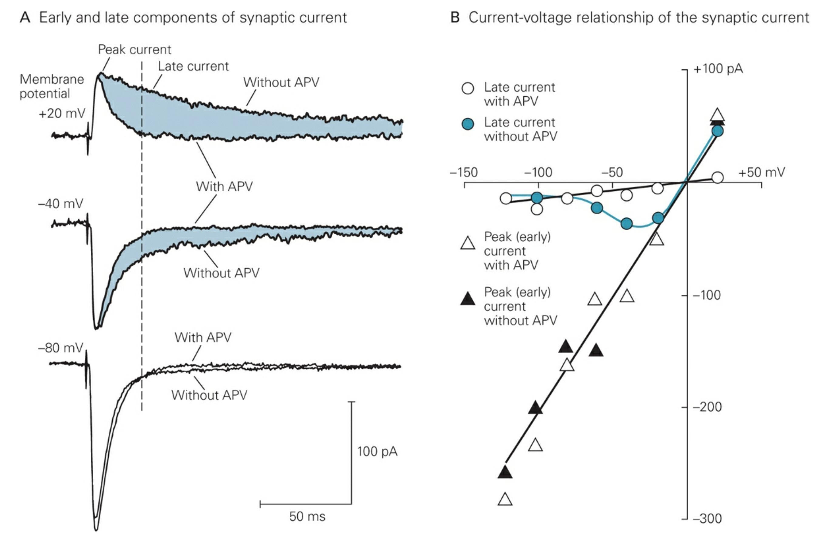
Glutamate Receptors: NMDAR
Ionotropic
Pop Quiz!
Always Excitatory!
Notes:
Extracellular glycine usually sufficient to allow NMDA receptor to be activated efficiently by glutamate

Slide 51
Glutamate Receptors: NMDAR
Ionotropic
Always Excitatory!
Notes:
Extracellular glycine usually sufficient to allow NMDA receptor to be activated efficiently by glutamate

Slide 52
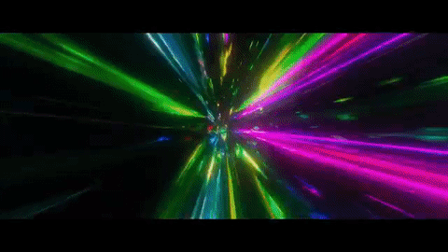
Glutamate Receptors: NMDAR
Ionotropic
Glutamate Toxicity
High intracellular [Ca²⁺] can activate Ca²⁺-dependent proteases & phospholipases that produce excessive toxic free radicals!
Always Excitatory!
Notes:
Extracellular glycine usually sufficient to allow NMDA receptor to be activated efficiently by glutamate

Slide 53
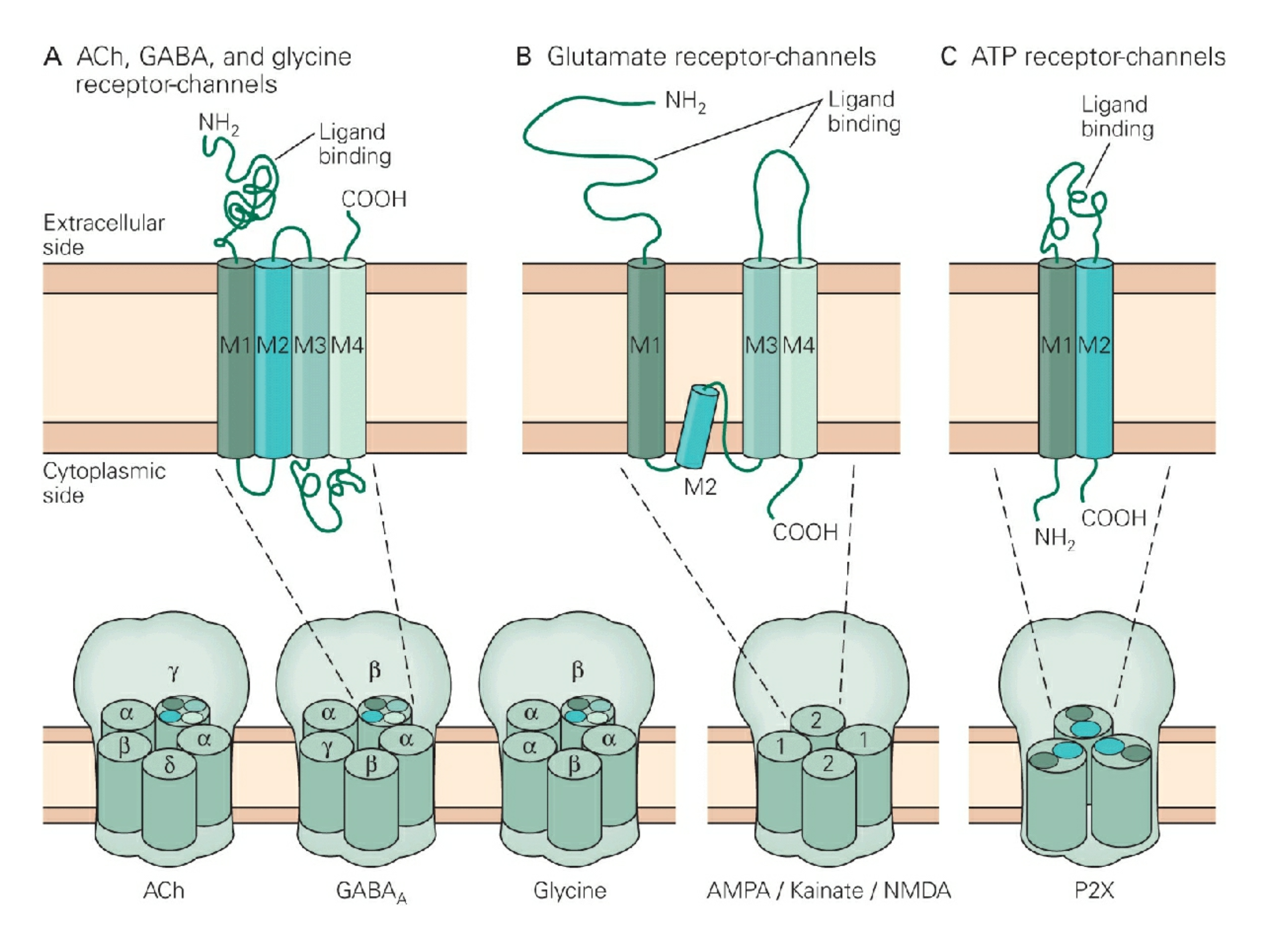
Glutamate Receptors: Structure
Notes:
Each subunit has 4 membrane spanning alpha helices

Slide 54
Glutamate Receptors: Structure

Slide 55
Glutamate Receptors: Structure

Slide 56
Glutamate Receptors: Structure

Slide 57
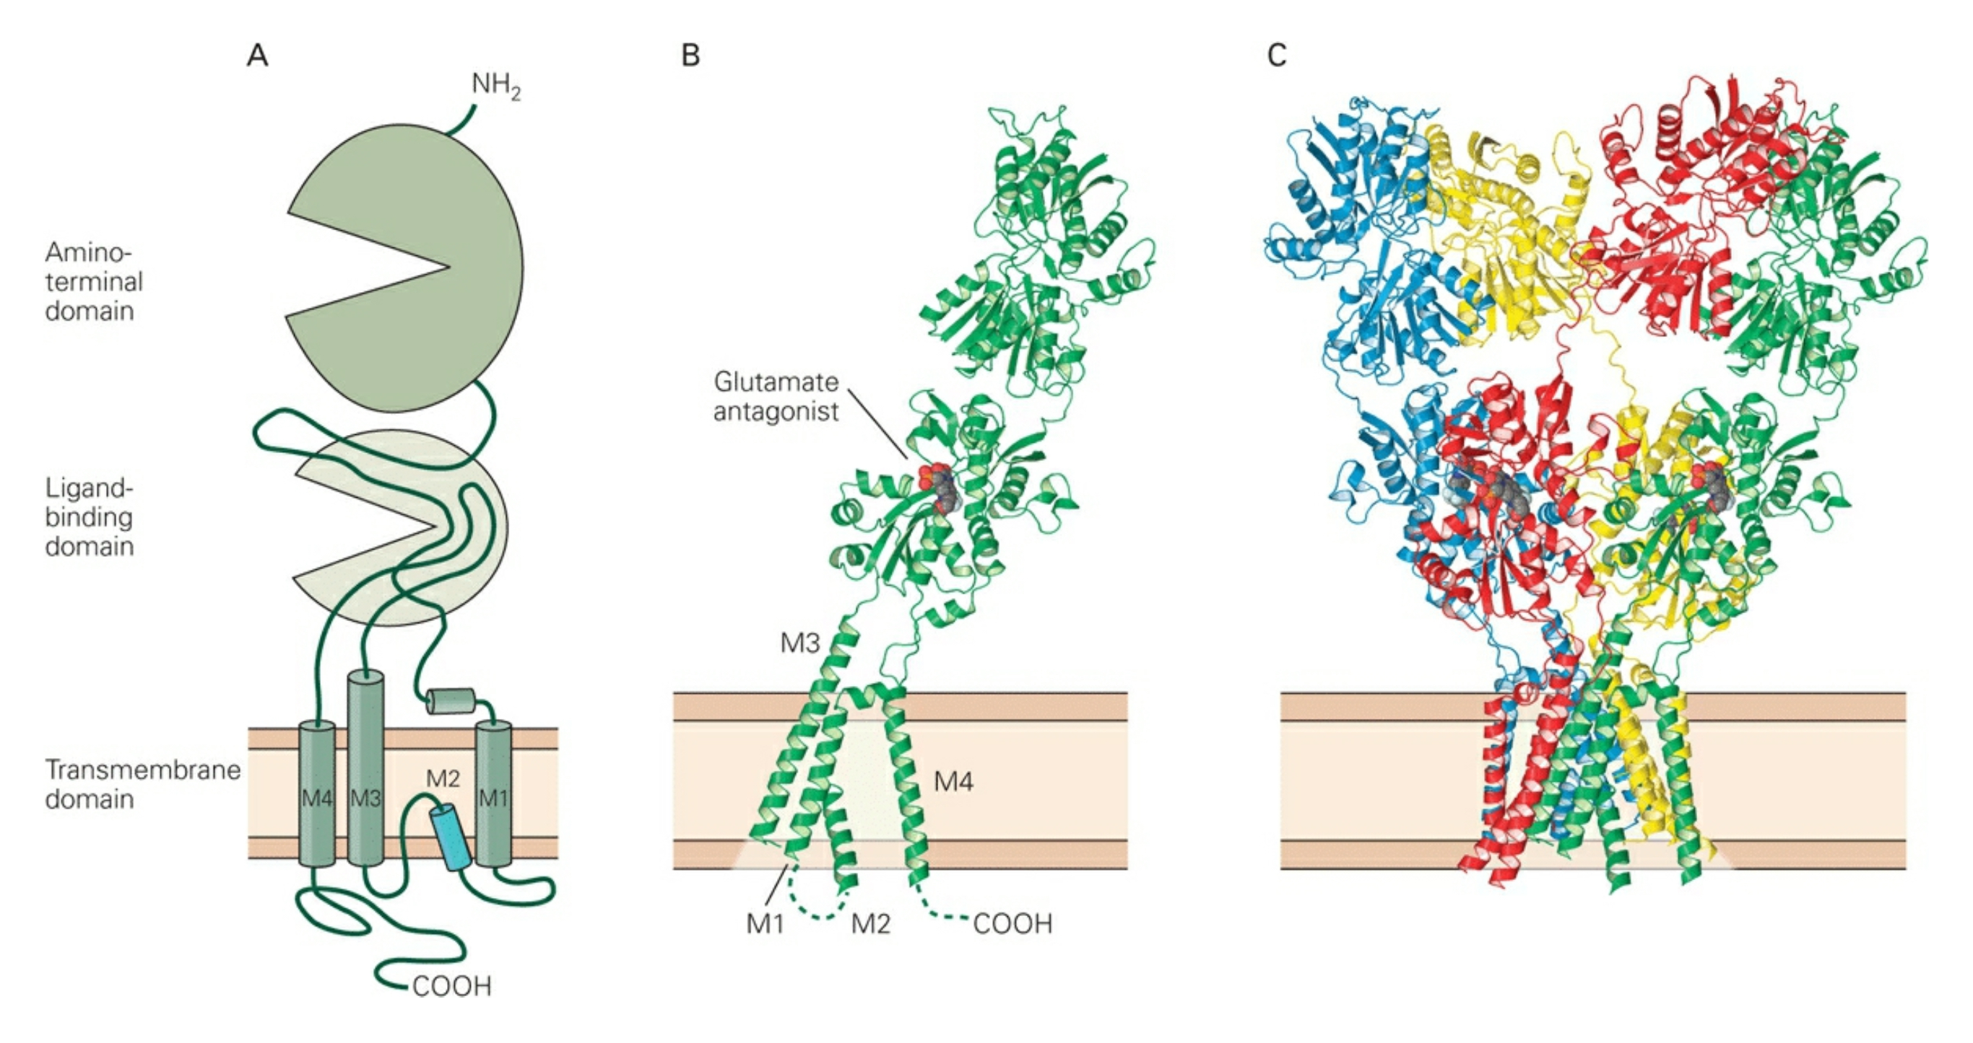
Glutamate Receptors: Structure
Structure
Tetrameric proteins: 4 subunits arranged around central pore.
AMPAR subunits encoded by 4 separate genes: GluA1-GluA4.
KAR subunits encoded by 5 separate genes: GluK1-GluK5.
Most AMPARs & KARs are heteromers.
NMDARs are encoded by a family of 5 different genes: GluN1 & GluN2A-D. Each NMDAR contains 2 GLuN1 subunits and 2 of the GluN2 subunits
Notes:
Amino-terminal domain is homologous to the ligand binding domain, but it does not bind glutamate. The A-T domain is involved with subunit assembly and modulation of receptor function.
When ligand binds to the ligand binding domain, the lobes of the clamshell shut and opens the channel. Competitive antagonists also bind to the LBD, but fail to close the lobes.

Slide 58
Glutamate Receptors: AMPAR
Ionotropic
Notes:
Extracellular glycine usually sufficient to allow NMDA receptor to be activated efficiently by glutamate

Slide 59
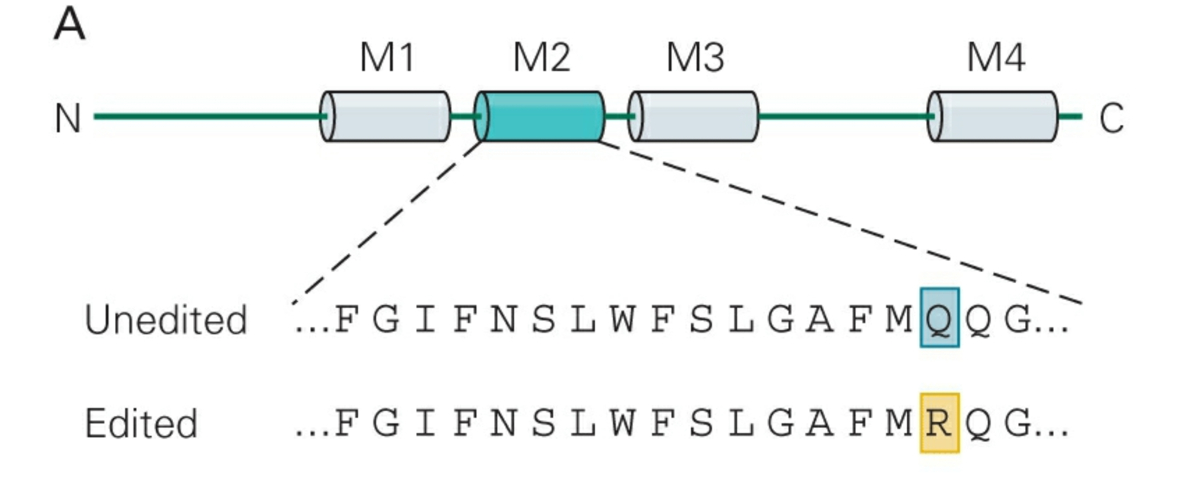
Glutamate Receptors: AMPAR
Ionotropic
Most AMPAR Subunits: Q
(uncharged)
GluA2: Subunit
(charged)
Pop Quiz!
Most AMPARs contain at least 1 GluA2 subunit
Notes:
Q: glutamine
R: arginine

Slide 60
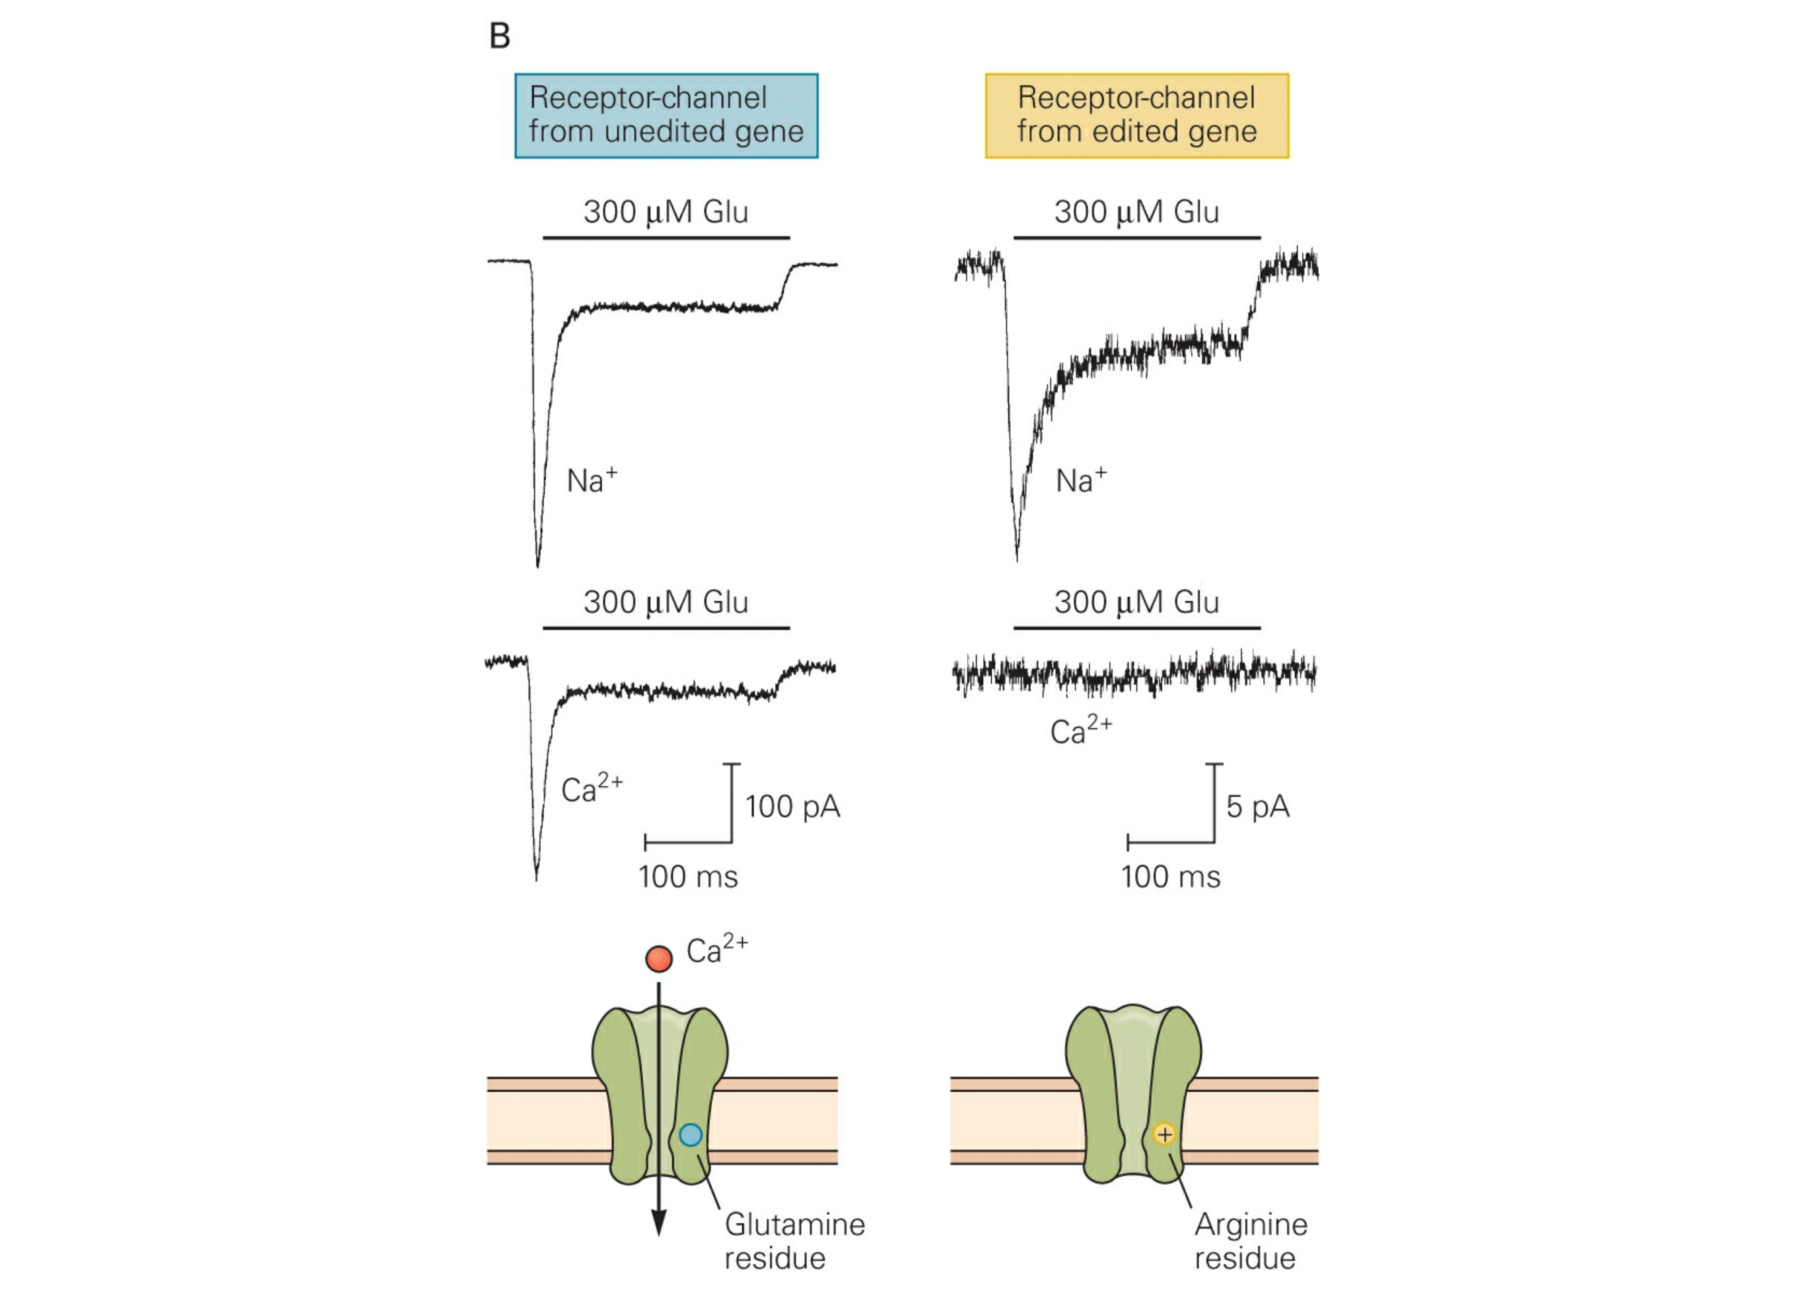
Glutamate Receptors: AMPAR
Ionotropic
Pop Quiz!
Notes:
Q: glutamine
R: arginine

Slide 61
Glutamate Receptors: AMPAR
Ionotropic
Pop Quiz!
Notes:
Q: glutamine
R: arginine
The GluA1 gene doesn’t actually encode for the R – it encodes for a Q. But the Q is replaced by an R in the GluA2 mRNA through RNA editing.

Slide 62
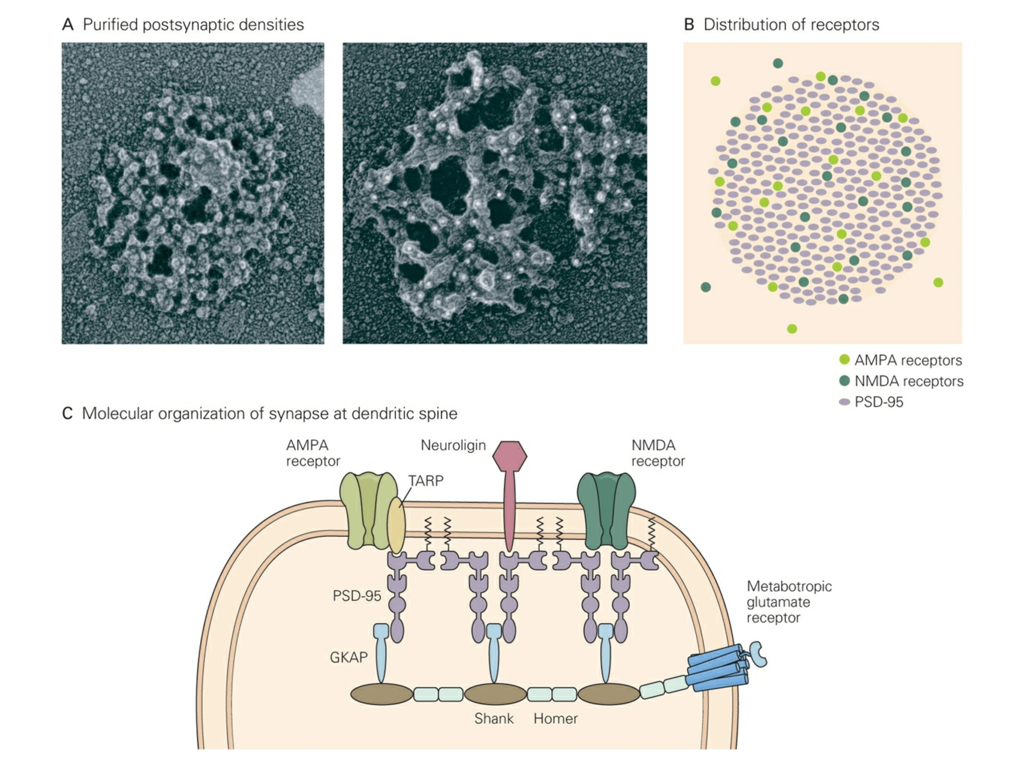
Glutamate Receptors: Synaptic Localization

Slide 63
Glutamate Receptors: Synaptic Localization
Notes:
PDZ domains: protein-protein interactions.

Slide 64

Inhibition
By far, inhibitory synapses are outnumbered by excitatory synapses.
Inhibition plays an important role in the nervous system: (1) prevent too much excitation, and (2) help coordinate activity among networks of neurons.
Mediated by GABA (mostly) & glycine.
Notes:
Both GABA & glycine opens chloride channels.
Eccles determined ionic mechanisms of inhibition (in spinal motor neurons)

Slide 65
Outline
Gap Junctions: direct electrical connections.
Chemical Transmission.
Ionotropic VS Metabotropic
The Neuromuscular Junction (NMJ): cholinergic transmission
Central synapses
Excitatory transmission
Inhibitory transmission

Slide 66
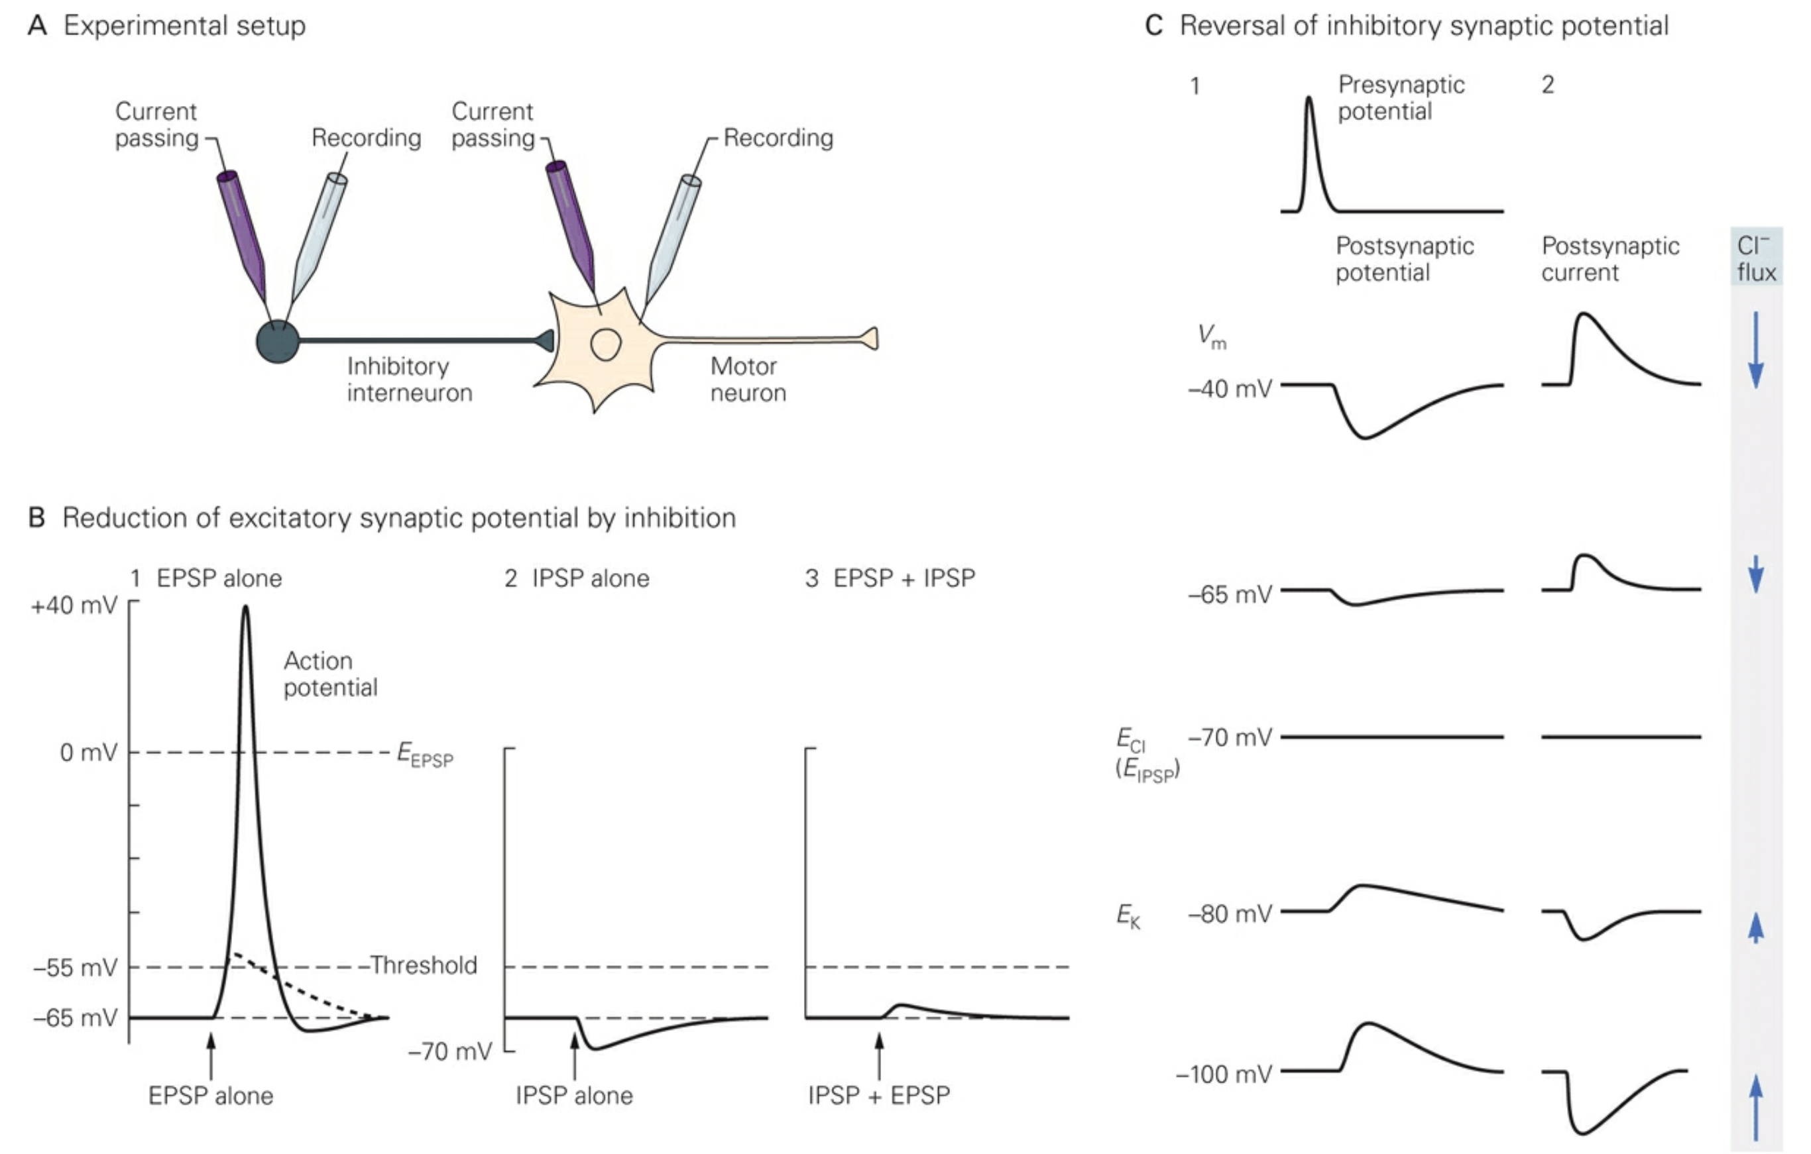
Inhibitory Synapse on Spinal Motor Neuron

Slide 67
Inhibitory Synapse on Spinal Motor Neuron

Slide 68
Inhibitory Synapse on Spinal Motor Neuron

Slide 69
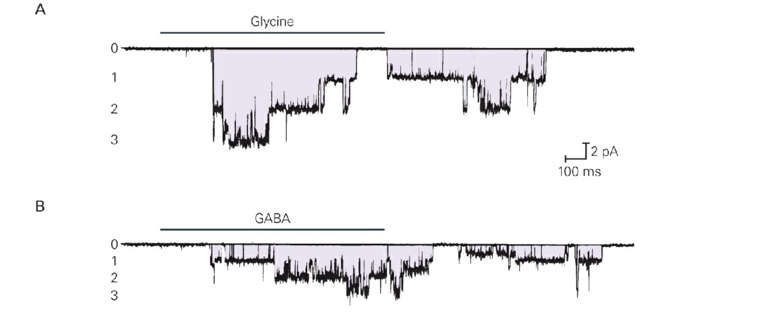
Glycine VS GABA Currents

Slide 70
Inhibitory Receptors: Structure

Slide 71

GABA_{A} Receptor
outside of neuron
inside of neuron

Slide 72

GABA_{A} Receptor
(from above)
5 subunits
(i.e. pentameric)
chloride pore

Slide 73




GABA_{A} Receptor
(from above)
5 subunits
(i.e. pentameric)
chloride pore
α
β
γ
δ
subunits

Slide 74

GABA_{A} Receptor
(from above)
5 subunits
(i.e. pentameric)
γ
α
β
β
α
chloride pore
α
β
γ
δ
subunits

Slide 75
GABA_{A} Receptor
(from above)
5 subunits
(i.e. pentameric)
γ
α
β
β
α
chloride pore
α
β
γ
δ
subunits

Slide 76



GABA_{A} Receptor
(from above)
5 subunits
(i.e. pentameric)
γ
GABA
binding
α
β
site
β
α
GABA
chloride pore
Inhibitory Current
20 pA
α
β
γ
δ
100 ms
subunits

Slide 77



GABA_{A} Receptor
(from above)
5 subunits
(i.e. pentameric)
BDZ
γ
GABA
benzo
binding
binding
α
β
site
site
β
α
GABA
chloride pore
Inhibitory Current
+ benzodiazepine
20 pA
20 pA
α
γ
100 ms
β
δ
100 ms
subunits

Slide 78








Allosteric Modulation
definition:
modulation achieved by binding of a drug to a site distinct
from the site required for activation.
- Rudolph & Knoflach, 2011
γ
BDZ
α
β
β
α
GABA
types:
GABA
positive (agonism)
0
benzodiazapines
0.5
Relative GABA-
negative (inverse agonism)
induced current
1.0
bCCE
antagonist (blocker)
2.0
- Rudolph & Knoflach, 2011
Flumazenil

Slide 79
Allosteric Modulation
definition:
modulation achieved by binding of a drug to a site distinct
from the site required for activation.
- Rudolph & Knoflach, 2011
γ
BDZ
α
β
β
α
GABA
types:
GABA
GABA
+ pos mod
positive (agonism)
0
benzodiazapines
0.5
Relative GABA-
negative (inverse agonism)
induced current
1.0
bCCE
antagonist (blocker)
2.0
- Rudolph & Knoflach, 2011
Flumazenil

Slide 80
Allosteric Modulation
definition:
modulation achieved by binding of a drug to a site distinct
from the site required for activation.
- Rudolph & Knoflach, 2011
γ
BDZ
α
β
β
α
GABA
types:
GABA
GABA
GABA
+ pos mod
+ neg mod
positive (agonism)
0
benzodiazapines
0.5
Relative GABA-
negative (inverse agonism)
induced current
1.0
bCCE
antagonist (blocker)
2.0
- Rudolph & Knoflach, 2011
Flumazenil

Slide 81
Allosteric Modulation
definition:
modulation achieved by binding of a drug to a site distinct
from the site required for activation.
- Rudolph & Knoflach, 2011
γ
BDZ
α
β
β
α
GABA
types:
GABA
GABA
GABA
GABA
+ pos mod
+ neg mod
+ antag
positive (agonism)
0
benzodiazapines
0.5
Relative GABA-
negative (inverse agonism)
induced current
1.0
bCCE
antagonist (blocker)
2.0
- Rudolph & Knoflach, 2011
Flumazenil

Slide 82
GABA_{A} Receptor
(from above)
5 subunits
(i.e. pentameric)
γ
GABA
benzo
binding
binding
α
β
site
site
β
α
chloride pore
Inhibitory Current
+ benzodiazapene
20 pA
α
β
γ
δ
100 ms
subunits

Slide 83
GABA_{A} Receptor
(from above)
5 subunits
(i.e. pentameric)
γ
GABA
benzo
binding
binding
α
β
site
site
β
α
chloride pore
Inhibitory Current
+ benzodiazapene
20 pA
α₁₋₆
β₁₋₃
γ₁₋₃
δ
100 ms
subunits

Slide 84
GABA_{A} Receptor
(from above)
5 subunits
(i.e. pentameric)
γ
GABA
benzo
binding
binding
α
β
site
site
β
α
chloride pore
Inhibitory Current
α₅
α₁
+ benzodiazapene
α₃
α₂
20 pA
other
α₁₋₆
β₁₋₃
γ₁₋₃
δ
100 ms
subunits

Slide 85








α Subunits and Selectivity
α₁
α₂
α₃
α₅
the good
the bad
Muscle
Anti-
Sedation
Anxiolysis
Relaxation
Convulsant
Amnesia
Addiction
Tan et al., 2011

Slide 86








α Subunits and Selectivity
α₁
α₂
α₃
α₅
α₁
α₂-selective agents
α₁-selective agents
α₂
non-sedating anxiolytics
20-fold higher affinity for
receptors containing a1
subunits
hopefully soon…
‘Z compounds’
technically non-benzos
good for insonmia
α₃
α₅
CH₃
O
H
O
Cl
O₂N
Cl
diazepam
clonazepam
benzodiazepine
imidazopyridine
(zolpidem)
Rudolph & Knoflach, 2011

Slide 87
GABA_{A} Receptor
(from above)
5 subunits
(i.e. pentameric)
γ
GABA
benzo
binding
binding
α
β
site
site
β
α
chloride pore
Inhibitory Current
+ benzodiazapene
20 pA
α₁₋₆
β₁₋₃
γ₁₋₃
δ
100 ms
subunits

Slide 88
Outline
Gap Junctions: direct electrical connections.
Chemical Transmission.
Ionotropic VS Metabotropic
The Neuromuscular Junction (NMJ): cholinergic transmission
Central synapses
Excitatory transmission
Inhibitory transmission
Neuroactive peptides

Slide 89


Peptides
Neuropeptides are packaged into large dense-core vesicles.

Slide 90
Peptides
Neuropeptides are packaged into large dense-core vesicles.
LDVs can contain both small-molecule transmitters and peptides.
Most neurons contain both small-molecule transmitters & peptides.
Released by exocytosis, similar to that observed in secretory glands.
Peptides derived from secretory proteins formed in the cell body.
Processed in ER/Golgi. Leave Golgi in secretory granules that become LDVs that travel to terminal via axonal transport.
Small-molecule transmitters: synthetic enzymes found in cytoplasm (generally).
Therefore, small-molecule transmitters can be formed in all parts of the neuron, importantly, the terminal.

Slide 91



Peptides

Slide 92
Outline
Gap Junctions: direct electrical connections.
Chemical Transmission.
Ionotropic VS Metabotropic
The Neuromuscular Junction (NMJ): cholinergic transmission
Central synapses
Excitatory transmission
Inhibitory transmission
Neuroactive peptides
Transcellular

Slide 93

Transcellular Messengers
Gaseous.
Nitric Oxide (NO) & Carbon Monoxide (CO)
Readily pass through cell membranes
Stimulate the synthesis of cGMP (2nd messenger).
Endocannabinoids
Derived from arachidonic acid
Activates CB1 & CB2 (GPCR). CB1 is the most abundant GPCR in the brain.

Slide 94
Outline
Gap Junctions: direct electrical connections.
Chemical Transmission.
Ionotropic VS Metabotropic
The Neuromuscular Junction (NMJ): cholinergic transmission
Central synapses
Excitatory transmission
Inhibitory transmission
Neuroactive peptides
Transcellular

