Slide 1
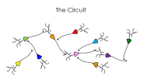
The Synapse
receptors
vesicle
pre
post

Slide 2
The Circuit

Slide 3
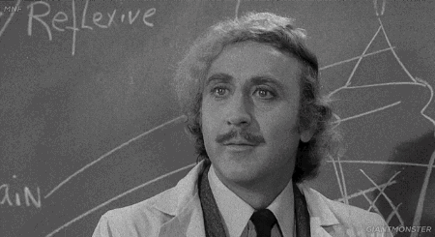

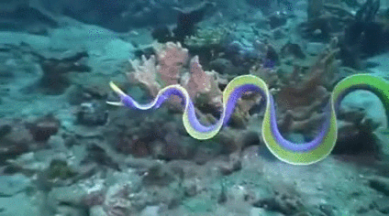

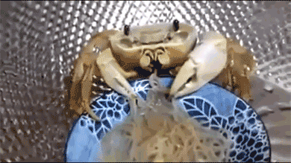
Rhythmically Active Neural Circuits
locomotion
respiration
feeding
thinking

Slide 4
Neural Circuit Building Blocks
What Does it Take to Understand?
Membrane Properties
Circuit Properties
channels
connections
neuron

Slide 5
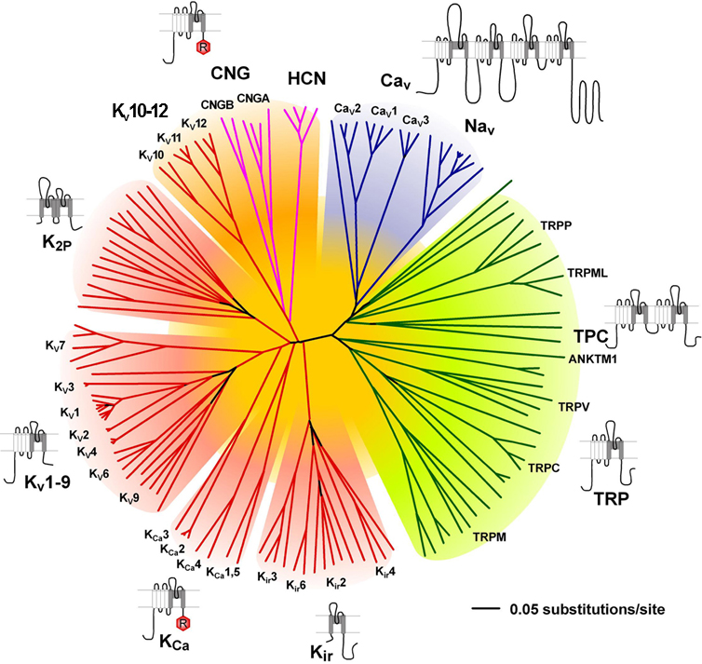
Neural Circuit Building Blocks
What Does it Take to Understand?
Membrane Properties
Ion Channels
channels
neuron

Slide 6
Neural Circuit Building Blocks
What Does it Take to Understand?
Membrane Properties
Nernst Equation
RT
zF
[Na]
[Na]
E =
ln
o
sodium
Na
channels
i
neuron

Slide 7
Neural Circuit Building Blocks
What Does it Take to Understand?
membrane
potential
Membrane Properties
calcium
+100 mV
sodium
channels
sodium
neuron
?
+0 mV
rest
-60 mV
chloride
-75 mV
potassium
-100 mV

Slide 8
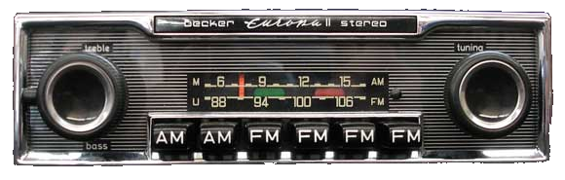
Neural Circuit Building Blocks
What Does it Take to Understand?
membrane
potential
Membrane Properties
calcium
+100 mV
sodium
channels
sodium
neuron
?
+0 mV
rest
-60 mV
chloride
-75 mV
potassium
-100 mV

Slide 9
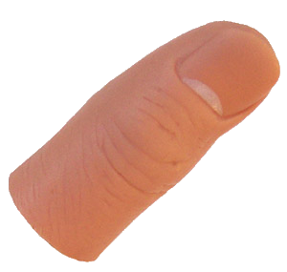
Neural Circuit Building Blocks
What Does it Take to Understand?
membrane
potential
Membrane Properties
calcium
+100 mV
sodium
channels
sodium
neuron
?
+0 mV
-
+
1
1
0
0
0
0
0
rest
-60 mV
chloride
-75 mV
potassium
-100 mV

Slide 10
Neural Circuit Building Blocks
What Does it Take to Understand?
membrane
potential
Membrane Properties
calcium
+100 mV
sodium
channels
sodium
neuron
?
+0 mV
-
+
1
1
0
0
0
0
0
rest
-60 mV
chloride
-75 mV
potassium
-100 mV

Slide 11
Neural Circuit Building Blocks
What Does it Take to Understand?
membrane
potential
Membrane Properties
calcium
+100 mV
sodium
channels
sodium
neuron
?
+0 mV
-
+
1
1
0
0
0
0
0
rest
-60 mV
GO!
chloride
-75 mV
potassium
-100 mV

Slide 12
Neural Circuit Building Blocks
What Does it Take to Understand?
Membrane Properties
Circuit Properties
channels
connections
neuron

Slide 13
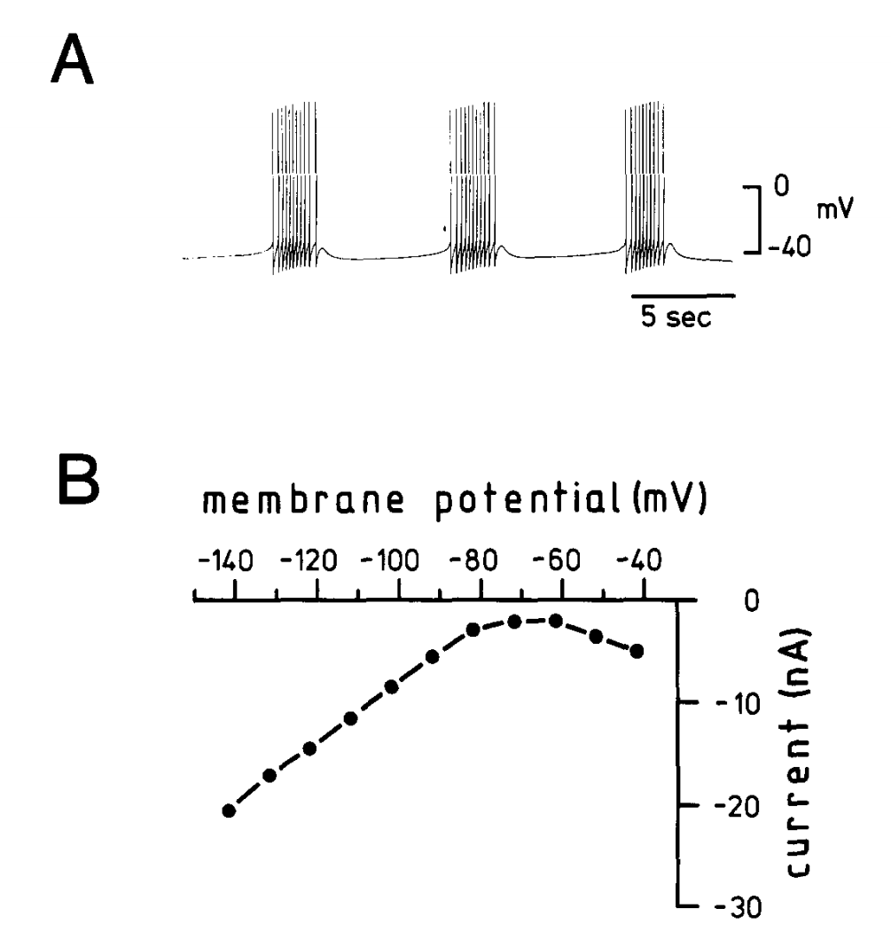
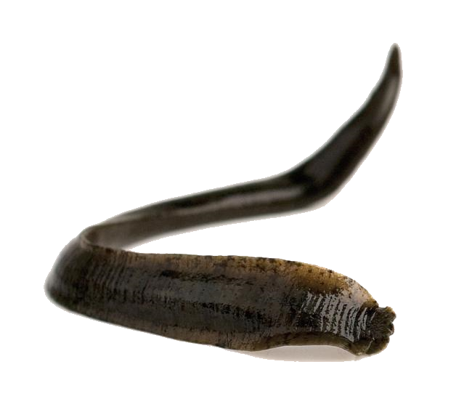

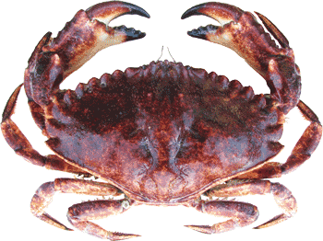
Neural Circuit Building Blocks
R15, the original
burster
Leach Hearts
Crabs Eating

Slide 14
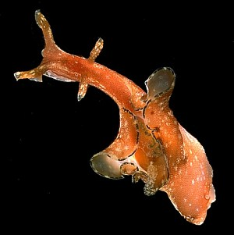
R15, the Original Burster
A
Endogenous Burster: Evidence
Lack of rhythmic synaptic input.
R15
Constant current injection alters oscillation frequency.
Pulsed current injection phase shifts oscillation.
Oscillates when isolated.
Aplysia

Slide 15
R15, the Original Burster
A
R15
B
voltage
commands

Slide 16
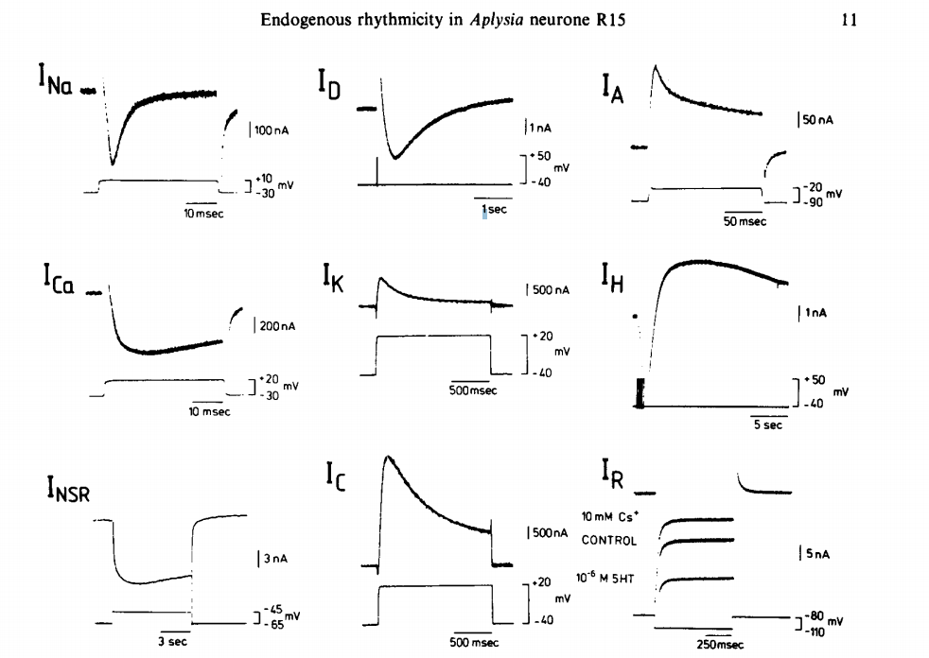
R15, the Original Burster
A
Diverse Currents Underlie
Whole Cell Membrane Current
R15
B
voltage
commands
aka membrane properties

Slide 17
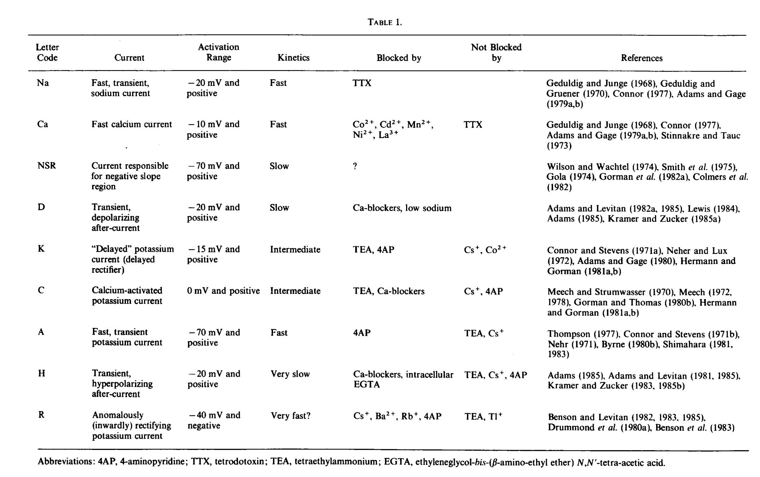

Slide 18
R15, the Original Burster
A
Diverse Currents Underlie
Whole Cell Membrane Current
R15
B
voltage
commands
Conceptually, imagine two sets of currents:
action potential currents.
(2) burst currents.

Slide 19
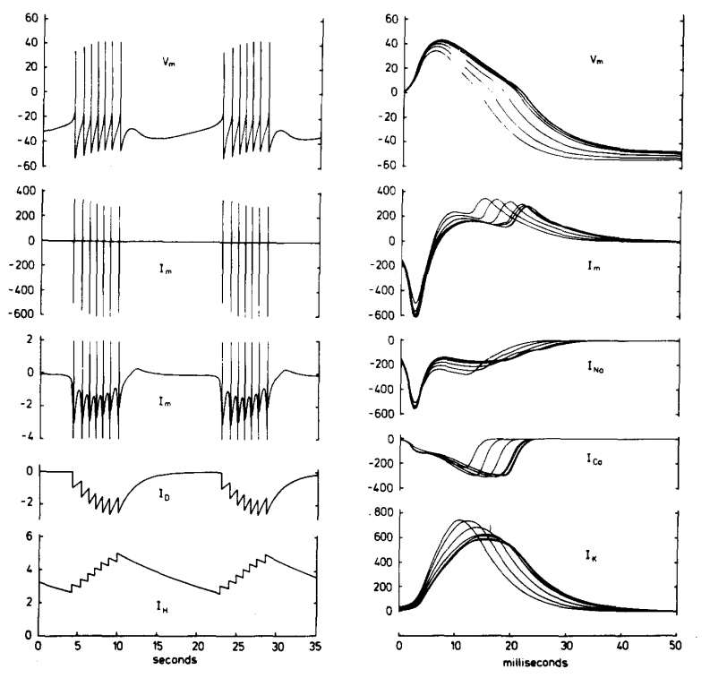
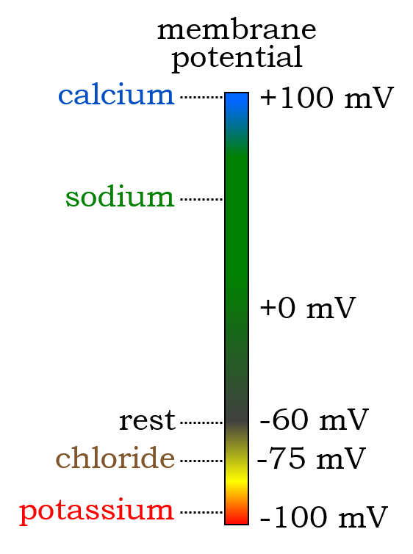
R15: the Action Potential
A
Action Potential
R15
V
m
B
voltage
commands

Slide 20
R15: the Action Potential
A
Action Potential
R15
V
m
I
m

Slide 21
R15: the Action Potential
A
Action Potential
R15
V
m
I
m
I
Na
I
Ca
I
K

Slide 22
R15: the Periodic Burst
A
R15
V
m
I
m
I
Na
I
Ca
I
K
Interburst

Slide 23
R15: the Periodic Burst
A
Action Potential
R15
V
m
I
m
I
Na
I
Ca
I
K
Interburst

Slide 24
R15, the Original Burster
A
R15
Take Home Messages
Membrane properties refers to
the diverse set of currents
that enable specific patterns of
electrical activity.
You don’t need a circuit for an electrical oscillation.
Aplysia
Small, subthreshold currents can go a long way.

Slide 25
Neural Circuit Building Blocks
R15, the original
burster
Leach Hearts
Crabs Eating

Slide 26
Neural Circuit Building Blocks
What Does it Take to Understand?
Membrane Properties
Circuit Properties
channels
connections
neuron

Slide 27
Leach Heartbeat: Circuit Oscillator
heart #1
heart #2

Slide 28
Leach Heartbeat: Circuit Oscillator
heart #1
heart #2

Slide 29
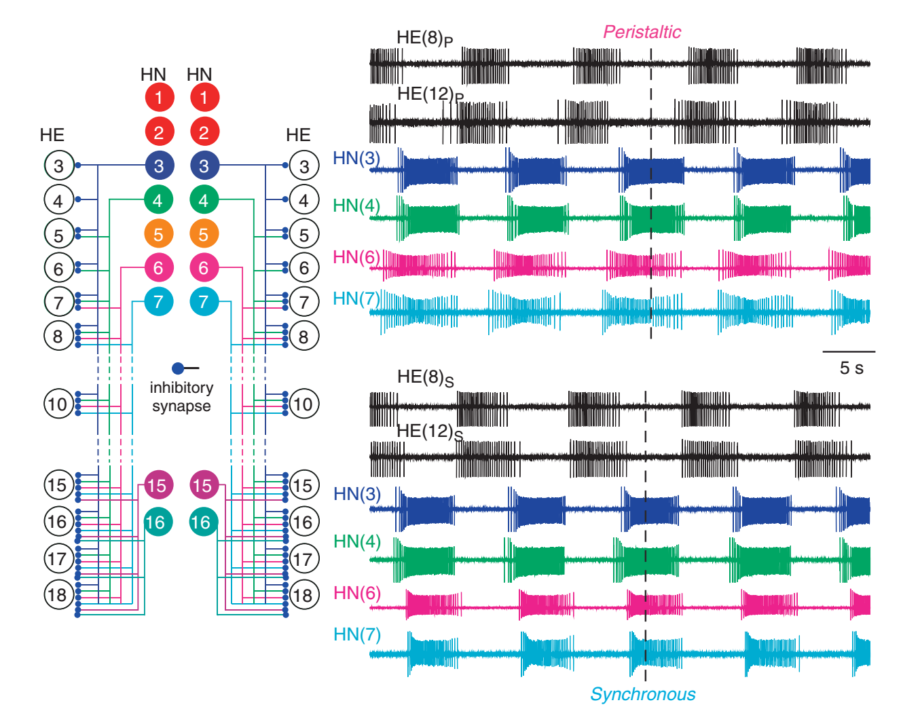
Leach Heartbeat: Circuit Oscillator
heart #1
heart #2

Slide 30
Leach Heartbeat: Circuit Oscillator
heart #1
heart #2

Slide 31
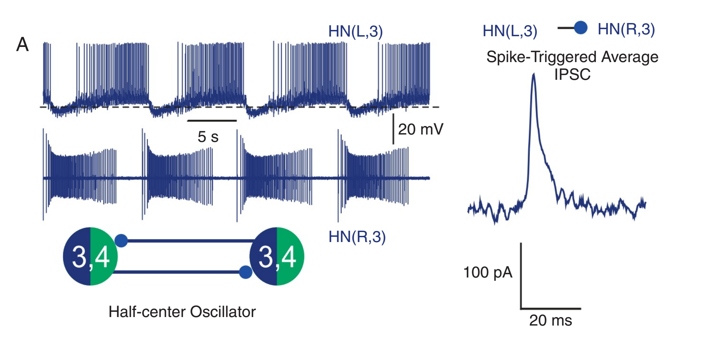
The Half-Center
Half-Center Circuit
Evidence
cholinergic
HN3_{L}
HN3_{R}
chloride
blocked by
bicuculline

Slide 32
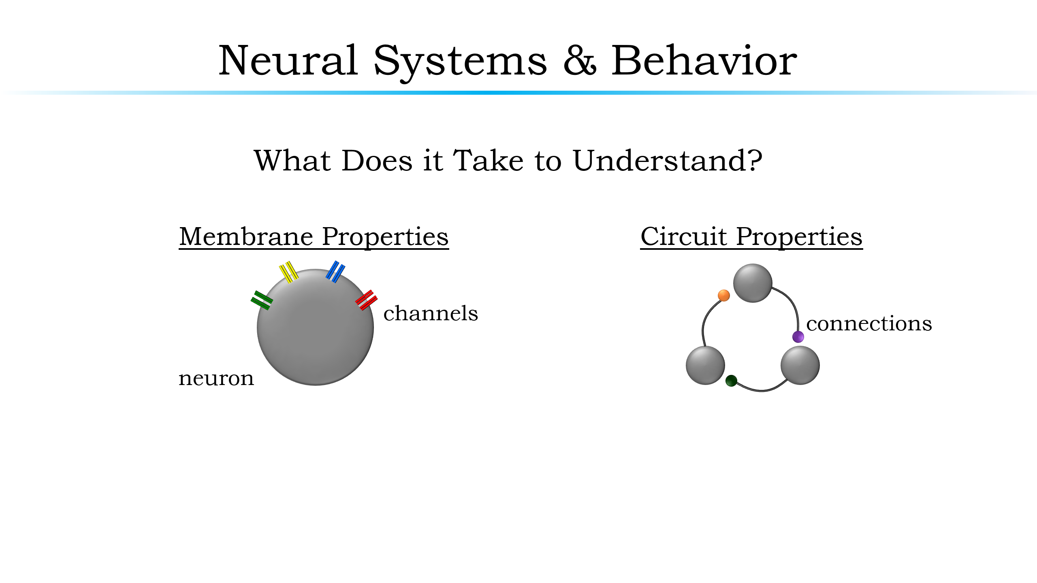
The Half-Center
Half-Center Circuit
HN3_{L}
HN3_{R}

Slide 33
The Half-Center
Half-Center Circuit
Membrane Properties
I_{Na}
I_{Ca-slow} & I_{Ca-fast}
(low threshold, slow & fast
inactivating)
inward
HN3_{L}
HN3_{R}
I_{h}
outward
3 I_{K}’s (I_{A} & 2 delayed rectifiers)
voltage
command
“Escape & Release”
I_{h}
1 sec

Slide 34
The Half-Center
Half-Center Circuit
Take Home Messages
HN3_{L}
HN3_{R}
Sometimes you need a circuit.
Inhibition can activate a neuron.
With the appropriate membrane properties, synaptic inhibition alone can drive rhythmicity.
Leaches have hearts!?

Slide 35
Neural Circuit Building Blocks
R15, the original
burster
Leach Hearts
Crabs Eating

Slide 36
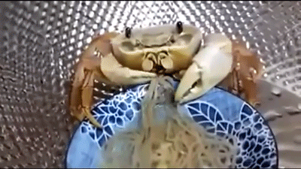
Crabs Eat

Slide 37
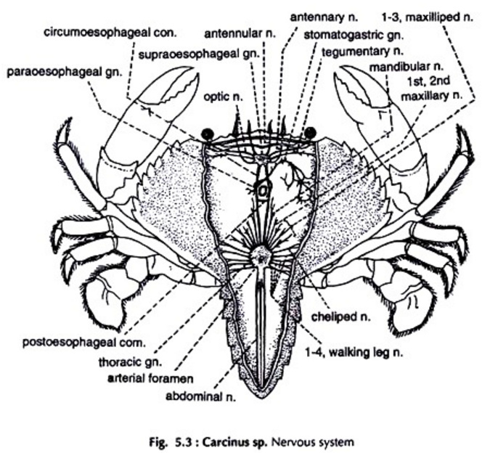
The Rock Crab

Slide 38
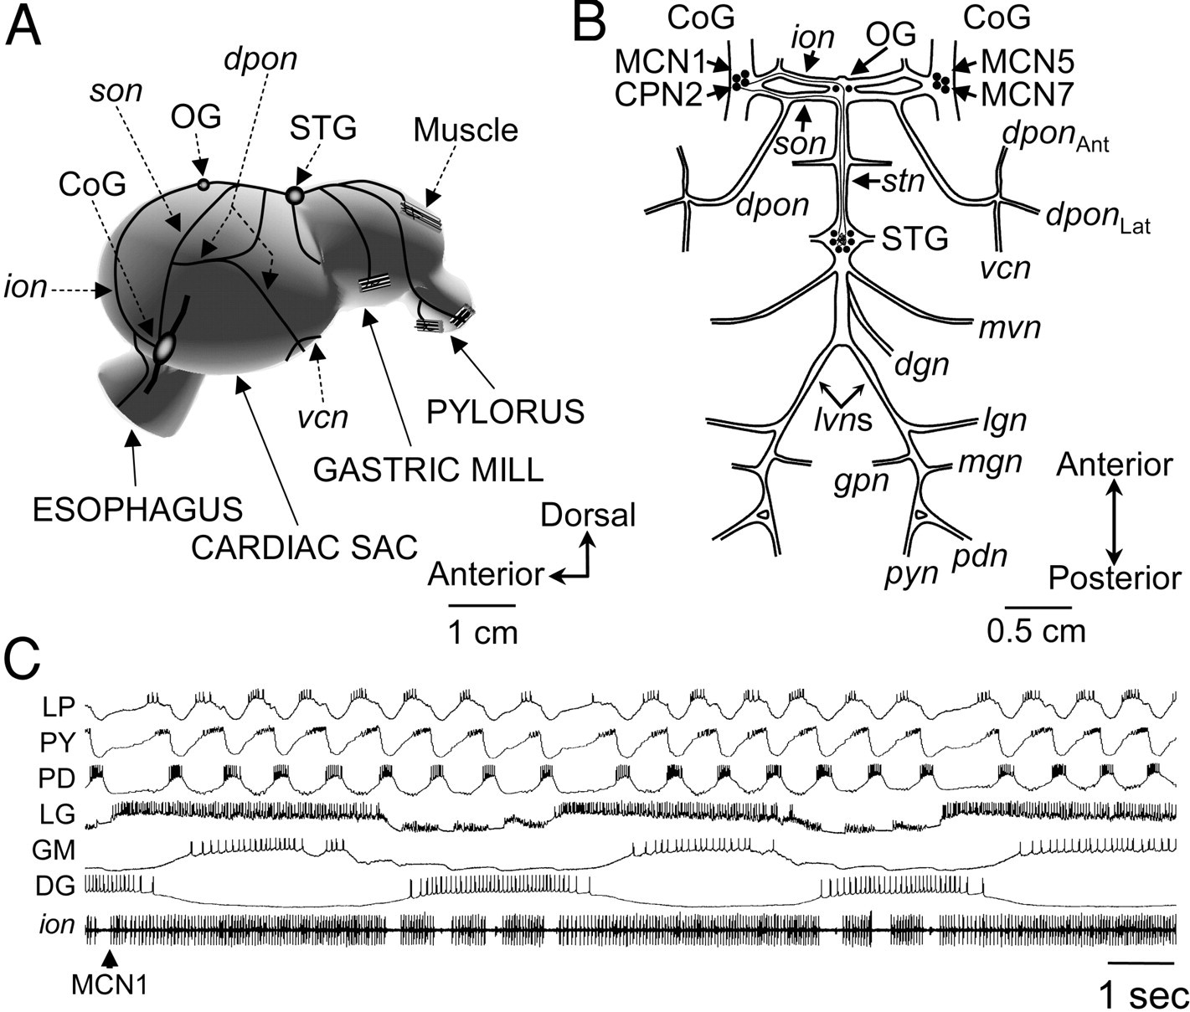
The Rock Crab Belly

Slide 39
The Rock Crab Belly
Stomatogastric Nervous System

Slide 40
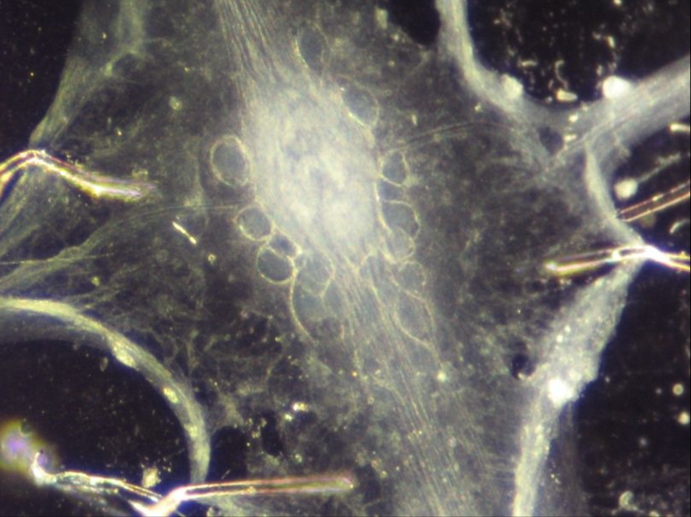
Stomatogastric Ganglion (STG)
Stomatogastric Nervous System
Stomatogastric Ganglion

Slide 41


Motor Patterns Generated By The STG
Stomatogastric Nervous System
Stomatogastric Ganglion

Slide 42
Motor Patterns Generated By The STG
Stomatogastric Nervous System
Stomatogastric Ganglion
Pyloric Rhythm

Slide 43
Motor Patterns Generated By The STG
Stomatogastric Nervous System
Stomatogastric Ganglion
Gastric Mill Rhythm

Slide 44
Motor Patterns Generated By The STG
Stomatogastric Nervous System
Stomatogastric Ganglion
Descending Projection
Neurons

Slide 45
Motor Patterns Generated By The STG
Stomatogastric Nervous System
Stomatogastric Ganglion
Descending Projection
Neurons
Pyloric Rhythm
Gastric Mill Rhythm

Slide 46
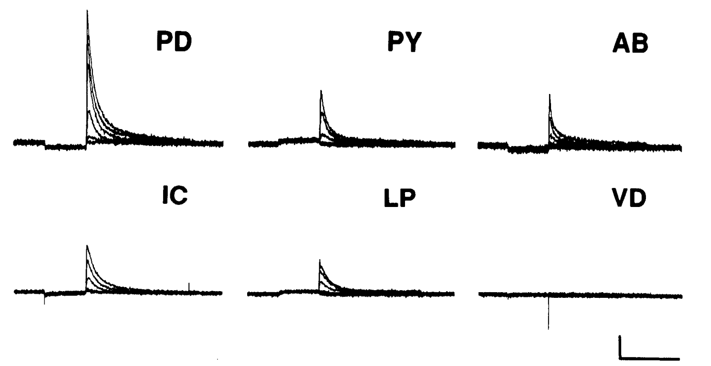
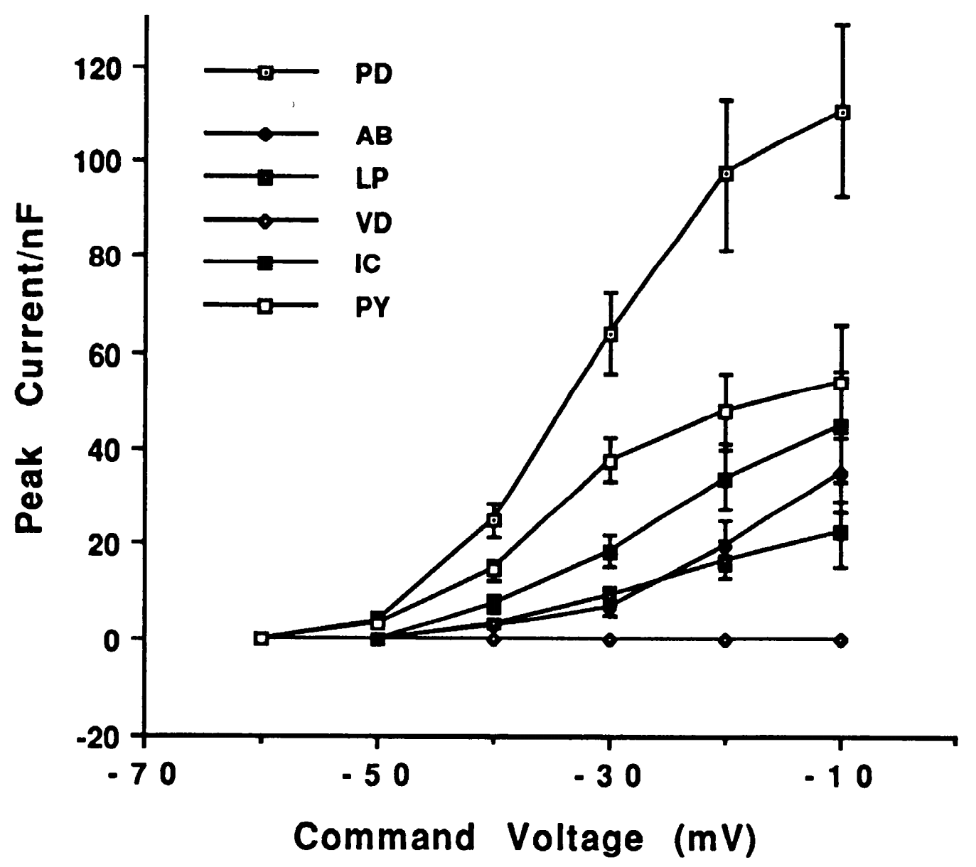
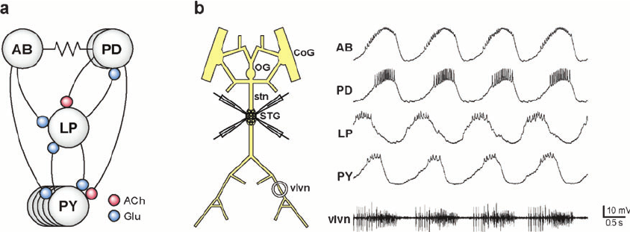
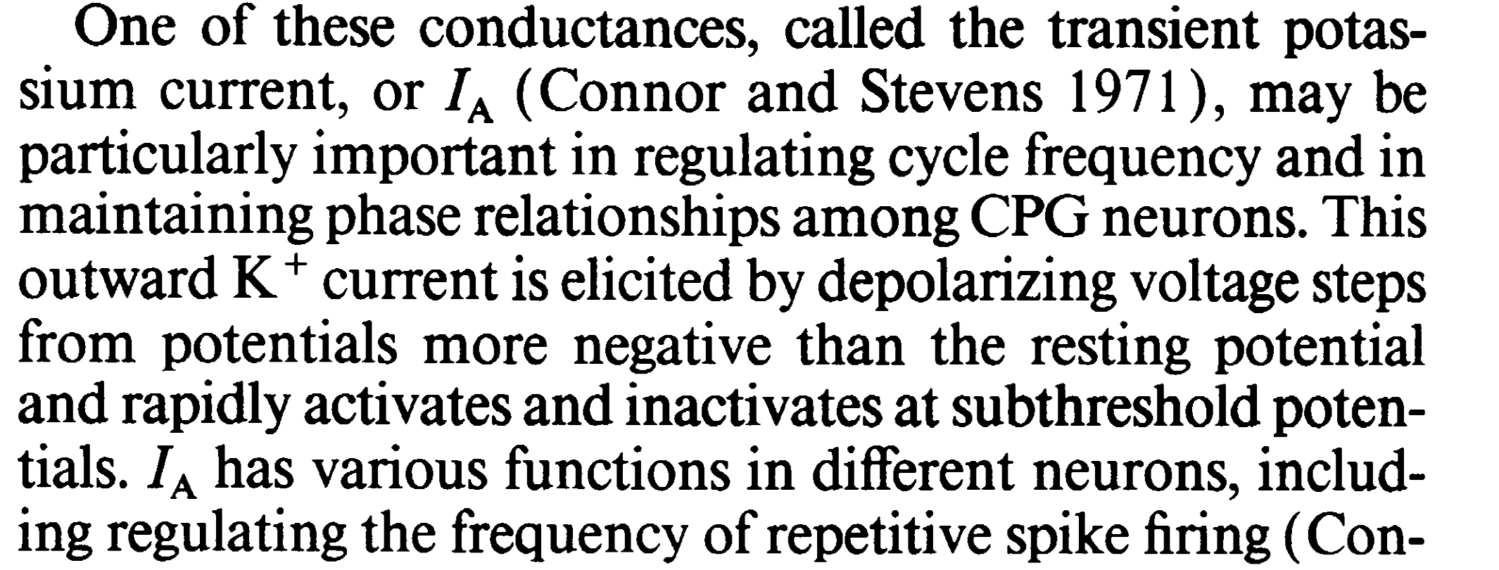
The Pyloric Rhythm
LP
PY
Lessons Learned
Pacemaker neurons are awesome.
Electrical coupling matters.
Circuit activity is sculpted by both (1) connections, (2) intrinsic membrane properties. You need to understand both for a complete picture.
Pacemaker Neuron
I_{A}
Stomatogastric Ganglion
AB
LP
PY
PD

Slide 47
The Gastric Mill Rhythm
Stomatogastric Nervous System

Slide 48
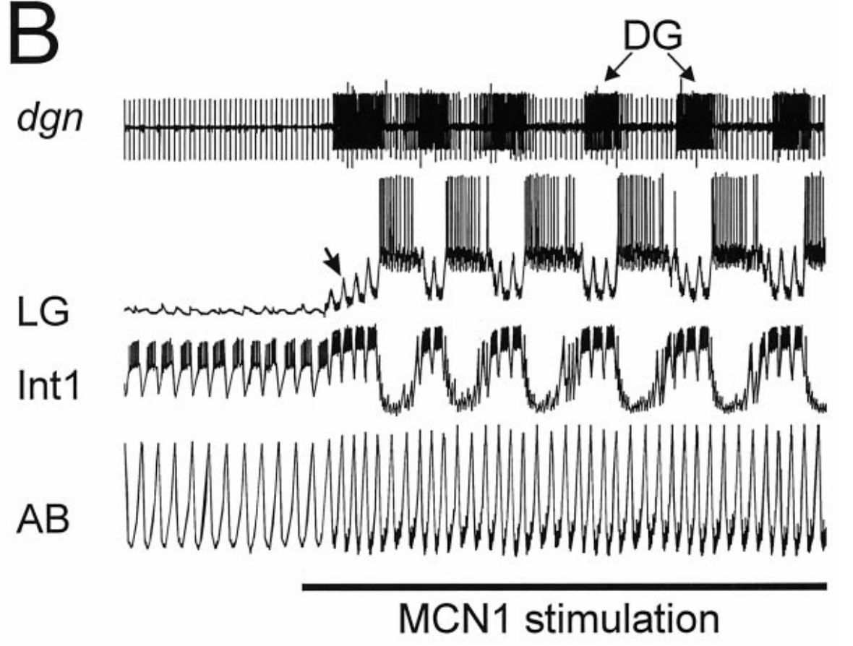
The Gastric Mill Rhythm
CoG
MCN
1
Stomatogastric Nervous System
CabTRP
STG
DG
LG
Int
1
AB

Slide 49
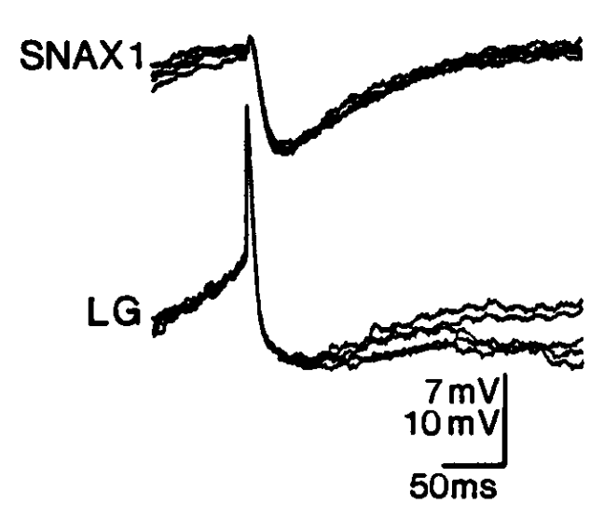
The Gastric Mill Rhythm
CoG
MCN
1
Stomatogastric Nervous System
CabTRP
STG
DG
LG
Int
1
AB

Slide 50
The Gastric Mill Rhythm
CoG
MCN
1
Lessons Learned
Descending inputs can activate circuits.
Pre-synaptic inhibition is amazing.
Electrical coupling matters.
Stomatogastric Nervous System
CabTRP
STG
DG
LG
Int
1
AB

Slide 51
Neural Circuit Building Blocks
R15, the original
burster
Leach Hearts
Crabs Eating

Slide 52
Neural Circuit Building Blocks
What Does it Take to Understand?
Membrane Properties
Circuit Properties
channels
connections
neuron

Slide 53


Slide 55

The Rock Crab Belly

Slide 56
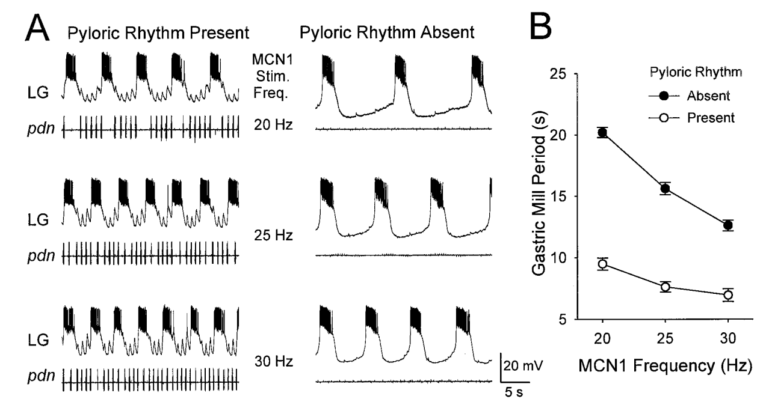
Circuit Interactions
CoG
MCN
1
What’s This?
Stomatogastric Nervous System
CabTRP
STG
DG
LG
Int
1
AB

Slide 57
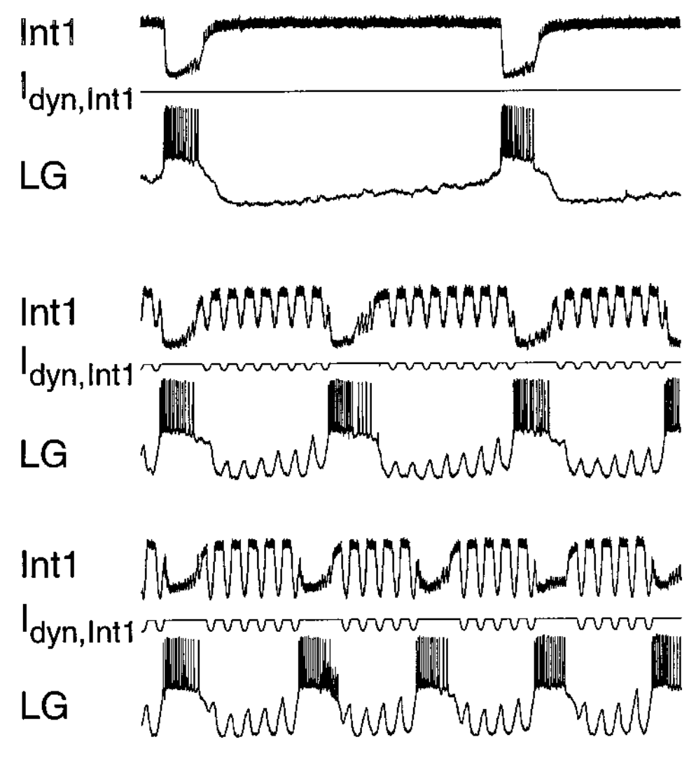
Circuit Interactions
CoG
MCN
1
Stomatogastric Nervous System
CabTRP
STG
DG
LG
Int
1
AB

Slide 58
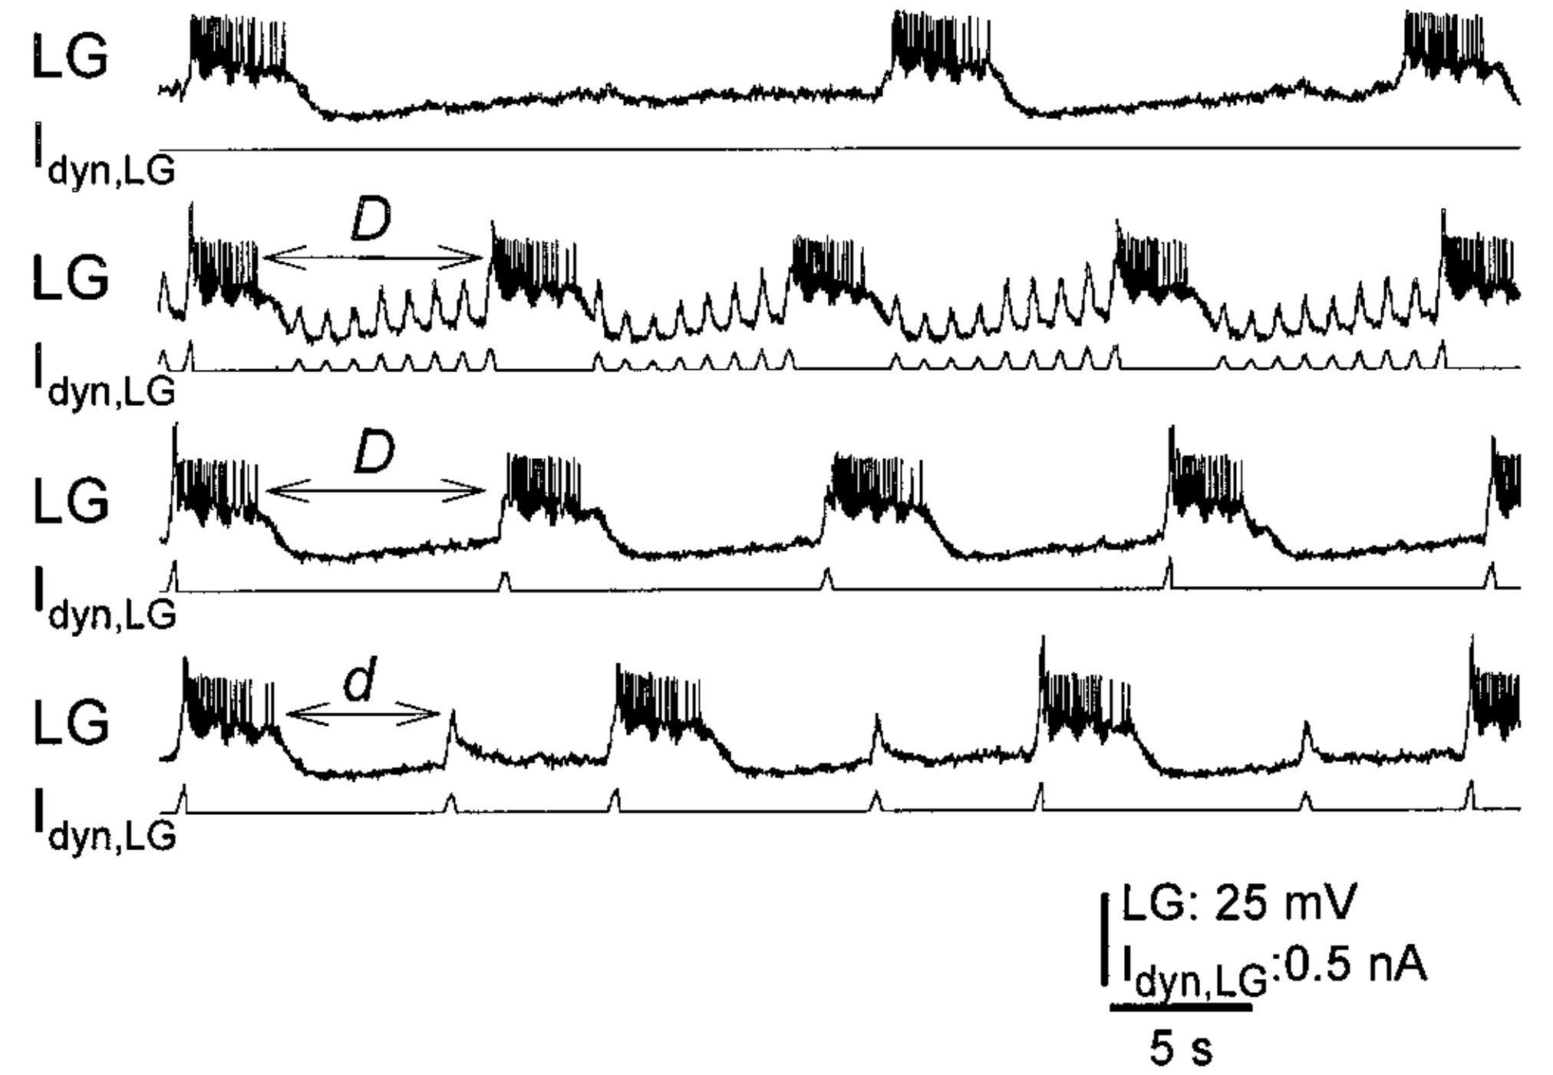
Circuit Interactions
CoG
MCN
1
Lessons Learned
Circuits interact.
Stomatogastric Nervous System
CabTRP
STG
DG
LG
Int
1
AB

Slide 59
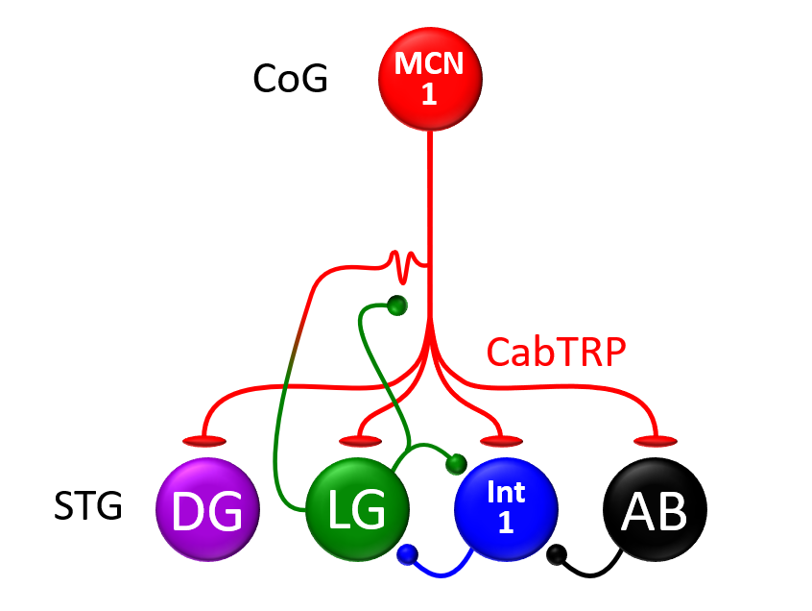
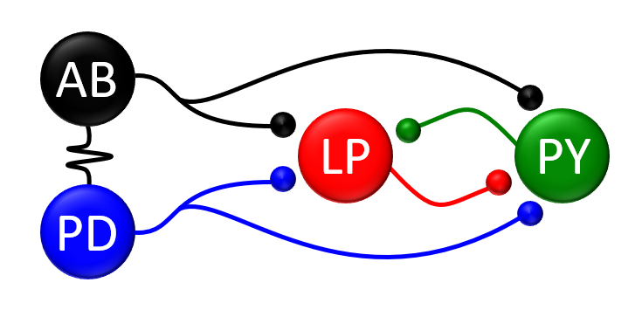
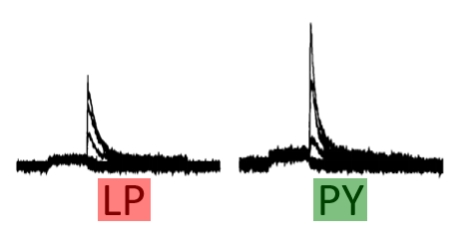
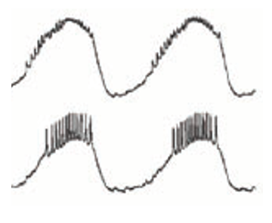
Lessons Learned
Pyloric Circuit
Gastric Mill Circuit
Stomatogastric Ganglion
Lessons Learned
Descending inputs can activate circuits.
Pre-synaptic inhibition is amazing.
Electrical coupling matters.
Circuits Interact
Lessons Learned
Pacemaker neurons are awesome.
Electrical coupling matters.
Circuit activity is sculpted by both (1) connections, (2) intrinsic membrane properties. You need to understand both for a complete picture.

