Slide 1
The Cortex
Synapses & Circuits
Lecture Seven
General Facts
Motor Cortex
Visual Cortex

Slide 2


Slide 3
Circuits

Slide 4
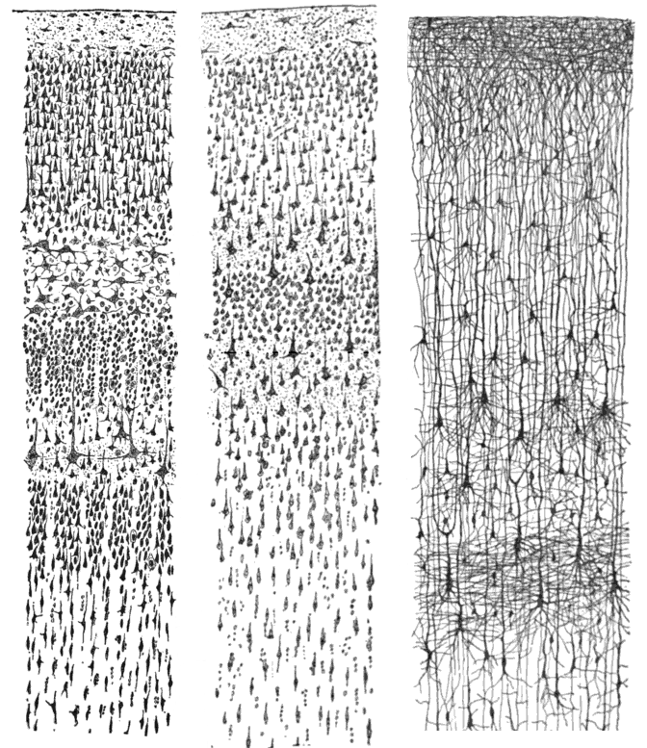

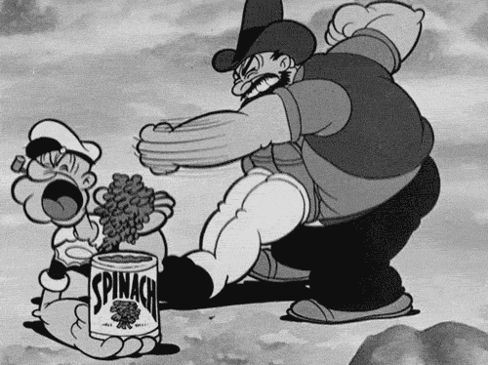
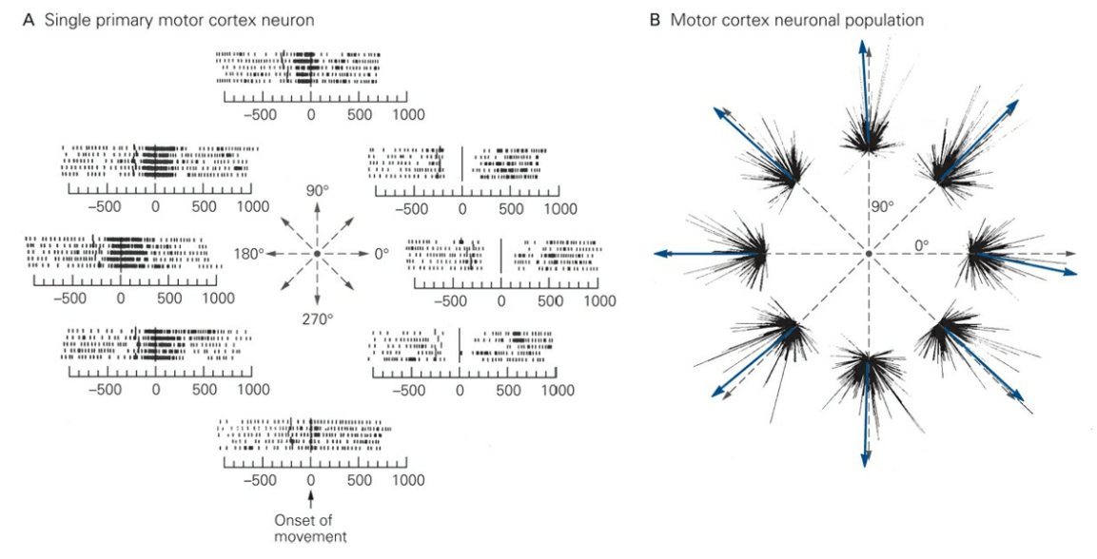
Circuits in the Cortex
Visual
Cortex
Motor
Cortex

Slide 5
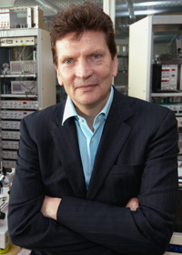
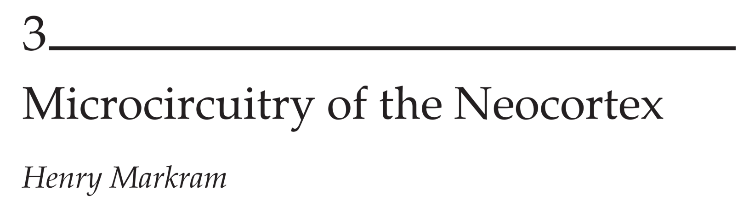

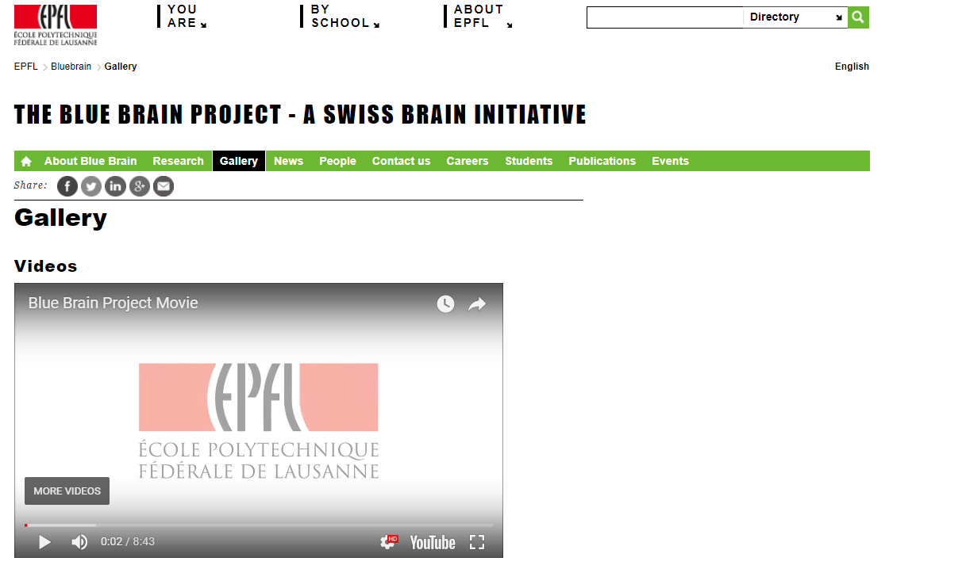
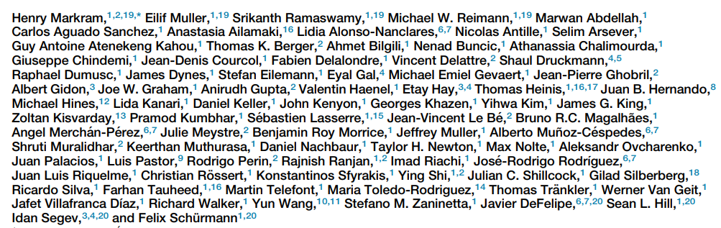
A Cortical Column
link

Slide 6
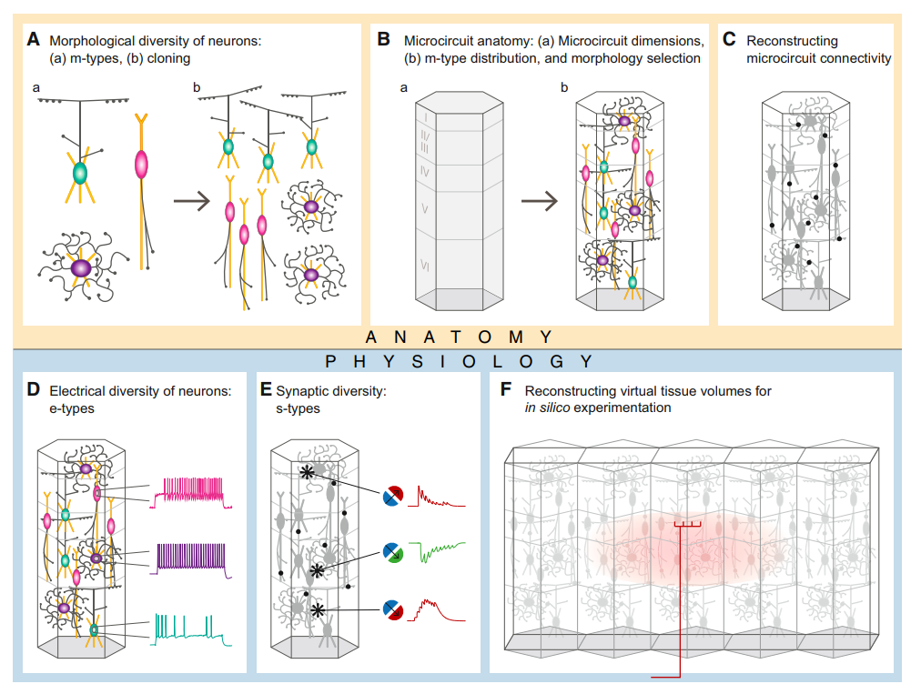
A Cortical Column
‘m’ type
‘e’ type

Slide 7
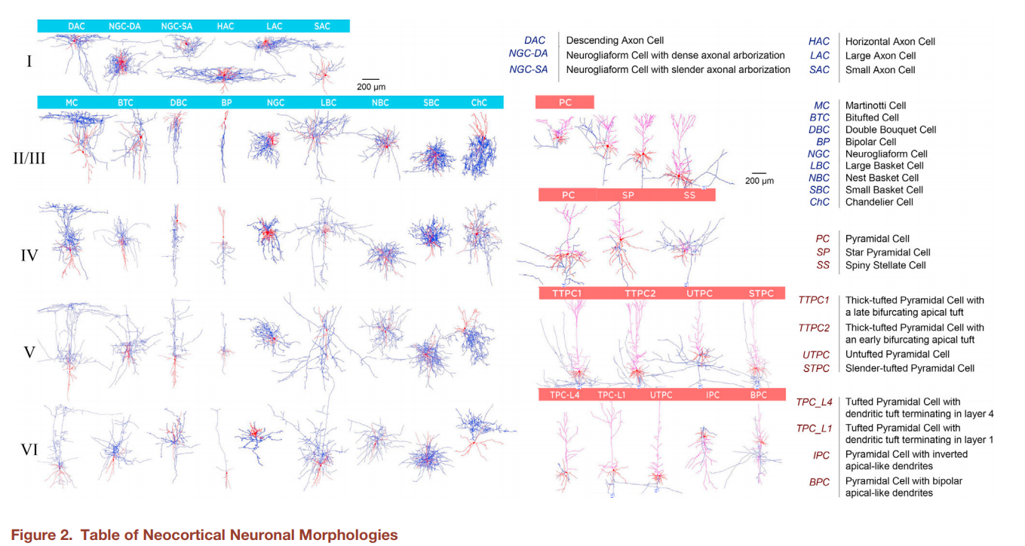
‘m’ Type Classification

Slide 8
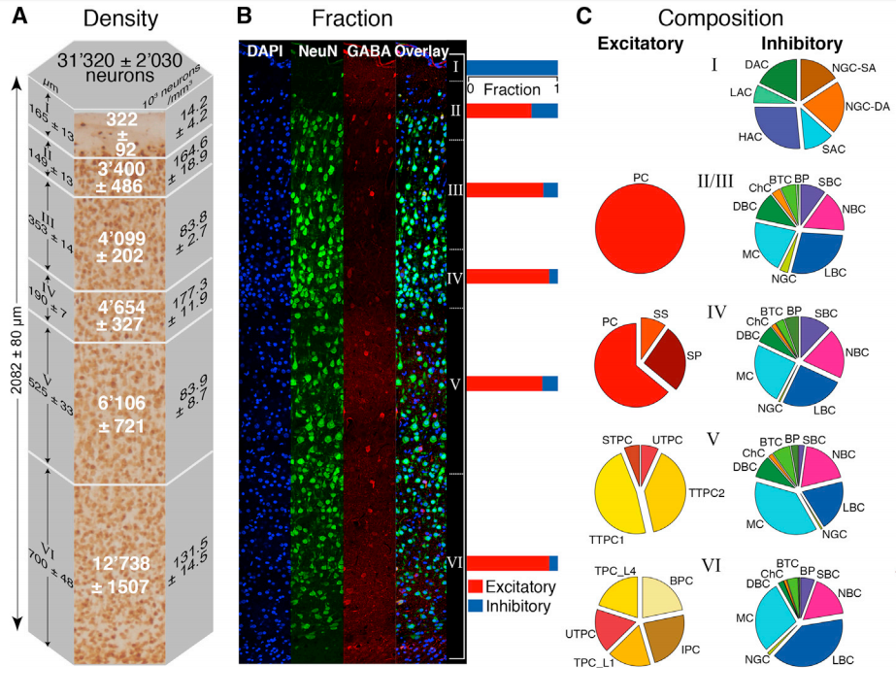
‘m’ Type Classification

Slide 9
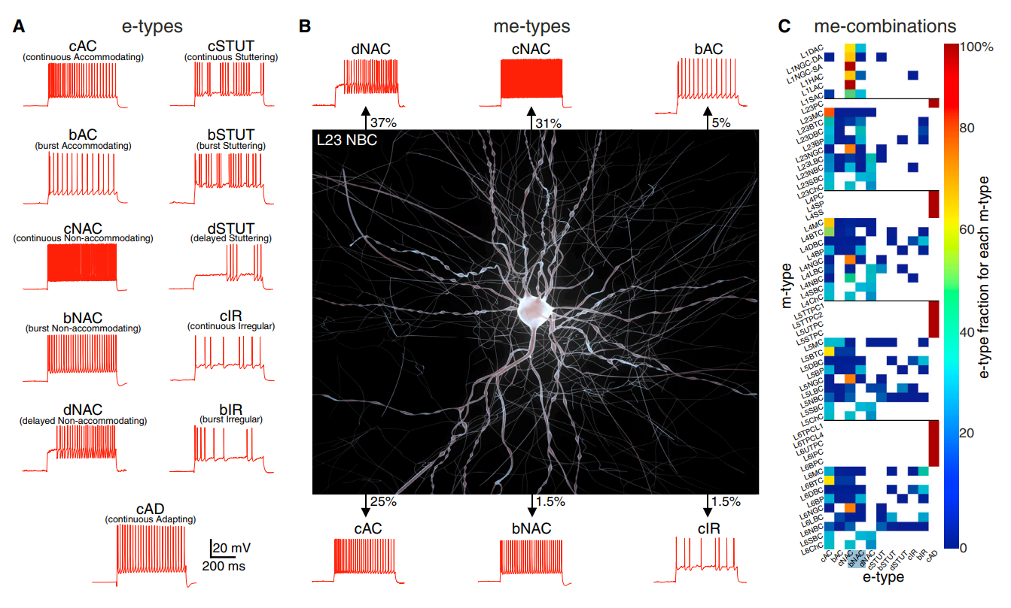
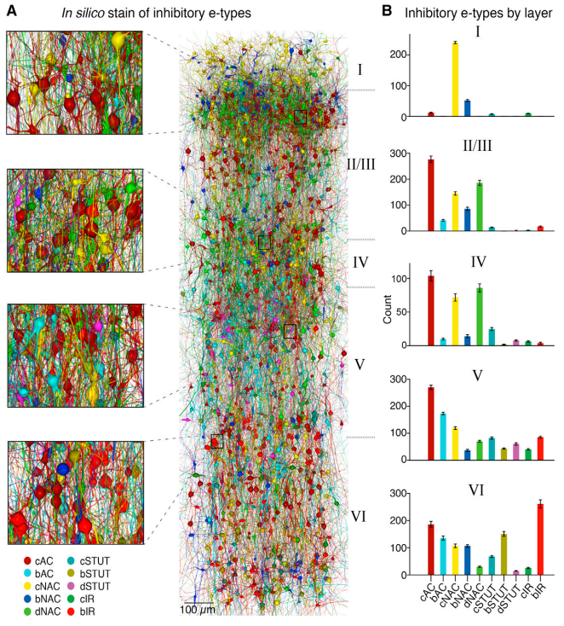
‘e’ Type Classification

Slide 10
‘e’ & ‘m-e’ Type Classification
‘e’ Type Classification

Slide 11
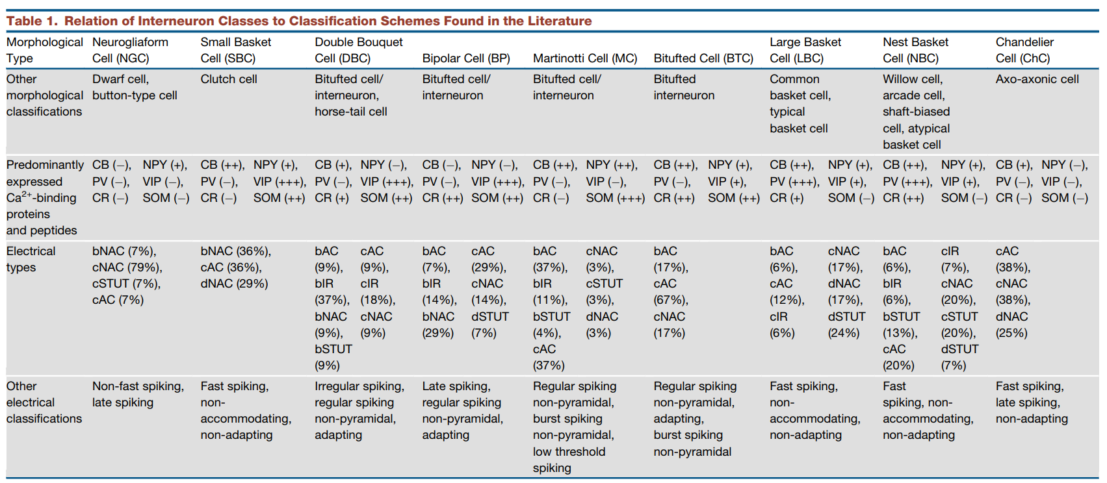
Diversity of Inhibitory Neurons

Slide 12
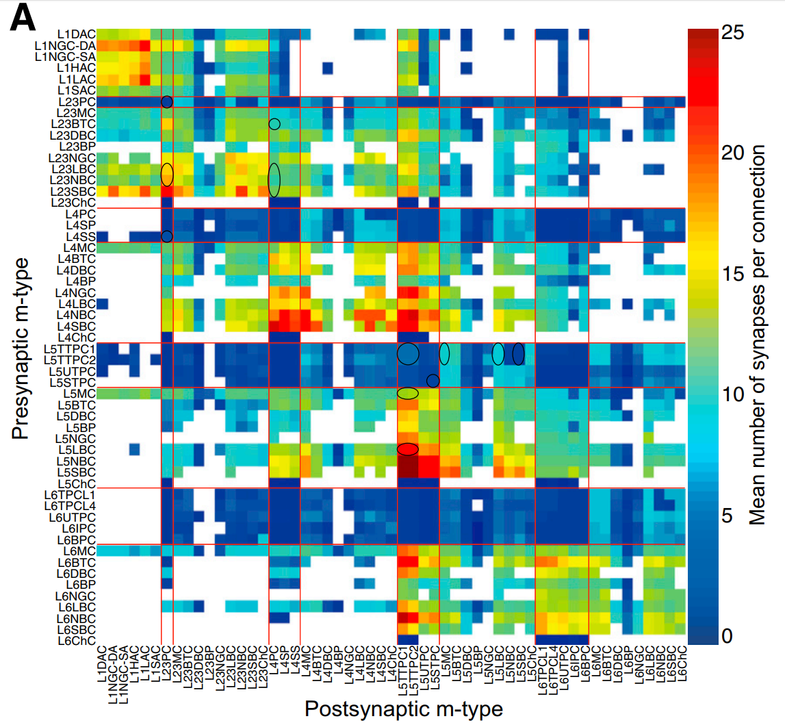
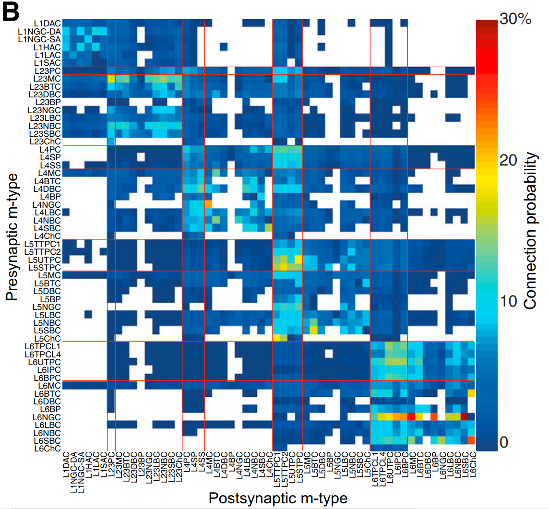
And Then There Are Connections…
Average # Synapses Per Connection
Probability Neurons are Connected
(within 100μm)

Slide 13
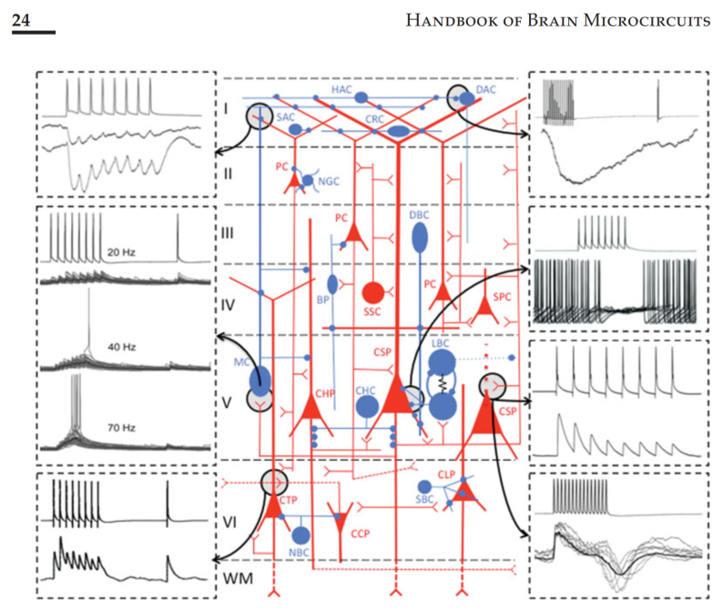
Can We Make Generalizations?

Slide 14
Can We Make Generalizations?
General Composition
~86% of all synapses in a column are excitatory. ~14% are inhibitory.
~1/3 of all excitatory synapses are formed by axons within that column, ~1/3 from a neighboring column, and ~1/3 from distant columns.
Principle Neurons
Generally refers to pyramidal neurons (excitatory).
Found in Layers 2-6.
In primary sensory areas (e.g. visual cortex), Layer 4 also contains glutamatergic spiny stellate cells.
Spiny stellate cells are targets of thalamocortical inputs.
Layer 5 contains two pyramidal subtypes: (1) thin, untufted (project to opposite hemisphere), and (2) thick, tufted (project subcortically).
Generally form 3-12 synapses onto inhibitory neurons, and only onto a small portion of the dendrites.
Inhibitory Neurons
Generally considered local because they mostly innervate neurons within the dimensions of a neocortical column.
Super diverse.
Generally form a much larger number of synapses onto their targets (up to 30/connection).

Slide 15
The Cortex
Synapses & Circuits
Lecture Seven
General Facts
Motor Cortex
Visual Cortex

Slide 16
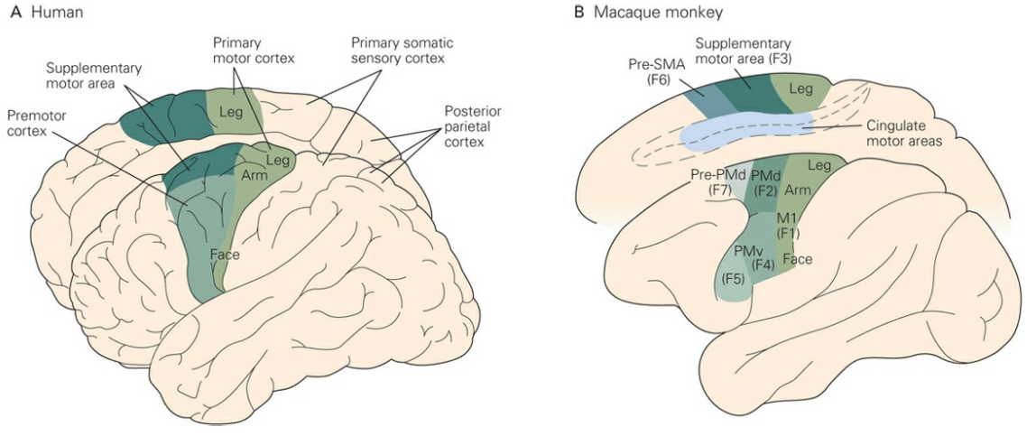
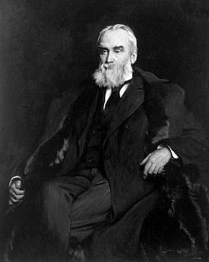
Cortical Areas Involved in Motor Control
Hughlings Jackson
Notes:
John Hughlings Jackson: specific parts of the cortex anterior to the central sulcus has a causal role in movement. He reached this conclusion by studying epileptic patients (Jacksonion March). Jackson was contemporary with Broca & Wernicke.

Slide 17

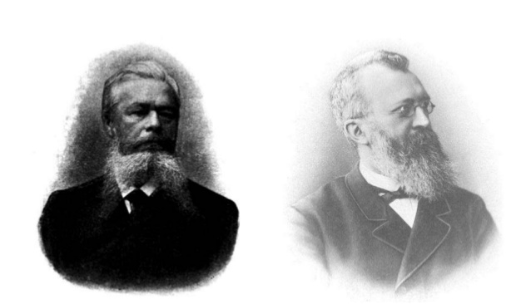
Cortical Areas Involved in Motor Control
Hughlings Jackson
Fritsch & Hitzig
Notes:
John Hughlings Jackson: specific parts of the cortex anterior to the central sulcus has a causal role in movement. He reached this conclusion by studying epileptic patients (Jacksonion March). Jackson was contemporary with Broca & Wernicke.

Slide 18
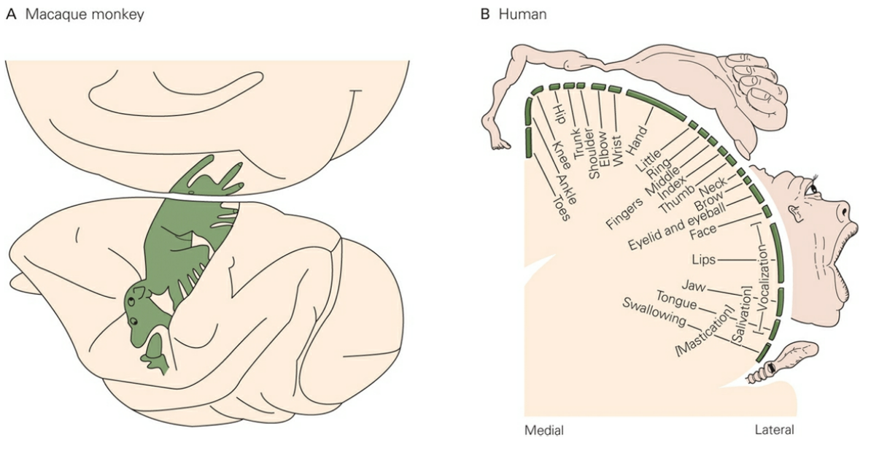
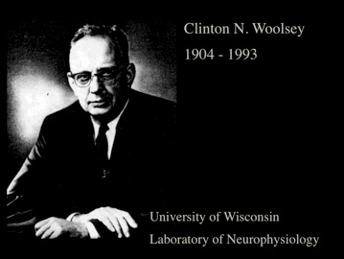
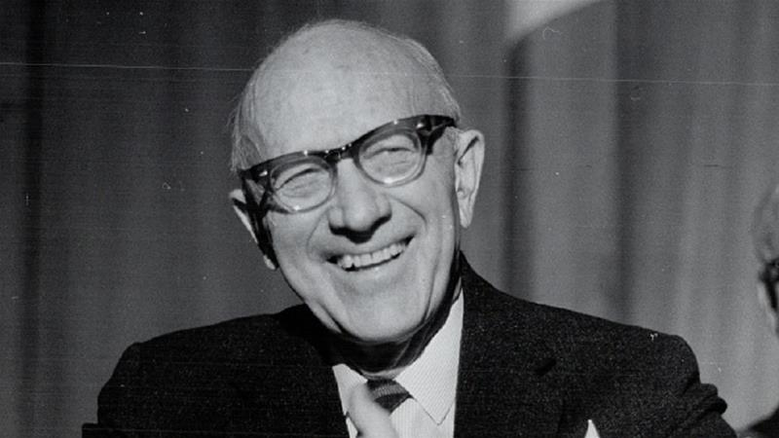
Motor Maps: Early Days
Clinton Woolsey
Wilder Penfield
Notes:
Woolsey stimulated in a number of animals in the first half of the century.
Penfield started doing it in humans.
The motor map is not a one-to-one representation. It’s disproportionately represented by the most finely controlled body parts (fingers, face, etc)

Slide 19
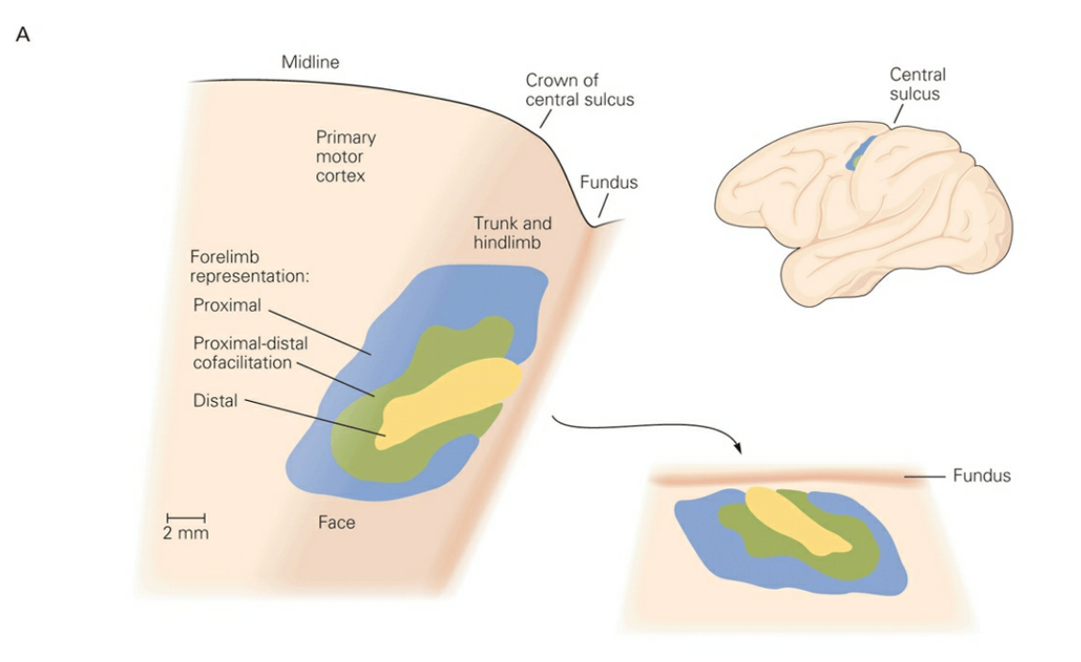
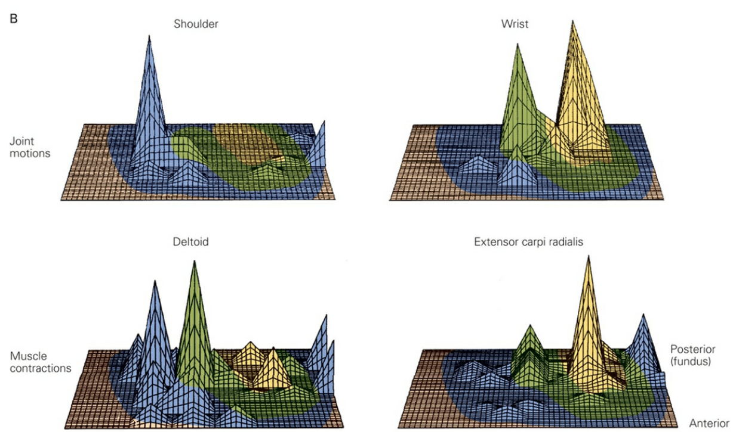
Motor Maps: These Days
Notes:
Recent mapping studies have revealed that the neurons controlling the muscles of the digits, hand, and distal arm tend to be concentrated within a central zone, whereas those controlling more proximal arm muscles are located in a horseshoe-shaped ring around the central core.
Microstimulation of several sites in the arm motor map can produce rotations of the same joint. Neurons that control wrist movements are concentrated in the central core whereas those that regulate shoulder movements are distributed around the core, with some overlap between the two populations.

Slide 20
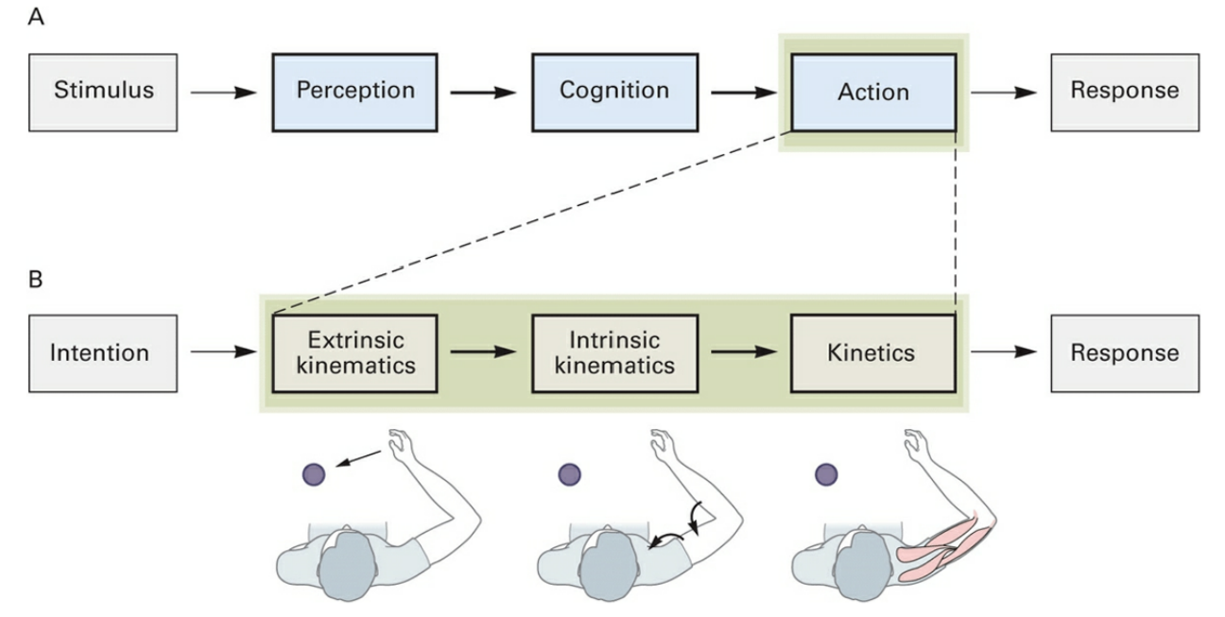
Serial Processing of Voluntary Motor Movements
Unfortunately, not much evidence for strict
serial processing of movement.
Notes:
Stages:
Perceptual mechanisms generate unified sensory representation of the external world.
Cognitive processes use the internal replica of the outside world to decide an action.
A selected motor plan is carried out.
IMPORTANT: direct neurophysiolgocal studies of neural mechanisms show that a strict adherence to serial processing is simplistic and incorrect.

Slide 21
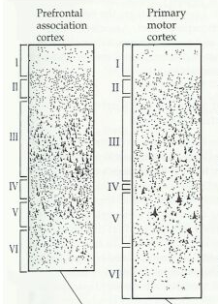

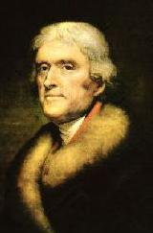
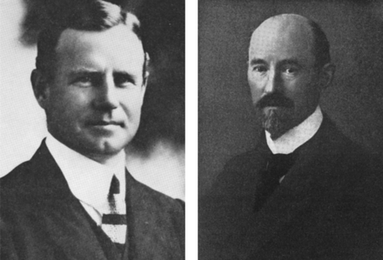
Two Major Divisions:
Premotor & Primary Motor Cortex
Alfred Campbell
Korbinian Brodmann
Notes:
Precentral cortex contains Brodmann’s Area 4 & 6. 4: primary motor cortex. 6: premotor cortex.
Both cortices are agranular: it lacks the 6 layers characteristic of most cortex (lacks granule cell layer).
Alfred Campbell proposed that motor cortex controlled the “motor apparatus” in the spinal cord, and that premotor cortex was more important for complex, conditional, and voluntary movements. Turns out he was wrong. Overturned when Woolsey stimulated premotor cortex and got movements on the contralateral side (like stimulating motor cortex).
And now, the modern view is the result of further compartmentalizing the chunks.

Slide 22
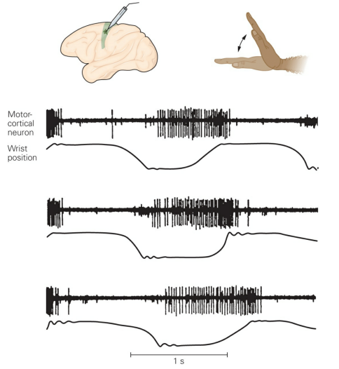

Neurons of the Motor Cortex are Activated
During Movements
Edward Evarts
Notes:
Edward Evarts was the first to use chronic microelectrode recordings to study the primary motor cortex in behaving monkeys.
This movement-related activity typically begins 50 to 150 ms before the onset of agonist muscle activity. These pioneering studies suggested that single neurons in primary motor cortex generate signals that provide specific information about movements of specific parts of the body before those movements are executed.

Slide 23
Motor Movements:
Precise Look-Up VS Broad Functional Map?

Slide 24
Motor Movements:
Precise Look-Up VS Broad Functional Map?

Slide 25
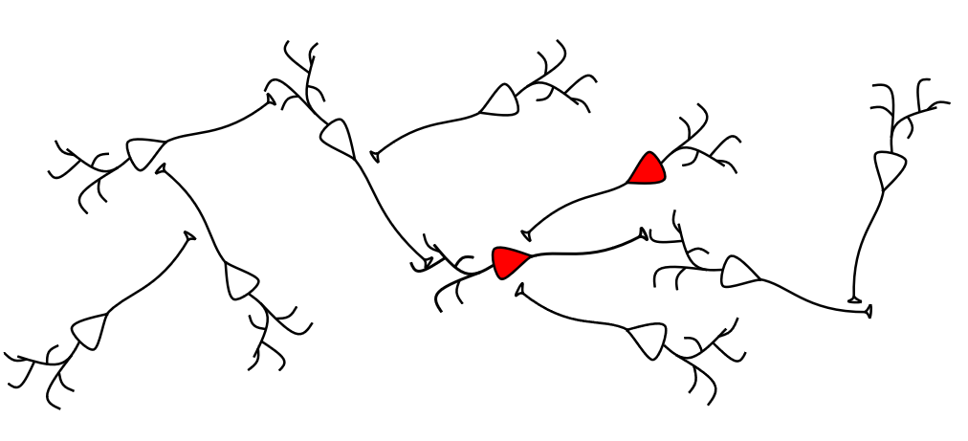
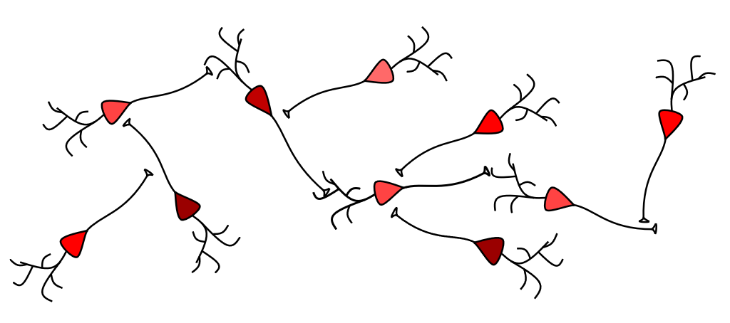

Motor Movements:
Precise Look-Up VS Broad Functional Map?
Apostolos
Georgopoulos

Slide 26
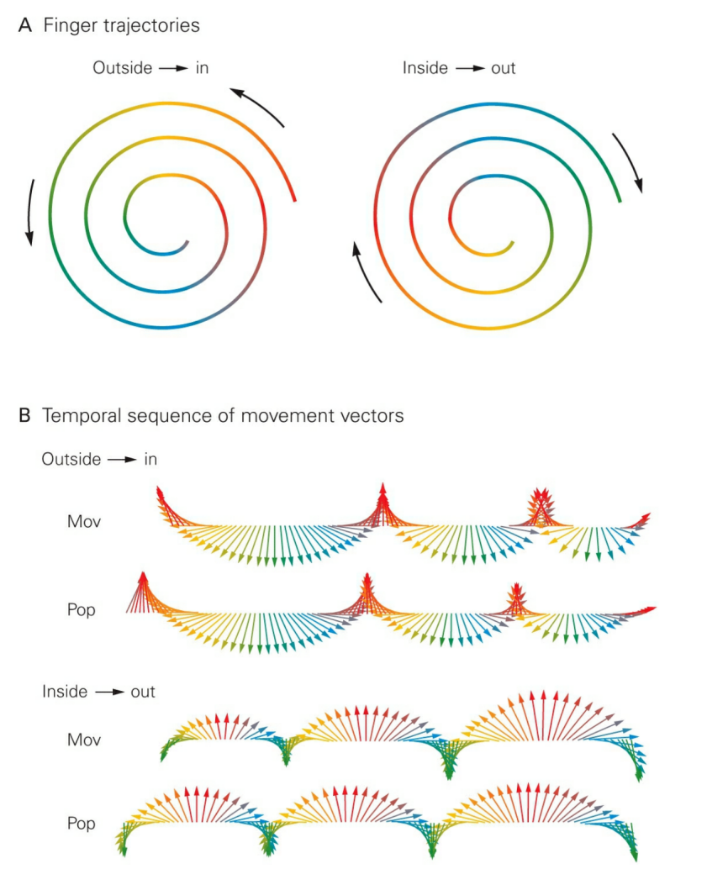

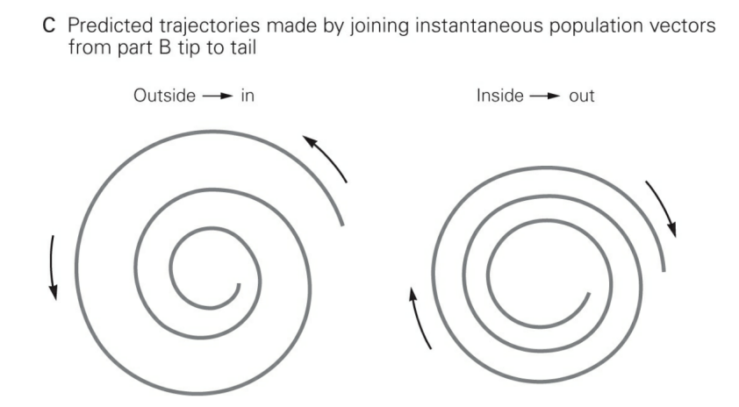
& Predicts (!)
Population Activity Vector Precedes Movement
Notes:
Motor Commands Are Population Codes The complex overlapping organization of the motor map for the arm and hand suggests at least two different ways to generate the motor command for a given movement. The map could function as a look-up table within which a desired movement is generated by selective activation of a few sites whose combined output produces all the required muscle activity and joint motions. Or it could be a distributed functional map in which many sites contribute to each motor command.

Slide 27
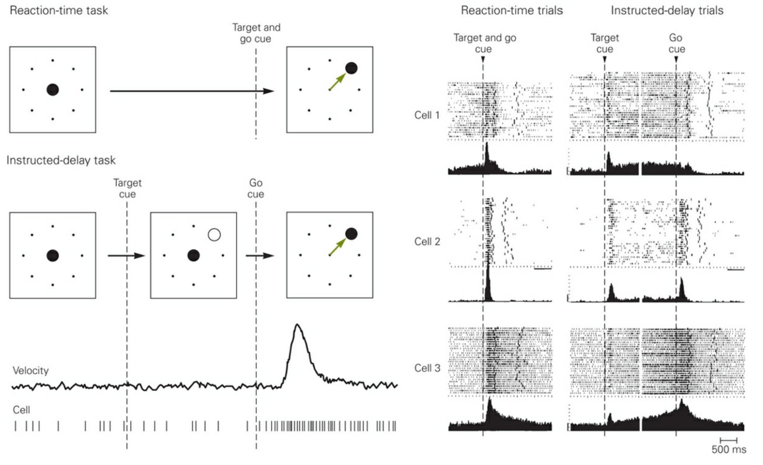
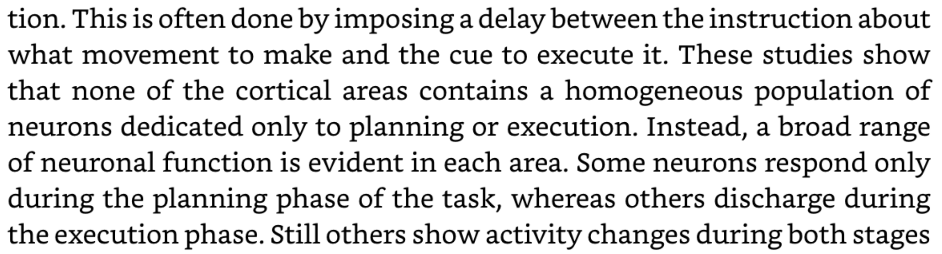
Planning a Movement
Voluntary Behavior
once an intention is formed,
the action can be delayed
(or not performed at all)
Notes:
Whereas many primary motor cortex neurons discharge mainly during execution, premotor and parietal cortices contain more neurons that are strongly activated during the planning stage.

Slide 28
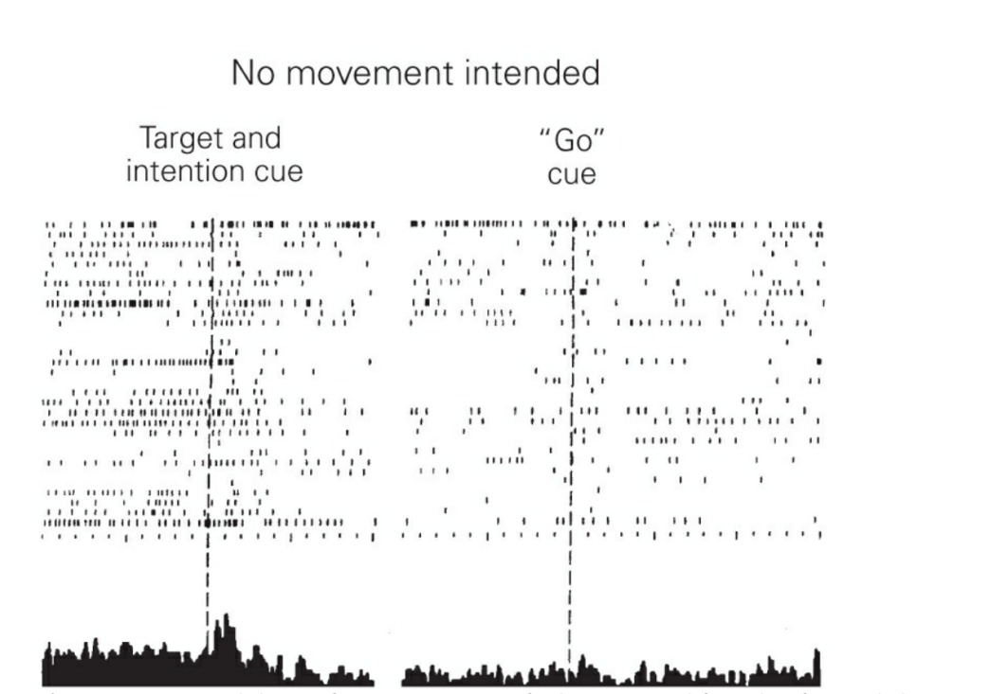
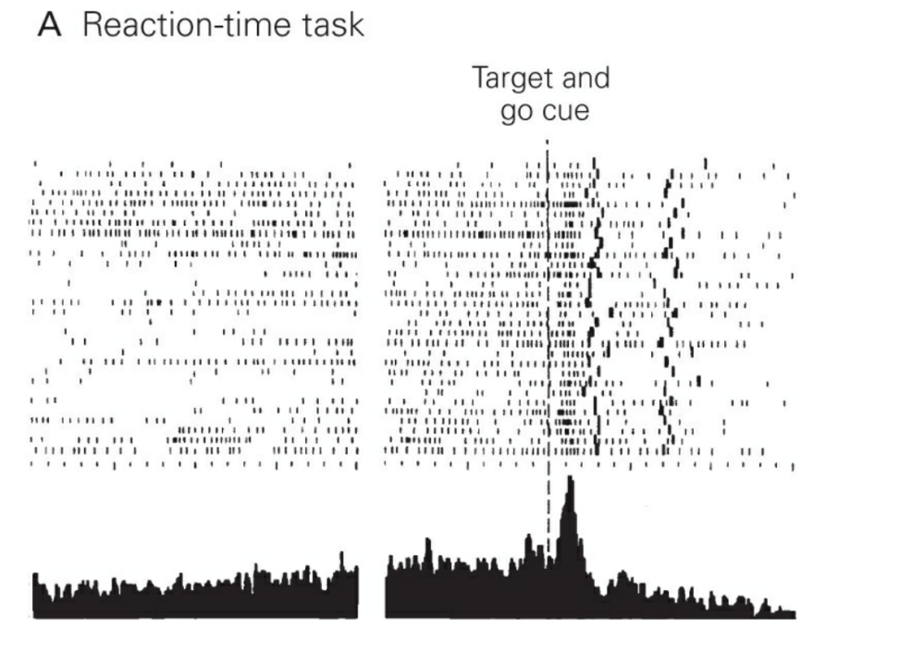
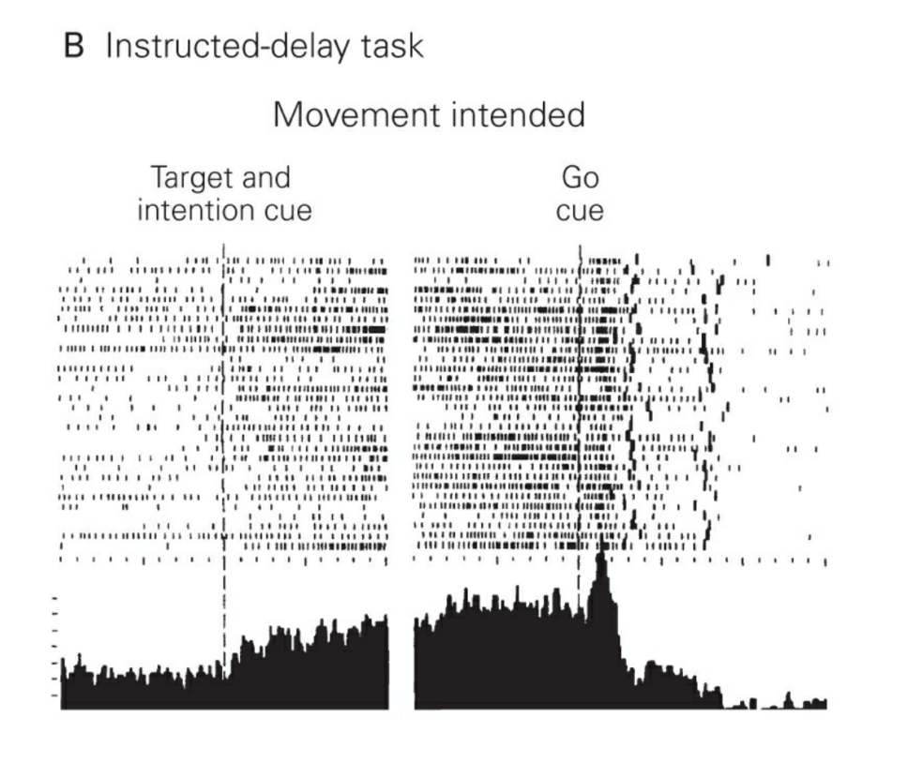
Context Dictates Firing Patterns
Start!
Go!
Start!
Go!
Start!
Don’t Go!
time
time
time
Premotor Cortex

Slide 29
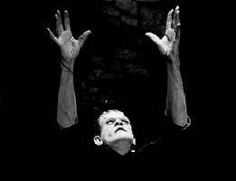
Reaching

Slide 30
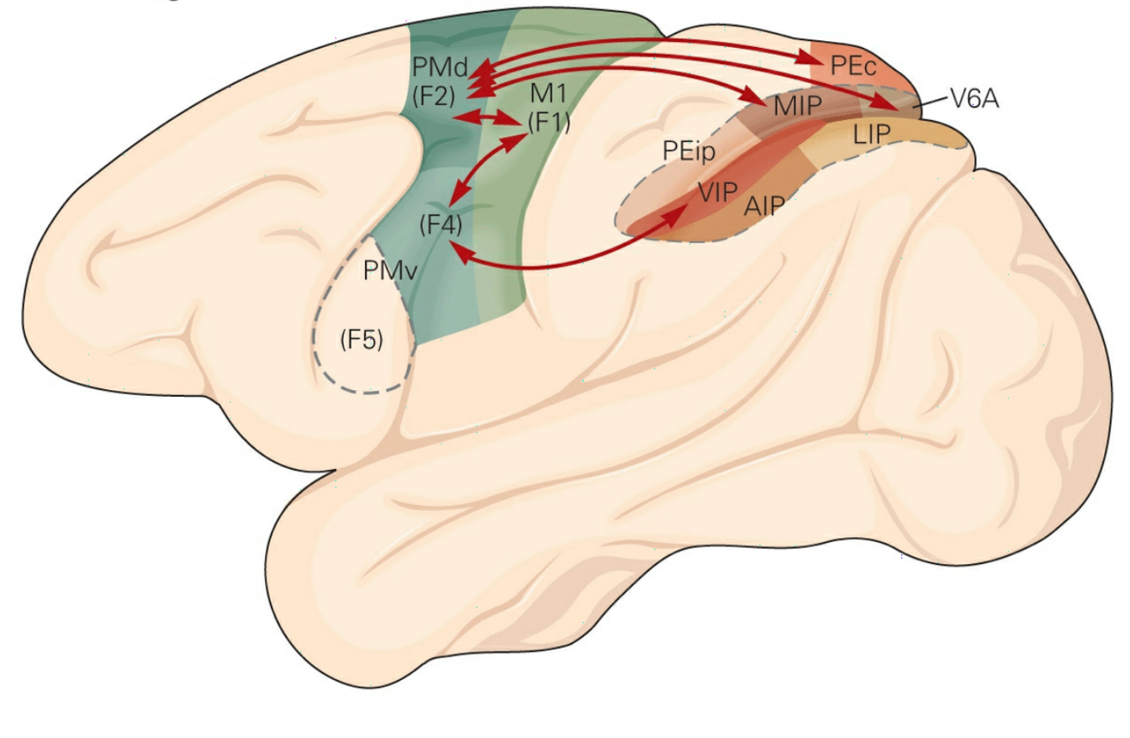
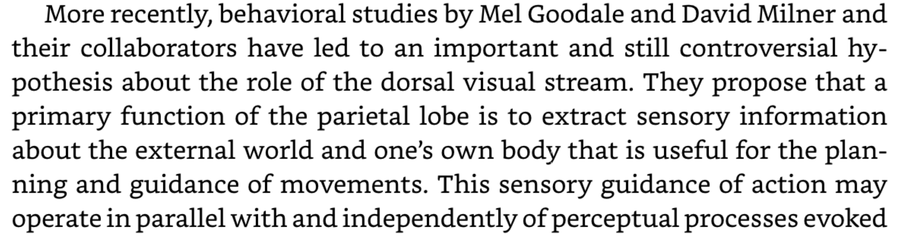
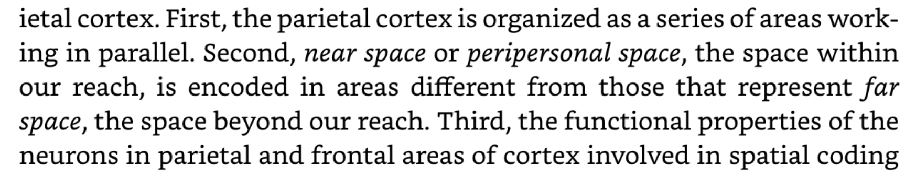
Goals Matter
Parietal Lobe
Dorsal and Ventral Visual Stream
Notes:
The ventral stream has its principal nodes in the ventral intraparietal area (VIP) and area F4 of the ventral premotor cortex, whereas the dorsal stream has synaptic relays in the superior parietal lobe (MIP, V6A) and the dorsal premotor cortex (gPMd), which includes area F2. (Parietal areas include AIP, anterior intraparietal area; LIP, lateral intraparietal area; and V6A, the parietal portion of the parieto-occipital area.) PEc and PEip are parietal areas according to the nomenclature of von Economo. Somatosensory areas 1, 2, and 3 and area PE, which provide somatosensory input to M1 (F1), are not shown in the figure. Precentral areas include F5, a subdivision of PMv, the ventral premotor cortex, and the primary motor cortex (M1, F1).

Slide 31
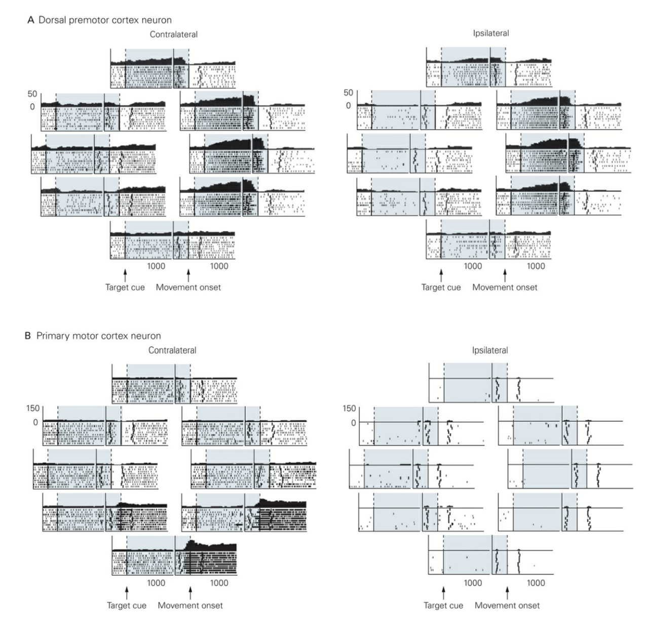
Parietal Projecting Neurons: More About the Goal
Start!
Go!
time

Slide 32
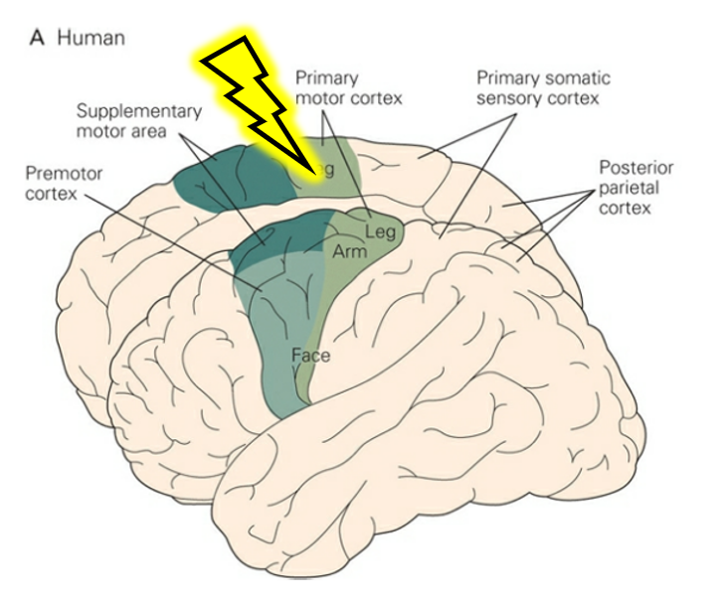
Summary

Slide 33
The Cortex
Synapses & Circuits
Lecture Seven
General Facts
Motor Cortex
Visual Cortex

Slide 34
Vision
Visual
Cortex

Slide 35
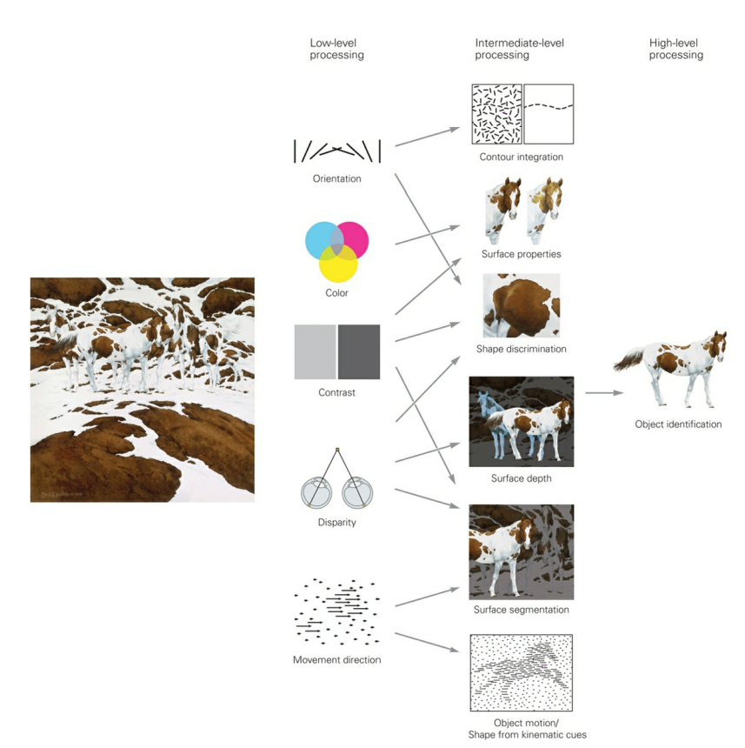
Three Levels of Visual Processing
Hierarchical
Versus
Distributed

Slide 36
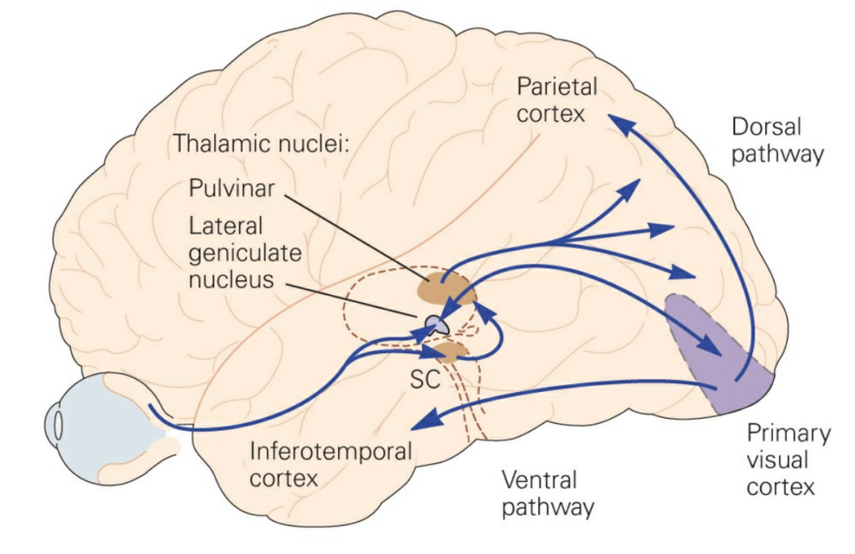
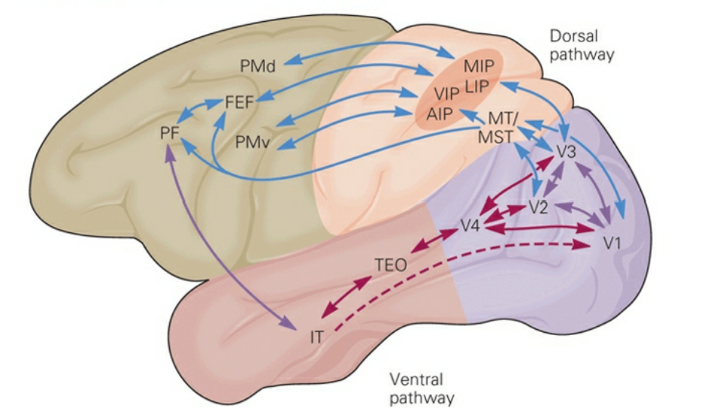
Pathways for Visual Processing

Slide 37
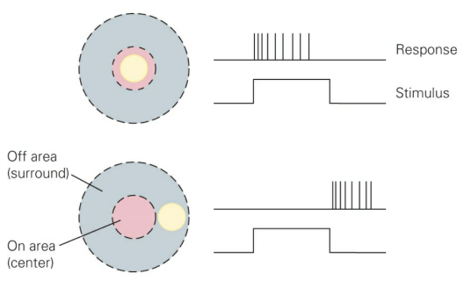
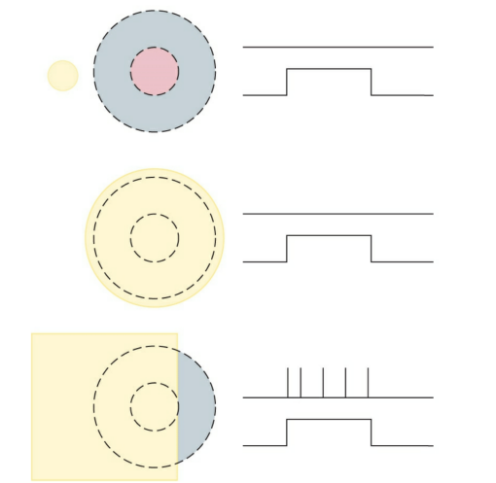
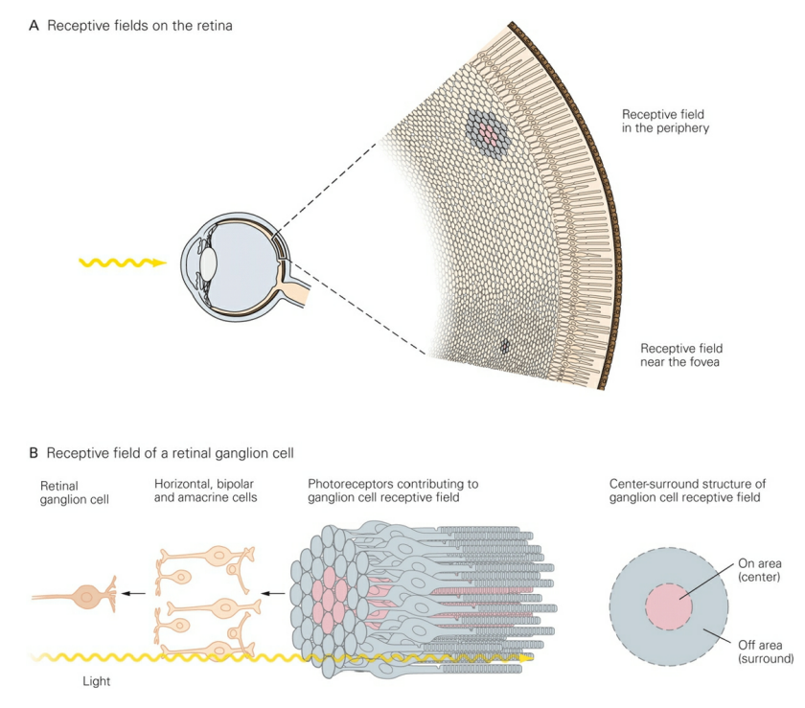
Pathways for Visual Processing

Slide 38

LGN: Things Start to Compartmentalize

Slide 39


Dominance, Pinwheels & Blobs
& Interblobs
Blasdel & Salama, Nature 1986

Slide 40

Dominance, Pinwheels & Blobs
& Interblobs
Bonhoeffer & Hubener, CSHL 2016

Slide 41


A 1mm Chunk of Computational Amazement

Slide 42
A 1mm Chunk of Computational Amazement
Absolutely No Clue

Slide 43


Inputs to the Chunk

Slide 44


Connections In & Around the Chunk

Slide 45

Might Even Be True

Slide 46

Neural Code:
Labeled Lines & Population Coding

Slide 47
Neural Code:
Labeled Lines & Population Coding

Slide 48

Can We Make Computers See?
(& make sense of the neural code)

Slide 49


The Perceptron

Slide 50


To Provide Support For An Old Hypothesis
A
B

Slide 51

The Perceptron: Conjunction & Disjunction

Slide 52

The Perceptron: Conjunction & Disjunction

Slide 53

The Perceptron Meets H&W
Sensitive
&
Invariant

Slide 54


The Neocognitron

Slide 55
The Neocognitron

Slide 56


Vision
Visual
Cortex

Slide 57


good bye

