Slide 1
Cerebellum & Basal Ganglia
Lecture Eight

Slide 2
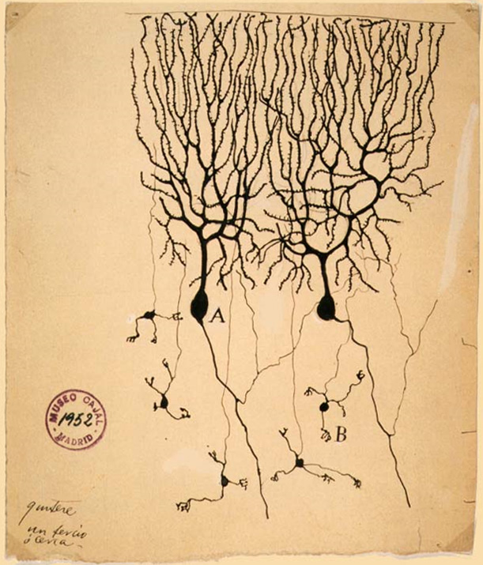
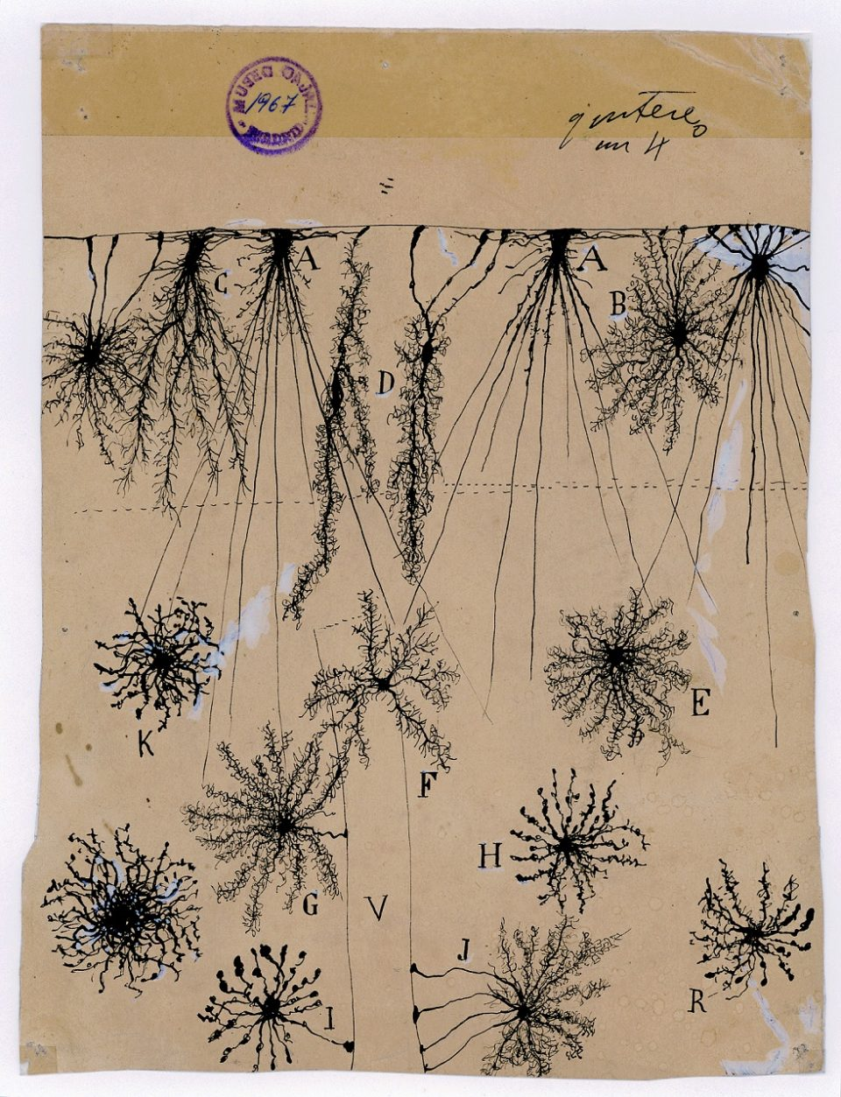
Cerebellum & Basal Ganglia
Cerebellum
Basal Ganglia

Slide 3
Cerebellum & Basal Ganglia
Cerebellum
Basal Ganglia

Slide 4
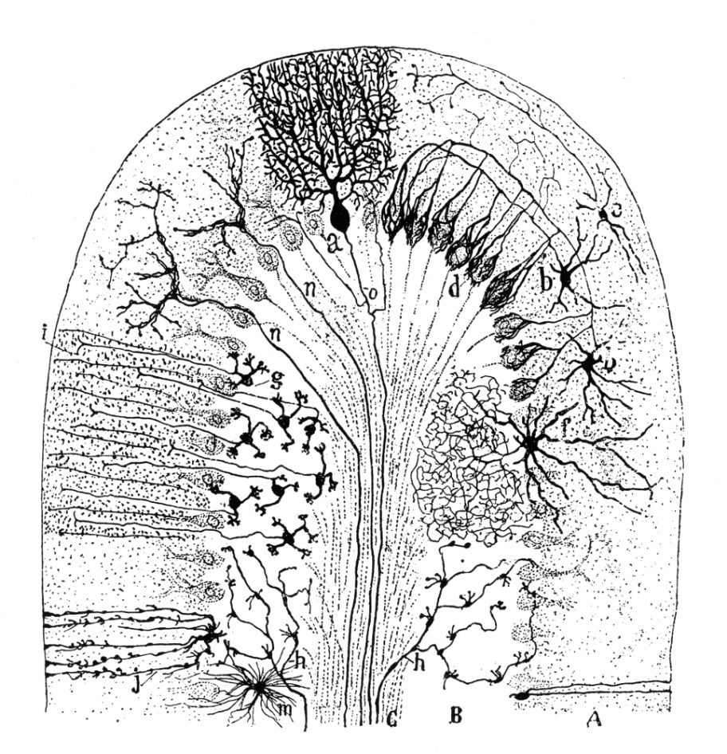
Cerebellum
Cerebellar diseases provide clues about function.
Disorders manifest in four symptoms:
Hypotonia.
Low resistance to passive limb movements.
Astasia-Abasia.
Loss of the ability to maintain a steady limb or body posture across multiple joints (astasia). Loss of ability to maintain upright stance against gravity (abasia).
Ataxia.
Abnormal execution of multi-jointed voluntary movements.
Action Tremor.
Tremor at the end of movement.

Slide 5
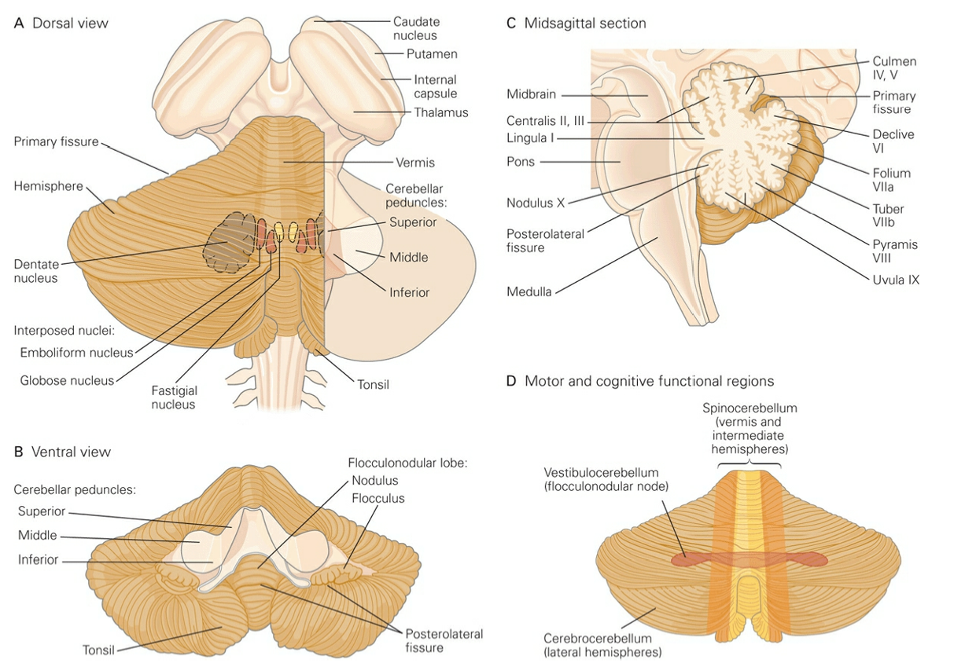
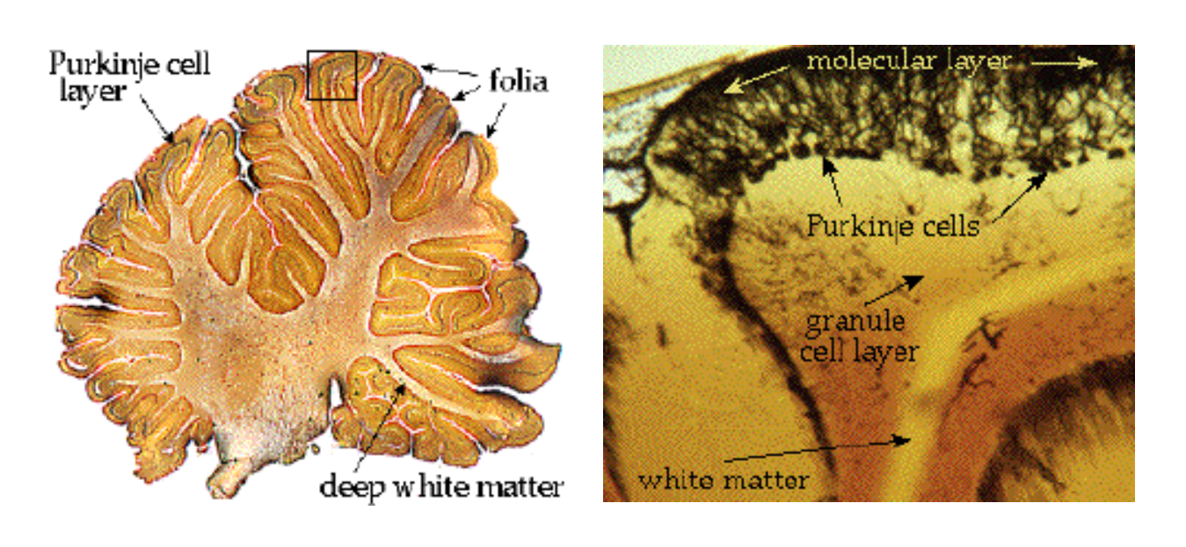
Cerebellum: Distinct Anatomical Regions
Notes:
The cerebellum occupies most of the posterior cranial fossa. It is composed of an outer mantle of gray matter (the cerebellar cortex), internal white matter, and three pairs of deep nuclei: the fastigial nucleus, the interposed nucleus (itself comprising the emboliform and globose nuclei), and the dentate nucleus
The surface of the cerebellum is highly convoluted, with many parallel folds called folia (Latin, leaves).
Kandel, Eric R.. Principles of Neural Science, Fifth Edition (Principles of Neural Science (Kandel)) (Kindle Locations 27453-27454). McGraw-Hill Education. Kindle Edition.

Slide 6
Cerebellum: Distinct Anatomical Regions
Notes:
The cerebellum occupies most of the posterior cranial fossa. It is composed of an outer mantle of gray matter (the cerebellar cortex), internal white matter, and three pairs of deep nuclei: the fastigial nucleus, the interposed nucleus (itself comprising the emboliform and globose nuclei), and the dentate nucleus
The surface of the cerebellum is highly convoluted, with many parallel folds called folia (Latin, leaves).
Kandel, Eric R.. Principles of Neural Science, Fifth Edition (Principles of Neural Science (Kandel)) (Kindle Locations 27453-27454). McGraw-Hill Education. Kindle Edition.

Slide 7
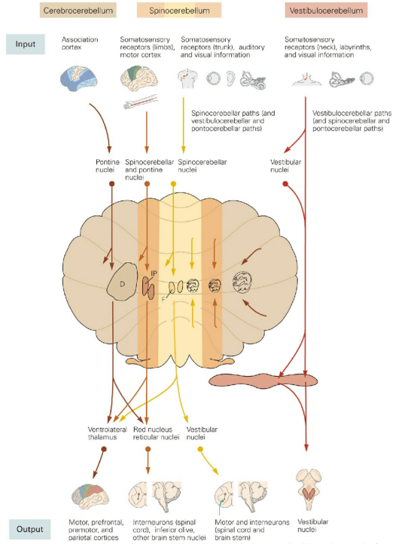
Cerebellum: Distinct Functional Regions

Slide 8
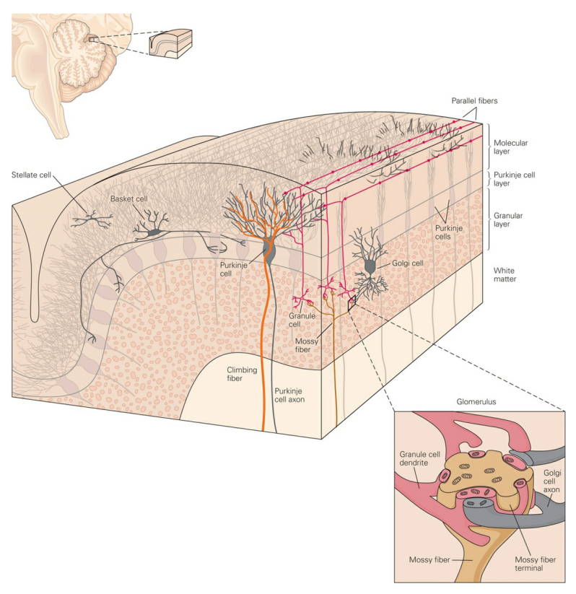
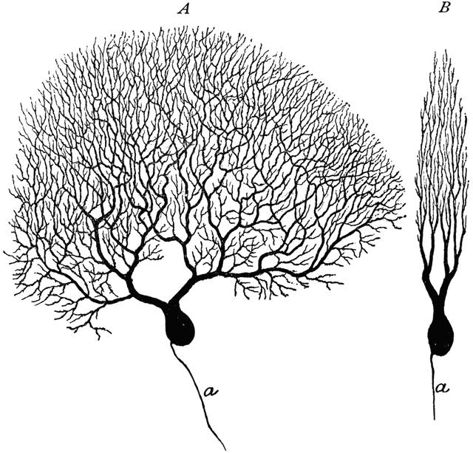
Cerebellar Microcircuits
Four organizing principles:
Cerebellar Cortex: Five types of neurons organized into three layers. Each layer performs a different task.
processing
Molecular Layer
contains 2 inhibitory cell
types: stellate & basket
output
Purkinje Layer
contains Purkinje cells
input
Granular Layer
contains the glomerulus
link
Notes:
100 bn granule cells

Slide 9
Cerebellar Microcircuits
Four organizing principles:
Cerebellar Cortex: Five types of neurons organized into three layers. Each layer performs a different task.
processing
Molecular Layer
contains 2 inhibitory cell
types: stellate & basket
output
Purkinje Layer
contains Purkinje cells
input
Granular Layer
contains the glomerulus
Differential Afferent Codes: Mossy fibers VS climbing fibers.
Purkinje/Molecular Layer
GC
Granular Layer
MF
CF
Originates mostly from cortex. Also from spinal cord & brain stem.
Originates in olivary nucleus.
Wraps around the Purkinje neuron like a vine.
Form excitatory synapses onto granule cells.
Notes:
100 bn granule cells
Mossy fibers originate from cell bodies in the spinal cord and brain stem and carry sensory information from the periphery as well as information from the cerebral cortex. They form excitatory synapses on the dendrites of granule cells in the granular layer (Figure 42–5). Each granule cell receives inputs from just a few mossy fibers, but the architecture of the granule cell axons distributes information widely from each mossy fiber to a large number of Purkinje cells. The mossy fiber input is highly convergent; each Purkinje neuron is contacted by axons from somewhere between 200,000 and 1 million granule cells. Climbing fibers originate in the inferior olivary nucleus and convey sensory information to the cerebellum from both the periphery and the cerebral cortex. The climbing fiber is so named because each enwraps the cell body and proximal dendrites of a Purkinje neuron like a vine on a tree, making numerous synaptic contacts (Figure 42–5). Each climbing fiber contacts 1 to 10 Purkinje neurons, but each Purkinje neuron receives synaptic input from only a single climbing fiber. The terminals of the climbing fibers are arranged topographically in the cerebellar cortex; the axons from clusters of related olivary neurons terminate in thin parasagittal strips that extend across several folia. In turn, the Purkinje neurons within one strip project to a common group of deep nuclear neurons.
Kandel, Eric R.. Principles of Neural Science, Fifth Edition (Principles of Neural Science (Kandel)) (Kindle Locations 27511-27522). McGraw-Hill Education. Kindle Edition.

Slide 10
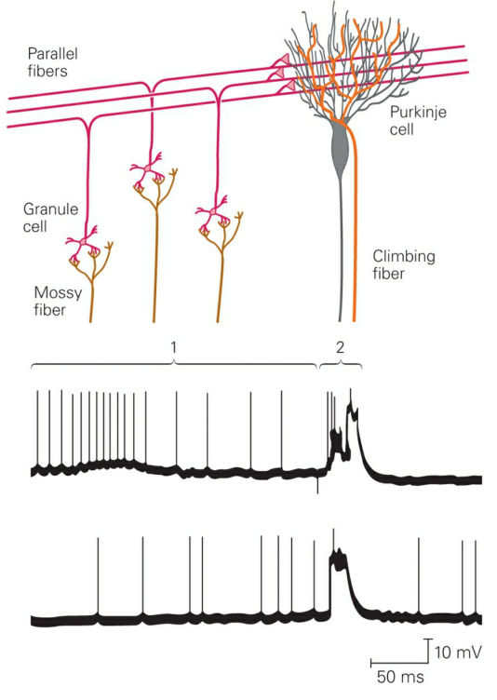
Cerebellar Microcircuits
Four organizing principles:
Cerebellar Cortex: Five types of neurons organized into three layers. Each layer performs a different task.
processing
Molecular Layer
contains 2 inhibitory cell
types: stellate & basket
output
Purkinje Layer
contains Purkinje cells
input
Granular Layer
contains the glomerulus
Differential Afferent Codes: Mossy fibers VS climbing fibers.
Purkinje/Molecular Layer
GC
Granular Layer
MF
CF
Originates mostly from cortex. Also from spinal cord & brain stem.
Originates in olivary nucleus.
Wraps around the Purkinje neuron like a vine.
Form excitatory synapses onto granule cells.
Notes:
Figure 42-5 Simple and complex spikes recorded intracellularly from a cerebellar Purkinje cell. Simple spikes are produced by mossy fiber input (1), whereas complex spikes are evoked by climbing fiber synapses (2). (Reproduced, with permission, from Martinez, Crill, and Kennedy 1971.)
Kandel, Eric R.. Principles of Neural Science, Fifth Edition (Principles of Neural Science (Kandel)) (Kindle Locations 27523-27525). McGraw-Hill Education. Kindle Edition.

Slide 11
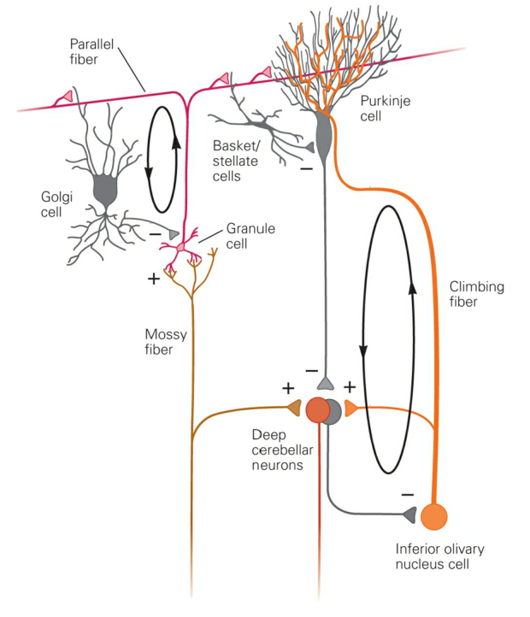
Cerebellar Microcircuits
Local &
Long Range
Four organizing principles:
Cerebellar Cortex: Five types of neurons organized into three layers. Each layer performs a different task.
processing
Molecular Layer
contains 2 inhibitory cell
types: stellate & basket
output
Purkinje Layer
contains Purkinje cells
input
Granular Layer
contains the glomerulus
Differential Afferent Codes: Mossy fibers VS climbing fibers.
Purkinje/Molecular Layer
GC
Granular Layer
MF
CF
Originates mostly from cortex. Also from spinal cord & brain stem.
Originates in olivary nucleus.
Wraps around the Purkinje neuron like a vine.
Form excitatory synapses onto granule cells.
E/I Signals Compared: In deep nuclei & cerebellar cortex.
Recurrent loops: In deep nuclei & cerebellar cortex.
Notes:
An important feature of the cerebellar circuit is that excitatory and inhibitory inputs are compared in both the cerebellar cortex and the deep nuclei. In the deep nuclei inhibitory inputs from Purkinje cells converge with excitatory inputs from mossy and climbing fibers (Figure 42–6).
In the cerebellar cortex excitatory and inhibitory inputs converge on Purkinje cells. Parallel fibers directly excite Purkinje neurons but also indirectly inhibit them through disynaptic connections from the stellate, basket, and Golgi interneurons. The short axons of stellate cells contact the nearby dendrites of Purkinje cells, whereas the long axons of basket cells run perpendicular to the parallel fibers and form synapses on the Purkinje cell bodies (Figure 42–4). The stellate cells have an inhibitory regulatory effect on the Purkinje cells that is local in that a stellate cell and the Purkinje cell it contacts are both excited by the same parallel fibers. In contrast, the basket cells create flanks of inhibition of Purkinje cells that are excited by flanking beams of parallel fibers other than the central beam that causes the lateral inhibition.
Figure 42-6 Synaptic organization of the cerebellar microcircuit. Excitation and inhibition converge both in the cerebellar cortex and in the deep nuclei. Recurrent loops involve Golgi cells within the cerebellar cortex and the inferior olive outside the cerebellum. (Adapted, with permission, from Raymond, Lisberger, and Mauk 1996.)
Kandel, Eric R.. Principles of Neural Science, Fifth Edition (Principles of Neural Science (Kandel)) (Kindle Locations 27547-27550). McGraw-Hill Education. Kindle Edition.

Slide 12
Cerebellar Microcircuits
Four organizing principles:
Cerebellar Cortex: Five types of neurons organized into three layers. Each layer performs a different task.
processing
Molecular Layer
contains 2 inhibitory cell
types: stellate & basket
output
Purkinje Layer
contains Purkinje cells
input
Granular Layer
contains the glomerulus
Differential Afferent Codes: Mossy fibers VS climbing fibers.
Purkinje/Molecular Layer
How about now?
GC
Granular Layer
MF
CF
Originates mostly from cortex. Also from spinal cord & brain stem.
Originates in olivary nucleus.
Wraps around the Purkinje neuron like a vine.
Form excitatory synapses onto granule cells.
E/I Signals Compared: In deep nuclei & cerebellar cortex.
Recurrent loops: In deep nuclei & cerebellar cortex.
Notes:
An important feature of the cerebellar circuit is that excitatory and inhibitory inputs are compared in both the cerebellar cortex and the deep nuclei. In the deep nuclei inhibitory inputs from Purkinje cells converge with excitatory inputs from mossy and climbing fibers (Figure 42–6).
In the cerebellar cortex excitatory and inhibitory inputs converge on Purkinje cells. Parallel fibers directly excite Purkinje neurons but also indirectly inhibit them through disynaptic connections from the stellate, basket, and Golgi interneurons. The short axons of stellate cells contact the nearby dendrites of Purkinje cells, whereas the long axons of basket cells run perpendicular to the parallel fibers and form synapses on the Purkinje cell bodies (Figure 42–4). The stellate cells have an inhibitory regulatory effect on the Purkinje cells that is local in that a stellate cell and the Purkinje cell it contacts are both excited by the same parallel fibers. In contrast, the basket cells create flanks of inhibition of Purkinje cells that are excited by flanking beams of parallel fibers other than the central beam that causes the lateral inhibition.
Figure 42-6 Synaptic organization of the cerebellar microcircuit. Excitation and inhibition converge both in the cerebellar cortex and in the deep nuclei. Recurrent loops involve Golgi cells within the cerebellar cortex and the inferior olive outside the cerebellum. (Adapted, with permission, from Raymond, Lisberger, and Mauk 1996.)
Kandel, Eric R.. Principles of Neural Science, Fifth Edition (Principles of Neural Science (Kandel)) (Kindle Locations 27547-27550). McGraw-Hill Education. Kindle Edition.

Slide 13
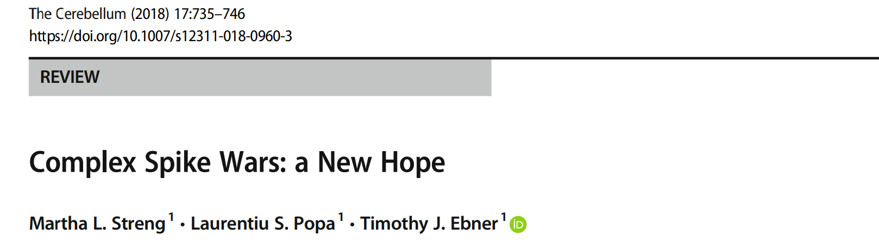
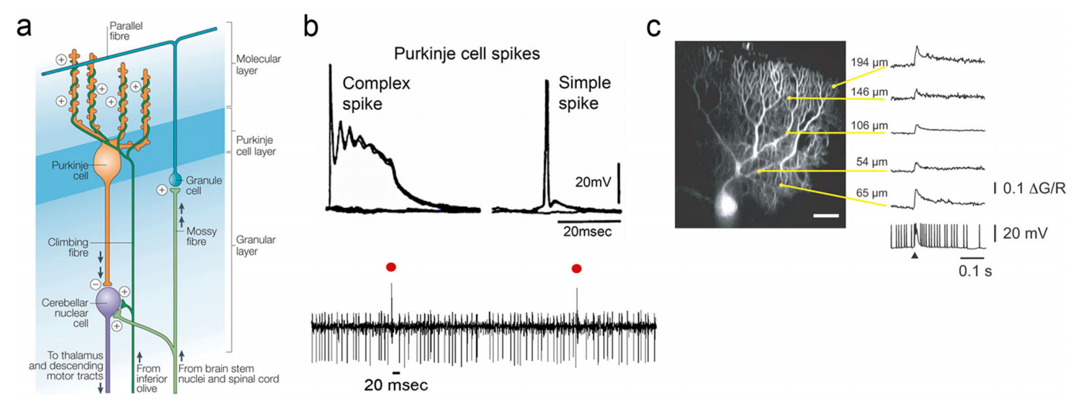
Emerging Perspectives
Driven by
Climbing Fibers
Driven by
Mossy/Parallel Fibers
Co-Activation Promotes LTD.
LTD at parallel fiber-PC synapse is important for motor learning

Slide 14
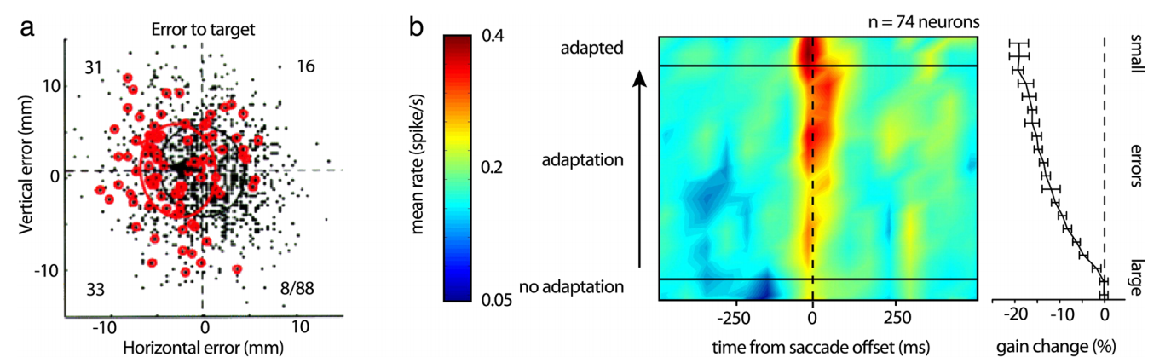
Error Hypothesis
= Error Signal
Does not = Error Signal

Slide 15
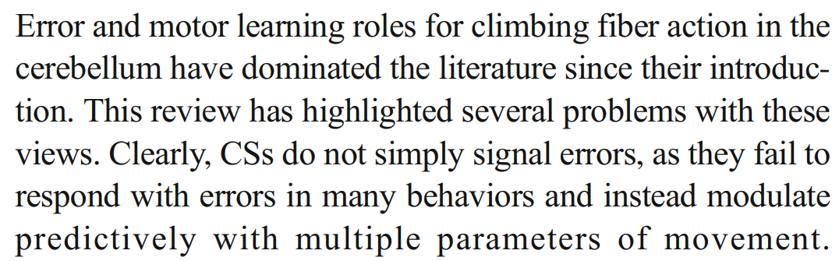
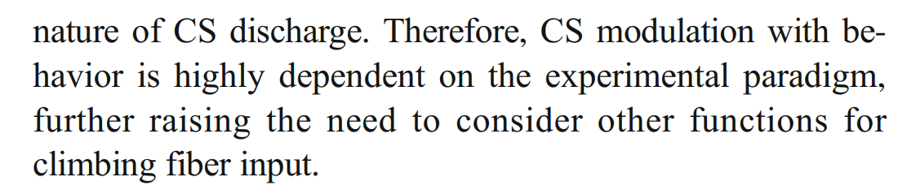
Error Hypothesis
= Error Signal
Does not = Error Signal

Slide 16
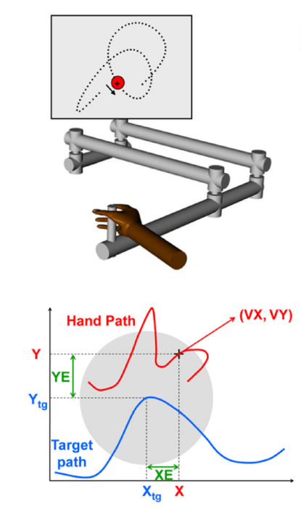
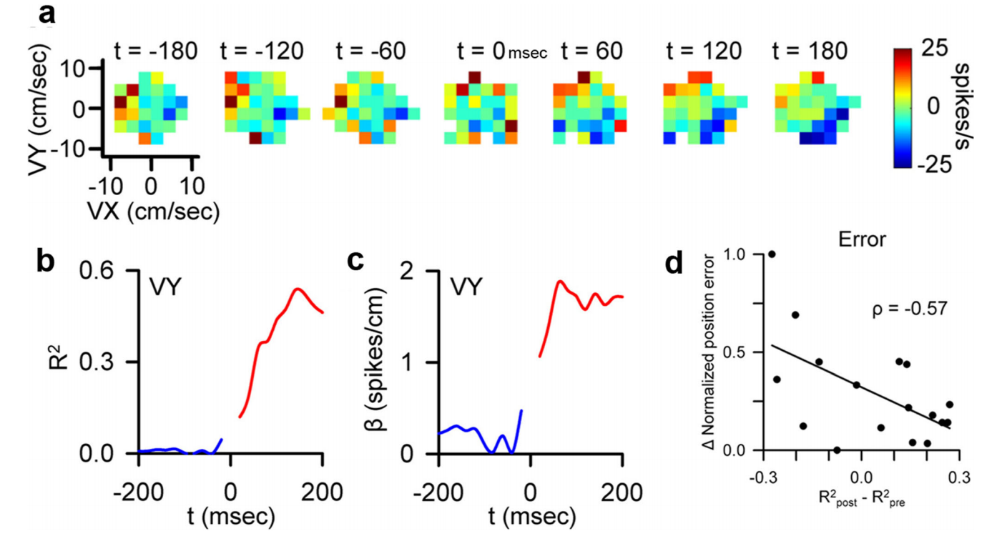
Dynamic Encoding

Slide 17
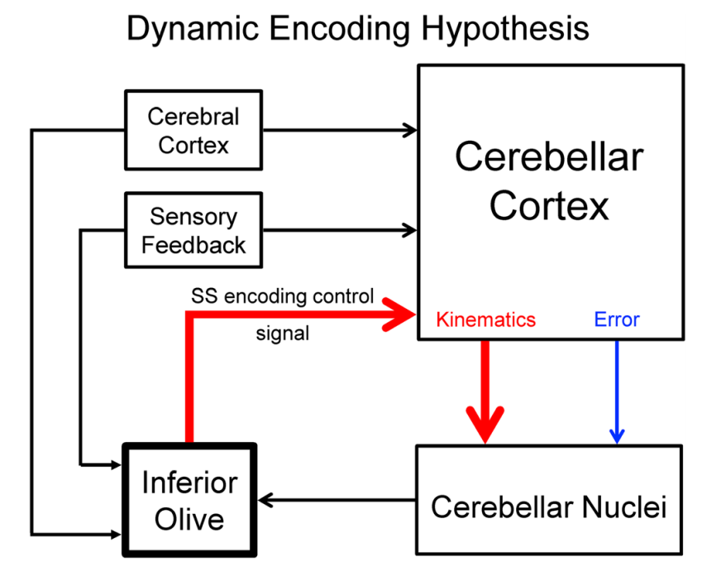
Dynamic Encoding

Slide 18
Cerebellum & Basal Ganglia
Cerebellum
Basal Ganglia

Slide 19
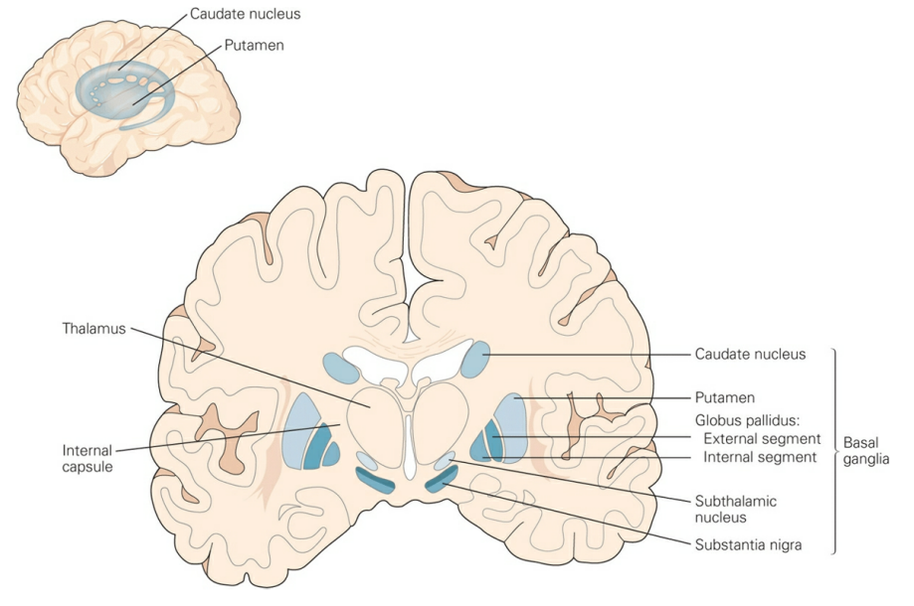
The Basal Ganglia
General Function:
Movement: Traditional view biased by prominent movement-based disorders (Parkinson & Huntington).
Nonmotor: Basal ganglia dysfunction also associated with complex behavioral and neuropsychiatric disorders.
Consist of several interconnected nuclei.
Striatum: major input structure of basal ganglia. Includes caudate nucleus & putamen (separated by internal capsule).
Globus pallidus: contains 2 separate nuclei (external & internal). Internal structure is major output structure of basal ganglia. External contains circuits intrinsic to basal ganglia.
Substantia nigra: contains pars compacta and pars reticulata (another major output).
Subthalamic nucleus: small nucleus between the thalamus & substantia nigra.
Notes:
Figure 43-1 The basal ganglia and surrounding structures. The nuclei of the basal ganglia are identified on right in this coronal section. (Adapted, with permission, from Nieuwenhuys, Voogd, and van Huijzen 1981.) The striatum is separated by the internal capsule into the caudate nucleus and the putamen. The striatum is the major input structure of the basal ganglia, receiving prominent projections from the cerebral cortex, brain stem, and thalamus. The globus pallidus consists of two separate nuclei, the external and internal segments, each with different connectivity and functions. The internal segment is one of the major output structures of the basal ganglia, whereas the external segment is part of their intrinsic circuitry. The substantia nigra includes two separate nuclei, the pars compacta and pars reticulata. Along with portions of the ventral tegmental area and other midbrain areas, the pars compacta, or mediodorsal portion of the substantia nigra, contains dopaminergic cells that project heavily to the striatum and to the other nuclei of the basal ganglia. The pars reticulata, or ventrolateral portion of the substantia nigra, is the other major output nucleus of the basal ganglia. In fact, the pars reticulata of the substantia nigra and the internal segment of the globus pallidus can be viewed as a single output structure divided by the internal capsule. The fourth principal structure of the basal ganglia, the subthalamic nucleus, is a small nucleus situated between the thalamus and the substantia nigra. This nucleus receives projections from the external segment of the globus pallidus, the cerebral cortex, thalamus, and brain stem, and sends output to both segments of the globus pallidus and to the substantia nigra pars reticulata. The cortical inputs to the subthalamic nucleus and the related subthalamopallidal projections are referred to as the hyperdirect pathway (Figure 43–2).
Kandel, Eric R.. Principles of Neural Science, Fifth Edition (Principles of Neural Science (Kandel)) (Kindle Locations 27977-27991). McGraw-Hill Education. Kindle Edition.

Slide 20
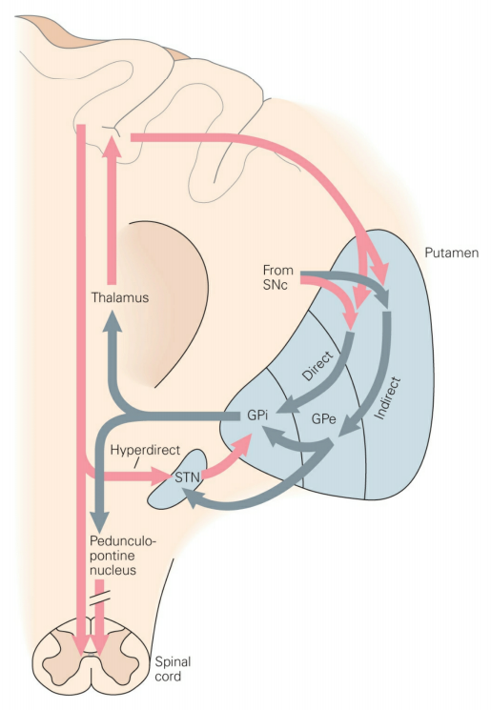
Basal Ganglia Pathways
Notes:
Figure 43-2 The basal ganglia–thalamocortical circuitry. The circuitry of the basal ganglia includes the striatum (here represented by one of its components, the putamen), the external and internal segments of the globus pallidus (GPe and GPi, respectively), the substantia nigra pars reticulata (not shown) and pars compacta (SNc), and the subthalamic nucleus (STN). Cortical input enters the striatum and subthalamic nucleus. Basal ganglia output is conveyed to several thalamic nuclei (the centromedian and parafascicular nuclei and the ventral anterior and ventral lateral nuclei) and the pedunculopontine nucleus. Excitatory connections are shown in red, inhibitory pathways in gray. The dopaminergic SNc projection to the striatum regulates corticostriatal transmission along direct and indirect pathways.
The output nuclei project to specific thalamic and brain stem areas. Projections to the thalamus are directed to the ventral anterior, the ventrolateral, and the intralaminar nuclei. Thalamic projections to the frontal lobe then transmit the output of the basal ganglia to the same areas of frontal cortex that provide input to the basal ganglia.

Slide 21
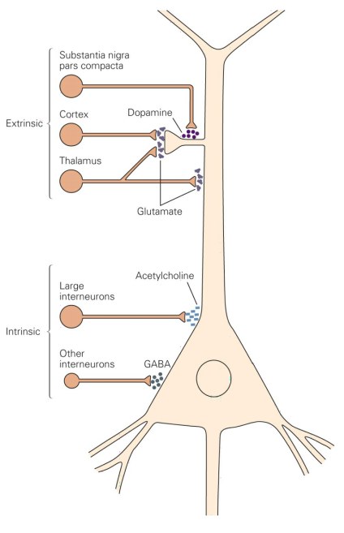
Basal Ganglia Pathways
Medium Spiny Neuron (MSN)
Notes:
In the striatum the most common neuronal cell type is the GABAergic (γ-aminobutyric acid) medium spiny neuron. These cells are so named because of the abundance of spines on their dendrites. They receive inputs from the cerebral cortex and thalamus as well as from several classes of local interneurons in the striatum, including large cholinergic interneurons and smaller GABAergic interneurons.
Kandel, Eric R.. Principles of Neural Science, Fifth Edition (Principles of Neural Science (Kandel)) (Kindle Locations 28008-28011). McGraw-Hill Education. Kindle Edition.

Slide 22
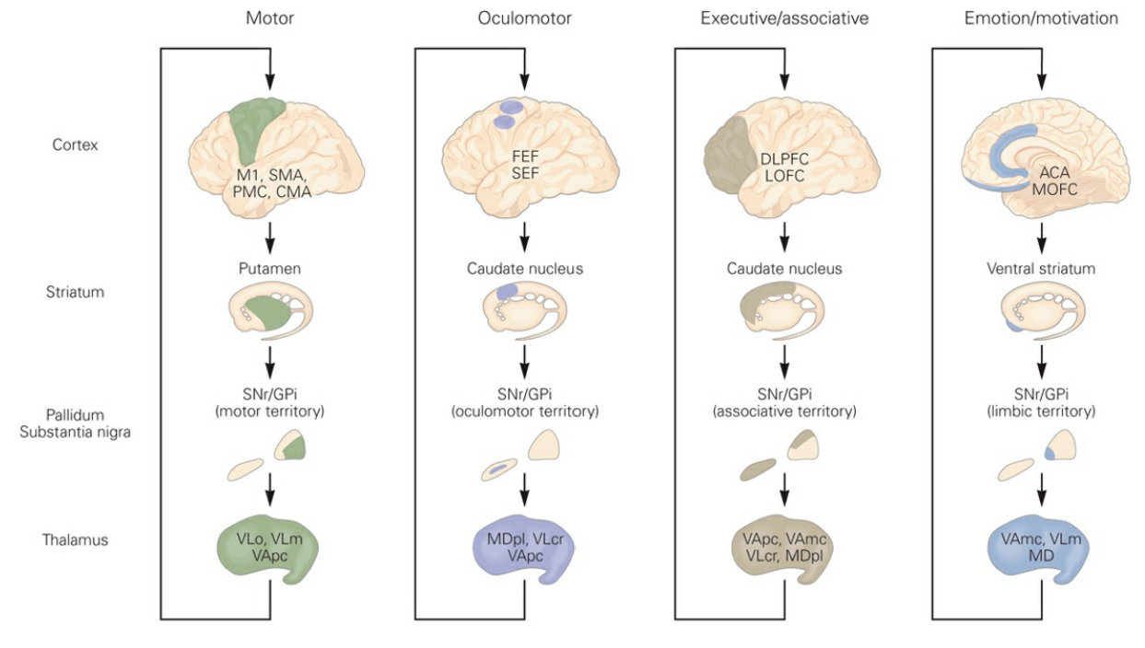
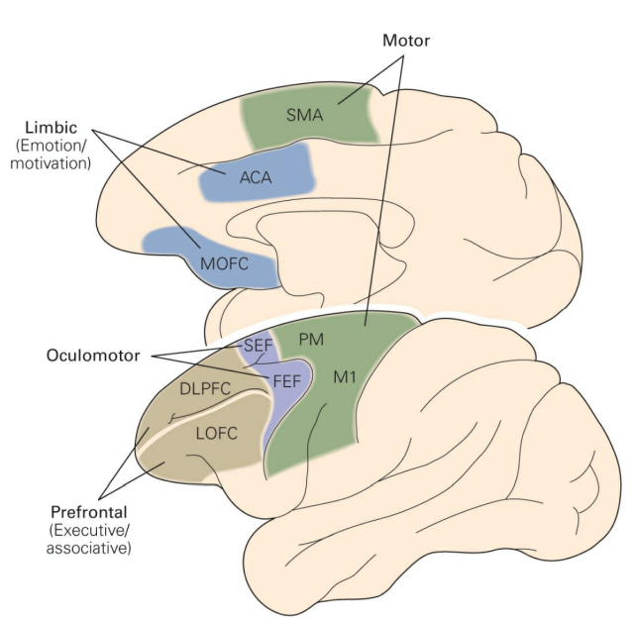
4 Cortico-BG-TC Circuits
1 circuit template.
Cortex
BG
Thalamus
4 functions, 4 circuits (highly topographic):
Skeletomotor.
Oculomotor.
Associative.
Limbic.

Slide 23
4 Cortico-BG-TC Circuits
1 circuit template.
Cortex
BG
Thalamus
4 functions, 4 circuits (highly topographic):
Skeletomotor.
Oculomotor.
Associative.
Limbic.
Notes:
Figure 43-5 Global anatomy of cortico–basal ganglia–thalamocortical circuits. (ACA, anterior cingulate area; CMA, cingulate motor area; DLPFC, dorsolateral pre-frontal cortex; FEF, frontal eye field; GPi, internal segment of the globus pallidus; LOFC, lateral orbitofrontal cortex; M1, primary motor cortex; MDpl, mediodorsal nucleus of thalamus, lateral part; MOFC, medial orbitofrontal cortex; PMC, premotor cortex; SEF, supplementary eye field; SMA, supplementary motor area; SNr, substantia nigra pars reticulata; VAmc, ventral anterior nucleus of thalamus, thalamus, magnocellular part; VApc, ventral anterior nucleus of thalamus, parvocellular part; VLcr, ventrolateral nucleus of thalamus, caudal part, rostral division; VLm, ventrolateral nucleus of thalamus, medial part; VLo, ventrolateral nucleus of thalamus, pars oralis.) (Adapted, with permission, from Wichmann and DeLong 2006.)
The centromedian nucleus, one of the intralaminar nuclei of the thalamus, projects largely to the putamen as part of a subcortical feedback loop.
Kandel, Eric R.. Principles of Neural Science, Fifth Edition (Principles of Neural Science (Kandel)) (Kindle Locations 28061-28062). McGraw-Hill Education. Kindle Edition.
Kandel, Eric R.. Principles of Neural Science, Fifth Edition (Principles of Neural Science (Kandel)) (Kindle Locations 28041-28043). McGraw-Hill Education. Kindle Edition.

Slide 24
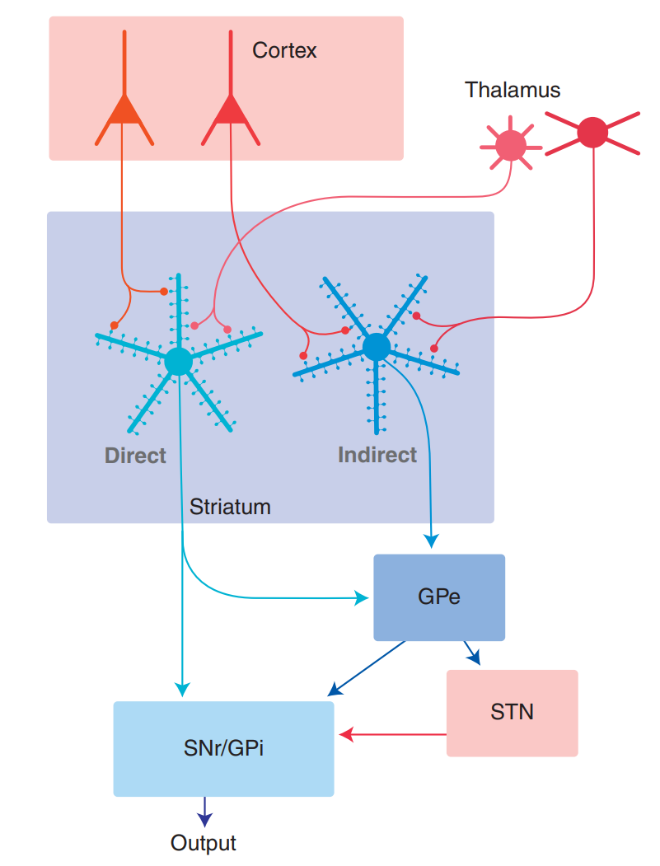
4 Cortico-BG-TC Circuits
1 circuit template.
Cortex
BG
Thalamus
4 functions, 4 circuits (highly topographic):
What it boils down to is what
subset of MSN’s are activated
Glut
GPo
GABA
indirect
direct
CTX
MSN
GPi
Thal
cortical output
Notes:
Bolam:
The essential computation performed by the striatum is the selection of which MSNs will fi re, the consequence of which is altered fi ring of basal ganglia output neurons and hence the selection of the basal ganglia–associated behavior.
Under resting conditions the large population of MSNs is in a quiescent relatively hyperpolarized state, and selected MSNs or groups of MSNs are activated by afferent excitatory input/drive originating in the cortex and thalamus ( Fig. 11.1 ). 2. The response of MSNs to excitatory drive from the cortex and thalamus is modifi ed by the local collaterals of the MSNs (feedback inhibition) and the activity of GABAergic interneurons (feedforward inhibition; Fig. 11.2 ).

Slide 25
4 Cortico-BG-TC Circuits
1 circuit template.
Cortex
BG
Thalamus
4 functions, 4 circuits (highly topographic):
What it boils down to is what
subset of MSN’s are activated
Glut
GPo
GABA
indirect
direct
CTX
MSN
GPi
Thal
cortical output

Slide 26
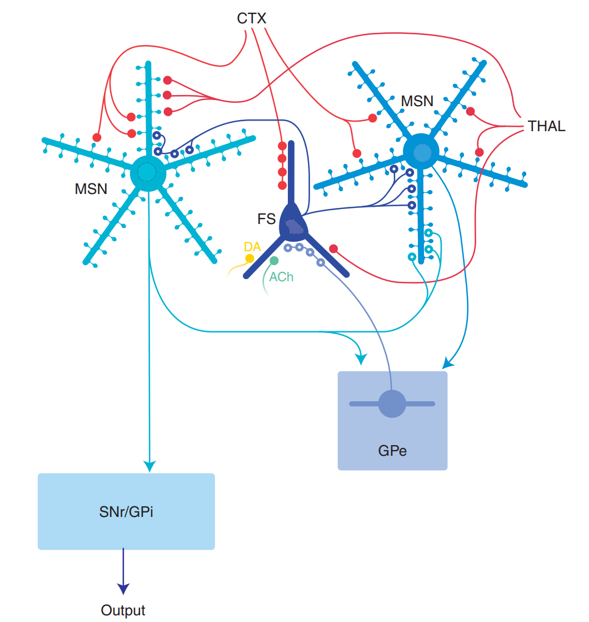
4 Cortico-BG-TC Circuits
1 circuit template.
Cortex
BG
Thalamus
4 functions, 4 circuits (highly topographic):
What it boils down to is what
subset of MSN’s are activated
Glut
GPo
GABA
indirect
direct
CTX
MSN
GPi
Thal
cortical output

Slide 27
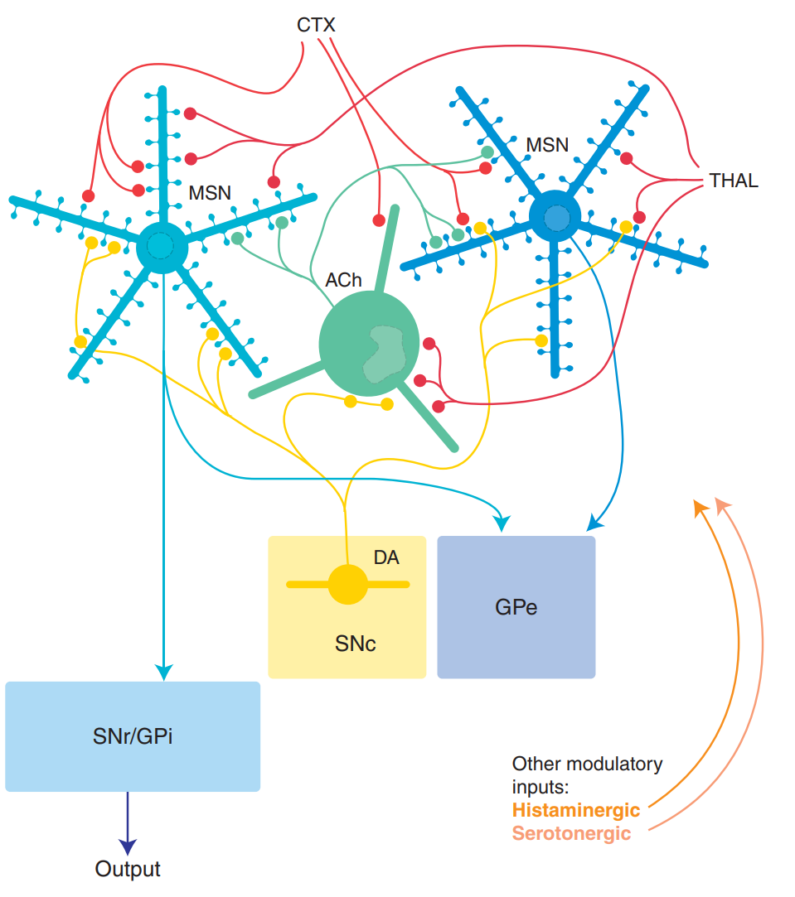
4 Cortico-BG-TC Circuits
1 circuit template.
Cortex
BG
Thalamus
4 functions, 4 circuits (highly topographic):
What it boils down to is what
subset of MSN’s are activated
Glut
GPo
GABA
indirect
direct
CTX
MSN
GPi
Thal
cortical output

Slide 28
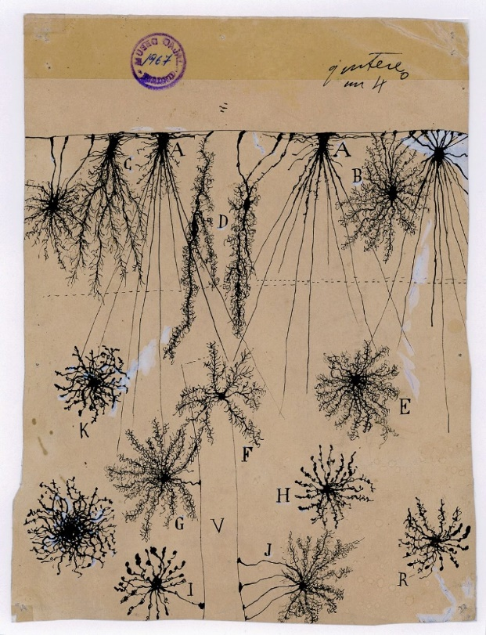
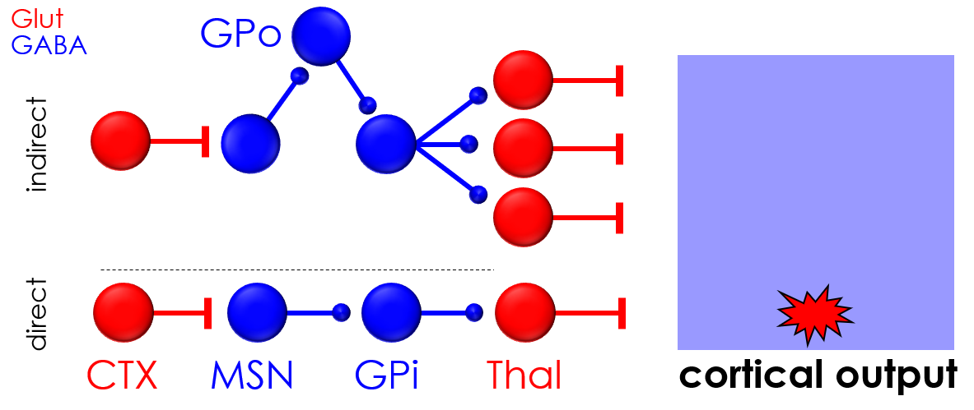
Circuits
Cerebellum
Basal Ganglia

Slide 29


