Slide 1
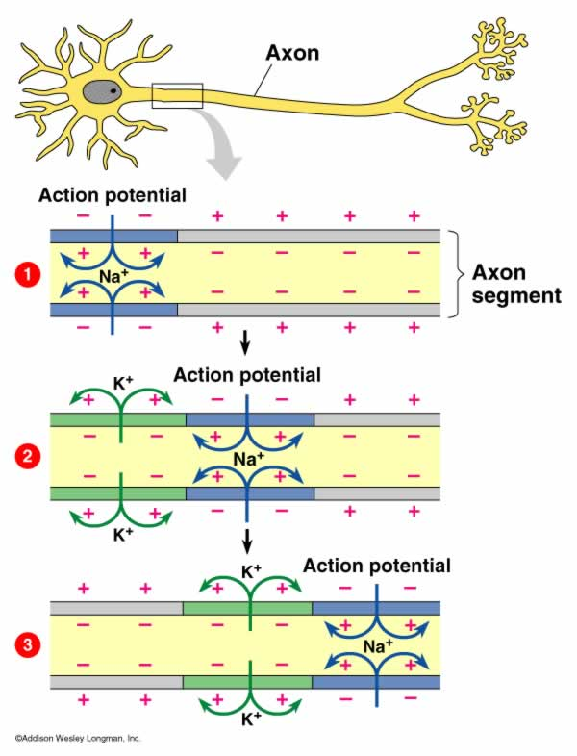
Spike Timing Dependent Plasticity
soma
dendrite
axon

Slide 2
Spike Timing Dependent Plasticity
soma
dendrite
axon
dendrite
soma
axon

Slide 3
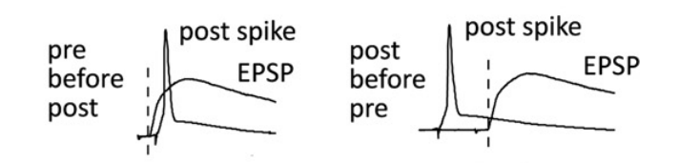
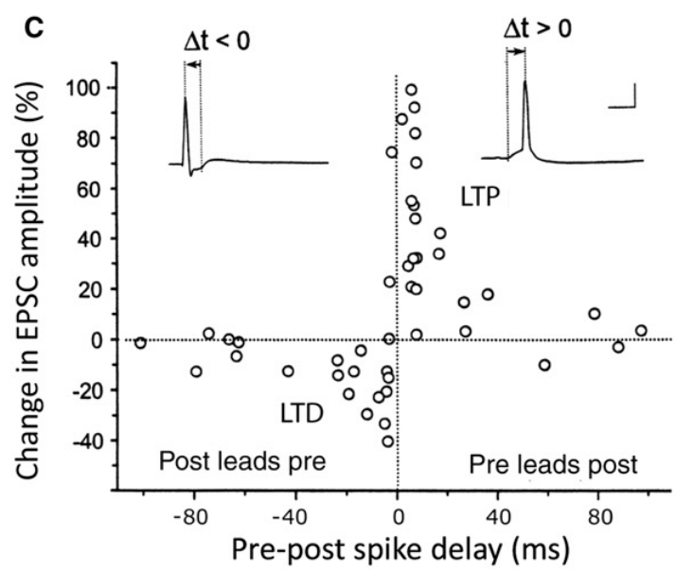
Spike Timing Dependent Plasticity
soma
soma
dendrite
axon
dendrite
axon
dendrite
soma
axon

Slide 4
Lessons from Crunchies & Squishies
Synapses & Circuits
Lecture Seven

Slide 5
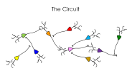

The Synapse
receptors
vesicle
pre
post

Slide 6
The Circuit

Slide 7
Lessons from Crunchies & Squishies
Synapses & Circuits
Lecture Seven

Slide 8
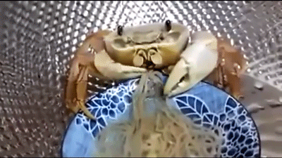
Crabs Eat

Slide 9
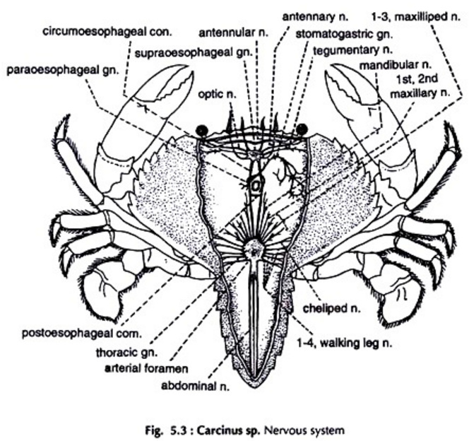
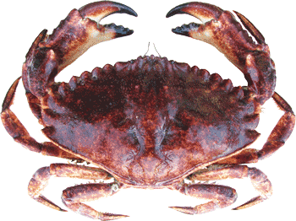
The Rock Crab

Slide 10
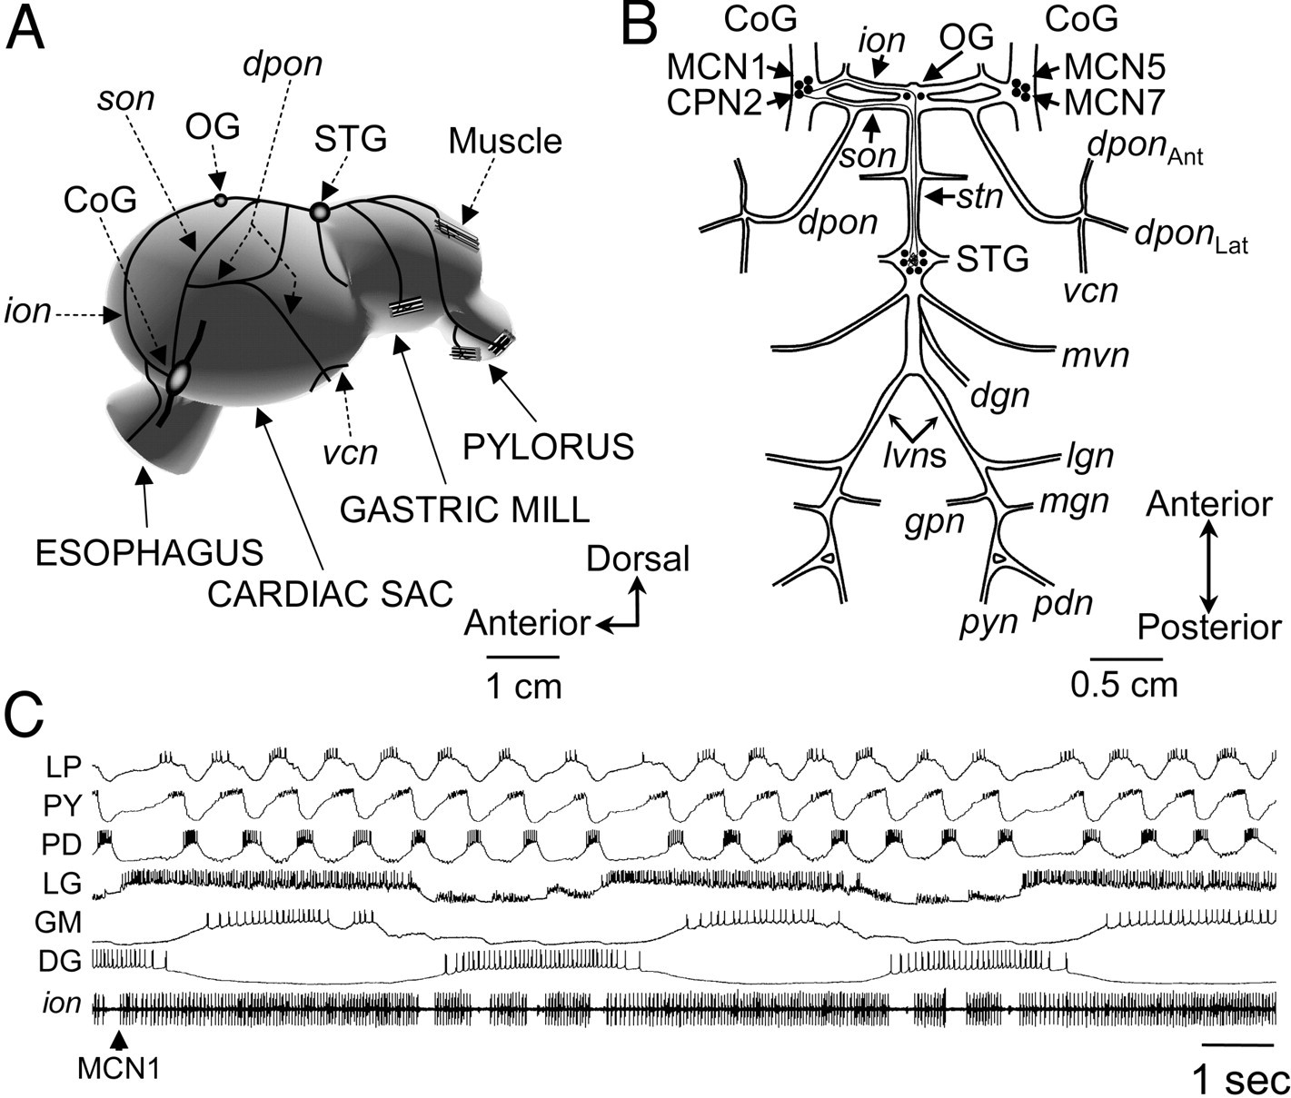
The Rock Crab Belly

Slide 11
The Rock Crab Belly
Stomatogastric Nervous System

Slide 12
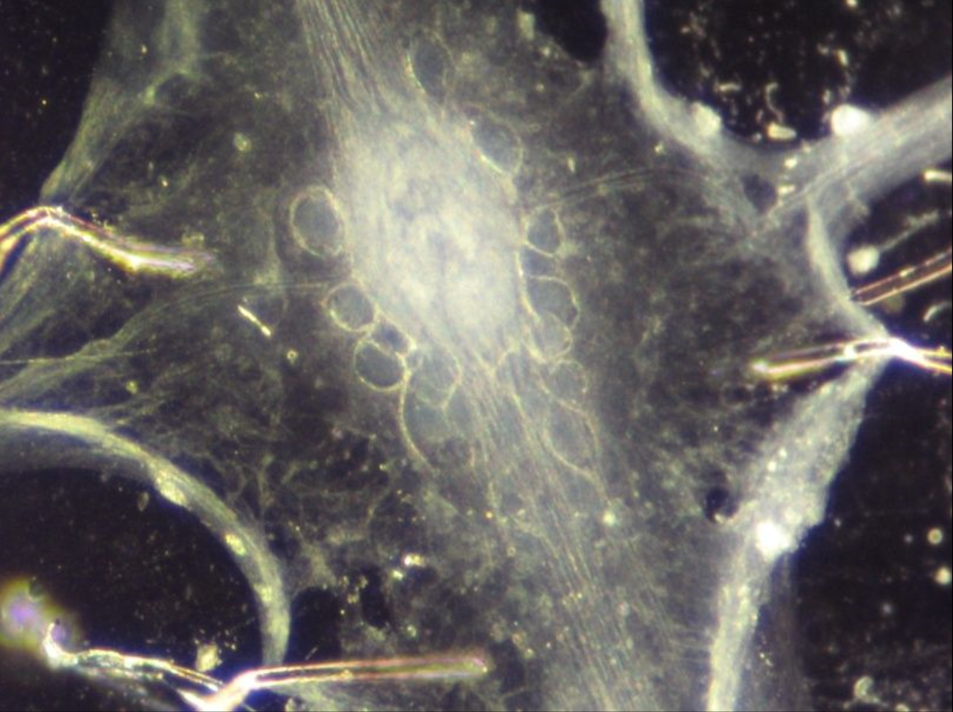
Stomatogastric Ganglion (STG)
Stomatogastric Nervous System
Stomatogastric Ganglion

Slide 13
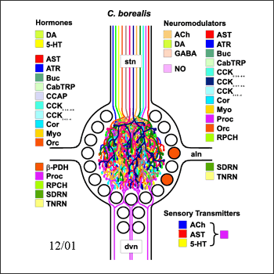

Stomatogastric Ganglion (STG)
Stomatogastric Nervous System
Stomatogastric Ganglion
Eve Marder

Slide 14
Stomatogastric Ganglion (STG)
Stomatogastric Nervous System
Stomatogastric Ganglion
Eve Marder

Slide 15


Motor Patterns Generated By The STG
Stomatogastric Nervous System
Stomatogastric Ganglion

Slide 16
Motor Patterns Generated By The STG
Stomatogastric Nervous System
Stomatogastric Ganglion
Pyloric Rhythm

Slide 17
Motor Patterns Generated By The STG
Stomatogastric Nervous System
Stomatogastric Ganglion
Gastric Mill Rhythm

Slide 18
Motor Patterns Generated By The STG
Stomatogastric Nervous System
Stomatogastric Ganglion
Descending Projection
Neurons

Slide 19
Motor Patterns Generated By The STG
Stomatogastric Nervous System
Stomatogastric Ganglion
Descending Projection
Neurons
Pyloric Rhythm
Gastric Mill Rhythm

Slide 20

The Rock Crab Belly

Slide 21
Motor Patterns Generated By The STG
Stomatogastric Nervous System
Stomatogastric Ganglion
Descending Projection
Neurons
Pyloric Rhythm
Gastric Mill Rhythm

Slide 22
Motor Patterns Generated By The STG
Stomatogastric Nervous System
Stomatogastric Ganglion
Descending Projection
Neurons
Pyloric Rhythm
Gastric Mill Rhythm

Slide 23
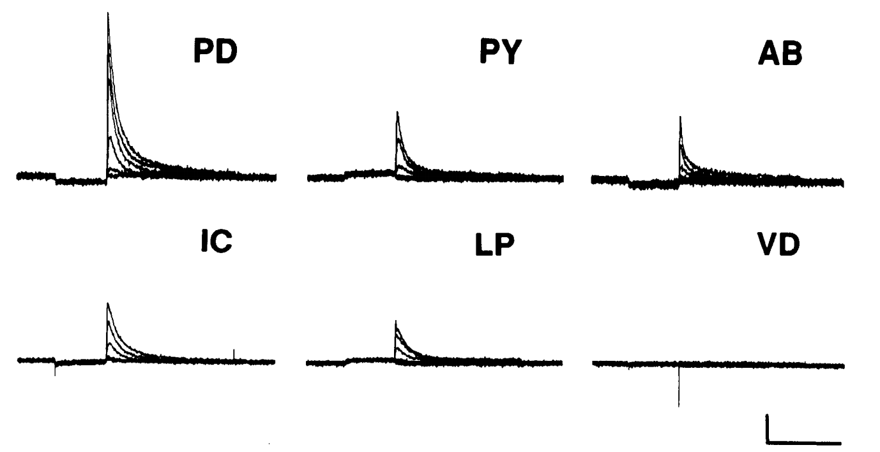
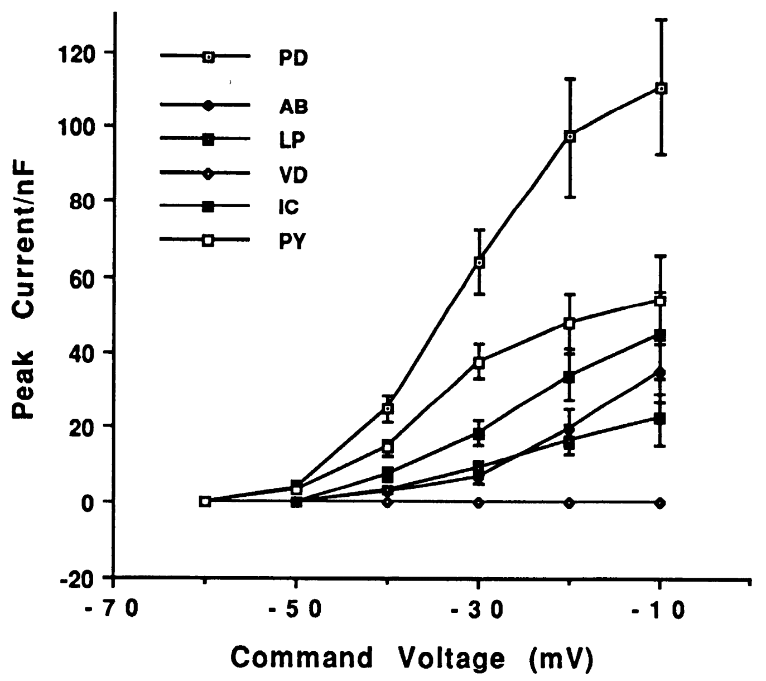
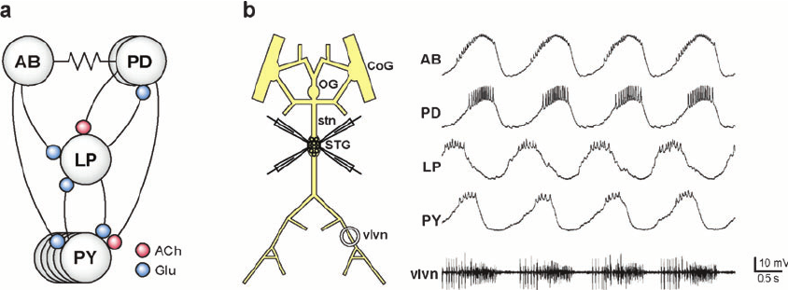
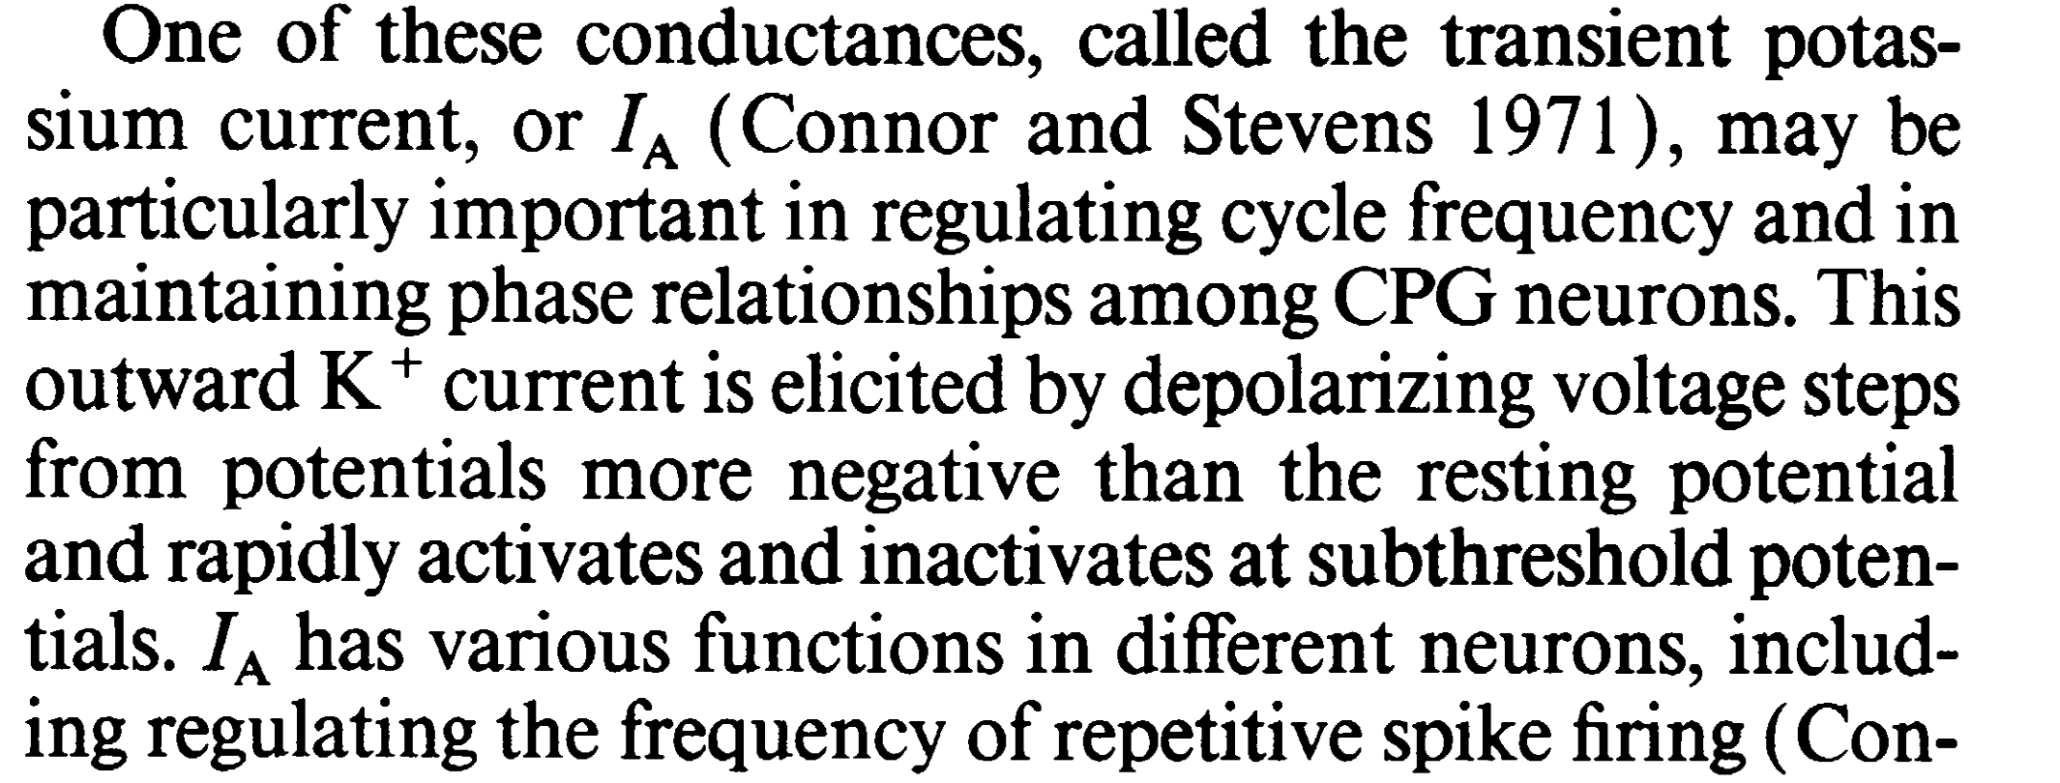
The Pyloric Rhythm
LP
PY
Lessons Learned
Pacemaker neurons are awesome.
Electrical coupling matters.
Circuit activity is sculpted by both (1) connections, (2) intrinsic membrane properties. You need to understand both for a complete picture.
Pacemaker Neuron
I_{A}
Stomatogastric Ganglion
AB
LP
PY
PD

Slide 24
The Gastric Mill Rhythm
Stomatogastric Nervous System
Stomatogastric Ganglion
Descending Projection
Neurons
Pyloric Rhythm
Gastric Mill Rhythm

Slide 25
The Gastric Mill Rhythm
Stomatogastric Nervous System

Slide 26
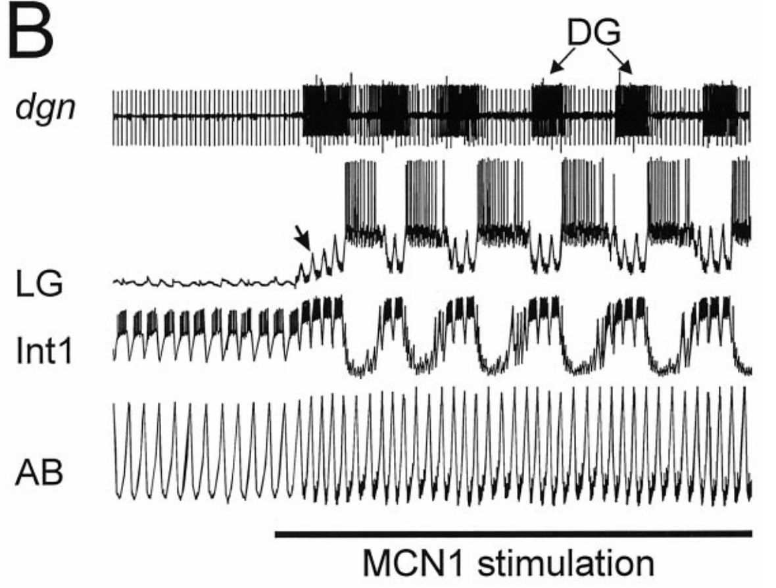
The Gastric Mill Rhythm
CoG
MCN
1
Stomatogastric Nervous System
CabTRP
STG
DG
LG
Int
1
AB

Slide 27
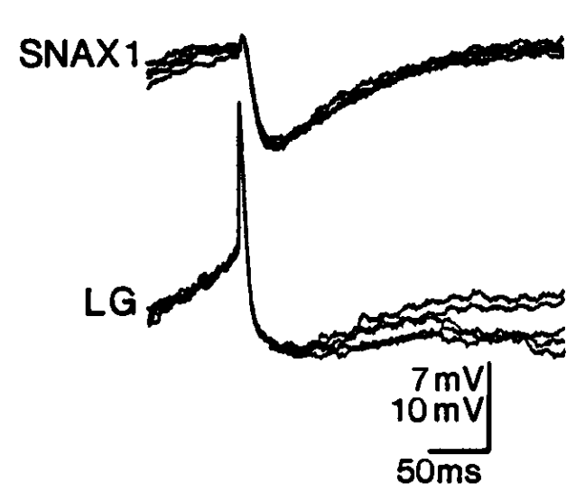
The Gastric Mill Rhythm
CoG
MCN
1
Stomatogastric Nervous System
CabTRP
STG
DG
LG
Int
1
AB

Slide 28
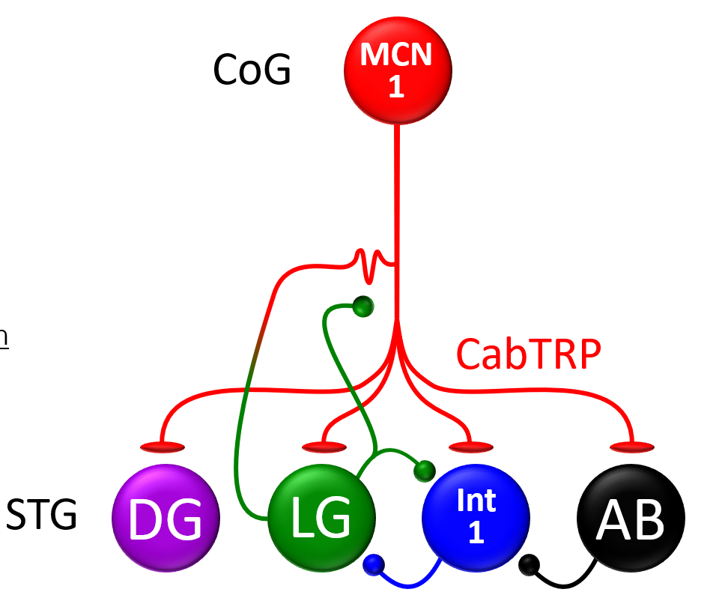
The Gastric Mill Rhythm

Slide 29
The Gastric Mill Rhythm
CoG
MCN
1
Lessons Learned
Descending inputs can activate circuits.
Pre-synaptic inhibition is amazing.
Electrical coupling matters.
Stomatogastric Nervous System
CabTRP
STG
DG
LG
Int
1
AB

Slide 30
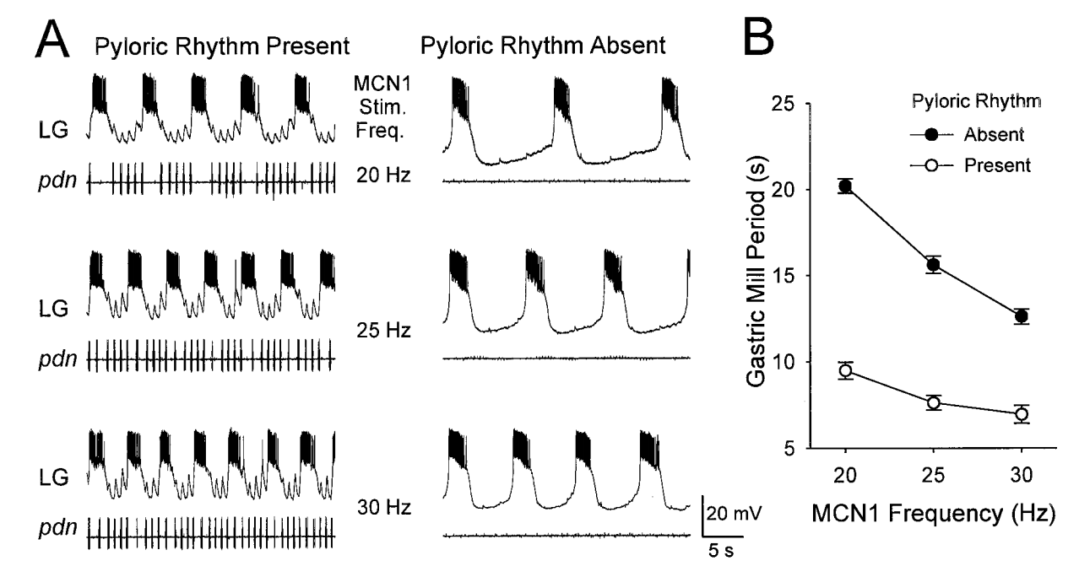
Circuit Interactions
CoG
MCN
1
What’s This?
Stomatogastric Nervous System
CabTRP
STG
DG
LG
Int
1
AB

Slide 31
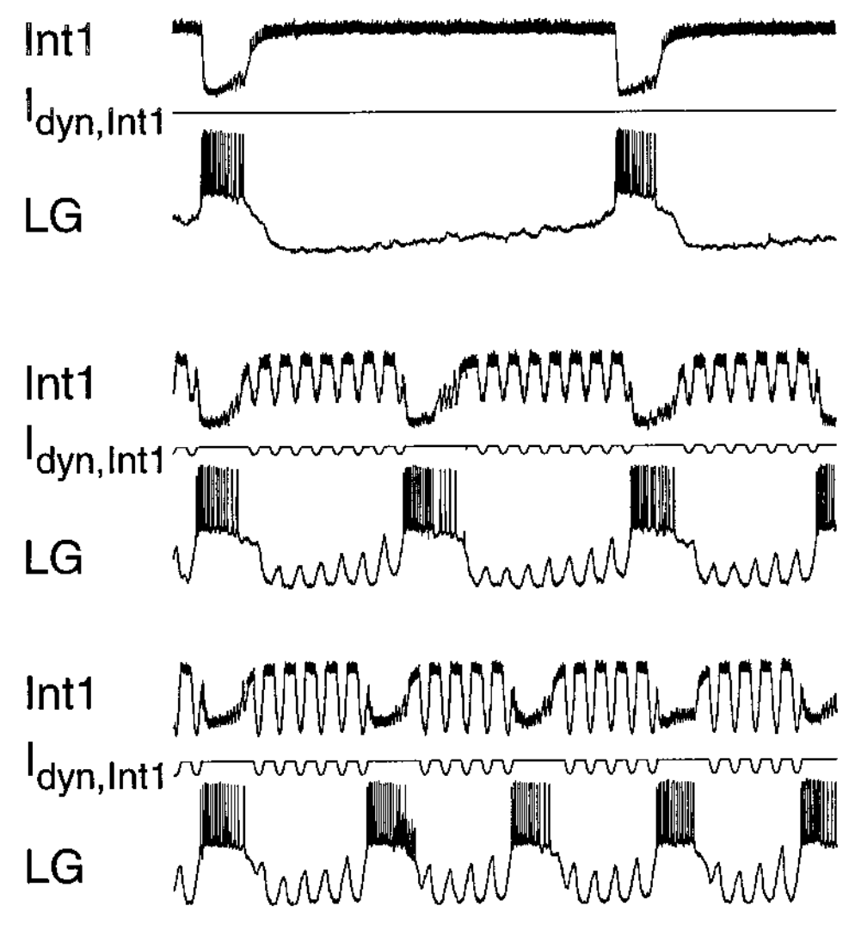
Circuit Interactions
CoG
MCN
1
Stomatogastric Nervous System
CabTRP
STG
DG
LG
Int
1
AB

Slide 32
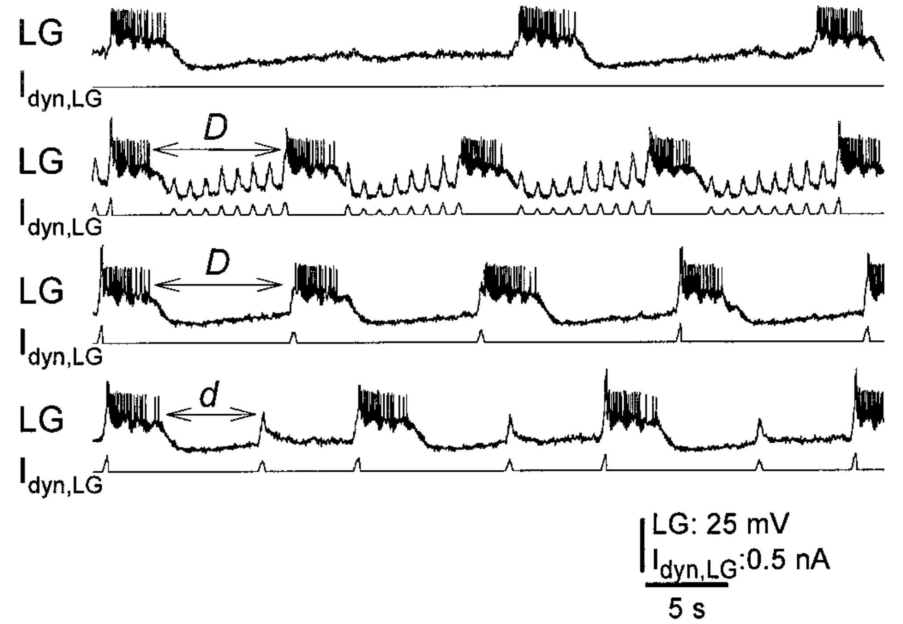
Circuit Interactions
CoG
MCN
1
Lessons Learned
Circuits interact.
Stomatogastric Nervous System
CabTRP
STG
DG
LG
Int
1
AB

Slide 33
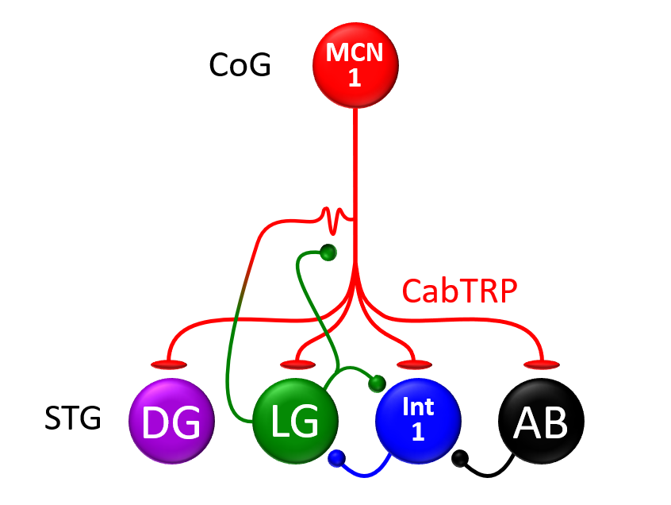
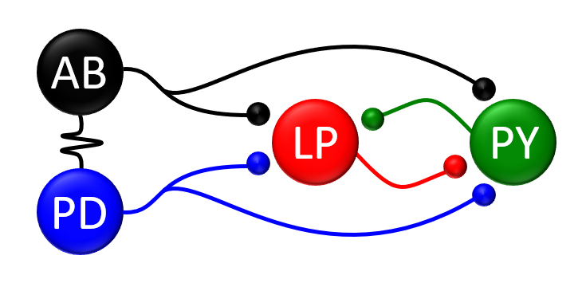
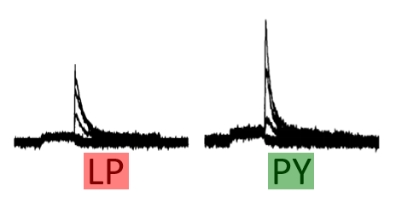
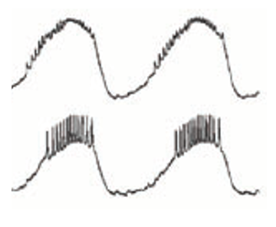
Lessons Learned
Pyloric Circuit
Gastric Mill Circuit
Stomatogastric Ganglion
Lessons Learned
Descending inputs can activate circuits.
Pre-synaptic inhibition is amazing.
Electrical coupling matters.
Circuits Interact
Lessons Learned
Pacemaker neurons are awesome.
Electrical coupling matters.
Circuit activity is sculpted by both (1) connections, (2) intrinsic membrane properties. You need to understand both for a complete picture.

Slide 34
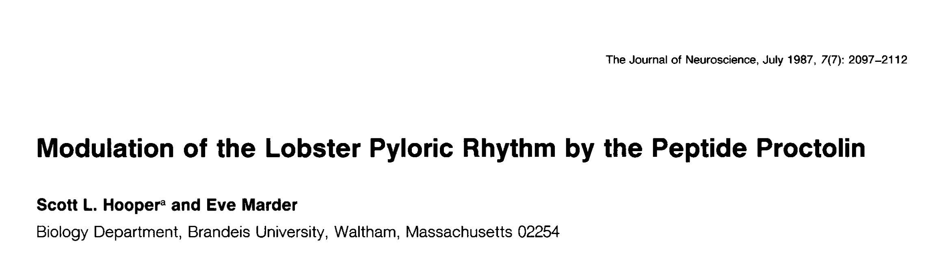
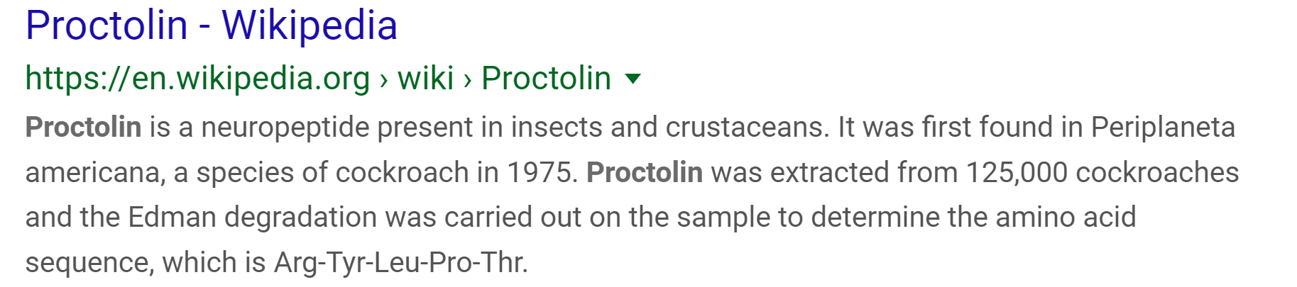
Eve Marder

Slide 35
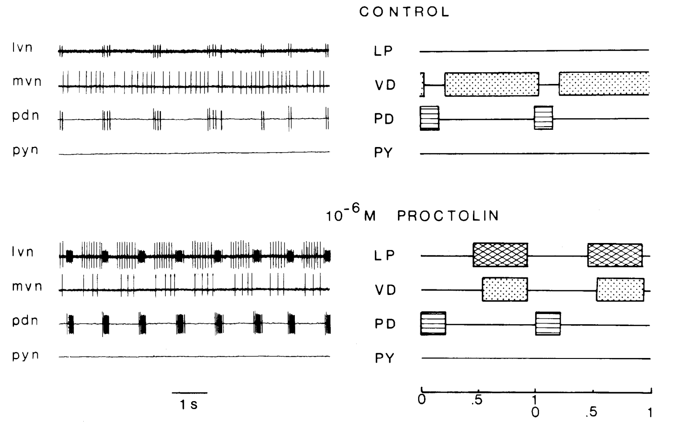
Proctolin Modulates the Pyloric Circuit
Stomatogastric Ganglion
Control
10⁻⁶ M Proctolin

Slide 36
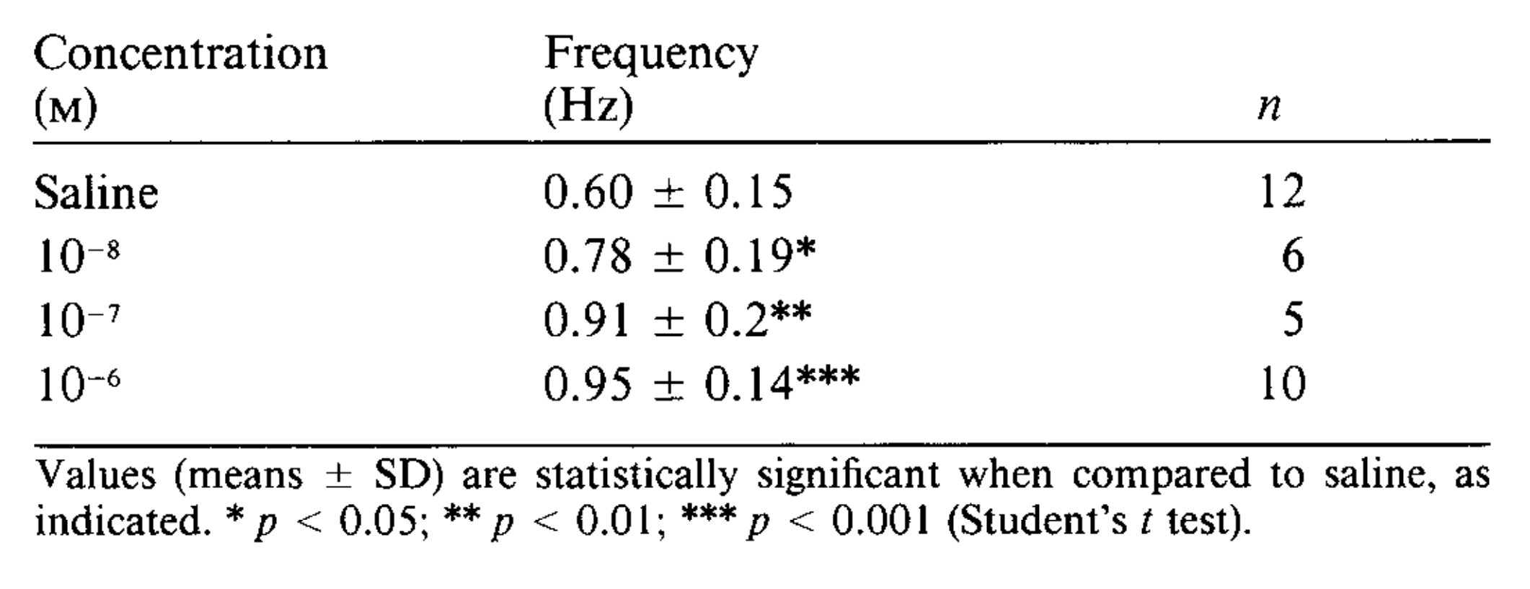
Proctolin Modulates the Pyloric Circuit
Stomatogastric Ganglion

Slide 37
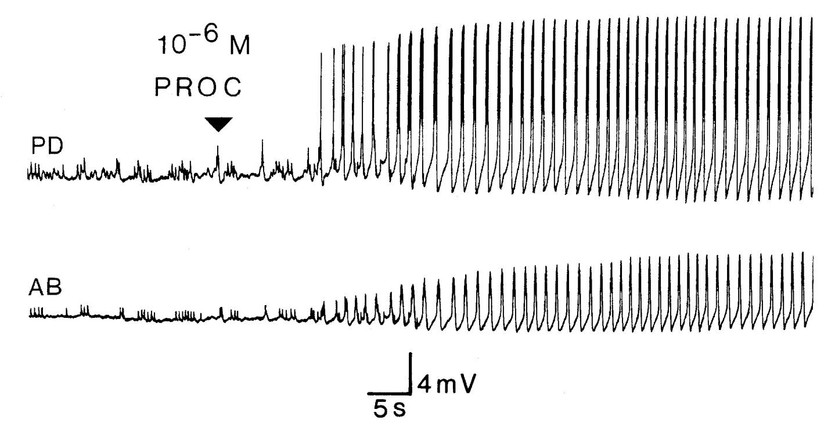
How Does Proctolin Do It?
VD
AB
LP
PY
PD
What do you do with this?

Slide 38
How Does Proctolin Do It?
VD
AB
LP
PY
PD
What do you do with this?

Slide 39
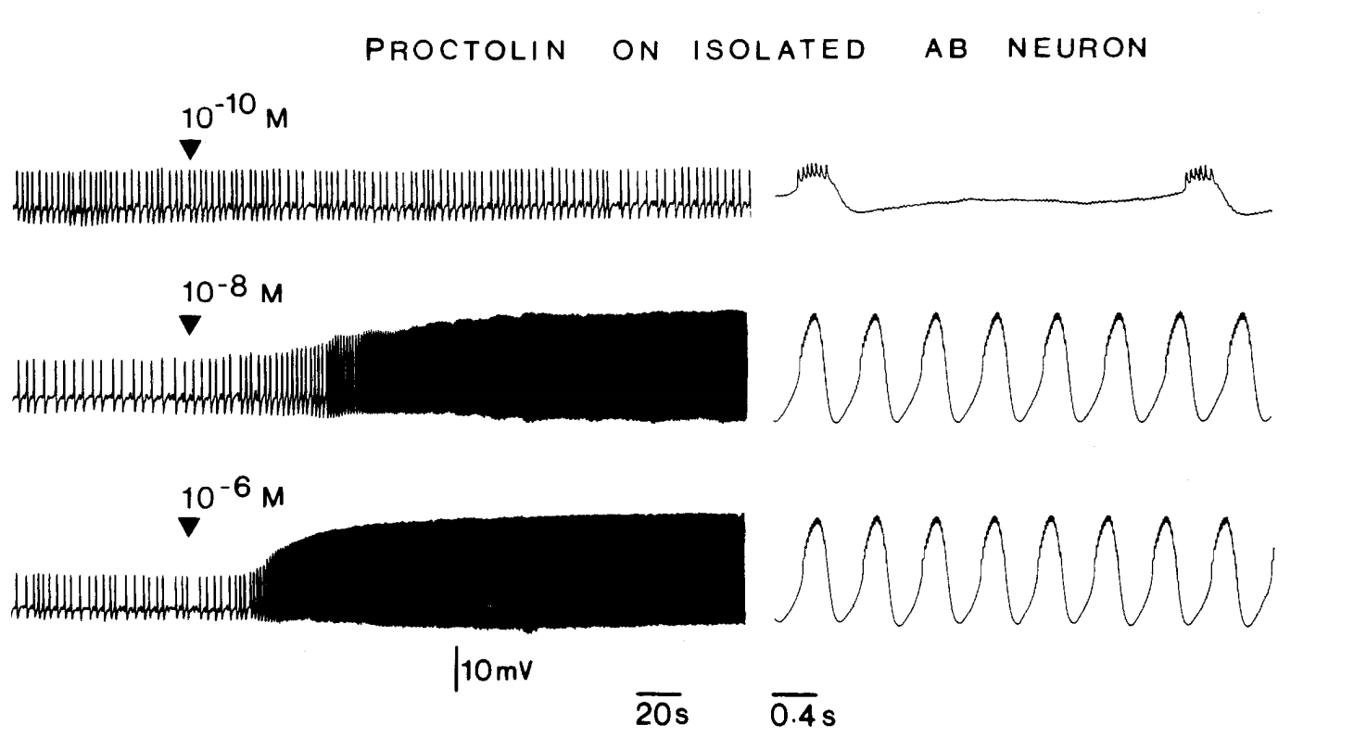
How Does Proctolin Do It?
VD
AB
LP
PY
PD

Slide 40
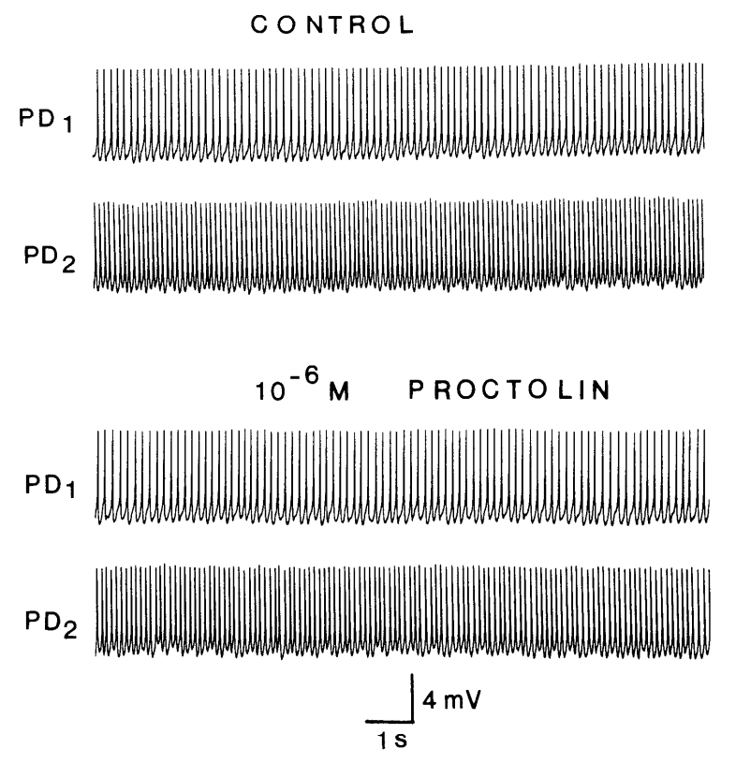
How Does Proctolin Do It?
VD
AB
LP
PY
PD

Slide 41
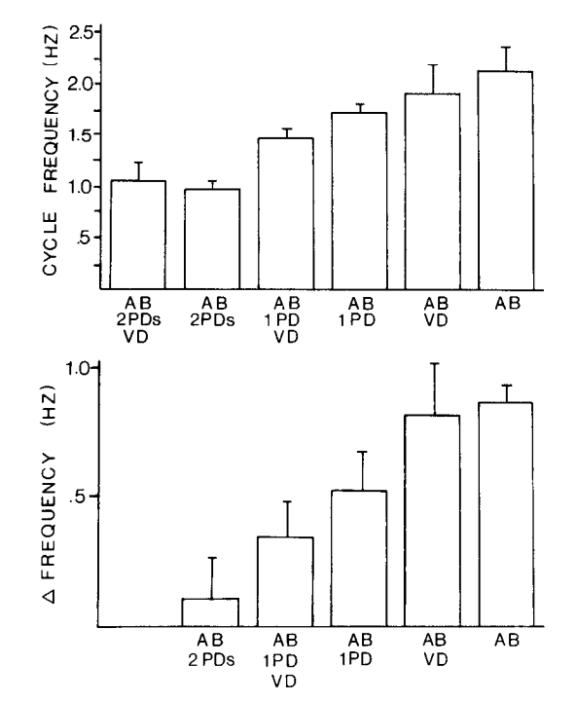
How Does Proctolin Do It?
VD
AB
LP
PY
PD

Slide 42
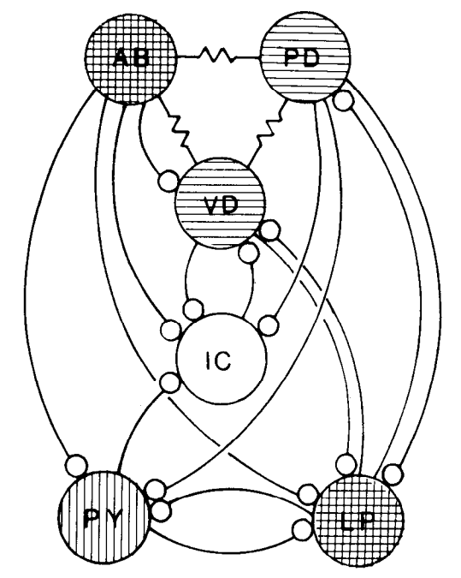
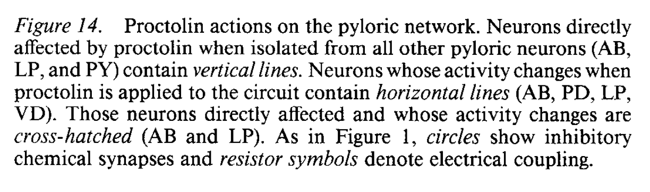
How Does Proctolin Do It?
VD
AB
LP
PY
PD

Slide 43
How Does Proctolin Do It?
VD
Lessons Learned
To get a complete picture of how a circuit is modulated, it is important to know both (1) those neurons that are directly targeted, and (2) those neurons that are not targeted.
Neurons interact.
AB
LP
PY
PD

Slide 44
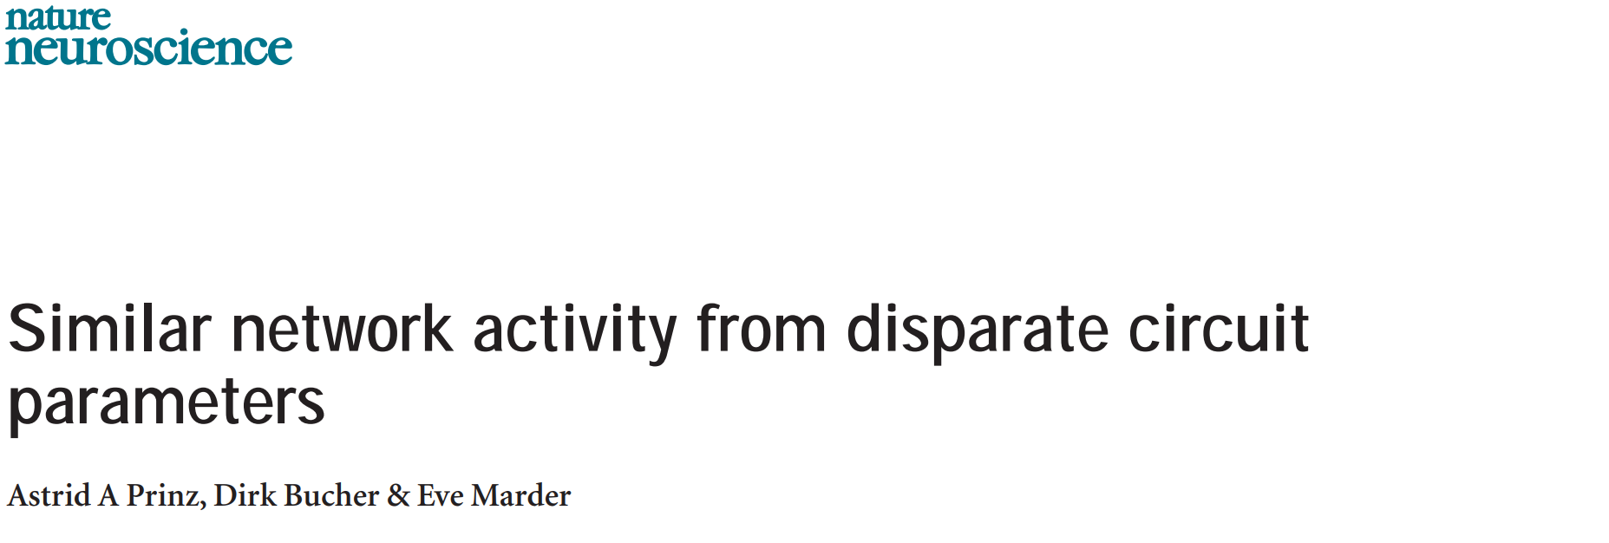
Another Great Lesson…

